Slide 1

Presented by
Ankur Kalita | 2023EBCS782
Pradyut Fogla | 2023EBCS788
Varun Deep Saini | 2023EBCS663
KubeView
BSc Computer Science | 2025-2026
Under the guidance of
Charan
Notes:
Timing: 0:00-0:30
Say: Good morning. We are presenting KubeView, a read-only Kubernetes dashboard that combines live cluster inspection with short-window historical replay. The project was developed by Ankur Kalita, Pradyut Fogla, and Varun Deep Saini under the guidance of Charan.
[Sources]
- Official BITS Capstone Project 15 Minute Demo Template
- KubeView final report cover page
[/Sources]

Slide 2
Operators lose incident context
Fragmented diagnosis: health, events, logs and configuration require several commands and manual correlation.
Present-state bias: once Kubernetes replaces an object or an event expires, the earlier state is difficult to reconstruct.
Heavy alternatives: full observability stacks add services, storage and configuration when a small team needs focused inspection.
Core question: what changed, and when?
Notes:
Timing: 0:30-1:30
Say: Kubernetes exposes rich state, but diagnosis is fragmented. An operator often joins the output of several kubectl commands mentally. Existing dashboards are useful for the current state, while a full metrics and log stack can be excessive for a small deployment. Our problem statement became one operational question: what changed, and when?
[Sources]
- KubeView final report, sections 1.1 and 1.2
- https://kubernetes.io/docs/reference/kubectl/
[/Sources]

Slide 3
Objectives and scope
Inspect: 11 Kubernetes resource kinds with search, namespace filters and pod detail.
Diagnose: stream logs from the selected container and surface events alongside resource state.
Stay current: combine REST snapshots with Server-Sent Events and reconnection resynchronization.
Switch safely: isolate kubeconfig contexts while keeping the product read-only.
Reconstruct: retain 72 hours of transformed state by default and compare two moments field by field.
Boundary: no cluster mutation, built-in user authentication, metrics, traces or CRDs.
Notes:
Timing: 1:30-2:25
Say: The implementation scope had five positive goals and a strict boundary. We cover resource inspection, logs, live updates, context switching, and historical reconstruction. We deliberately excluded mutation, built-in identity management, metrics, tracing, and custom resources. This keeps the project focused and preserves a read-only operating model.
[Sources]
- KubeView final report, sections 1.3 and 1.4
- Repository README at commit 8ee601c
[/Sources]

Slide 4
The gap KubeView fills
kubectl: powerful and scriptable, but diagnosis is command-driven and spread across outputs.
Kubernetes Dashboard and Lens: strong current-state interfaces, with broader administration goals.
Grafana and Loki: deep telemetry and log retention, but require additional collection and storage infrastructure.
Unique value proposition
KubeView combines live inspection and lightweight historical replay in a local, read-only browser workflow.
Notes:
Timing: 2:25-3:25
Say: KubeView does not try to replace kubectl, Kubernetes Dashboard, Lens, Grafana, or Loki. Its contribution is narrower. It puts current resources, container logs, live changes, and a recent historical state in one read-only browser workflow without requiring a separate observability platform.
[Sources]
- KubeView final report, section 1.2
- https://kubernetes.io/docs/tasks/access-application-cluster/web-ui-dashboard/
- https://grafana.com/docs/loki/latest/
[/Sources]

Slide 5
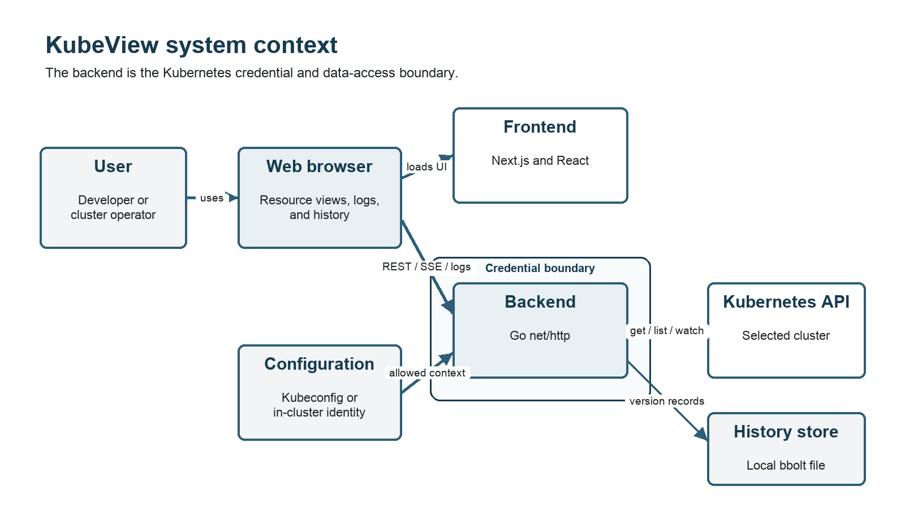
Read-only architecture
The Go backend owns Kubernetes credentials, context selection, live watches and the local history store.
Notes:
Timing: 3:25-4:45
Say: The browser loads a Next.js frontend and calls the Go backend over REST and Server-Sent Events. The backend is the security boundary because it holds the selected Kubernetes credentials. It uses the official client-go library for list, get and watch operations. The flight recorder writes transformed resource versions and deletion tombstones into bbolt, then reconstructs state at a requested timestamp. Production manifests grant only get, list, and watch permissions.
[Sources]
- Local visual: submission/architecture/system-context.png
- KubeView final report, section 2.1
- Repository source at commit 8ee601c
[/Sources]

Slide 6
Technology choices
Backend: Go 1.26, net/http, client-go and Kubernetes API libraries.
Frontend: Next.js 16, React 19, TypeScript 5 and Tailwind CSS 4.
History: bbolt 1.5 embedded storage with configurable retention.
Quality: Go testing, Vitest, Testing Library, Playwright, golangci-lint, CodeQL and govulncheck.
Delivery: Docker, Docker Compose, Kubernetes manifests, Kustomize, read-only RBAC and NetworkPolicy.
Notes:
Timing: 4:45-5:35
Say: The stack stays deliberately small. Go provides the backend and concurrency model, the standard HTTP library avoids an unnecessary web framework, and client-go gives supported Kubernetes access. Next.js and React provide the browser interface. bbolt keeps history local and deployment simple. CI combines language-level tests, browser tests, static analysis, vulnerability checks, and real-cluster execution.
[Sources]
- KubeView final report, table 1 and section 2.2
- Repository go.mod and kubeview-frontend/package.json at commit 8ee601c
[/Sources]

Slide 7
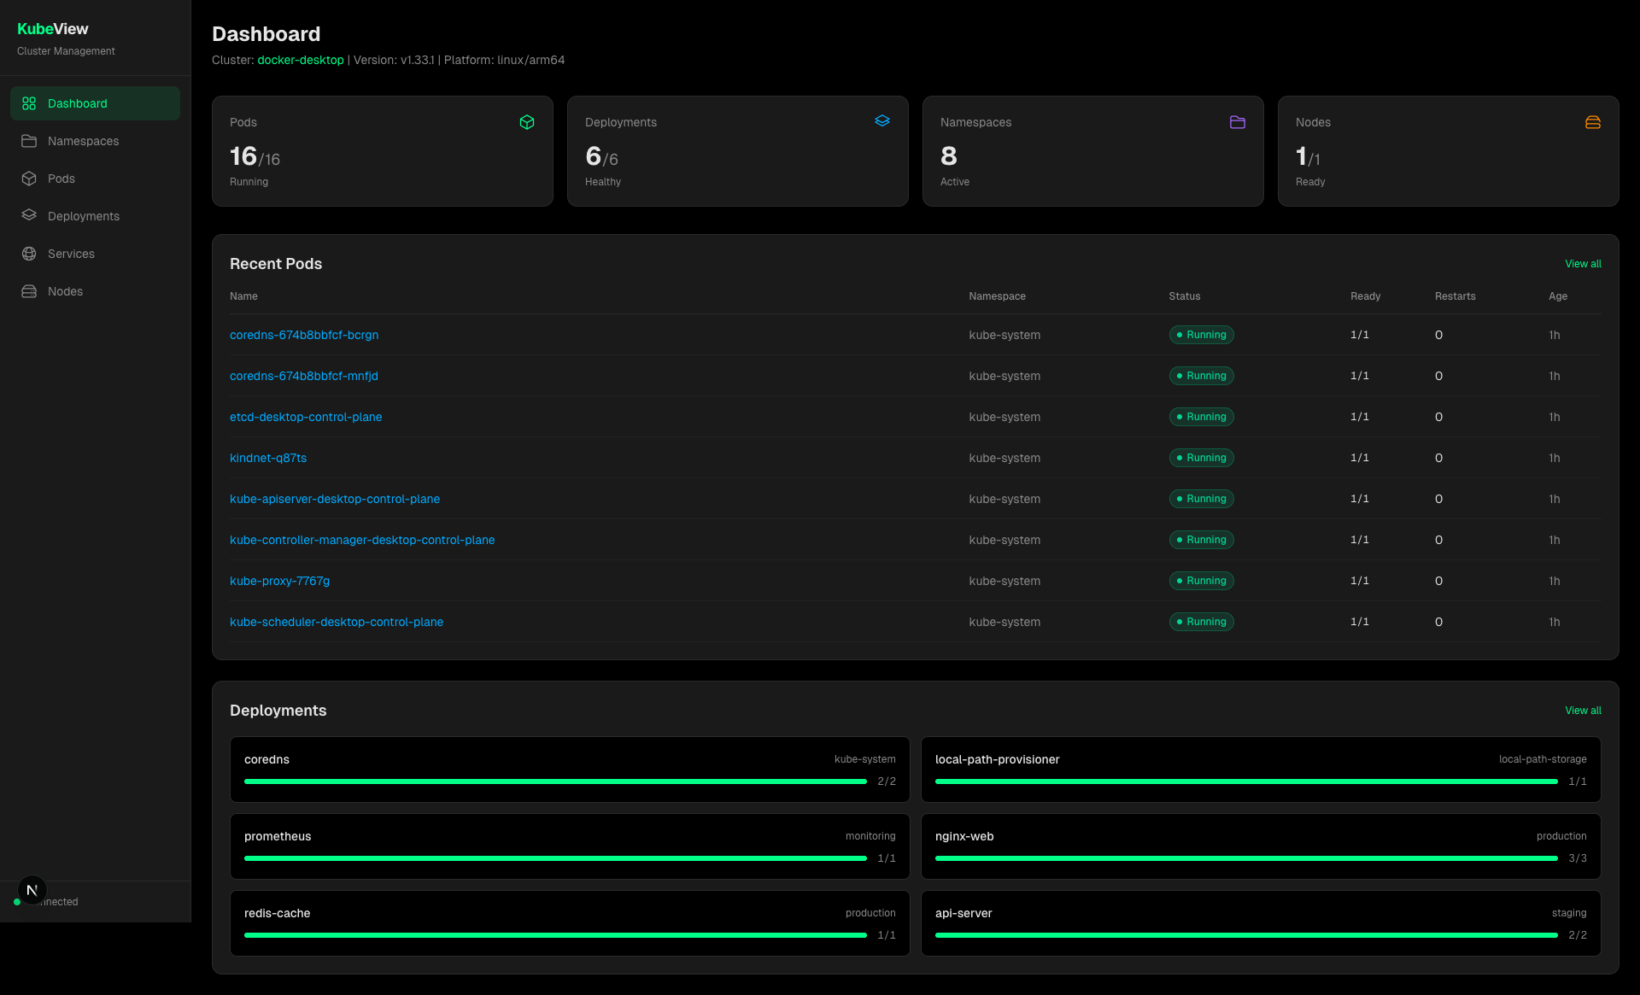
Implementation and demo
Recorded demo (4:20): resources -> pod logs -> live scale -> events -> historical comparison
Notes:
Timing: 5:35-10:15, including the 4:20 recording
Presenter action: Before final submission, insert the MOV file or add a portable hyperlink over the dashboard image. Start the recording after this introduction.
Say before playback: The demo uses a disposable Kubernetes namespace. It shows the dashboard, namespace and search filters, pod detail, multi-container log selection, pause and resume buffering, Secret metadata protection, a kubectl scale from two to three replicas without refreshing the page, correlated Events, and the flight recorder timeline comparison.
After playback say: The visible scale update proves the watch and SSE path, while the earlier-state and diff views prove that KubeView can reconstruct more than the present state.
[Sources]
- Local visual: screenshots/01-dashboard.png
- Recorded demo: /Users/pradyut/Movies/2026-08-28 18-39-02.mov
- Demo runbook: submission/drafts/DEMO_AND_VIVA_GUIDE.md
[/Sources]

Slide 8
Validation results
227 Go test functions
60 frontend unit tests
45 Playwright tests against a real kind cluster
CI gates
Race detector | lint | type check | production build | CodeQL | govulncheck
Notes:
Timing: 10:15-11:25
Say: Validation is layered. The backend contains 227 Go test functions, including handlers, transformers, context isolation, concurrent streams, history retention and tombstones. The frontend has 60 unit tests. The 45 Playwright cases start a real kind cluster and drive the actual Go and Next.js applications through browser workflows. CI also runs the race detector, lint, type checking, production builds, CodeQL and govulncheck. These are test counts and pass evidence, not code-coverage percentages.
[Sources]
- Repository test inventory at commit 8ee601c
- GitHub Actions run https://github.com/varundeepsaini/kubeview/actions/runs/33142315221
- submission/drafts/VALIDATION_REPORT.md
[/Sources]

Slide 9
Challenges and limitations
Solved during implementation
Stream recovery: a fresh REST list repairs state after an SSE or Kubernetes watch reconnect.
Pod correctness: container status is matched by name across init, sidecar and ephemeral containers.
Historical deletion: tombstones prevent removed objects from reappearing in reconstructed snapshots.
Current boundaries
Access: shared exposure requires an authentication proxy; read-only data can still be sensitive.
Storage: the embedded history database assumes one backend writer.
Scope: KubeView does not store metrics, traces or a complete long-term log archive.
Notes:
Timing: 11:25-12:30
Say: Three implementation problems required careful handling. Streams can disconnect, pod container arrays cannot be joined safely by index, and historical deletions need tombstones. We solved each with explicit recovery and identity rules. The remaining limits are also explicit: authentication must sit in front of shared deployments, bbolt is a single-writer local store, and the product is not a metrics, tracing, or long-term log platform.
[Sources]
- KubeView final report, sections 2.4, 6.3 and 6.4
- Repository source and tests at commit 8ee601c
[/Sources]

Slide 10
Conclusion and future work
Delivered
One workflow: live resources, pod logs, context switching, watch updates and recent historical replay.
Read-only by design: inspection routes and get/list/watch RBAC keep mutation outside the product.
Evidence: backend, frontend, security and real-cluster browser checks run in CI.
Next
Production access: integrated authentication and per-user authorization.
Scale: shared history storage, load testing, accessibility validation, metrics and CRDs.
KubeView helps an operator answer what is wrong now and what changed before it.
Notes:
Timing: 12:30-13:30, leaving approximately 90 seconds for transition or questions
Say: KubeView delivers a working read-only Kubernetes inspection tool with live updates, container logs, context isolation, and recent historical comparison. The clearest future steps are authentication, shared history storage, larger-scale measurement, accessibility validation, metrics, and CRD support. The final outcome is simple: an operator can answer what is wrong now and what changed before it. Thank you.
[Sources]
- KubeView final report, chapter 6
- Repository README at commit 8ee601c
[/Sources]

