Slide 1
CuCNN
CuML
CSN-221: Computer Architecture and Microprocessor
Jitesh Jain
Enr. No.-19114039
(Batch - O2)

Slide 2
Contents
Project Statement
Setting
Observations

Slide 3
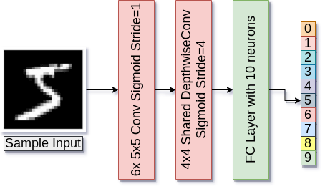
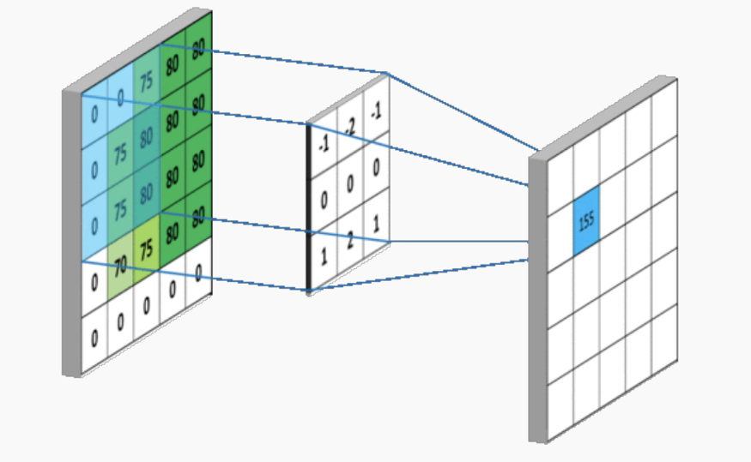
Project Statement
Implement a 3 layer CNN for Image Classification on MNIST using CUDA and observe the effect of different kernel settings on the performance of the model.
Convolution Operation [Source]
CNN Architecture

Slide 4
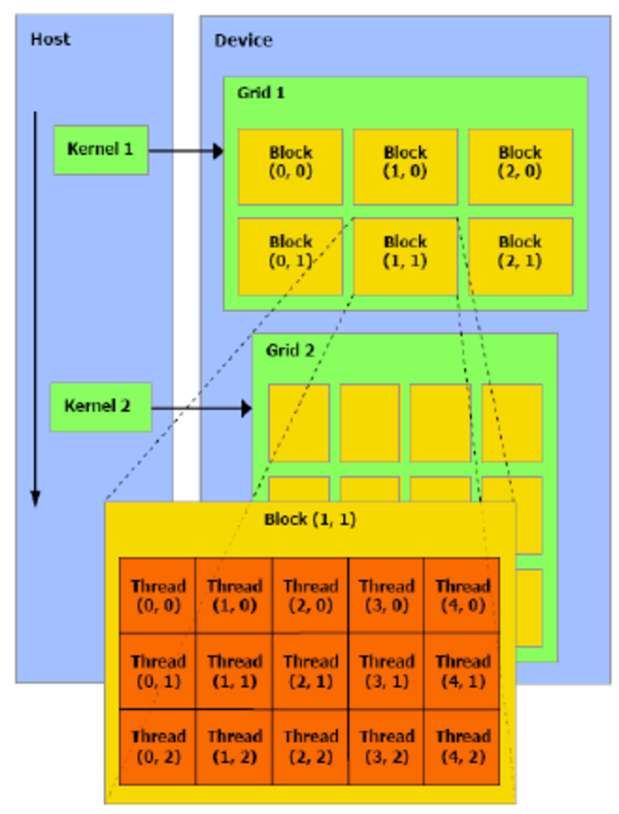
Setting
Show results on different settings of the kernel dimensions
Host = CPU
Device = GPU
CNN has many operations like convolution (sliding-window multiplications and additions), activation functions, backpropagation (gradient calculations), etc.
These all are executed using kernels which are composed of blocks (composed of threads).
kernel <<<NumBlocks, NumThreads>>>
High-level Overview of CUDA [Source]

Slide 5
Observations
Performance of the model depends on GridSize (numBlocks) and BlockSize (numThreads).
Higher order (product) gives inaccurate results as compared to those of lower order of 2.
As the order of the product becomes smaller, even if accuracy remains the same, training time increases (2⁸ order v/s 2¹² order).
Products of the same order give almost the same results (in terms of time and accuracy).
GridSize | BlockSize | Order (2) | Epochs | Test Accuracy | Training Time (Minutes)
64 | 64 | 12 | 50 | 97.12 | 4.54
64 | 64 | 12 | 100 | 97.41 | 9.10
128 | 512 | 16 | 50 | 87.92 | 4.86
256 | 256 | 16 | 50 | 87.92 | 4.93
16 | 16 | 8 | 50 | 97.12 | 10.02
Best Setting: kernel<<<64,64>

Slide 6
References
https://www.nvidia.com/content/cudazone/download/Getting_Started_w_CUDA_Training_NVISION08.pdf
https://classroom.udacity.com/courses/cs344 (Course on Udacity)
https://towardsdatascience.com/an-introduction-to-convolutional-neural-networks-eb0b60b58fd7
https://www.researchgate.net/publication/221053545_Solving_Classification_Problems_Using_Genetic_Programming_Algorithms_on_GPUs

Slide 7
Thank You

