Slide 1
Parallel decision Tree using CUDA
ANSHIKA MITTAL
19114009

Slide 2
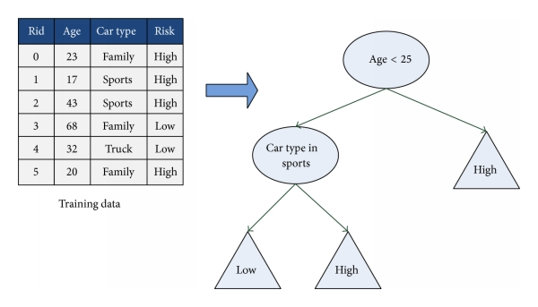
INTRODUCTION
Decision Tree is commonly used in machine learning or data mining and shows the one-way path for specific decision algorithms.
It is a decision support tool that uses a tree-like graph and consists of 2 kinds of nodes -
an internal node representing a decision rule, and
a leaf node shows the result of a decision.
Parallel Decision Trees overcomes limitations of equivalent serial algorithms and enables the use of the very-large-scale training sets that are increasingly of interest in real-world applications of machine learning and data mining.

Slide 3
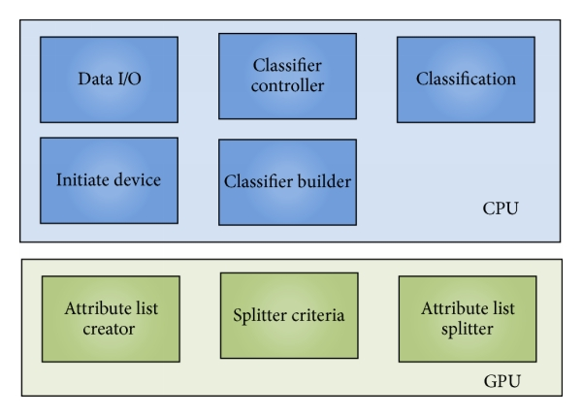
Methodology
The principle of CuDecisionTree includes dispatching flow control, handling, and communication tasks to CPU and simultaneously assigning computing intensive jobs to GPU.
Major steps in the CuDecisionTree system:
Load training and testing data to host memory from disks.
Initialization of the device which includes query device information, allocation memory space, and copy of training data into the device.
The system sets up some parameters for the user. For instance, the minimum numbers of data of a leaf, the maximum depth of the classifier etc.

Slide 4
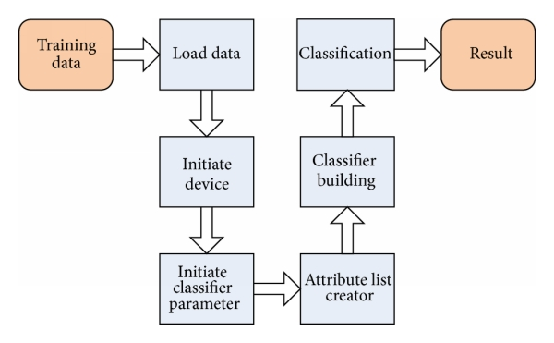
Contd..
(4) Creating attribute lists in device by moving each attribute to corresponding position and then sorting all attribute lists in devices.
(5) This is the most important step of the system where an iterative breadth first scheme is used instead of the recursive model of decision tree building algorithm. Host is in charge of the working flow of the whole system.
(6) Now the classification is performed on the host sequentially.
(7) The results are presented on hosts.

Slide 5
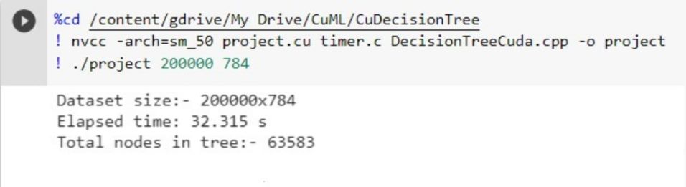
RESULTS

Slide 6
REFERENCES
Getting Started with CUDA
About CUDA
Parallel Implementation of Decision Tree Research paper
Google Colab Introduction
Neural networks and deep learning
CUDT: A CUDA Based Decision Tree Algorithm

