Slide 1
CuCNN
CuML
CSN-221: Computer Architecture and Microprocessor
Jitesh Jain
Enr. No.-19114039
(Batch - O2)

Slide 2
Contents
Project Statement
Setting
Observations

Slide 3
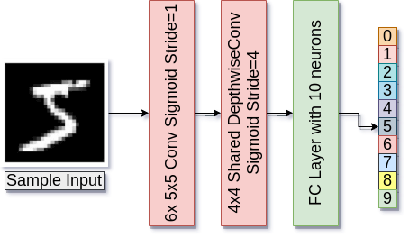
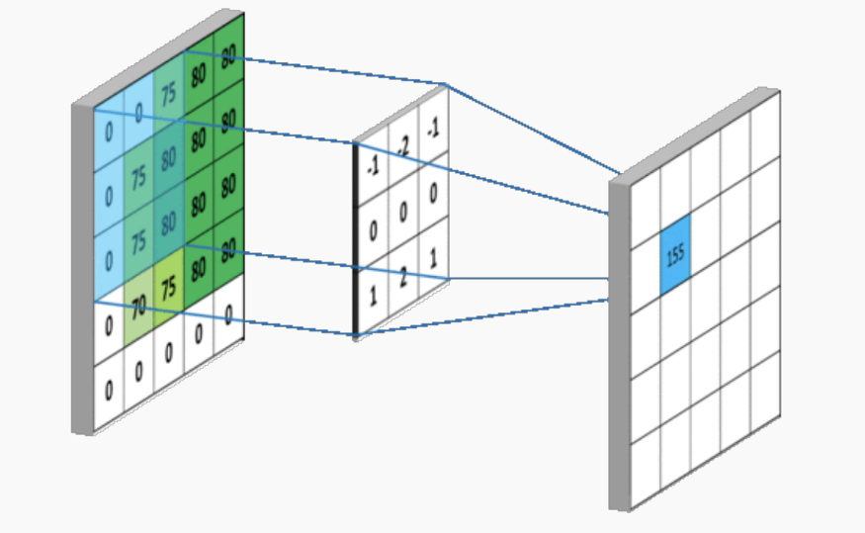
Project Statement
Implement a 3 layer CNN for Image Classification on MNIST using CUDA and observe the effect of different kernel settings on the performance of the model.
Convolution Operation [Source]
CNN Architecture

Slide 4
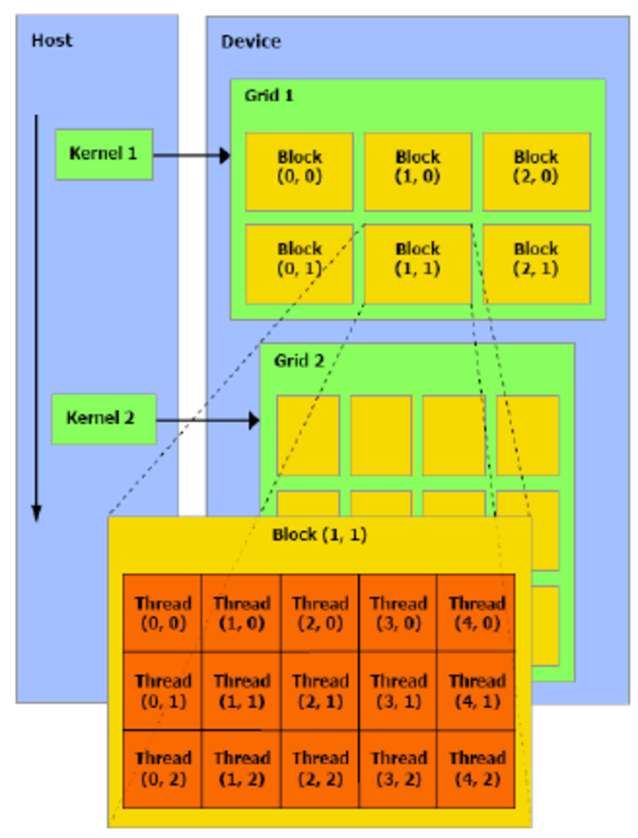
Setting
Show results on different settings of the kernel dimensions
Host = CPU
Device = GPU
CNN has many operations like convolution (sliding-window multiplications and additions), activation functions, backpropagation (gradient calculations), etc.
These all are executed using kernels which are composed of blocks (composed of threads).
kernel <<<NumBlocks, NumThreads>>>
High-level Overview of CUDA [Source]

Slide 5
Observations
Performance of the model depends on Grid Size (numBlocks) and Block Size (numThreads).
Higher order (product) gives inaccurate results as compared to those of lower order of 2.
As the order of the product becomes smaller, even if accuracy remains the same, training time increases (2⁸ order v/s 2¹² order).
Products of the same order give almost the same results (in terms of time and accuracy).
Grid Size | Block Size | Order (2) | Epochs | Test Accuracy | Training Time (Minutes)
64 | 64 | 12 | 50 | 97.12 | 4.54
64 | 64 | 12 | 100 | 97.41 | 9.10
128 | 512 | 16 | 50 | 87.92 | 4.86
256 | 256 | 16 | 50 | 87.92 | 4.93
16 | 16 | 8 | 50 | 97.12 | 10.02
Best Setting: kernel<<<64,64>

Slide 6
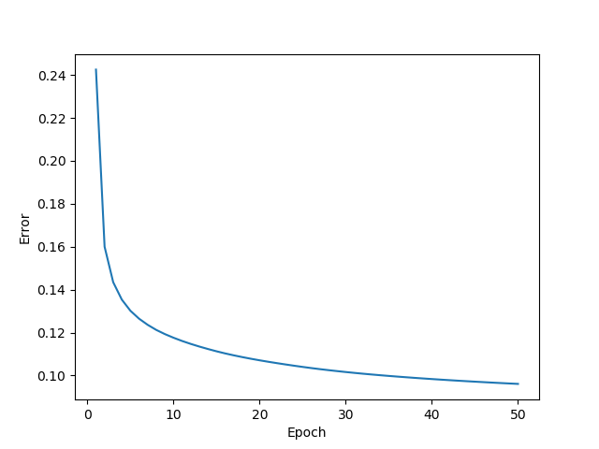

Epochs = 50
Order = 2¹²
kernel<<<64,64>>
Training Time = 4.54 minutes
Test Accuracy = 97.12%
Epochs = 50
Order = 2⁸
kernel<<<16,16>>
Training Time = 10.02 minutes
Test Accuracy = 97.12%

Slide 7
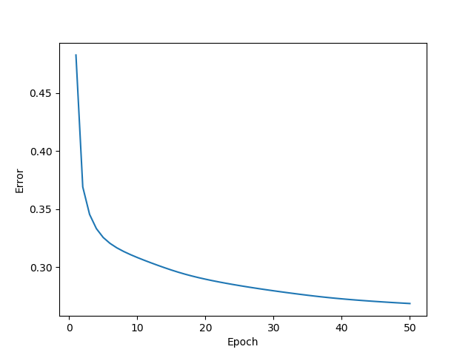

Epochs = 50
Order = 2¹⁶
kernel<<<128,512>>
Training Time = 4.86 minutes
Test Accuracy = 87.92%
Epochs = 50
Order = 2¹⁶
kernel<<<256,256>>
Training Time = 4.93 minutes
Test Accuracy = 87.92%

Slide 8
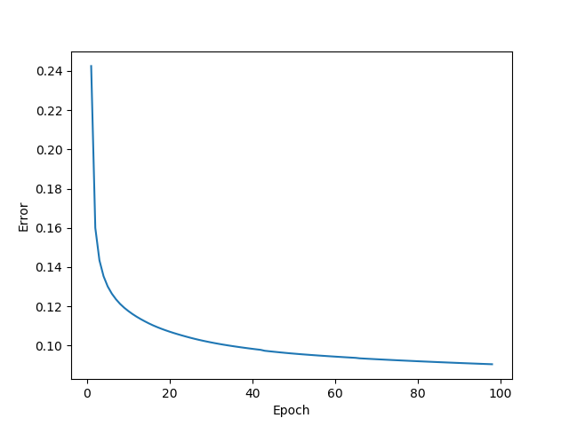
Epochs = 50
Order = 2¹²
kernel<<<64,64>>
Training Time = 4.54 minutes
Test Accuracy = 97.12%
Epochs = 100
Order = 2¹²
kernel<<<64,64>>
Training Time = 9.10 minutes
Test Accuracy = 97.41%

Slide 9
References
https://www.nvidia.com/content/cudazone/download/Getting_Started_w_CUDA_Training_NVISION08.pdf
https://classroom.udacity.com/courses/cs344 (Course on Udacity)
https://towardsdatascience.com/an-introduction-to-convolutional-neural-networks-eb0b60b58fd7
https://www.researchgate.net/publication/221053545_Solving_Classification_Problems_Using_Genetic_Programming_Algorithms_on_GPUs
ImageNet Classification with Deep Convolutional Neural Networks

Slide 10
Thank You

