Slide 1
AI-Driven Prior Authorization
Solution Architecture for a Large US Health Plan
Paul Prae | Principal AI Engineer & Architect
www.paulprae.com

Slide 2
The Problem & Opportunity
The Problem
Manual PA processing costs $10.97 in labor per provider transaction (CAQH 2024 Index), takes days, and burns out clinical staff — 93% of physicians say PA delays patient care (AMA 2024 Survey). On the payer side, each manual transaction costs $3.52 versus roughly $0.05 when fully electronic.
The Opportunity — Altais + Autonomize AI (Feb 2026)
Metric | Result
PA review time reduction | 45%
Manual error reduction | 54%
Auto-determination rate | 50%
Why Autonomize AI

Slide 3
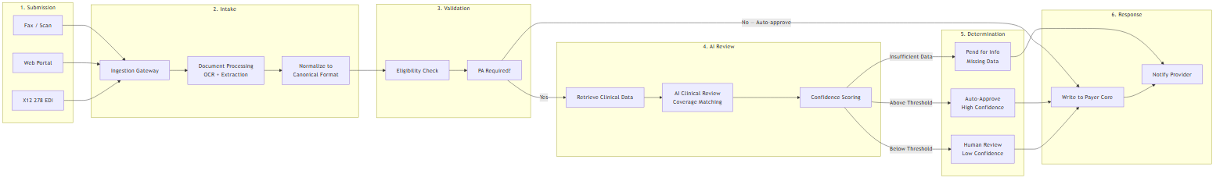
PA Request Lifecycle
6-step process: Submit → Intake (OCR/extraction) → Validate (eligibility) → AI Review (coverage matching + confidence scoring) → Route (auto-approve / human review / pend) → Respond (payer core writeback + provider notification)

Slide 4
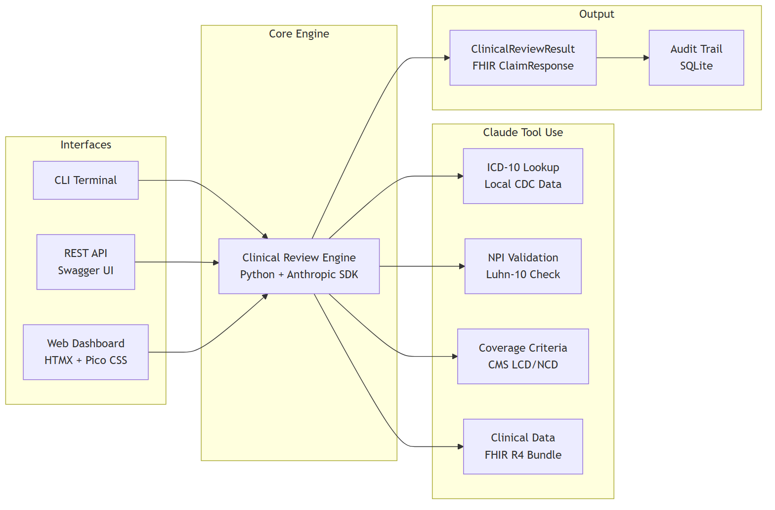
Demo — Proof of Concept
LIVE DEMO: I built a working proof of concept to validate this architecture. It demonstrates the core clinical review flow — steps 4 and 5 of the lifecycle.

Slide 5
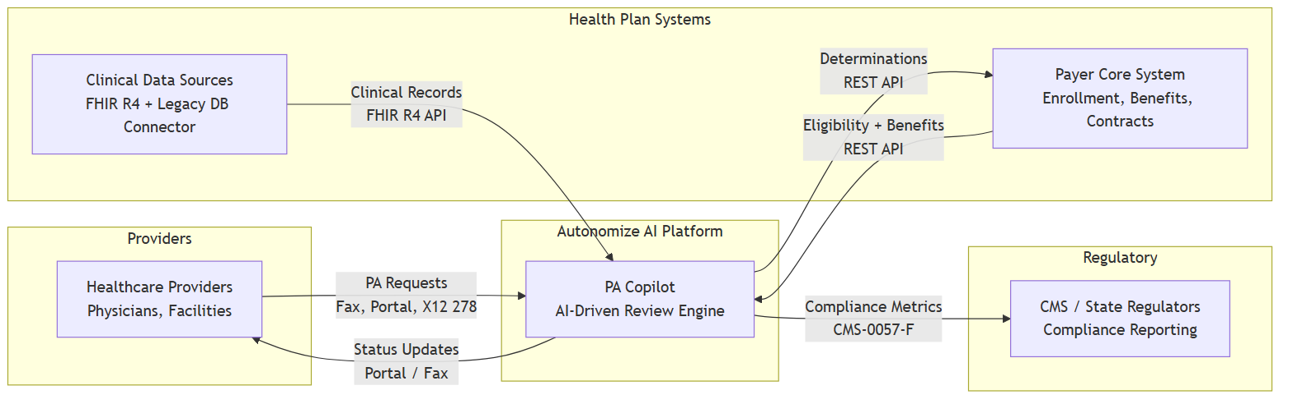
System Context
Actor | Role | Integration
Healthcare Providers | Submit PA requests via multiple channels | Fax, Portal, X12 278
Autonomize AI Platform | AI-driven clinical review engine | PA Copilot on Genesis
Health Plan Systems | Eligibility, benefits, clinical data | REST API, FHIR R4

Slide 6
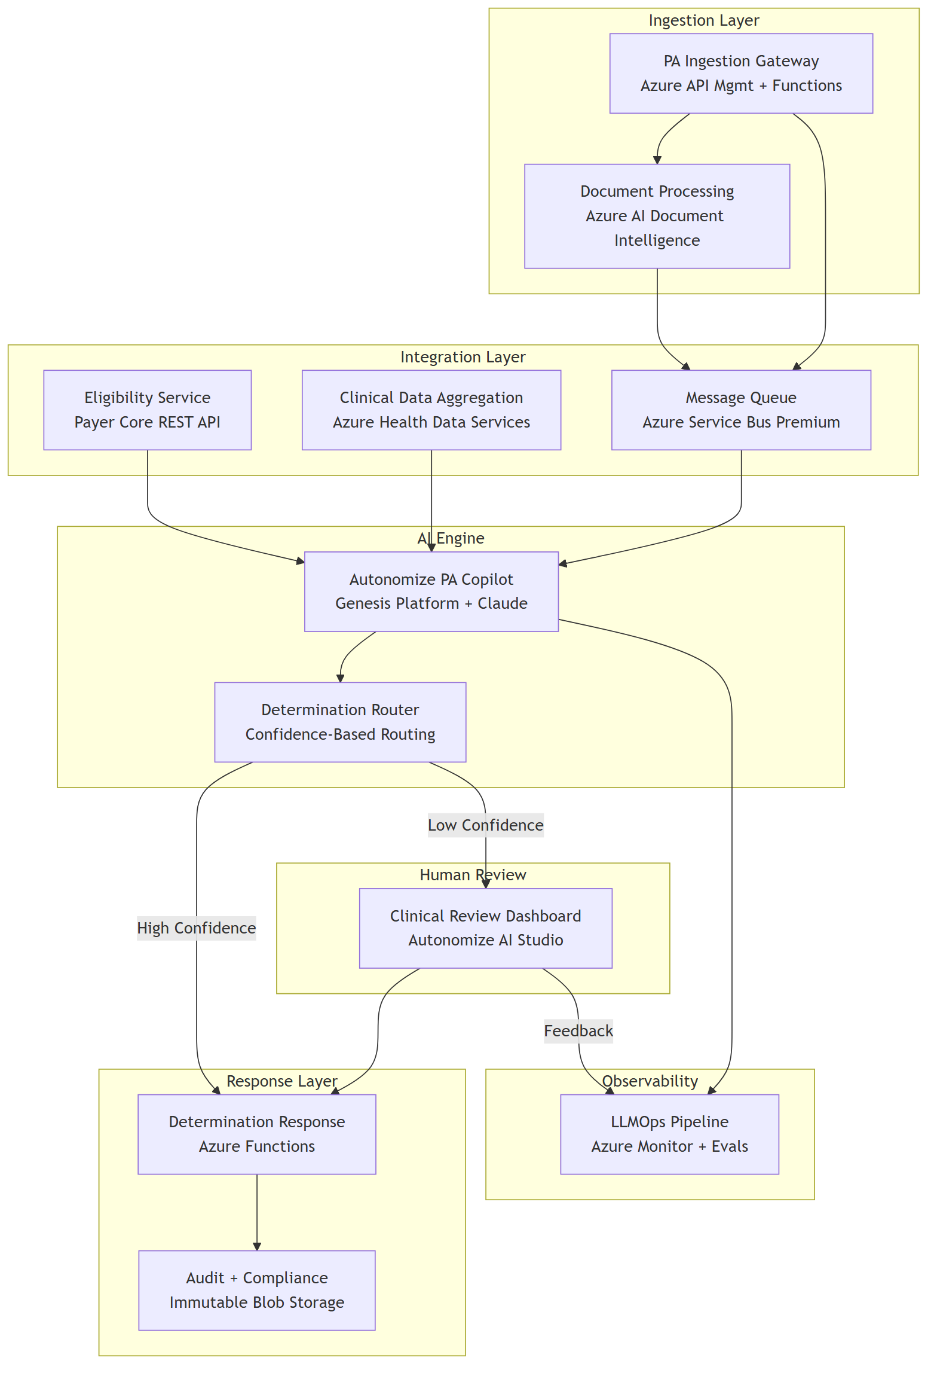
Solution Architecture

Slide 7
Why This Architecture
Key business benefits of these specific technical choices:
• Safety-first determination routing — confidence thresholds route low-certainty cases to human reviewers; no case is ever auto-denied without clinical review
• Configurable confidence thresholds — start conservative, tune with real performance data as the system learns
• CMS-0057-F compliance readiness — FHIR R4 foundation meets the Jan 2027 API deadline without re-architecture
• Azure-native deployment — leverages Autonomize's existing Azure ecosystem, Pegasus Program membership, and Marketplace presence
• Full audit trail — every determination records model version, input hash, reasoning, evidence, and confidence for 7-year regulatory retention

Slide 8
Top 3 Security Risks & Mitigations
# | Risk | Mitigation 1: Architectural | Mitigation 2: Operational
1 | PHI exposure through AI pipeline | PHI tokenization before LLM — AI sees clinical facts without patient identity | Anthropic API: zero data retention for model training (enterprise terms)
2 | Prompt injection via clinical documents | Document sanitization + system prompt isolation | Output validation requiring evidence citations — hallucinated claims fail verification
3 | Untraceable AI decisions | Tamper-proof audit trail: model version, input hash, reasoning, evidence, confidence | Immutable 7-year retention with append-only writes
Additional controls: Entra ID RBAC, AES-256 at rest, TLS 1.2+ in transit, private endpoints, no auto-deny without human review.

Slide 9
Progressive Delivery
Phase | Focus | Key Deliverable
Phase 0: Demo | Prove the concept | Working AI PA review with mock data
Phase 1: MVP | Single LOB, single channel | Production PA processing with human review
Phase 2: Scale | Multi-channel, multi-LOB | Fax OCR, legacy data, LOB configuration
Phase 3: Enterprise | Full scale, compliance | All channels, 20 LOBs, CMS reporting
Design principle: Each phase produces a deployable, demonstrable system. Decision gates between phases use real performance data to scope the next phase.

Slide 10
Discussion Starters
Business Strategy
• How does the ServiceNow partnership change the payer integration strategy?
• What is the target auto-determination rate for Phase 1?
Technical Depth
• How does the Genesis Platform handle coverage criteria updates?
• What's the Azure AI Foundry Agent Service integration status?
Implementation
• Which LOB is the ideal Phase 1 candidate?
• What's been the biggest integration challenge with existing payer deployments?

Slide 11
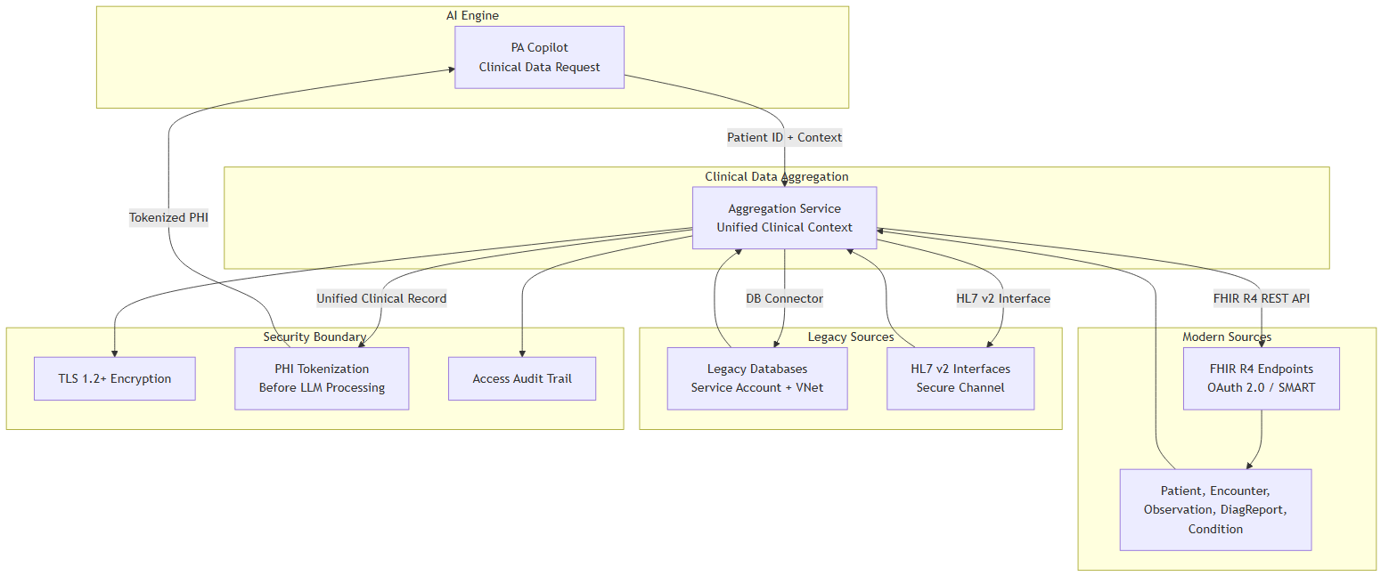
Appendix A: Clinical Data Integration

Slide 12
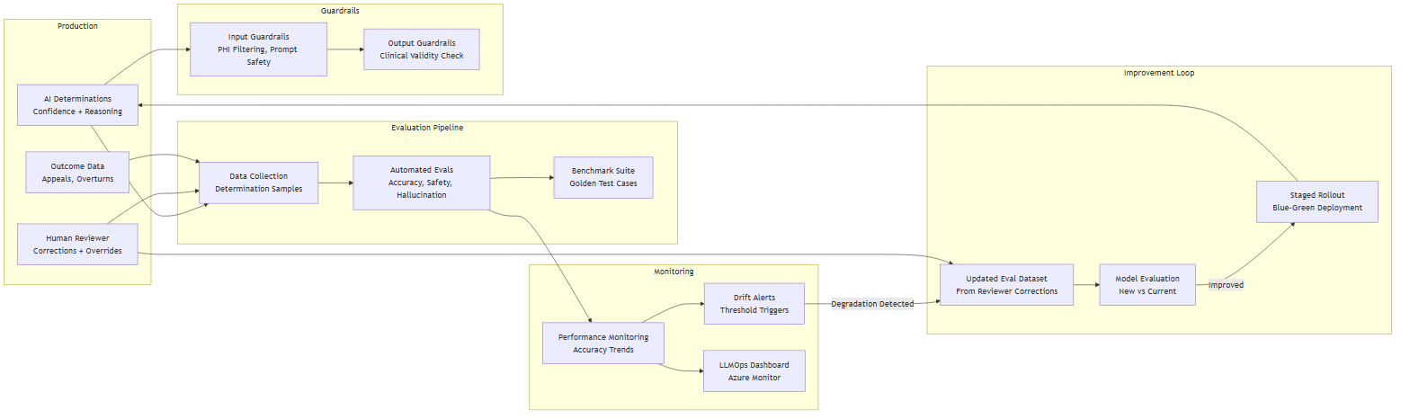
Appendix B: AI Model Monitoring & Feedback
Detect drift
• Outcome monitoring — track overturn rate (human overrides AI), appeal rate, accuracy trends
• Automated evals — golden test cases benchmarked on schedule
• Confidence distribution — shifts signal model or data changes

Slide 13
Appendix C: Scaling to 20 LOBs
Approach | Cost | Isolation | Complexity
Multi-tenant | Lower | Logical | Lower
Multi-instance | Higher | Physical | Higher
Recommendation: Start multi-tenant with per-LOB configuration. Autonomize Genesis Platform already supports it. Deploy separate instances only where regulation requires physical isolation.
Honest unknowns: The right answer depends on actual LOB rule complexity and regulatory requirements — both are discovery questions.

Slide 14
Sources & References
# | Claim | Source
1 | $10.97 manual PA labor cost (provider) | CAQH 2024 Index, p. 9
2 | $3.52 manual PA labor cost (payer) | CAQH 2024 Index, p. 9
3 | ~$0.05 electronic PA cost (payer) | CAQH 2024 Index, p. 9
4 | 45% PA review time reduction | Altais + Autonomize AI (BusinessWire Feb 2026)
5 | 54% manual error reduction | Altais + Autonomize AI (BusinessWire Feb 2026)
6 | 50% auto-determination rate | Altais + Autonomize AI (BusinessWire Feb 2026)
7 | 93% of physicians say PA delays care | AMA 2024 Prior Auth Survey, p. 5
8 | CMS-0057-F Phase 1 operational Jan 2026 | CMS Interoperability Final Rule Fact Sheet
9 | CMS-0057-F Phase 2 APIs due Jan 2027 | CMS Interoperability Final Rule Fact Sheet
10 | Autonomize live at 3 of 5 largest US plans | Autonomize AI (BusinessWire Feb 2026)
11 | PA Copilot on Azure Marketplace | Azure Marketplace listing
12 | Autonomize + ServiceNow partnership | BusinessWire Mar 2026
13 | Claude models in Azure AI Foundry | Microsoft Learn documentation
14 | Autonomize Genesis Platform | GlobeNewsWire Apr 2025
15 | Microsoft Pegasus Program member | BusinessWire Nov 2025

