Slide 1
AI-Driven Prior Authorization
Solution Architecture for a Large US Health Plan Paul Prae | Principal AI Engineer & Architect www.paulprae.com

Slide 2
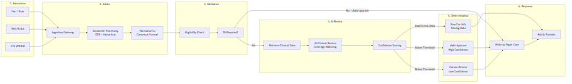
PA Request Lifecycle
Submit → Intake (OCR/extraction) → Validate (eligibility) → AI Review (coverage matching + confidence scoring) → Route (auto-approve / human review / pend) → Respond (writeback + notification)

Slide 3
Demo — Proof of Concept
Demo Scope (Phase 0)
5 realistic PA cases with real ICD-10/CPT codes
AI reviews each case in ~30 seconds using Claude tool use
FHIR R4 data models throughout
Three interfaces: CLI, REST API + Swagger, Web Dashboard
Production Differences
Mock eligibility → Payer Core System integration
Local criteria → CMS Coverage Database API
Synthetic patients → Real clinical records via FHIR
Single-user → Azure Container Apps with auto-scaling
▶ LIVE DEMO follows this slide

Slide 4
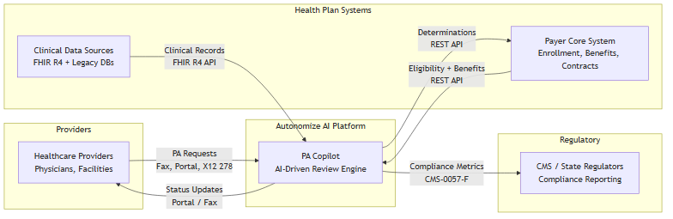
System Context
Actor | Role | Integration
Healthcare Providers | Submit PA requests via multiple channels | Fax, Portal, X12 278
Autonomize AI Platform | AI-driven clinical review engine | PA Copilot on Genesis
Health Plan Systems | Eligibility, benefits, clinical data | REST API, FHIR R4
Regulators (CMS) | Compliance reporting and oversight | CMS-0057-F metrics

Slide 5
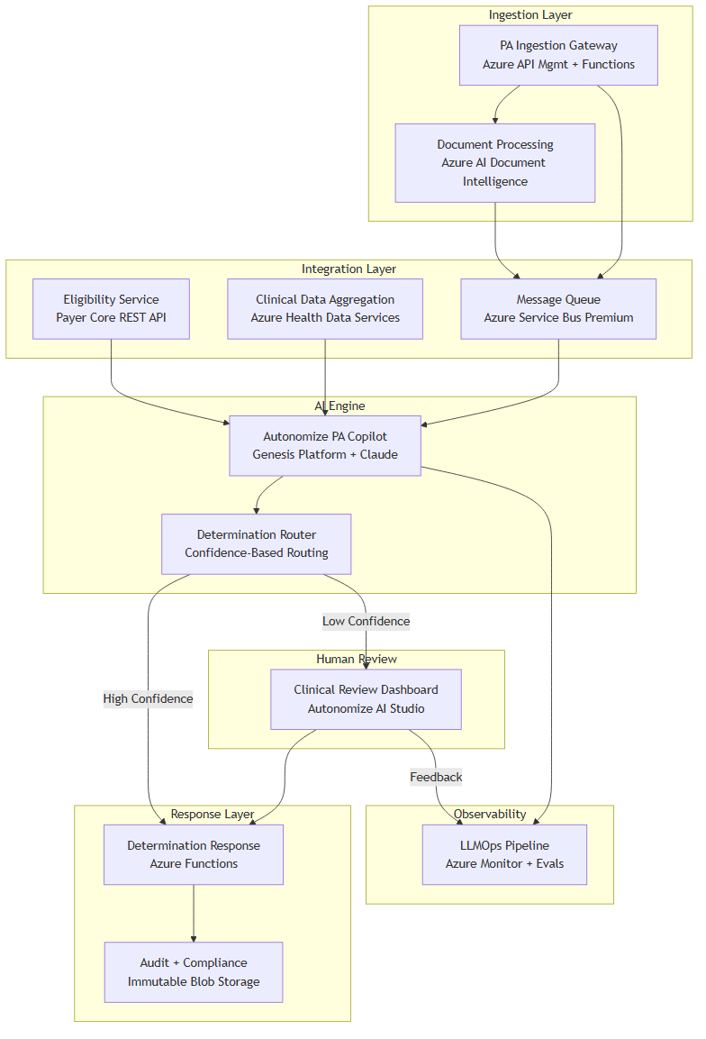
Component Architecture
Component | Azure Service | Purpose
Ingestion Gateway | API Mgmt + Functions | Receives all PA channels
Document Processing | AI Document Intelligence | OCR for faxes
Eligibility Service | Payer Core REST API | Member validation
Clinical Data | Health Data Services | Unified clinical context
PA Copilot | Genesis + Claude | AI clinical review
Determination Router | Functions + Rules | Confidence-based routing
Review Dashboard | AI Studio | Human reviewer interface
Audit & Compliance | Immutable Blob Storage | Tamper-proof audit trail

Slide 6
Why This Architecture
The Problem
Manual PA costs $10.97 per transaction
Takes days, burns out clinical staff
93% of physicians say PA delays patient care
45%
Review Time Reduction
Why These Specific Choices
AI-driven clinical review with human oversight — never auto-deny
Configurable confidence thresholds — start conservative, tune with real data
CMS-0057-F compliance readiness — FHIR R4 meets Jan 2027 deadline
Azure-native deployment — leverages Autonomize ecosystem
54%
Manual Error Reduction
50%
Auto-Determination Rate
Metrics: Altais + Autonomize AI (Feb 2026) | Cost: CAQH 2024 Index | Survey: AMA 2024

Slide 7
Top 3 Security Risks & Mitigations
# | Risk | Mitigation 1: Architectural | Mitigation 2: Operational
1 | PHI exposure through AI pipeline | PHI tokenization before LLM — AI sees clinical facts without patient identity | Zero data retention for model training (Anthropic enterprise terms)
2 | Prompt injection via clinical documents | Document sanitization + system prompt isolation | Output validation requiring evidence citations — injected claims fail verification
3 | Untraceable AI decisions | Tamper-proof audit trail: model version, input hash, reasoning, evidence | Immutable 7-year retention with append-only writes
Additional controls: Entra ID RBAC, AES-256 at rest, TLS 1.2+ in transit, private endpoints, no auto-deny without human review.

Slide 8
Progressive Delivery
Phase | Focus | Key Deliverable
Phase 0: Demo | Prove the concept | Working AI PA review with mock data
Phase 1: MVP | Single LOB, single channel | Production PA processing with human review
Phase 2: Scale | Multi-channel, multi-LOB | Fax OCR, legacy data, LOB configuration
Phase 3: Enterprise | Full scale, compliance | All channels, 20 LOBs, CMS reporting
Each phase produces a deployable, demonstrable system. Decision gates between phases use real performance data to scope the next phase.

Slide 9
Discussion Starters
Business Strategy
How does the ServiceNow partnership change the payer integration strategy?
What is the target auto-determination rate for Phase 1?
Technical Depth
How does the Genesis Platform handle coverage criteria updates?
What's the Azure AI Foundry Agent Service integration status?
Implementation
Which LOB is the ideal Phase 1 candidate?
What's been the biggest integration challenge with existing payer deployments?

Slide 10
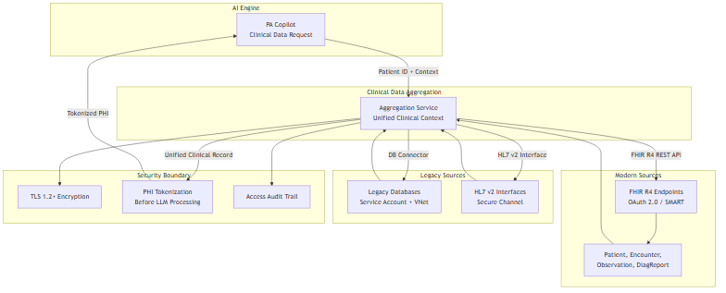
Appendix A: Clinical Data Integration
Source | Protocol | Auth
Modern EMRs | FHIR R4 REST API | OAuth 2.0 / SMART on FHIR
Legacy DB Connector | DB connector / HL7 v2 | Service account + VNet
FHIR R4 role: Interoperability standard for clinical data exchange. Modern sources expose it natively. Legacy data normalized to FHIR-compatible format before AI processing.
Security: All clinical data passes through PHI tokenization layer before reaching the AI engine.

Slide 11
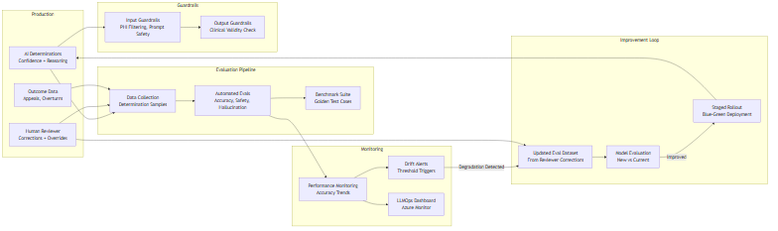
Appendix B: AI Model Monitoring & Feedback
Detect Drift
Outcome monitoring — overturn rate, appeal rate, accuracy trends
Automated evals — golden test cases benchmarked on schedule
Confidence distribution — shifts signal model or data changes
Feedback Loop
Human reviewer corrections → updated eval dataset
Eval dataset → benchmark new model versions vs current
If improved → staged blue-green rollout
Guardrails always active: input filtering, output validation, clinical safety

Slide 12
Appendix C: Scaling to 20 LOBs
Approach | Cost | Isolation | Complexity
Multi-tenant | Lower | Logical | Lower
Multi-instance | Higher | Physical | Higher
Recommendation: Start multi-tenant with per-LOB configuration. Autonomize Genesis Platform already supports it. Deploy separate instances only where regulation requires physical isolation.
Honest unknowns: The right answer depends on actual LOB rule complexity and regulatory requirements — both are discovery questions.

