Slide 1


AI-Driven Prior Authorization
Solution Architecture for a Large US Health Plan
Paul Prae | Principal AI Engineer & Architect
www.paulprae.com
1 / 15

Slide 2
The Problem & Opportunity
The Problem
Manual PA processing costs $10.97 per provider transaction and $3.52 per payer transaction, versus $0.05 when fully electronic (CAQH 2024). 93% of physicians report PA delays patient care (AMA 2024).
The Opportunity — Altais + Autonomize AI (Feb 2026)
Metric | Result
PA review time reduction | 45%
Manual error reduction | 54%
Auto-determination rate | 50%
Why Autonomize AI
• Live at 3 of the 5 largest US health plans • PA Copilot on Azure Marketplace — Microsoft Pegasus Program member • ServiceNow partnership extends reach into payer workflows • CMS-0057-F deadline (Jan 2027) creates urgency
2 / 15

Slide 3
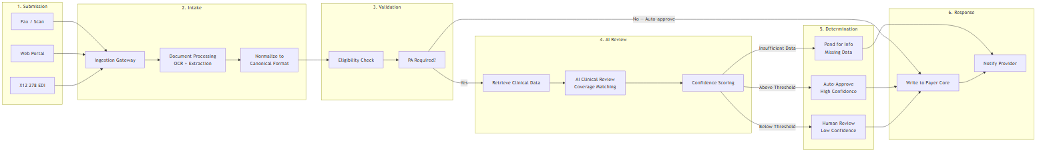
PA Request Lifecycle
Submit → Intake (OCR) → Validate (eligibility) → AI Review (coverage matching + confidence) → Route (auto-approve / human review / pend) → Respond (payer core + provider notification)
3 / 15

Slide 4
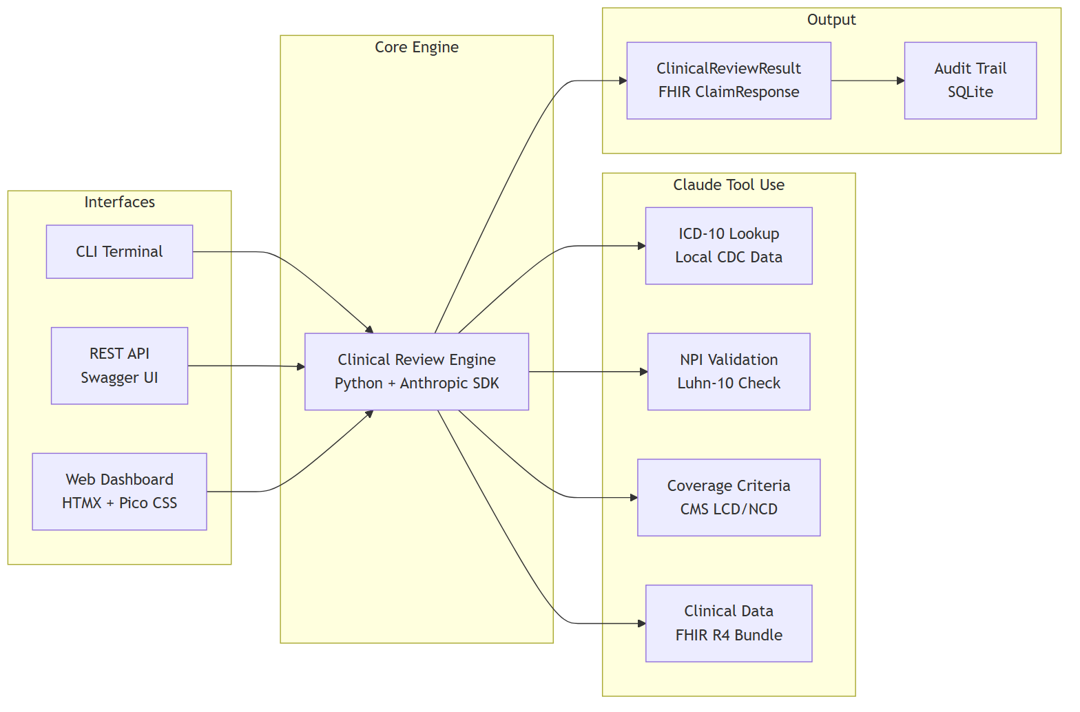
Demo — Proof of Concept
LIVE DEMO: Working proof of concept — demonstrates core clinical review (steps 4-5 of the lifecycle).
Demo Scope (Phase 0) | Production Differences
5 PA cases with real ICD-10/CPT codes | Mock eligibility → Payer Core integration
AI reviews in ~30s via Claude tool use | Local criteria → CMS Coverage Database API
FHIR R4 data models (fhir.resources R4B) | Synthetic data → real clinical records via FHIR
CLI, REST API + Swagger, Web Dashboard | Single-user → Azure Container Apps + auto-scale
4 / 15

Slide 5
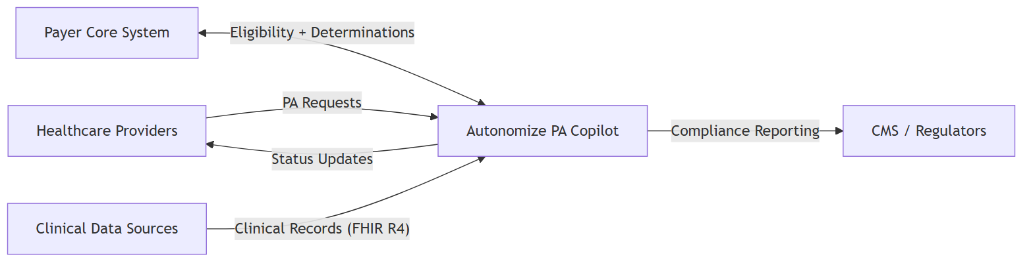
System Context
Four actors, one platform. Providers submit PA requests. The Payer Core provides eligibility and receives determinations. Clinical data sources feed FHIR R4 records. CMS receives compliance reporting. Autonomize PA Copilot sits in the center — automating the clinical review, not replacing it.
5 / 15

Slide 6
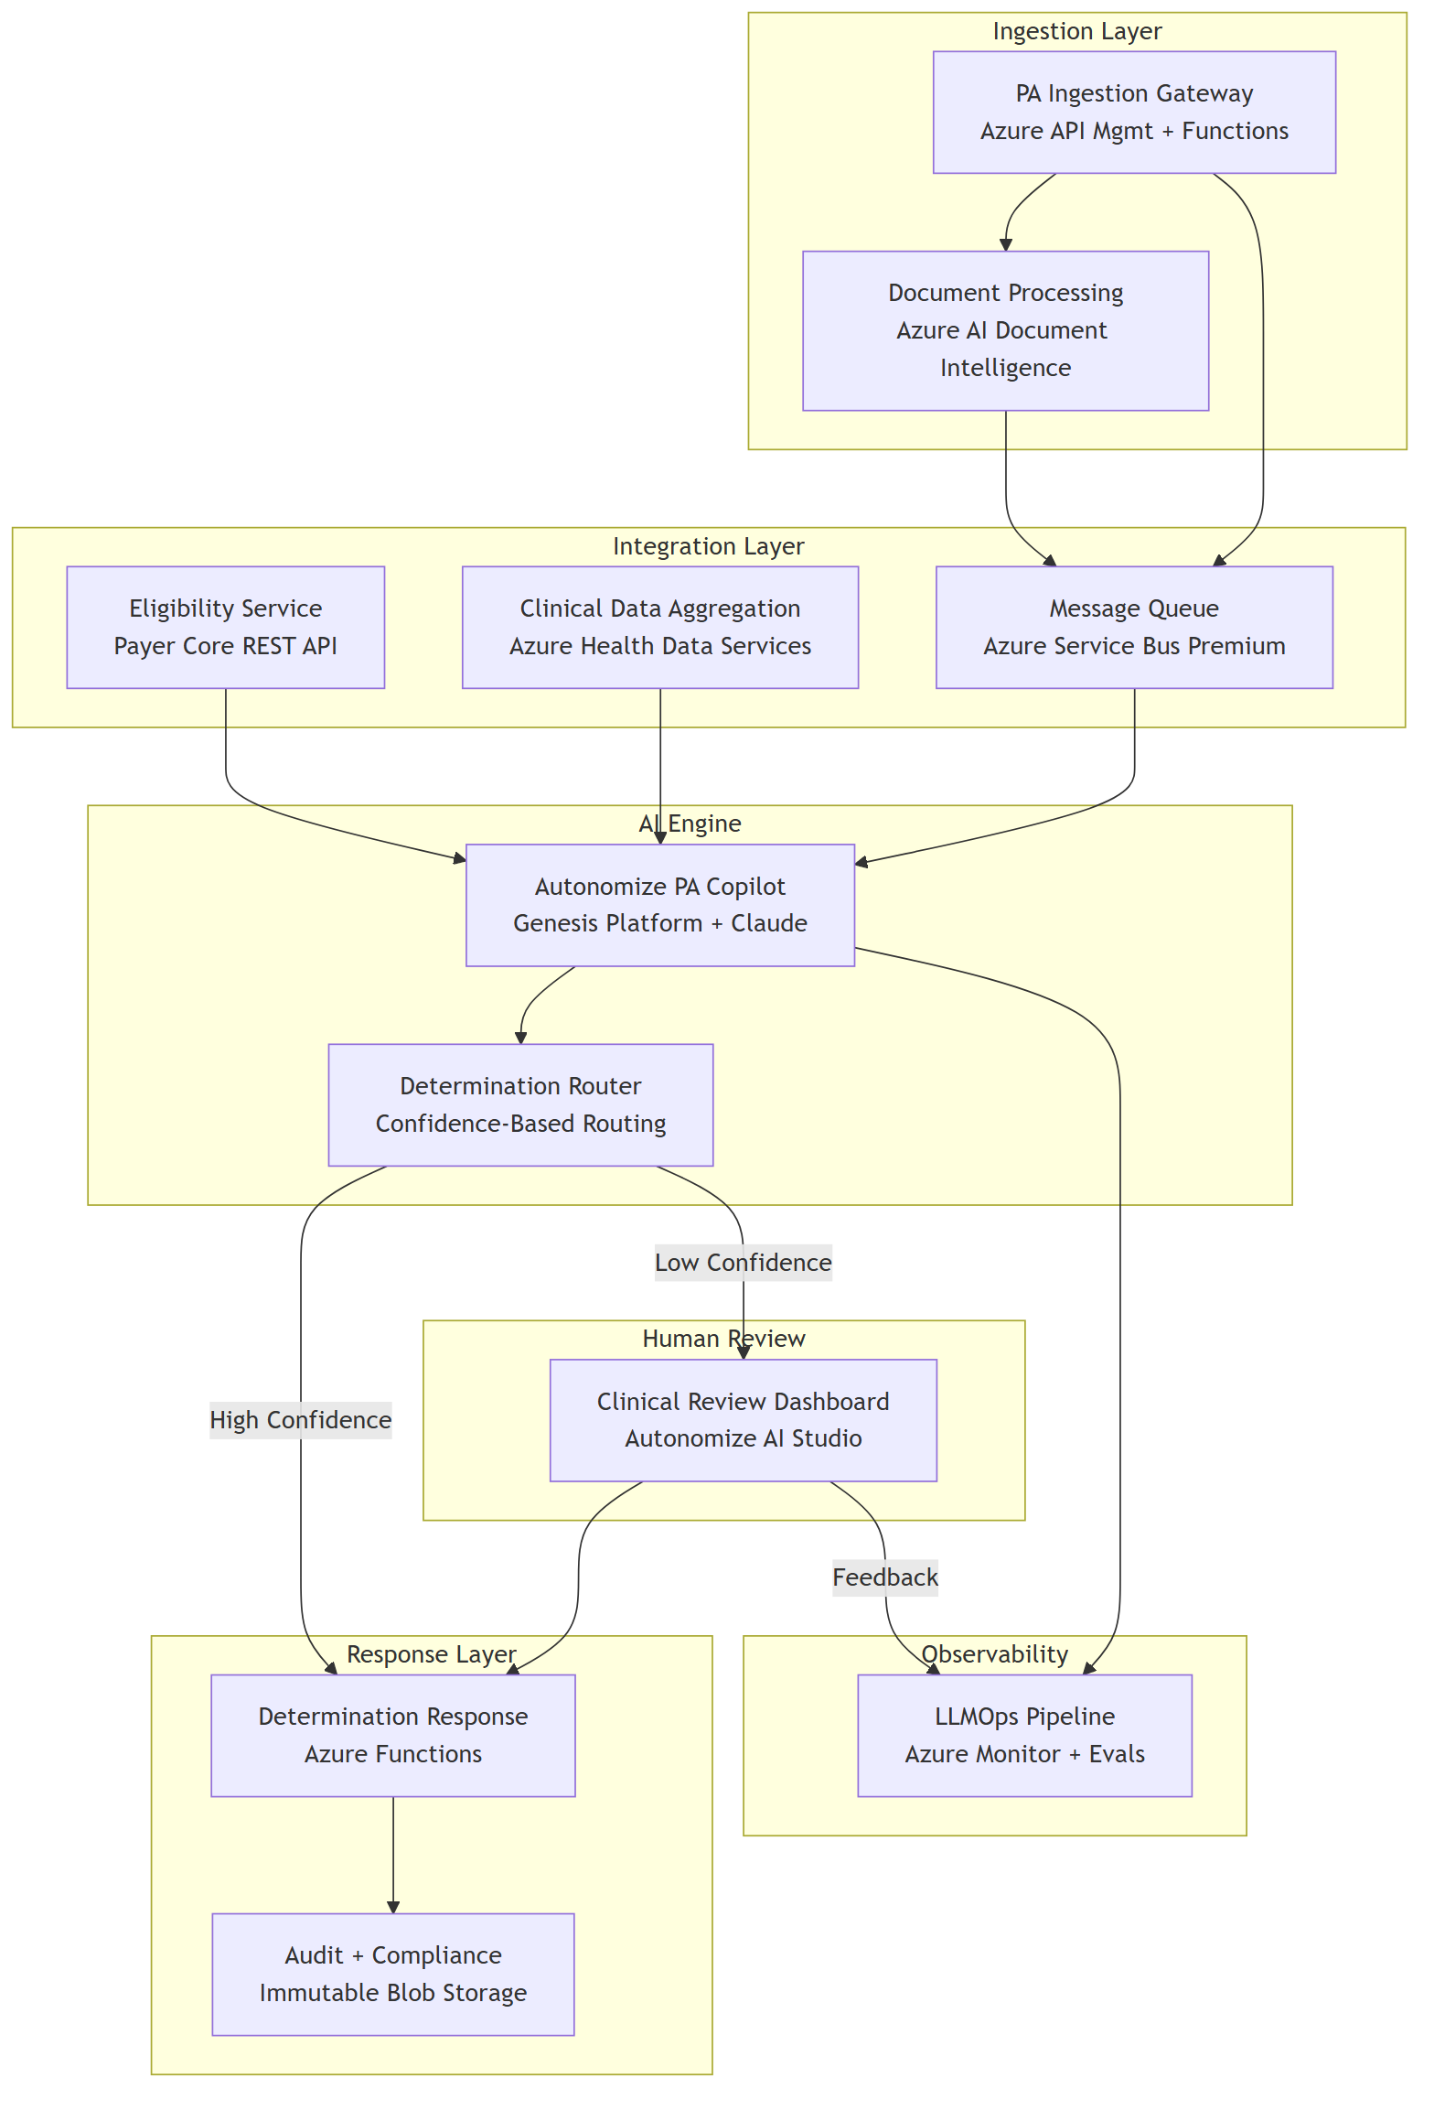
Solution Architecture
6 / 15

Slide 7
Solution Architecture — Components
Component | Azure Service | Purpose
Ingestion Gateway | API Mgmt + Functions | Receives all PA channels
Document Processing | AI Document Intelligence | OCR for faxes
Eligibility Service | Payer Core REST API | Member validation
Clinical Data Aggregation | Health Data Services (FHIR R4) | Unified clinical context
PA Copilot | Genesis Platform + Claude | AI clinical review
Determination Router | Functions + Rules | Confidence-based routing
Clinical Review Dashboard | Autonomize AI Studio | Human reviewer interface
Determination Response | Azure Functions | Payer Core writeback
LLMOps Pipeline | Azure Monitor + Evals | Performance monitoring
Audit & Compliance | Immutable Blob Storage | Tamper-proof audit trail
7 / 15

Slide 8
Why This Architecture
• Safety-first determination routing — confidence thresholds route low-certainty cases to human reviewers; no case is ever auto-denied without clinical review • Configurable confidence thresholds — start conservative, tune with real performance data as the system learns • CMS-0057-F compliance readiness — FHIR R4 foundation meets the Jan 2027 API deadline without re-architecture • Azure-native deployment — leverages Autonomize’s existing Azure ecosystem, Pegasus Program membership, and Marketplace presence • Full audit trail — every determination records model version, input hash, reasoning, evidence, and confidence for 7-year regulatory retention
8 / 15

Slide 9
Top 3 Security Risks & Mitigations
# | Risk | Mitigation 1: Architectural | Mitigation 2: Operational
1 | PHI exposure through AI pipeline | PHI tokenization before LLM — AI sees clinical facts without patient identity | Anthropic API: zero data retention for model training (enterprise terms)
2 | Prompt injection via clinical documents | Document sanitization + system prompt isolation | Output validation requiring evidence citations — hallucinated claims fail verification
3 | Untraceable AI decisions | Tamper-proof audit trail: model version, input hash, reasoning, evidence, confidence | Immutable 7-year retention with append-only writes
Additional controls: Entra ID RBAC, AES-256 at rest, TLS 1.2+ in transit, private endpoints, no auto-deny without human review.
9 / 15

Slide 10
Progressive Delivery — Agile, Iterative, Data-Driven
Phase | Duration | What We Deliver | How We Work
Phase 0: Demo | Weeks 1-2 | Working AI PA review with mock data | Spike + validate core architecture
Phase 1: MVP | Weeks 3-6 | Single LOB, single channel in production | 2-week sprints, daily standups, human review on all cases
Phase 2: Scale | Weeks 7-10 | Multi-channel, multi-LOB | Iterate on real performance data, add fax OCR + legacy connectors
Phase 3: Enterprise | Weeks 11-12 | All channels, 20 LOBs, CMS reporting | Harden, load test, compliance validation
Each phase: Design → Build → Test → Demo → Decision Gate. No phase starts without stakeholder sign-off. Real performance data drives scope decisions — not assumptions.
10 / 15

Slide 11
Discussion Starters
For the team:
• Which LOB would be the best Phase 1 candidate — and why? • What auto-determination rate should we target for Phase 1? • What’s been the biggest integration surprise with existing payer deployments?
What I’d want to learn in discovery:
• How does Genesis handle coverage criteria updates today? • What does the ServiceNow partnership mean for payer workflow integration? • What Autonomize platform components are available for a new engagement?
11 / 15

Slide 12
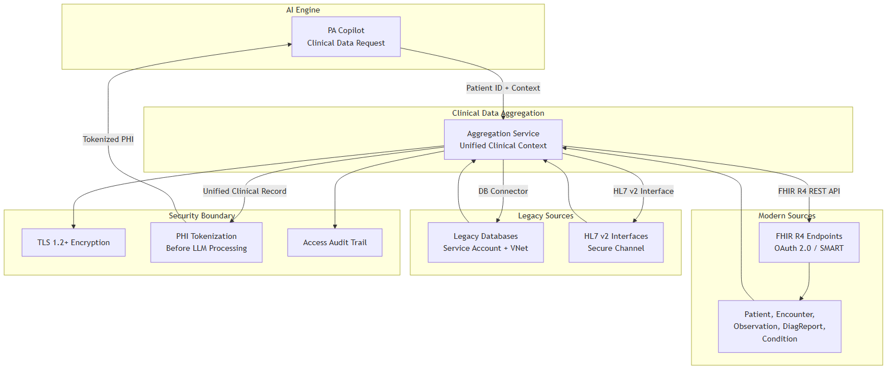
Appendix A: Clinical Data Integration
Source | Protocol | Auth
Modern EMRs | FHIR R4 REST API | OAuth 2.0 / SMART on FHIR
Legacy DB Connector | DB connector / HL7 v2 | Service account + VNet
FHIR R4: Interoperability standard for clinical data. Modern sources expose natively; legacy data normalized before AI processing.
Security: All clinical data passes through PHI tokenization before reaching the AI engine.
12 / 15

Slide 13
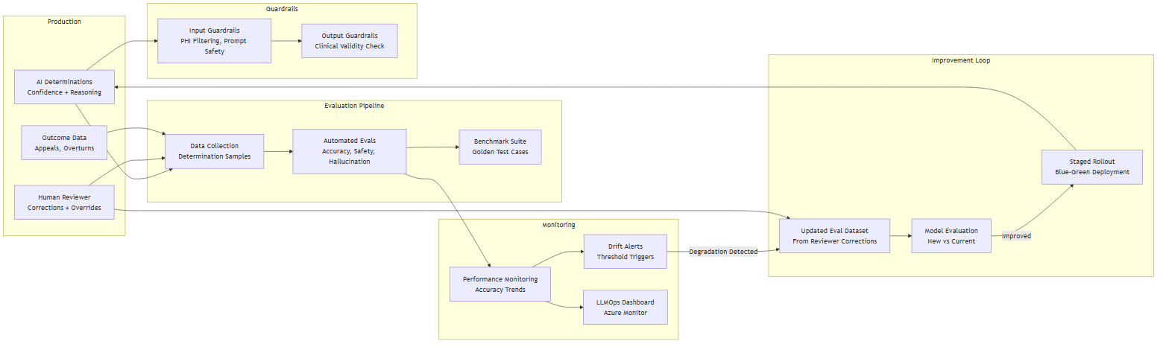
Appendix B: AI Model Monitoring & Feedback
Detect drift
• Overturn rate monitoring (human overrides AI), appeal rate, accuracy trends • Automated evals — golden test cases benchmarked on schedule • Confidence distribution shifts signal model or data changes
Feedback loop
1. Reviewer corrections → updated eval dataset 2. Benchmark new vs current 3. Staged blue-green rollout 4. Guardrails always active
13 / 15

Slide 14
Appendix C: Scaling to 20 LOBs
Approach | Cost | Isolation | Complexity
Multi-tenant | Lower | Logical | Lower
Multi-instance | Higher | Physical | Higher
Recommendation: Multi-tenant with per-LOB configuration. Separate instances only where regulation requires physical isolation. The right answer depends on actual LOB rule complexity — a discovery question.
14 / 15

Slide 15
Sources & References
# | Claim | Source
1 | $10.97 manual PA labor cost (provider) | CAQH 2024 Index, p. 9
2 | $3.52 manual PA labor cost (payer) | CAQH 2024 Index, p. 9
3 | ~$0.05 electronic PA cost (payer) | CAQH 2024 Index, p. 9
4 | 45% PA review time reduction | Altais + Autonomize AI (BusinessWire Feb 2026)
5 | 54% manual error reduction | Altais + Autonomize AI (BusinessWire Feb 2026)
6 | 50% auto-determination rate | Altais + Autonomize AI (BusinessWire Feb 2026)
7 | 93% physicians say PA delays care | AMA 2024 Prior Auth Survey, p. 5
8 | CMS-0057-F Phase 1 Jan 2026 | CMS Interoperability Final Rule Fact Sheet
9 | CMS-0057-F Phase 2 Jan 2027 | CMS Interoperability Final Rule Fact Sheet
10 | Live at 3 of 5 largest US plans | Autonomize AI (BusinessWire Feb 2026)
11 | PA Copilot on Azure Marketplace | Azure Marketplace listing
12 | ServiceNow partnership | BusinessWire Mar 2026
13 | Claude in Azure AI Foundry | Microsoft Learn
14 | Genesis Platform | GlobeNewsWire Apr 2025
15 | Microsoft Pegasus Program | BusinessWire Nov 2025
15 / 15

