Slide 1
Hey this is a PPT

Slide 2
Slide 2
No way!

Slide 3
We made it to 3

Slide 4
Its Number 4!
asdasdasd

Slide 5
Yo I’m slide 5

Slide 6
Slide 6 is the best slide

Slide 7
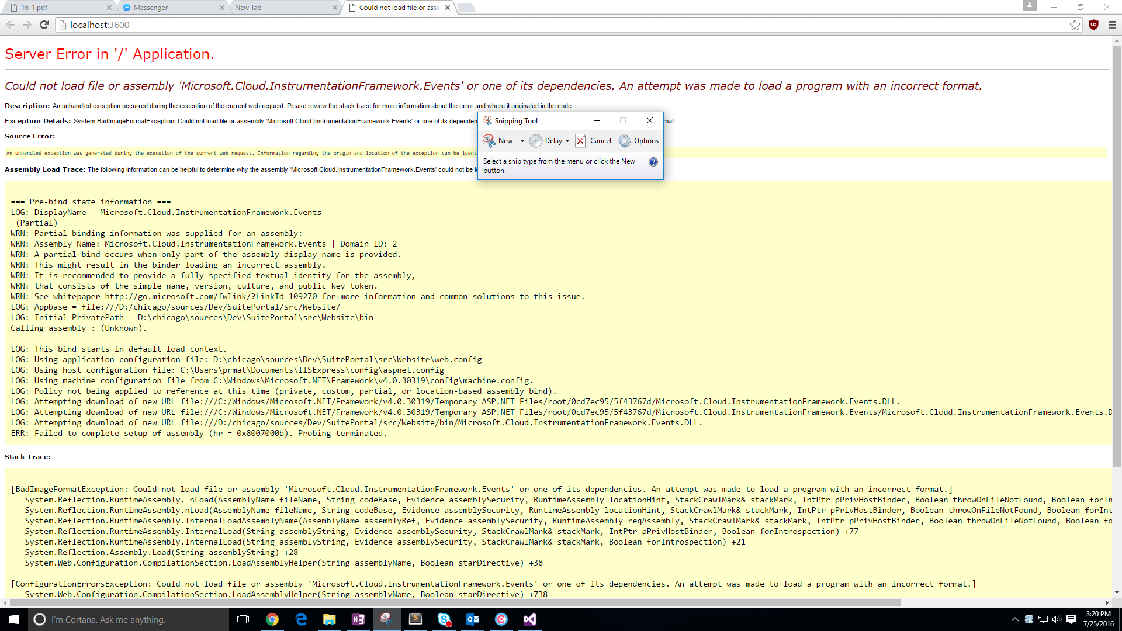
Slide 7!!!!!

