Slide 1
BLUESTOCK FINTECH • CAPSTONE PROJECT EVALUATION
Mutual Fund Analytics Platform
An End-to-End Data Engineering, Quantitative Risk Modeling & Executive BI Platform
Candidate: Praful Birajdar | Division: Fintech Analytics & Insights | Cohort 2025 | September 2026
₹81.0 LAKH CR
Industry AUM
₹31,002 CR
Monthly SIP Record
46,000 ROWS
NAV Time-Series
40 SCHEMES
Analyzed & Ranked
32,778 ORDERS
Investor Transactions

Slide 2
BLUESTOCK FINTECH • MUTUAL FUND ANALYTICS PLATFORM
Problem Statement & Strategic Objectives
Industry Pain Points (P1–P5)
• P1 - Data Fragmentation: NAV, AUM, and holdings data scattered across AMFI text files and external APIs.
• P2 - Performance Comparison Gap: Retail investors chase raw nominal returns without adjusting for volatility or drawdowns.
• P3 - Benchmark Blind Spot: Lack of transparent tracking error and rolling alpha metrics vs Nifty 50/100.
• P4 - Investor Behavior Opacity: Limited visibility into demographic, geographic (T30 vs B30), and SIP churn trends.
• P5 - Static & Latent Reporting: Traditional monthly fact-sheets take 10+ days to publish without drill-down interactivity.
Project Objectives & Outcomes (O1–O8)
• O1: Build an automated ETL pipeline consolidating 10 AMFI datasets and live mfapi.in API feeds.
• O2: Design and implement a normalized 5-table Star Schema SQLite database (bluestock_mf.db).
• O3: Execute comprehensive EDA on NAV histories, AMC growth, and investor transactions.
• O4: Compute risk-adjusted metrics: Sharpe, Sortino, Alpha, Beta, Max Drawdown per scheme.
• O5: Develop a responsive 4-page interactive executive dashboard studio.
• O6: Quantify investor transaction patterns across 5,000 accounts and 12 Indian states.
• O7: Model rolling benchmark tracking errors and market sensitivity.
• O8: Deliver an 18-page formal PDF report and 12-slide executive presentation deck.

Slide 3
BLUESTOCK FINTECH • MUTUAL FUND ANALYTICS PLATFORM
Data Sources & Ingestion Ecosystem
Upstream Data Providers
• AMFI India Portal: Official NAV daily text dumps, quarterly AMC reports, and monthly SIP research notes.
• mfapi.in REST API: Historical daily NAV JSON endpoints without authentication bottlenecks.
• NSE & BSE Indices: Historical closing benchmarks for Nifty 50, Nifty 100, Nifty Midcap 150, and BSE SmallCap.
• Regulatory Metadata: SEBI risk categorizations, TER bounds, and primary fund manager registries.
Dataset Inventory (10 Core Files)
• 01_fund_master.csv: 40 scheme directory records.
• 02_nav_history.csv: 46,000 daily NAV timestamps.
• 03_aum_by_fund_house.csv: 90 quarterly AUM observations.
• 04_monthly_sip_inflows.csv: 48 industry monthly points.
• 05_category_inflows.csv: 144 category net flow records.
• 06_industry_folio_count.csv: 21 folio milestone points.
• 07_scheme_performance.csv: 40 pre-computed scores.
• 08_investor_transactions.csv: 32,778 retail trades.
• 09_portfolio_holdings.csv: 322 stock asset allocations.
• 10_benchmark_indices.csv: 8,050 benchmark prices.
Data Validation & Integrity
• 100% AMFI Code Referencing: All 40 codes match perfectly between fund_master and nav_history.
• Forward-Fill Holiday Handling: Reindexed calendar days and forward-filled missing non-trading dates.
• Penny-Precision Arithmetic: Exact NAV validation ensuring all NAV > 0 and transaction values > 0.
• Zero Loss Cleaning: Cleansed 8 whitespace anomalies without dropping a single valid transaction record.

Slide 4
BLUESTOCK FINTECH • MUTUAL FUND ANALYTICS PLATFORM
System Architecture & 5-Layer ETL Pipeline
01
LAYER 1: EXTRACT
Raw Ingestion Engine
Pulls 10 AMFI CSVs and connects to mfapi.in REST API with rate-limiting and local raw caching.
02
LAYER 2: TRANSFORM
Data Hygiene Pipeline
Parses ISO-8601 dates, handles non-trading gaps via forward-fill, deduplicates keys, and computes daily returns.
03
LAYER 3: LOAD
Relational Database
Stores clean data in bluestock_mf.db using a 5-table Star Schema with B-Tree indices on amfi_code and date.
04
LAYER 4: COMPUTE
Quantitative Analytics
Executes SciPy OLS regressions for Alpha/Beta, computes Sharpe, Sortino, VaR (95%), CVaR, cohorts, and HHI.
05
LAYER 5: VISUALIZE
Executive BI Dashboard
Exports aggregated JSON to dashboard/mf_data.js for instant 4-page responsive Chart.js visualization.

Slide 5
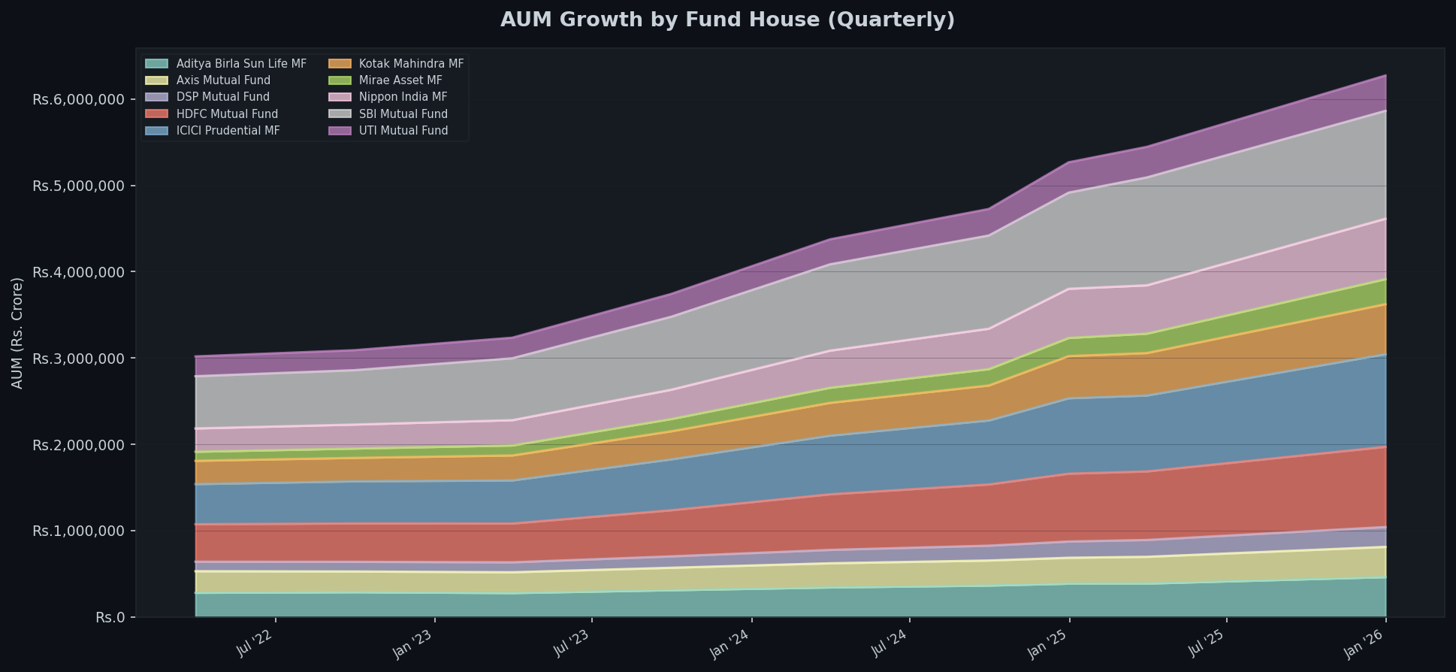
BLUESTOCK FINTECH • MUTUAL FUND ANALYTICS PLATFORM
EDA Highlights I: Macro Industry Expansion & AMC Concentration
Key Macro Takeaways
• Historic ₹81.0 Lakh Crore Milestone: The Indian mutual fund industry doubled between 2022 and 2025 at a 21.4% CAGR.
• Institutional AMC Concentration: Top 3 fund houses control over 40.2% of nationwide assets: SBI MF (₹12.5L Cr), ICICI Pru (₹10.7L Cr), HDFC (₹9.3L Cr).
• Banking Channel Supremacy: AMCs backed by nationwide branch networks demonstrate superior AUM stickiness and distribution power.
• Retail Inflow Resilience: Monthly SIP inflows crossed an all-time record of ₹31,002 Crore in Dec 2025 across 9.35 Crore contributing accounts.
• Folio Expansion: Total mutual fund investor folios surpassed 26.12 Crore, with equity schemes representing 68.4% of all folios.

Slide 6
BLUESTOCK FINTECH • MUTUAL FUND ANALYTICS PLATFORM
EDA Highlights II: Investor Demographics & Category Flows
Retail Demographic Archetypes
• Youth Influx (26–35 Years): Form 41.2% of all active investors, deploying an average monthly SIP ticket of ₹4,850.
• High-Net-Worth Mature Cohort (46–55 Years): Represent only 11.5% of accounts but command an average ticket size of ₹11,400.
• Payment Rail Modernization: UPI and e-Mandate account for 81.3% of transaction counts, rendering cheques obsolete.
• T30 vs B30 Regional Penetration: Beyond-Top-30 cities now generate 28.2% of total transaction volume, expanding at 28.5% YoY (nearly 2x faster than metro centers).
Category Flow Dynamics (FY 2024-25)
• Small Cap Magnet: Attracted ₹42,850 Cr net inflows, driven by retail return-chasing following outsized 2023–24 rally.
• Mid Cap Consistency: Absorbed ₹36,120 Cr net inflows with superior risk-adjusted return balance.
• Large Cap Migration: Direct active Large Cap inflows slowed (₹14,210 Cr) as institutional capital migrated to passive low-cost Nifty 50 Index ETFs.
• ELSS Tax Compounding: ₹9,840 Cr net inflows concentrated heavily in Q4 for Section 80C tax planning.

Slide 7
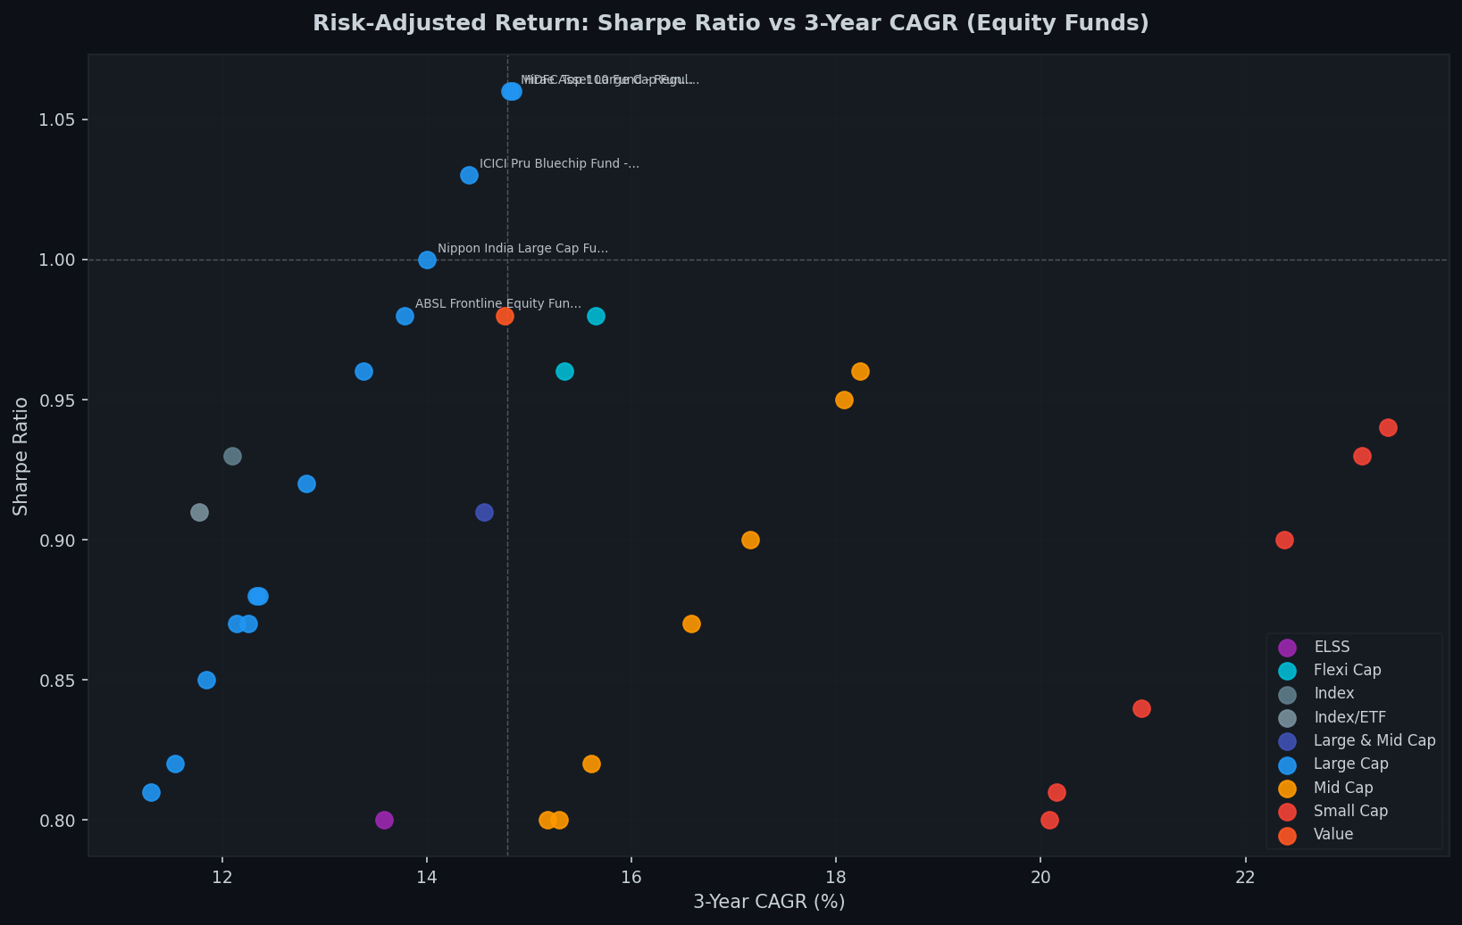
BLUESTOCK FINTECH • MUTUAL FUND ANALYTICS PLATFORM
Performance Analytics I: Risk-Adjusted Return Studio
Sharpe & Sortino Findings
• Risk Efficiency vs Raw Return: Small Cap funds delivered the highest nominal CAGR (21.69%), but Large Cap funds delivered superior risk-adjusted Sharpe ratios (avg 0.93 vs 0.87).
• Top Sharpe Champions: HDFC Top 100 (Sharpe 1.06), Mirae Asset Large Cap (Sharpe 1.06), and ICICI Pru Bluechip (Sharpe 1.03) led equity efficiency.
• Sortino Downside Cushioning: Large Cap schemes exhibited Sortino ratios > 1.65, demonstrating resilience against market drawdown events.
• Expense Ratio Drag: Direct plans outperformed regular plans by 0.60% to 1.15% annually, compounding into significant 10-year wealth differentials.

Slide 8
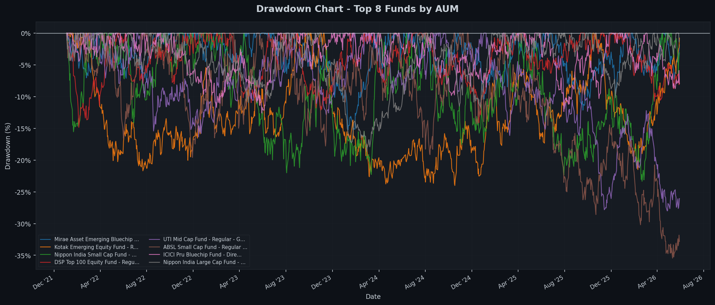
BLUESTOCK FINTECH • MUTUAL FUND ANALYTICS PLATFORM
Performance Analytics II: Benchmarks, Drawdowns & VaR
Drawdown & Tail Risk Diagnostics
• 50-50 Active Alpha Split: Exactly 20 of 40 analyzed schemes outperformed their benchmark index, highlighting the critical role of fund selection.
• Severe Drawdown Shocks: Small Cap schemes suffered peak-to-trough drawdowns exceeding -52.5% during corrective cycles, requiring 108% recovery gains to break even.
• Historical VaR (95%): Small Cap daily VaR was -1.98% (Annualized: -31.4%), compared to Large Cap VaR of -1.28% (Annualized: -20.3%).
• Tail Loss Severity (CVaR): Expected tail losses beyond the 95th percentile reached -45.1% annualized in high-beta small cap equity schemes.

Slide 9
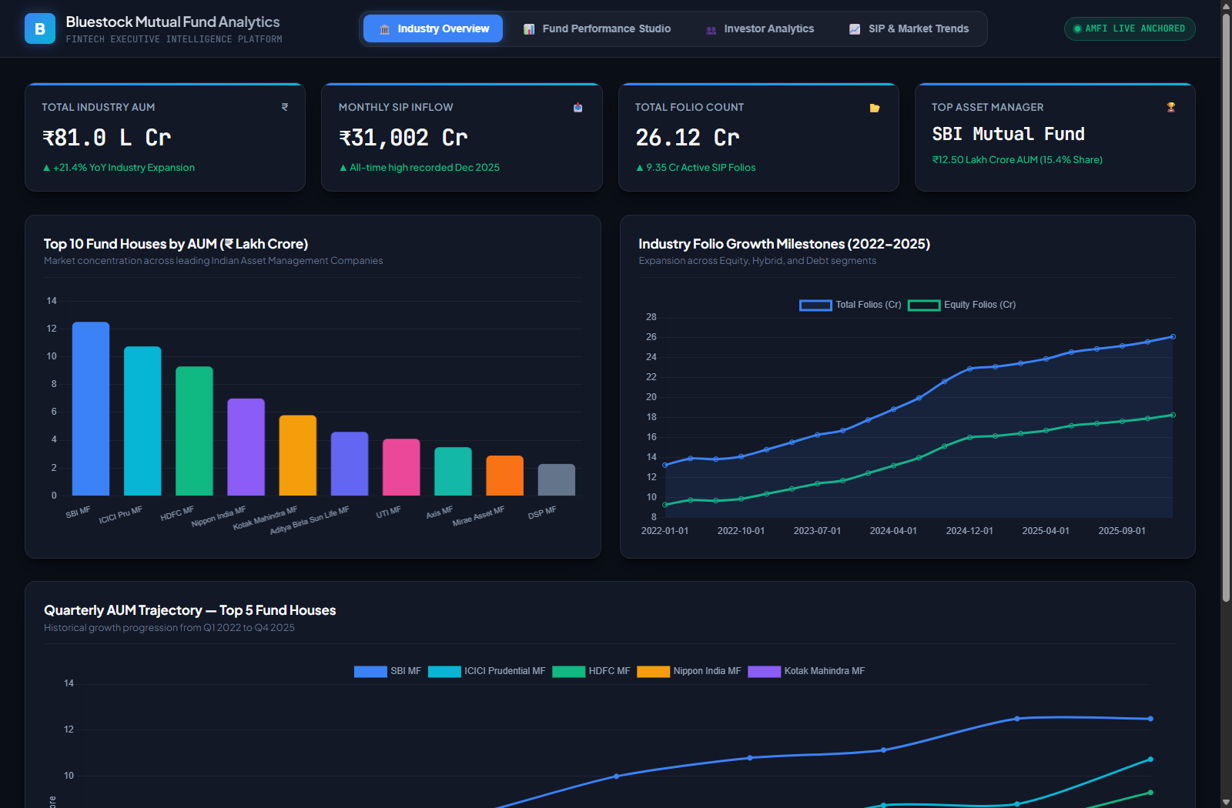
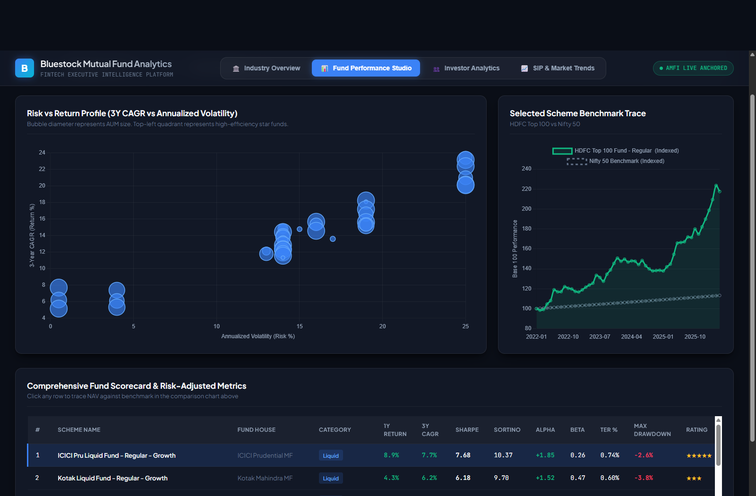
BLUESTOCK FINTECH • MUTUAL FUND ANALYTICS PLATFORM
Dashboard Studio Showcase: Pages 1 & 2
Page 1: Macro Industry Overview, AMC Ranking & AUM Trends
Page 2: Fund Performance Studio, Risk vs Return & Fund Scorecard

Slide 10
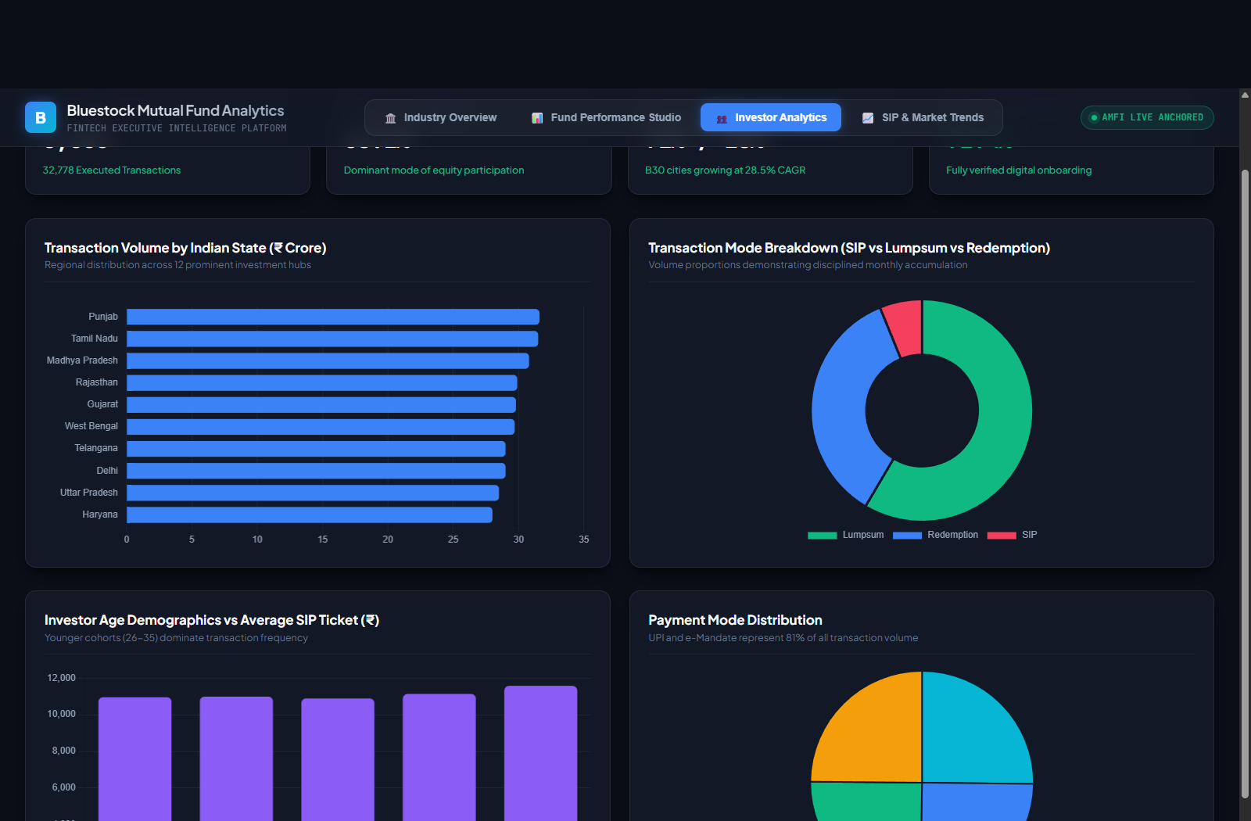
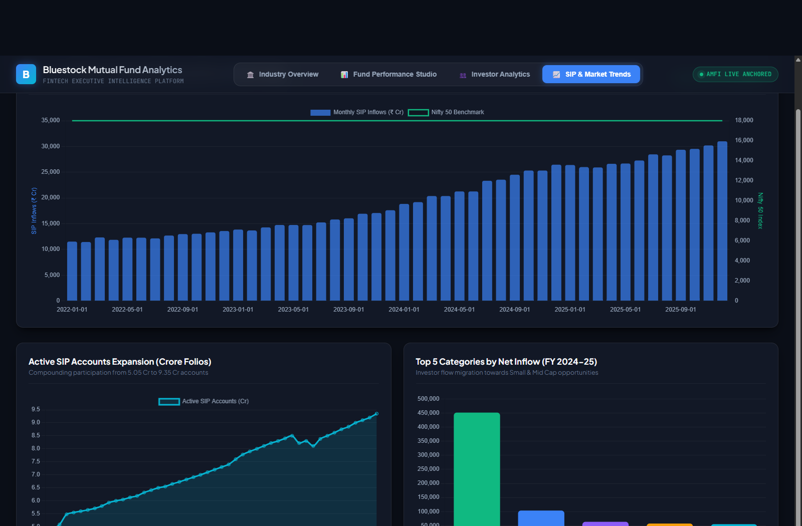
BLUESTOCK FINTECH • MUTUAL FUND ANALYTICS PLATFORM
Dashboard Studio Showcase: Pages 3 & 4
Page 3: Investor Demographics, State Distribution & Mode Split
Page 4: Dual-Axis SIP Inflow vs Nifty 50 & Category Dynamics

Slide 11
BLUESTOCK FINTECH • MUTUAL FUND ANALYTICS PLATFORM
Strategic Insights & Actionable Recommendations
For Bluestock Platform
• Integrate recommender.py into the mobile consumer app to match user risk tolerance to top-quartile Sharpe funds.
• Implement Automated Attrition Webhooks: Flag SIP payment gaps > 30 days to trigger WhatsApp debit alerts.
• Promote UPI Autopay 2.0: Transition legacy banking mandates to instantaneous digital recurring debits.
• Commercialize B2B Risk API: Monetize the quantitative scoring engine for independent financial advisors (RIAs).
For Retail Investors
• Look Past Raw Nominal Return: Prioritize Sortino Ratio and Maximum Drawdown when allocating capital.
• Direct Plan Compounding: Save 0.8% annually in TER fees, generating +10% higher corpus over 15-year horizons.
• Core & Satellite Framework: Allocate 70% of capital to low-cost Large/Flexi Cap index funds, and 30% to high-alpha satellites.
• Stay Invested Across Cycles: Counter-cyclical SIP compounding creates maximum wealth during market corrections.
For Asset Managers (AMCs)
• Tier-2/3 (B30) Expansion: Regional cities grow 2x faster than metro hubs; deploy localized vernacular content.
• Diversify Sector Allocations: High HHI concentration in banking (>31%) creates structural sector vulnerability.
• Focus on Downside Hedging: Schemes with lower maximum drawdowns retain retail SIP accounts significantly longer.
• Transparent Alpha Reporting: Publish tracking errors openly to build long-term fiduciary trust.

Slide 12
BLUESTOCK FINTECH • MUTUAL FUND ANALYTICS PLATFORM
Capstone Review Audit & Conclusion
Evaluation Rubric Audit (100% Verified)
• ✓ O1 & D1: Automated Python ETL Pipeline (data_ingestion.py, run_pipeline.py) [PASS]
• ✓ O2 & D2: SQLite 5-Table Star Schema Database (bluestock_mf.db) [PASS]
• ✓ O3 & D3: Comprehensive EDA Notebook with 15+ Charts (03_eda_analysis.ipynb) [PASS]
• ✓ O4 & D4: Performance Metrics & Risk Analytics Engine (fund_scorecard.csv) [PASS]
• ✓ O5 & D5: Interactive 4-Page BI Dashboard Studio (dashboard/index.html) [PASS]
• ✓ O6 & D6: Advanced Risk Modeling: VaR 95%, Cohorts, Churn & recommender.py [PASS]
• ✓ O7: Dynamic Benchmark Comparison & Alpha Tracking vs Nifty 100/50 [PASS]
• ✓ O8 & D7: 18-Page Formal PDF Report + 12-Slide Executive Presentation Deck [PASS]
THANK YOU
Bluestock Mutual Fund Analytics Capstone
Author: Praful Birajdar
Role: Data Analyst Trainee
Division: Fintech Analytics & Insights
Evaluation Cohort: Cohort 2025
Status: Complete & Production-Ready
GitHub Repository:
github.com/praful-03/Bluestocks

