Slide 1
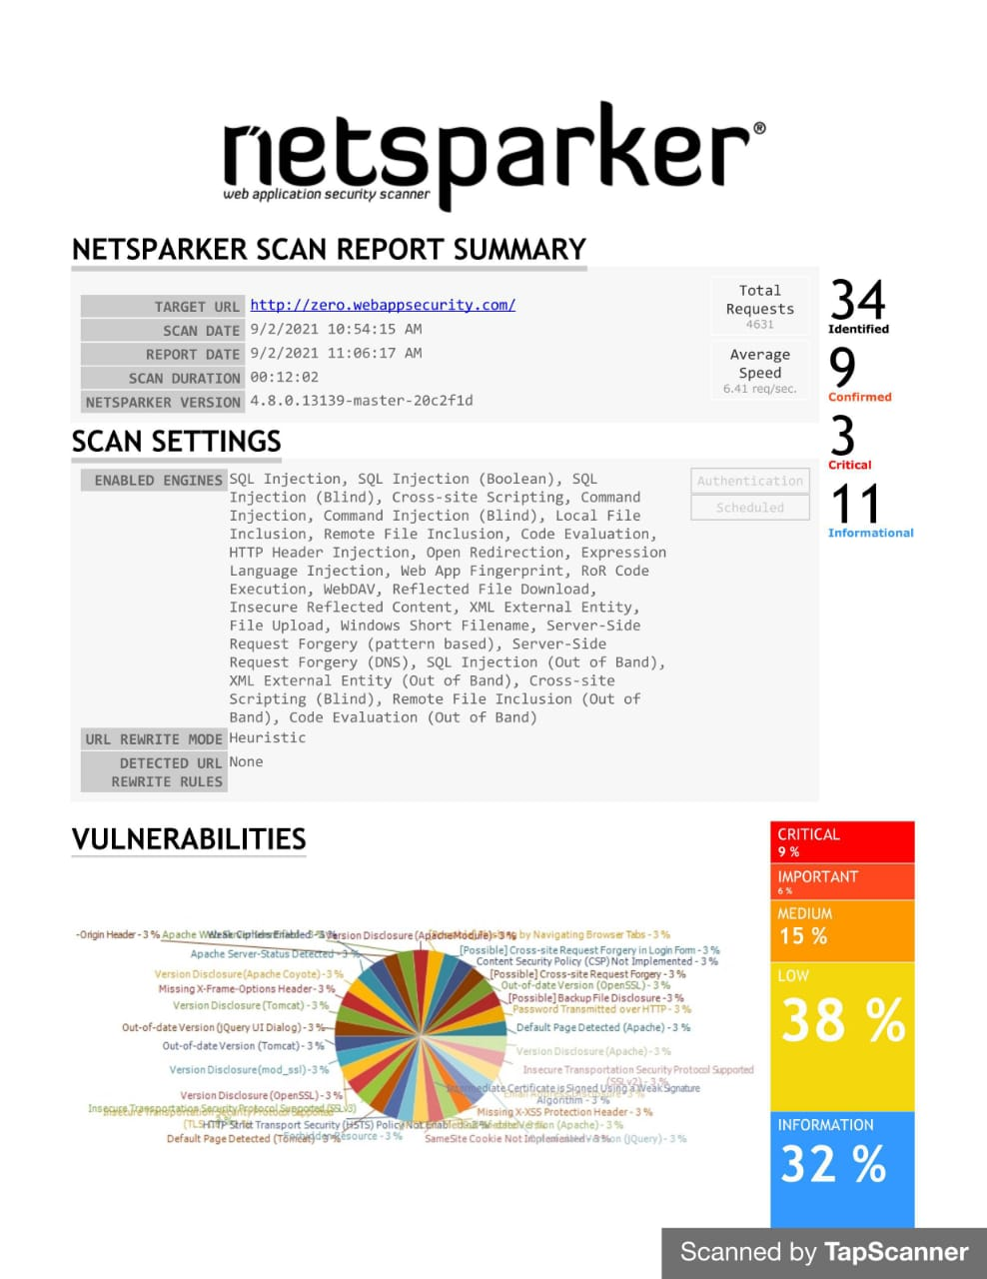

Slide 2
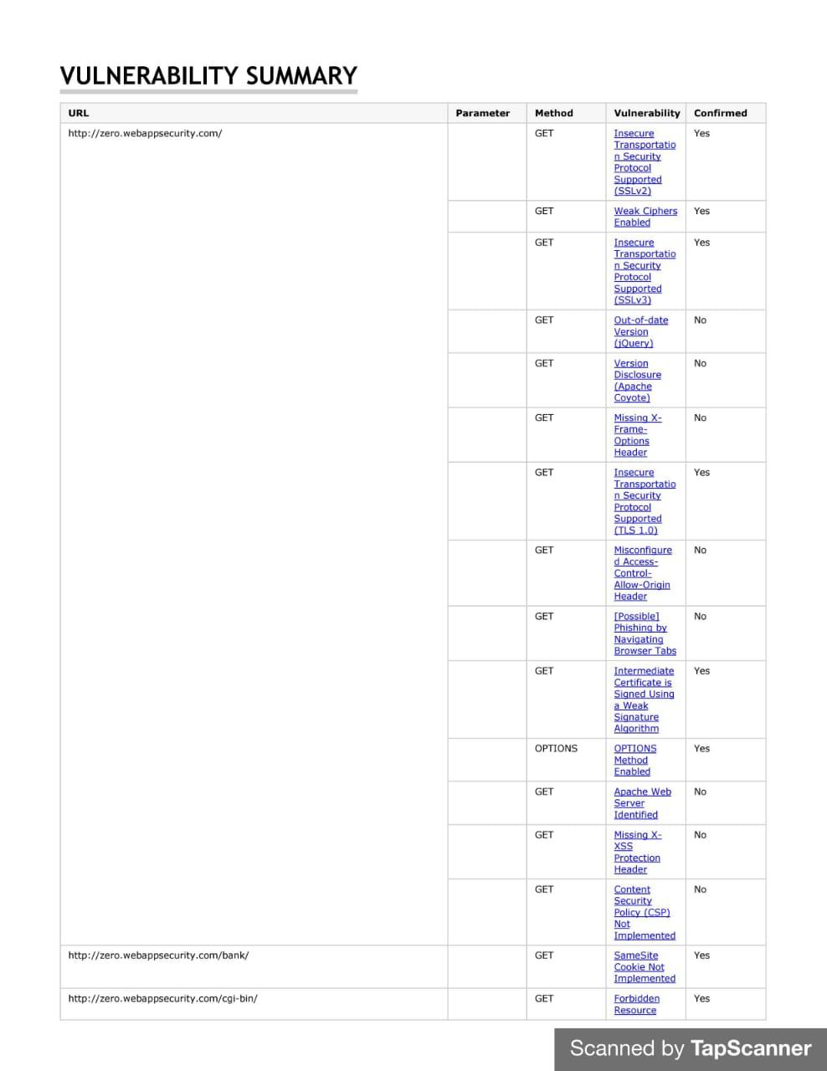

Slide 3
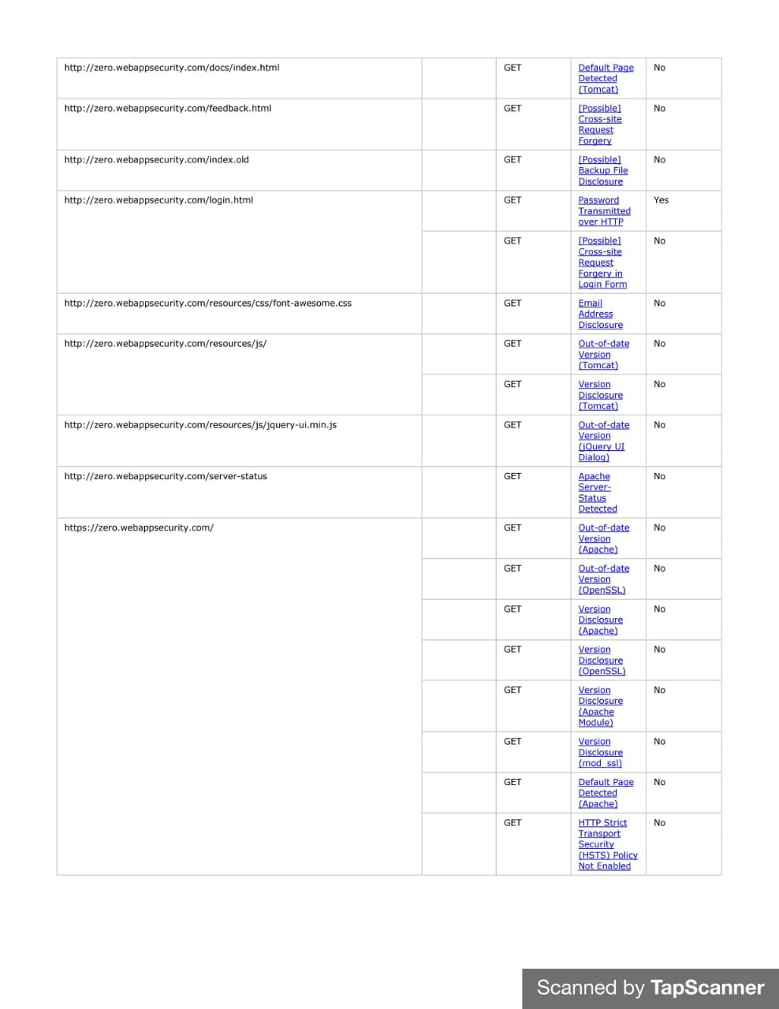

Slide 4
Report 1.Out-Of-Date Version (Tomcat)
Netsparker identified you are using an out-of-date version of Tomcat.
Domain : http://zero.webappsecurity.com/resources/js/
Identified version :
7.0.70 (contains 4 critical and 45 other vulnerabilities)
Latest version :
10.0.10
Impact :
1. Expose of sensitive information to an unauthorized person.
2.Unrestricted upload of file.
Recommandation :
update to the latest version.
External Reference :
CVE - 2017-12617
CVE –2016-6794

