Slide 1


PES UNIVERSITY
Department of Electronics and Communication Engineering
14-Credits Project
17-05-2019

Slide 2
LOW LIGHT IMAGE ENHANCEMENT TECHNIQUE
ESA
17-05-2019

Slide 3
Under the guidance of
Dr. Shikha Tripathi
Undertaken by:
Praful B S 01FB15EEC156
Praveen Kumar R 01FB15EEC164
Syed Arif 01FB15EEC263
17-05-2019

Slide 4
OUTLINE OF PRESENTATION
Introduction
Applications and Motivation
Literature review
Summary of literature survey
Research Challenges/Gaps
Objectives
Methodology
Implementation
Results
Performance evaluation
Conclusion and Future Scope
References
17-05-2019

Slide 5
Introduction
Vision of human eye is limited to a certain intensity of light, below which the things become almost invisible or not clear to human eyes.
In the same way, the images captured in the presence of low-light and hazy environment are not clear to human eyes and also there is loss of details captured by human eyes due to low-light and haziness.
Images that are taken in low light hazy conditions are not even conducive to the computer algorithms for image analysis.
17-05-2019

Slide 6
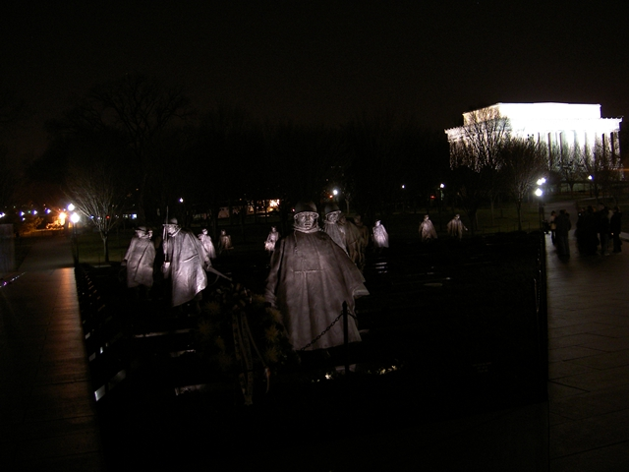
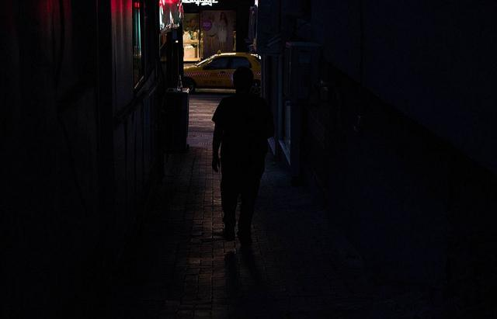
Low-light Images
Images captured under low-light conditions can be categorized under Low-light images.
In low-light images, most of the scene details are hidden in it and not visible due to lack of light.
Low-light images
17-05-2019
Notes:
Swapped Slide 5 and 6

Slide 7
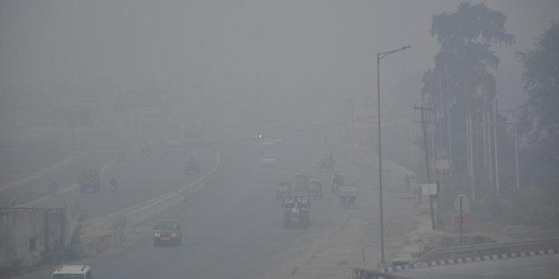
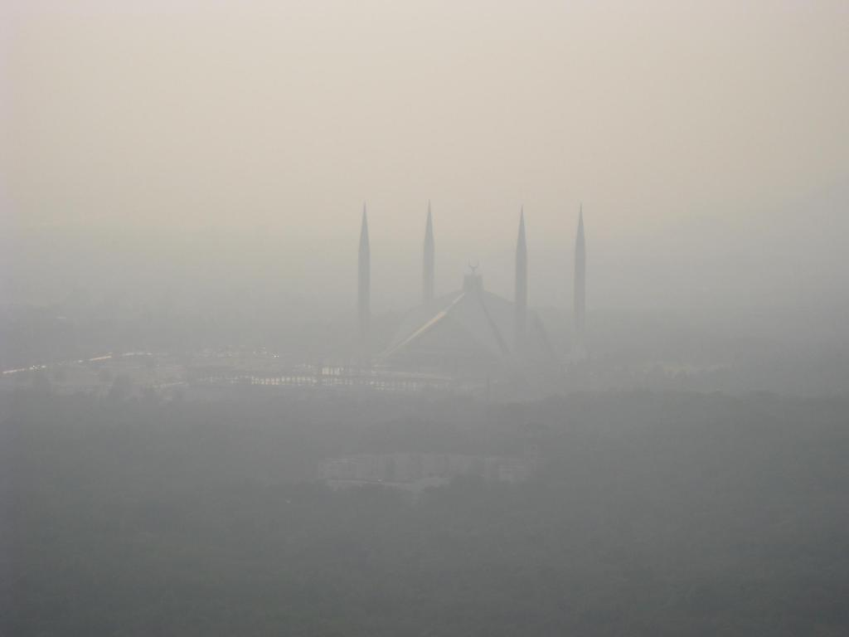
Hazy Images
Haze is traditionally an atmospheric phenomenon in which dust, smoke, and other dry particulates obscure the clarity of the sky. Images taken under such conditions are known as Hazy images.
Due to haze clarity of the image is degraded and details are lost.
Hazy images
17-05-2019

Slide 8
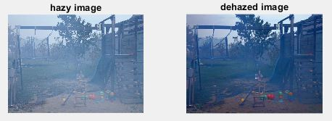
Image Dehazing
Image Dehazing is a technique of enhancing images captured in poor weather conditions such as fog, haze, dust, etc.
Dehazing is highly required in consumer photography and computer vision applications.
17-05-2019

Slide 9
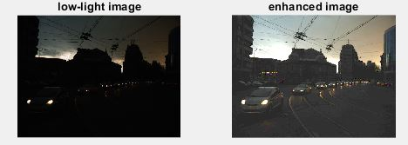
Image Enhancement
Image enhancement is a process of enhancing a digital image in order to increase the image quality (visibility, intensity, contrast, details) so that the enhanced images are suitable for computer vision or further image analysis.
17-05-2019

Slide 10
Applications and Motivation
Deep sea photography
Used in Space research and satellite imaging operations
Medical imaging like in MRI, ultrasound and X-Rays
Industrial X-ray image processing
Forensic laboratories
Astrophotography
Fingerprint or face recognition
Remote sensing applications
Defence applications
17-05-2019

Slide 11
Background
Existing image enhancement techniques are divided into two major categories: Global enhancement and Local enhancement.
Global enhancement performs same operation on all image pixels.
Example : Linear amplification.
Local enhancement performs different operations on different image windows.
Example : Histogram equalization.
Global enhancement may result in bright regions(non uniform images) by getting saturated and detail loss.
Local enhancement can perform good enhancement compared to Global enhancement.
In this project, Local enhancement is performed.
17-05-2019

Slide 12
To achieve more accurate enhancement results, in-camera processing needs to be considered when designing enhancement algorithm.
The nonlinear function relating camera sensor irradiance and image pixel value is called Camera Response Function (CRF).
Proposed enhancement algorithm takes CRF into consideration.
Two key problems of enhancement is addressed in this project:
1. To find a suitable camera response model.
2. To determine the exposure ratio map.
Then we extend our work and consider low-light hazy image for enhancement.
In Dehazing process we use Dark channel prior model to enhance single hazy image.
17-05-2019

Slide 13
Literature Review
Some of the reviewed papers are listed here:
Kaiming He(2009) studied on Single Image Haze Removal Using Dark Channel Prior. He worked on medium transmission, where he estimated thickness of haze and recovered high quality haze free images with the help of soft matting algorithm.
S. Wang (2013) worked on Naturalness preserved enhancement algorithm for non-uniform illumination images. He Synthesised the reflectance and mapped illumination, with reference to the RT model to obtain an image with preserved details.
17-05-2019

Slide 14
Lin Li (2015) studied about low-light image enhancement method for both denoising and contrast enlarging. He worked on estimation of noise-texture levels of image using BM3D filter that is superpixel based adaptive denoising method and later combined different layers to get noise-free and detail preserved image.
Xiaojie Guo(2017) worked on Low-light Image Enhancement via Illumination Map Estimation. He estimated the illumination for each pixel individually and found the maximum total value in the image's three channel.
17-05-2019

Slide 15
Zhenqiang Ying(2017) worked on Low Light Image Enhancement Algorithm based on Camera Response Model. He investigated the relationship between two images with different exposures to obtain an accurate camera response model. Later he borrowed the illumination estimation techniques to estimate the exposure ratio map and then by using camera response model to adjust each pixel to its desired exposure according to the estimated exposure ratio map.
17-05-2019

Slide 16
Literature Survey Summary
Retinex model is used as part of research and implementation in most techniques and stands backbone for most enhancement algorithm. The main drawback of using Retinex model was, the noise factor as traditional Retinex model does not consider the noise during image enhancement.
Kaiming He, Shuhang Wang, Lin Li and Dong studied on facts like image Naturalness, Visuality, details, Noise and came up with different methods of image enhancement.
The Deep learning based techniques achieved a good performance by removing the image noise, which is a major concern. But these methods require a large data set to train.
17-05-2019
Notes:
Don’t mix up survey with your work

Slide 17
Research Challenges/Gaps
The NRI have spectrum just past R,G,B light so human eyes aren’t capable of visualising these images. Infrared wavelengths are longer than visible light and they also bend at different angles when passing through the lens. This involves extra work to re-adjust camera lens when picturing Near Infrared Images.
The failure in the range of reﬂectance cause low quality of image that is detail loss.The naturalness of non-uniform illumination images cannot be effectively preserved .
Saturation, data-ﬁdelity and visual effect of low light color image needs to be enhanced.
The optical quality, underwater motion images,shutter speed of camera are major challenges in this field.
17-05-2019

Slide 18
Objectives
The main objective of our project is to improve the visibility of the images captured under dark or low-light using CRM model.
Our objective is not only to improve the image visibility, but also to retain the image quality and naturalness while enhancing the images.
Our project also includes haze removal process in order to increase the image visibility and image quality.
17-05-2019

Slide 19
Methodology
In this process, the enhancement is done by dehazing followed by enhancement using the response characteristics of cameras.
First, the dehazing of the input image is done using Dark-Channel Prior dehazing technique.
Then a Camera response function is obtained with the help of two images with different exposure. Then we borrow the illumination estimation techniques to estimate the exposure ratio map.
Finally, we use our camera response model to adjust each pixel to its desired exposure ratio according to the estimated exposure ratio map.
17-05-2019

Slide 20
APPROACH [Kaiming He, 2009]
The bad medium in the atmosphere usually degrades images of outdoor scenes.
Haze and noise are two major concerns.
The model used to describe the haze image is as follows:
I(x)=J(x)t(x)+A(1−t(x))
where J is the scene radiance, I is the observed intensity, A is the global atmospheric light, and t is the medium transmission describing the portion of the light that is not scattered and reaches the camera.
The goal of removing haze is to recover J, A, and t from I. The term A(1−t(x)) is called airlight (ambient light reflected into line of sight by atmospheric particles) and term J(x)t(x) called direct attenuation.
17-05-2019
Notes:
Proposed means it is proposed by you

Slide 21
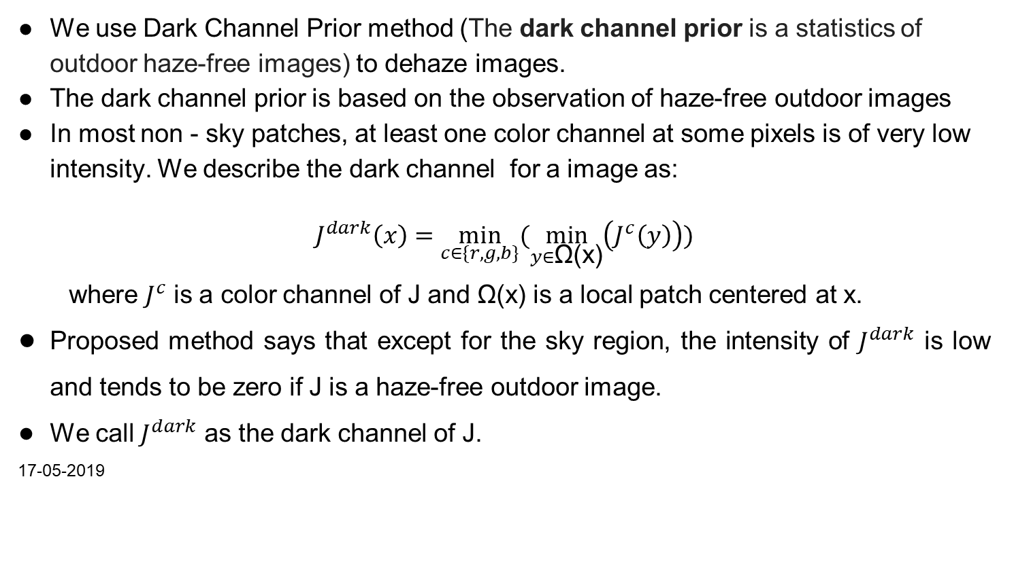
We use Dark Channel Prior method (The dark channel prior is a statistics of outdoor haze-free images) to dehaze images.
The dark channel prior is based on the observation of haze-free outdoor images
In most non - sky patches, at least one color channel at some pixels is of very low intensity. We describe the dark channel for a image as:
$$J^{dark}\left(x\right)=\min_{c∈\{r,g,b\}}{(\min_{y∈\text{Ω}\text{(}\text{x}\text{)}}\left(J^{c}\left(y\right)\right))}$$
where $J^{c}$ is a color channel of J and Ω(x) is a local patch centered at x.
Proposed method says that except for the sky region, the intensity of $J^{dark}$ is low and tends to be zero if J is a haze-free outdoor image.
We call $J^{dark}$ as the dark channel of J.
17-05-2019
Notes:
Check the formula
Included bullets instead of long paras

Slide 22
Haze removal using Dark Channel Prior
Involves four major steps
Estimating the transmission
Soft Matting
Recovering the Scene Radiance
Determining the Atmospheric Light
17-05-2019

Slide 23
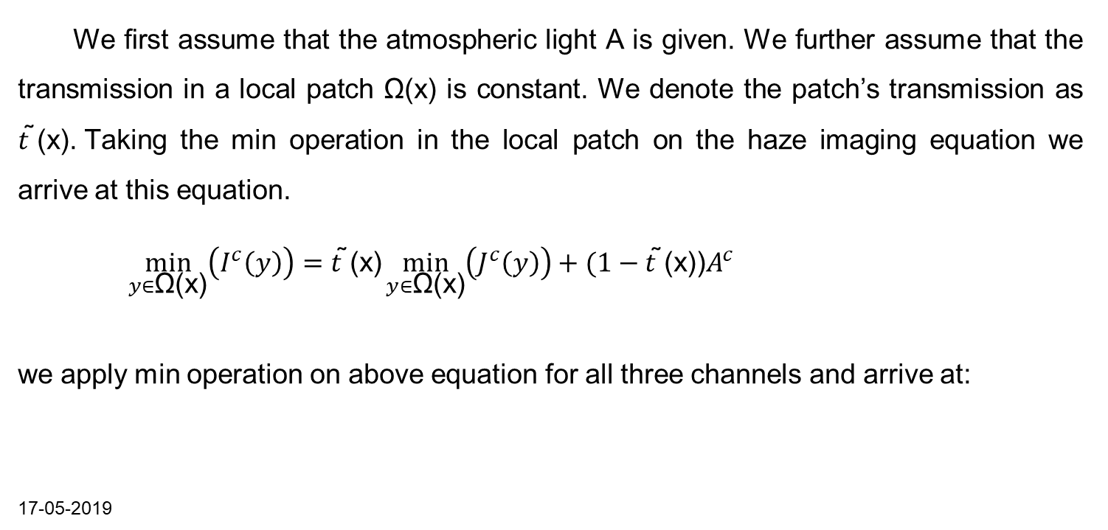
ESTIMATING THE TRANSMISSION
We ﬁrst assume that the atmospheric light A is given. We further assume that the transmission in a local patch Ω(x) is constant. We denote the patch’s transmission as $t \text{̃}\text{(}\text{x}\text{). }$Taking the min operation in the local patch on the haze imaging equation we arrive at this equation.
$\min_{y∈\text{Ω}\text{(}\text{x}\text{)}}\left(I^{c}\left(y\right)\right)=t \text{̃}\text{(}\text{x}\text{)}\min_{y∈\text{Ω}\text{(}\text{x}\text{)}}\left(J^{c}\left(y\right)\right)+(1−t \text{̃}\text{(}\text{x}\text{))}A^{c}$
we apply min operation on above equation for all three channels and arrive at:
17-05-2019

Slide 24
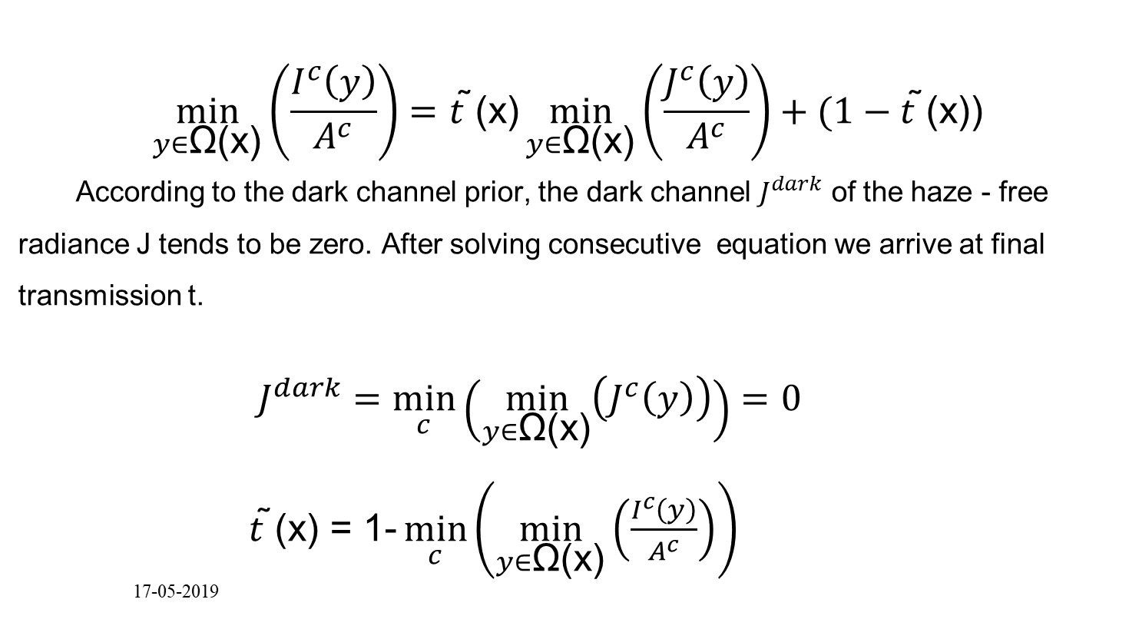
$$\min_{y∈\text{Ω}\text{(}\text{x}\text{)}}\left(\frac{I^{c}\left(y\right)}{A^{c}}\right)=t\text{ ̃(}\text{x}\text{)}\min_{y∈\text{Ω}\text{(}\text{x}\text{)}}\left(\frac{J^{c}\left(y\right)}{A^{c}}\right)+(1−t \text{̃}\text{(}\text{x}\text{))}$$
According to the dark channel prior, the dark channel $J^{dark}$ of the haze - free radiance J tends to be zero. After solving consecutive equation we arrive at final transmission t.
$J^{dark}=\min_{c}\left(\min_{y∈\text{Ω}\text{(}\text{x}\text{)}}\left(J^{c}\left(y\right)\right)\right)=0$
$t\text{ ̃(}\text{x}\text{)}\text{ = }\text{1}\text{-}\min_{c}\left(\min_{y∈\text{Ω}\text{(}\text{x}\text{)}}\left(\frac{I^{c}\left(y\right)}{A^{c}}\right)\right)$
17-05-2019

Slide 25
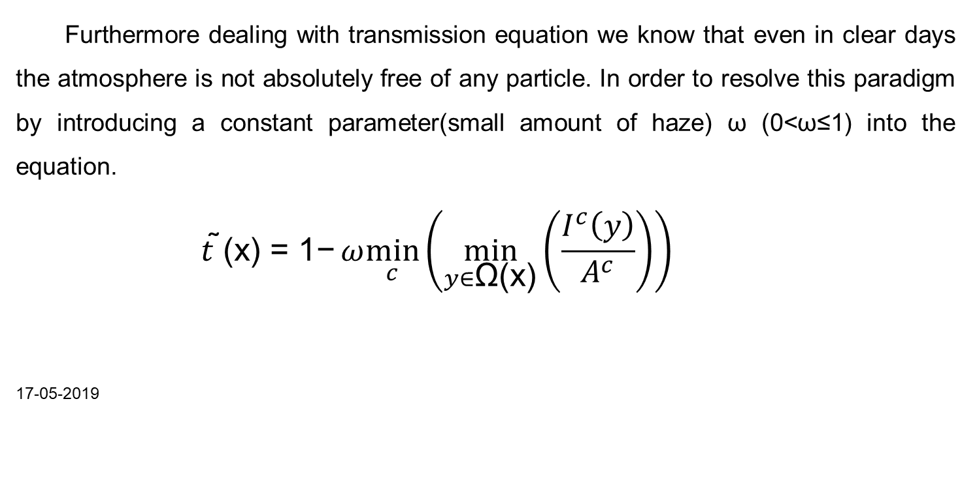
Furthermore dealing with transmission equation we know that even in clear days the atmosphere is not absolutely free of any particle. In order to resolve this paradigm by introducing a constant parameter(small amount of haze) ω (0<ω≤1) into the equation.
$$t\text{ ̃(}\text{x}\text{) = }\text{1}\text{−}ω\min_{c}\left(\min_{y∈\text{Ω}\text{(}\text{x}\text{)}}\left(\frac{I^{c}\left(y\right)}{A^{c}}\right)\right)$$
17-05-2019

Slide 26
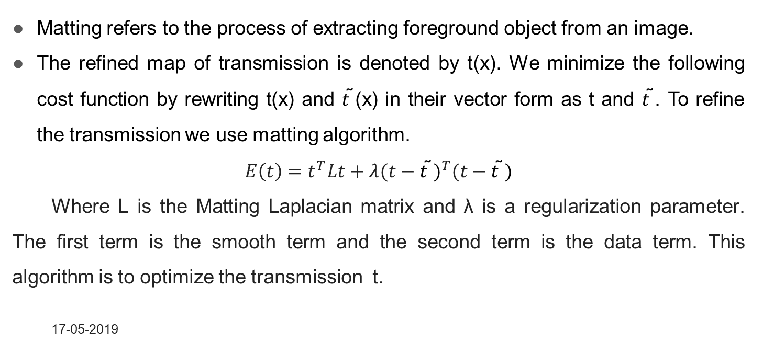
SOFT MATTING
Matting refers to the process of extracting foreground object from an image.
The refined map of transmission is denoted by t(x). We minimize the following cost function by rewriting t(x) and $t\text{ ̃(}\text{x}\text{)}$ in their vector form as t and $t \text{̃}$. To refine the transmission we use matting algorithm.
$$E\left(t\right)=t^{T}Lt+λ{(t−t\text{ ̃})}^{T}(t−t\text{ ̃})$$
Where L is the Matting Laplacian matrix and λ is a regularization parameter. The ﬁrst term is the smooth term and the second term is the data term. This algorithm is to optimize the transmission t.
17-05-2019

Slide 27
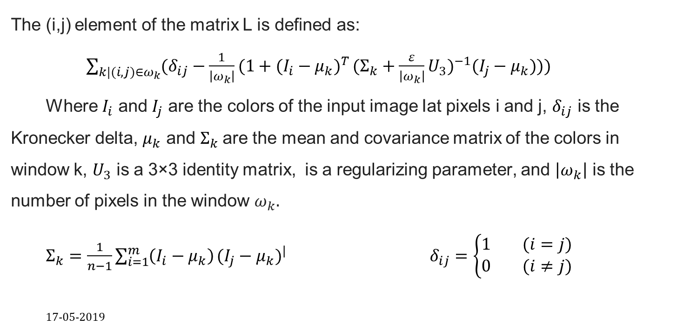
The (i,j) element of the matrix L is deﬁned as:
$\sum_{k|(i,j)∈ω_{k}}{(δ_{ij}−\frac{1}{\left|ω_{k}\right|}(1+(I_{i}−μ_{k})^{T}}(Σ_{k}+\frac{ε}{\left|ω_{k}\right|}U_{3})^{−1}(I_{j}−μ_{k})))$
Where $I_{i}$ and $I_{j}$ are the colors of the input image Iat pixels i and j, $δ_{ij}$ is the Kronecker delta, $μ_{k}$ and $Σ_{k}$are the mean and covariance matrix of the colors in window k, $U_{3}$ is a 3×3 identity matrix, is a regularizing parameter, and $\left|ω_{k}\right|$ is the number of pixels in the window $ω_{k}.$
$Σ_{k}=\frac{1}{n−1}\sum_{i=1}^{m}{\left(I_{i}−μ_{k}\right)}(I_{j}−μ_{k})^{|}$ $δ_{ij}=\left\{\begin{aligned}1 (i=j) \\ 0 (i≠j)\end{aligned}\right.$
17-05-2019
Notes:
Please check the formula.

Slide 28
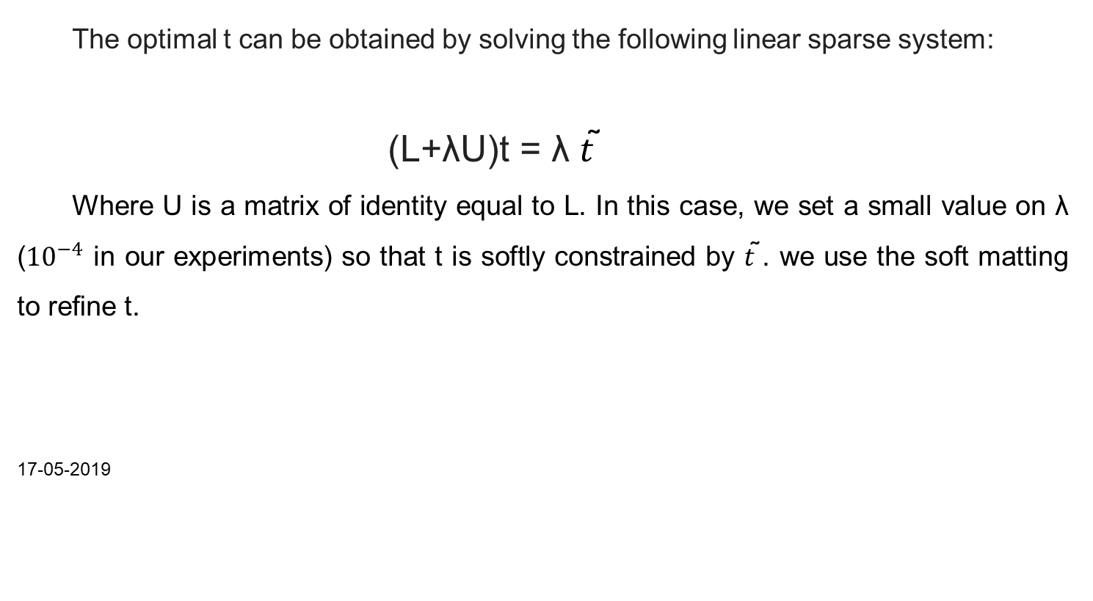
The optimal t can be obtained by solving the following linear sparse system:
(L+λU)t = λ $t\text{ ̃}$
Where U is a matrix of identity equal to L. In this case, we set a small value on λ (${10}^{−4}$ in our experiments) so that t is softly constrained by $t\text{ ̃}$. we use the soft matting to reﬁne t.
17-05-2019

Slide 29
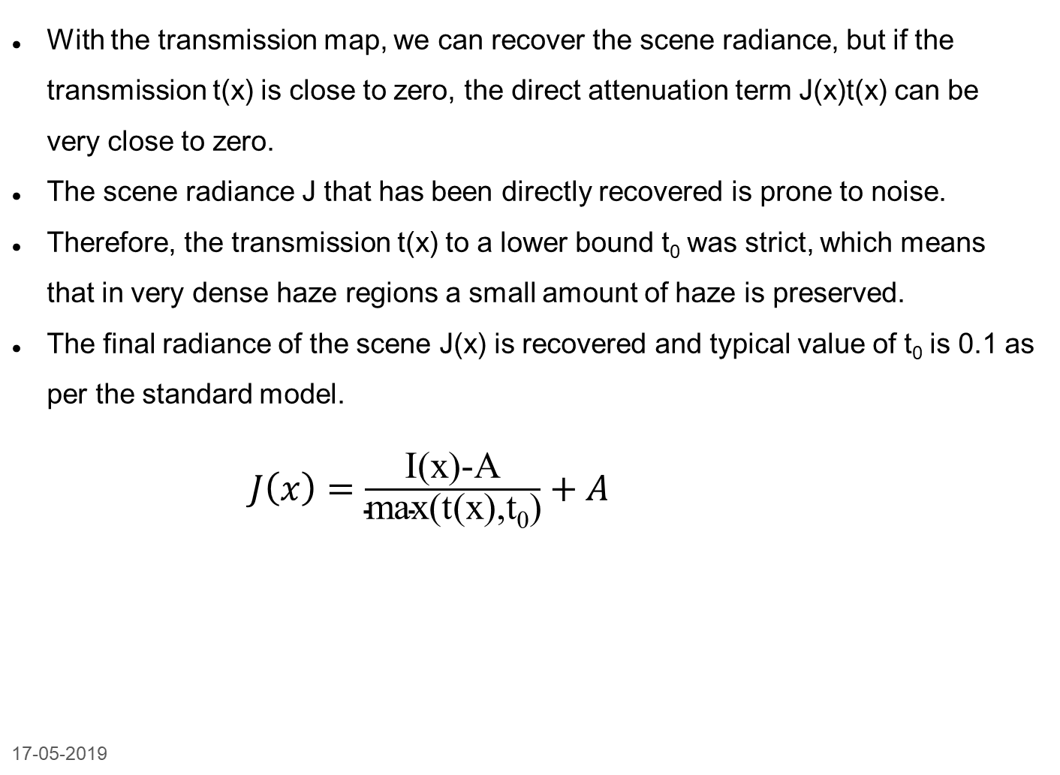
RECOVERING THE SCENE RADIANCE
With the transmission map, we can recover the scene radiance, but if the transmission t(x) is close to zero, the direct attenuation term J(x)t(x) can be very close to zero.
The scene radiance J that has been directly recovered is prone to noise.
Therefore, the transmission t(x) to a lower bound t₀ was strict, which means that in very dense haze regions a small amount of haze is preserved.
The final radiance of the scene J(x) is recovered and typical value of t₀ is 0.1 as per the standard model.
$J\left(x\right)=\frac{\text{I}\text{(}\text{x}\text{)-}\text{A}}{\text{max}\text{(}\text{t}\text{(}\text{x}\text{),}\text{t}\text{0}\text{)}}+A$
17-05-2019

Slide 30
Determining the Atmospheric Light
The atmospheric light A is estimated from the dark channel.
We first select the dark channel's top 0.1 percent brightest pixels.
Most of these pixels are opaque haze.
The pixels with the highest intensity in the input image I are selected as the atmospheric light among these pixels.
17-05-2019

Slide 31
Later we work on enhancement of image based on work of two parameter model and Retinex model.
A low-light image may either be global enhancement or local enhancement , so we cannot get all pixels well-exposed using an uniform exposure ratio ‘k’. In order to solve this issue, we extend k to a matrix ‘K’.
P′ = g( P, K)
The approach is as follows:
1. Enhancement framework.
2. Camera Response model to solve g.
3. Estimation of K (Exposure ratio map).
17-05-2019
17-05-2019

Slide 32
FRAMEWORK:
To provide a physical meaningful model for image enhancement, Retinex theory is proposed. According to this model, the amount of light reaching observers can be decomposed into illuminations and scene reflection.
E = R o T
where R and T are the scene reflectance map and the illumination map, respectively. The operator o represents element-wise multiplication. E is the light reaching the camera, i.e. the image irradiance.
17-05-2019
17-05-2019
16-03-2019

Slide 33
In most cameras, there exists a nonlinear radiometric response function f. Therefore, f should be considered in forming the actual input image P and the desired recovery image P’
P = f(E), P′=f(R)
P′ = f(R) = f( E o ( 1 Ø T ))
= g( f(E), 1 ØT ) = g( P, 1 Ø T )
Where Ø represents element wise division.
The relationship between CRF and BTF is given by Comparametric equation.
g( f(E),k)=f(kE)……..comparametric equation
We can find the relation between T and K as : K=(1⊘T).
17-05-2019

Slide 34
Camera Response Model (CRM):
A Camera Response Model consists of two sub parts : CRF model and BTF model.
CRF model parameter is determined only by camera , whereas BTF model parameters are determined by camera and exposure ratio.
17-05-2019

Slide 35
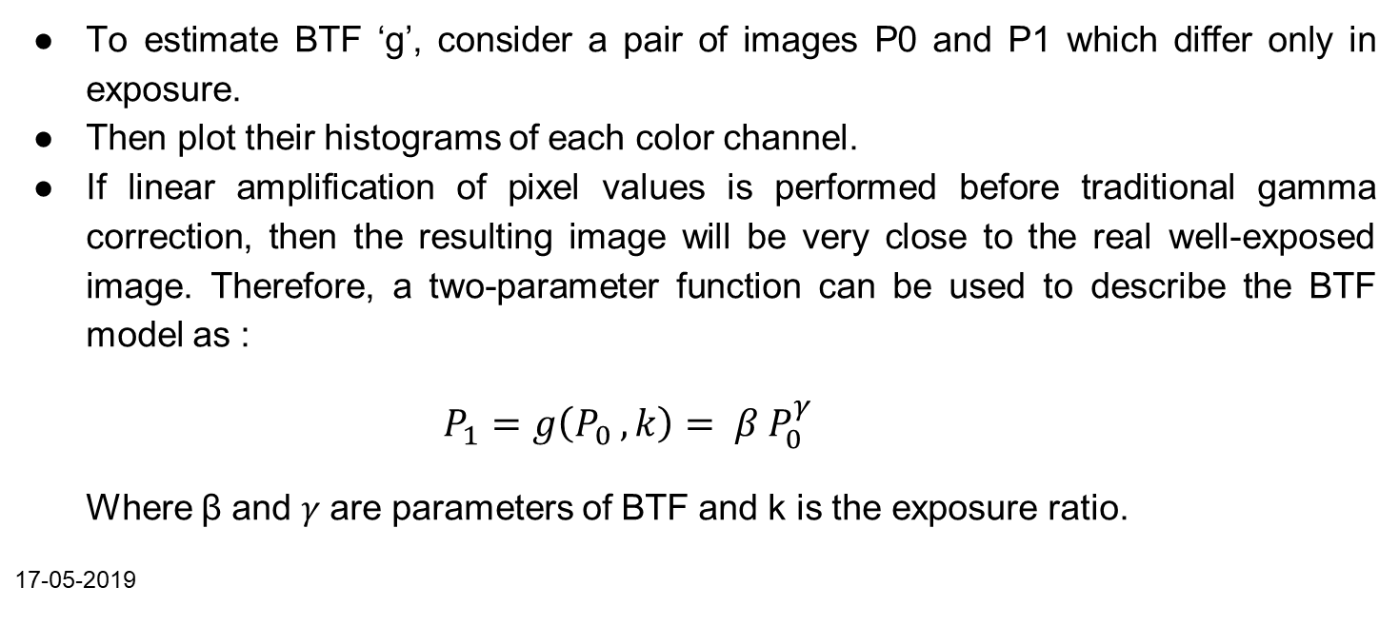
BTF ESTIMATION
To estimate BTF ‘g’, consider a pair of images P0 and P1 which differ only in exposure.
Then plot their histograms of each color channel.
If linear amplification of pixel values is performed before traditional gamma correction, then the resulting image will be very close to the real well-exposed image. Therefore, a two-parameter function can be used to describe the BTF model as :
$P_{1}=g\left(P_{0 },k\right)= β P_{0}^{γ}$
Where β and 𝛾 are parameters of BTF and k is the exposure ratio.
17-05-2019

Slide 36
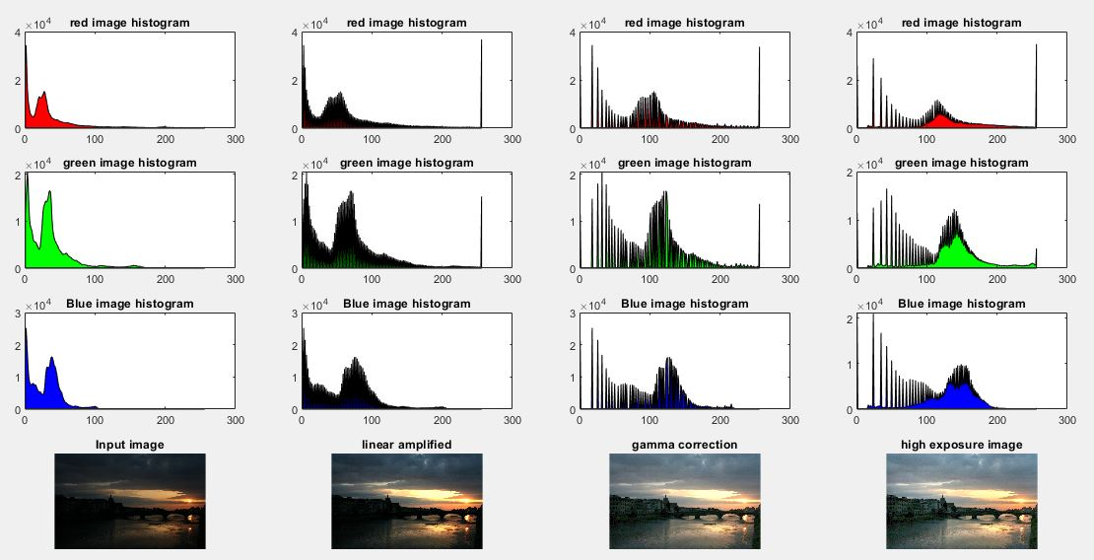

Slide 37
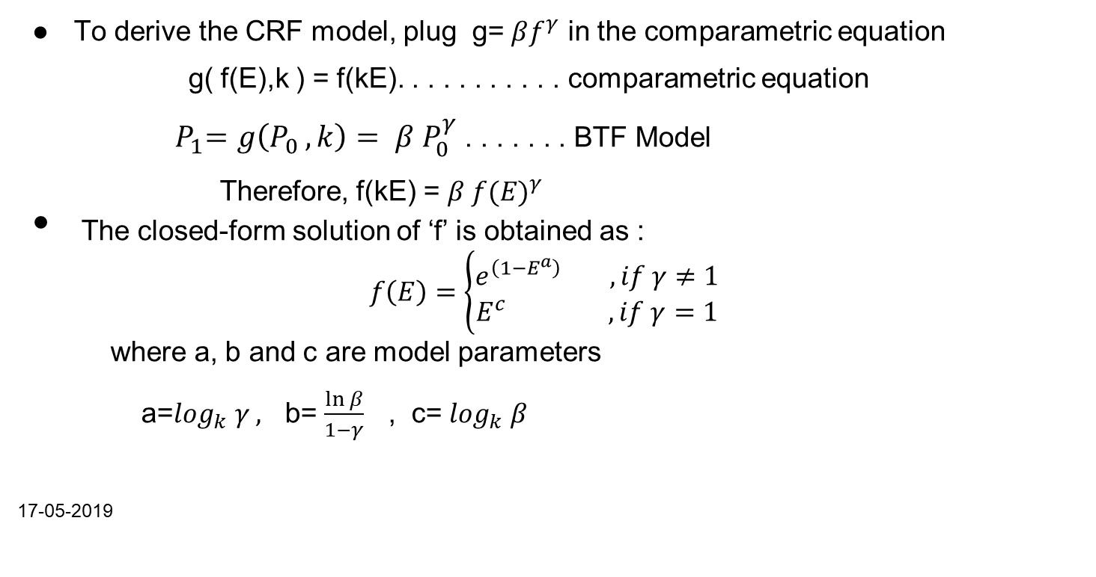
CRF ESTIMATION
To derive the CRF model, plug g= $βf^{γ}$ in the comparametric equation
g( f(E),k ) = f(kE). . . . . . . . . . . comparametric equation
${ P}_{1}=g\left(P_{0 },k\right)= β P_{0}^{γ}$ . . . . . . . BTF Model
Therefore, f(kE) = $β f({E)}^{γ}$
The closed-form solution of ‘f’ is obtained as :
$$f\left(E\right)=\left\{\begin{aligned}e^{\left(1−E^{a}\right) } , if γ≠1 \\ E^{c } , if γ=1\end{aligned}\right.$$
where a, b and c are model parameters
a=$\log_{k} γ ,$ b= $\frac{\ln{β}}{1−γ}$ , c= $\log_{k} β$
17-05-2019
Notes:
Type the equations using equation editor instead of copying from pdf

Slide 38
Two CRF models can be derived from previous two cases.
When γ =1, the CRF model is a power function and the BTF model is a simple linear function.
When γ≠1, the CRF model is a two-parameter function and the BTF model is a nonlinear function.
Since the BTF is non-linear for most cameras, we mainly consider the case of γ ≠ 1
To measure the goodness of the two CRF models, we use Root Mean Square Error (RMSE) evaluation.
17-05-2019

Slide 39
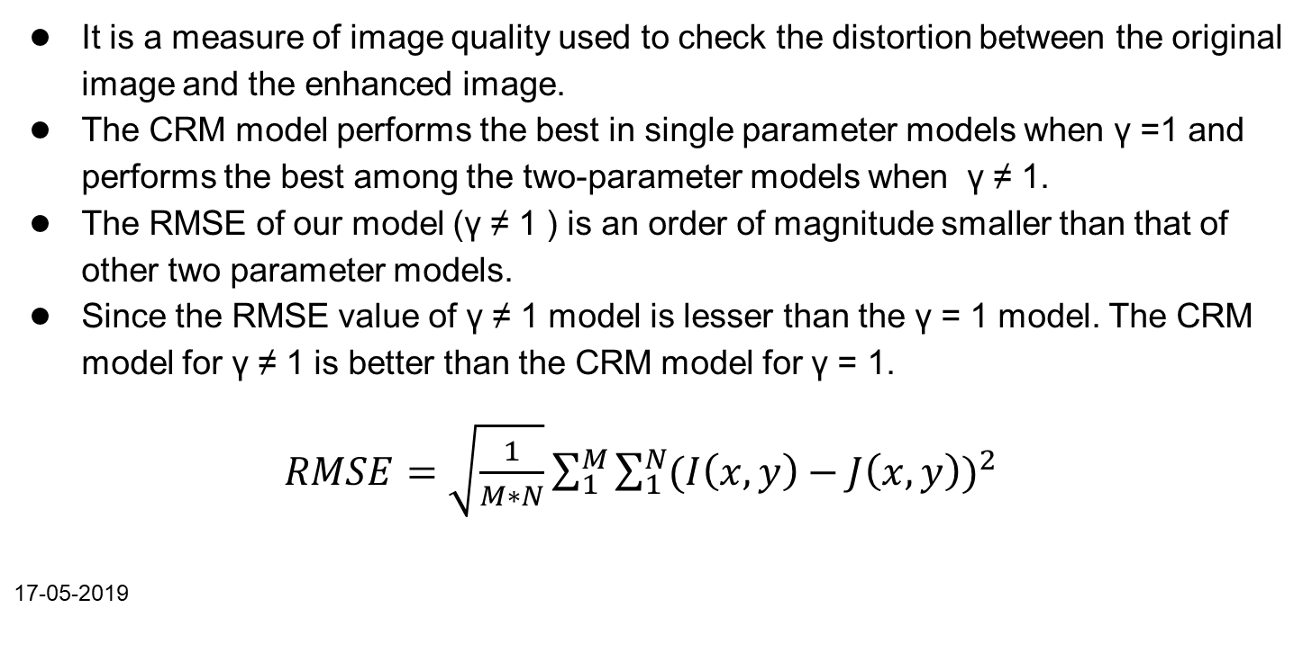
RMSE (Root Mean Square Error)
It is a measure of image quality used to check the distortion between the original image and the enhanced image.
The CRM model performs the best in single parameter models when γ =1 and performs the best among the two-parameter models when γ ≠ 1.
The RMSE of our model (γ ≠ 1 ) is an order of magnitude smaller than that of other two parameter models.
Since the RMSE value of γ ≠ 1 model is lesser than the γ = 1 model. The CRM model for γ ≠ 1 is better than the CRM model for γ = 1.
$RMSE=\sqrt{\frac{1}{M∗N}}\sum_{1}^{M}{\sum_{1}^{N}{{(I\left(x,y\right)−J\left(x,y\right))}^{2}}}$
17-05-2019

Slide 40
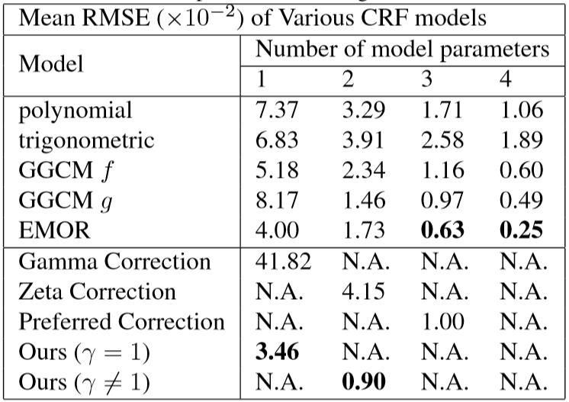
17-05-2019

Slide 41
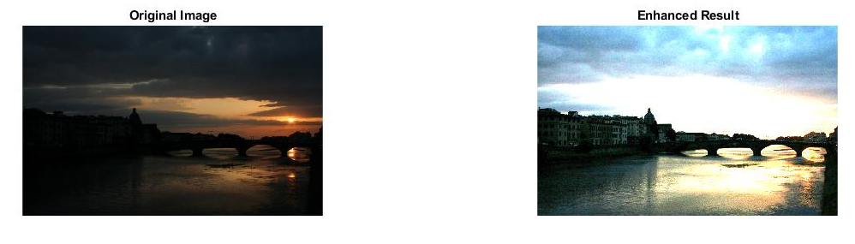
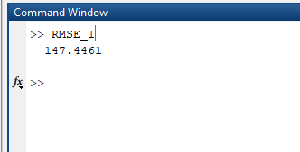
For γ = 1 :
RMSE value :
17-05-2019

Slide 42
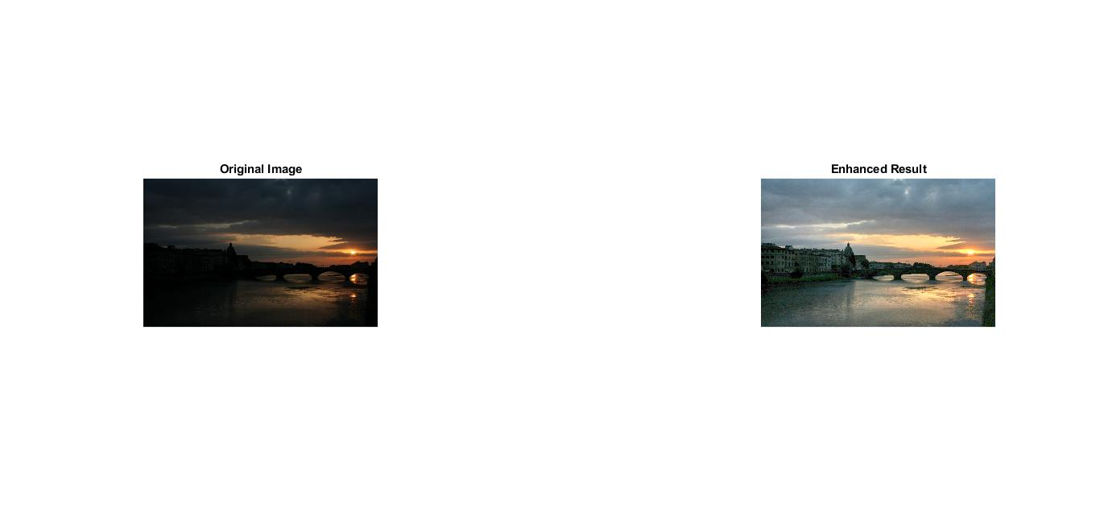
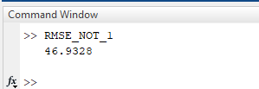
.
For γ ≠ 1 :
RMSE Values :
17-05-2019

Slide 43
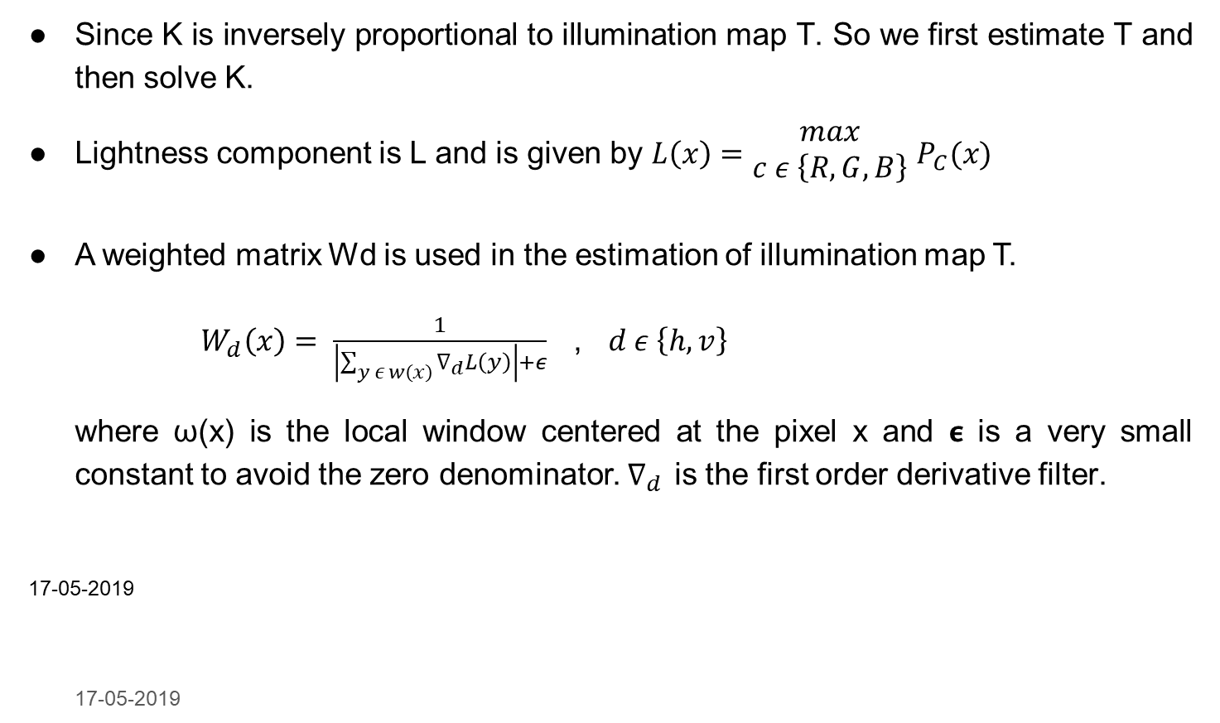
EXPOSURE RATIO MAP (K) ESTIMATION
Since K is inversely proportional to illumination map T. So we first estimate T and then solve K.
Lightness component is L and is given by $L\left(x\right)=\begin{matrix}max \\ c ε \left\{R,G,B\right\}\end{matrix}$ $P_{C}(x)$
A weighted matrix Wd is used in the estimation of illumination map T.
${ W}_{d}\left(x\right)= \frac{1}{\left|\sum_{y ε w\left(x\right)}{∇_{d}}L\left(y\right)\right|+ε}$ , $d ε \left\{h,v\right\}$
where ω(x) is the local window centered at the pixel x and 𝞊 is a very small constant to avoid the zero denominator. $∇_{d }$is the first order derivative filter.
17-05-2019
17-05-2019

Slide 44
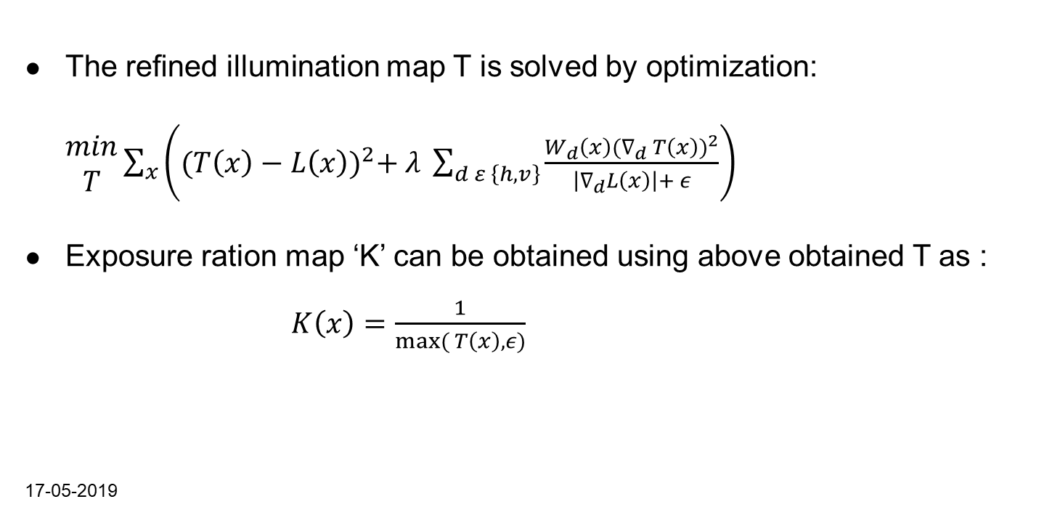
The reﬁned illumination map T is solved by optimization: $\begin{matrix}min \\ T\end{matrix}\sum_{x}{\left({(T\left(x\right)−L\left(x\right))}^{2}+ λ \sum_{d ε \left\{h,v\right\}}{\frac{W_{d}\left(x\right){(∇_{d} T\left(x\right))}^{2}}{\left|∇_{d}L\left(x\right)\right|+ ε}}\right)}$
Exposure ration map ‘K’ can be obtained using above obtained T as :
$K\left(x\right)=\frac{1}{max⁡( T\left(x\right), ε)}$
17-05-2019

Slide 45
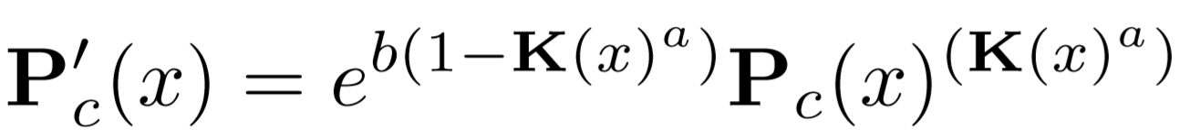
Implementation
After the estimation of Exposure ration map K, every individual pixel of the low light input image P(x) is enhanced accordingly using the Camera response model and Exposure ratio map K.
17-05-2019

Slide 46
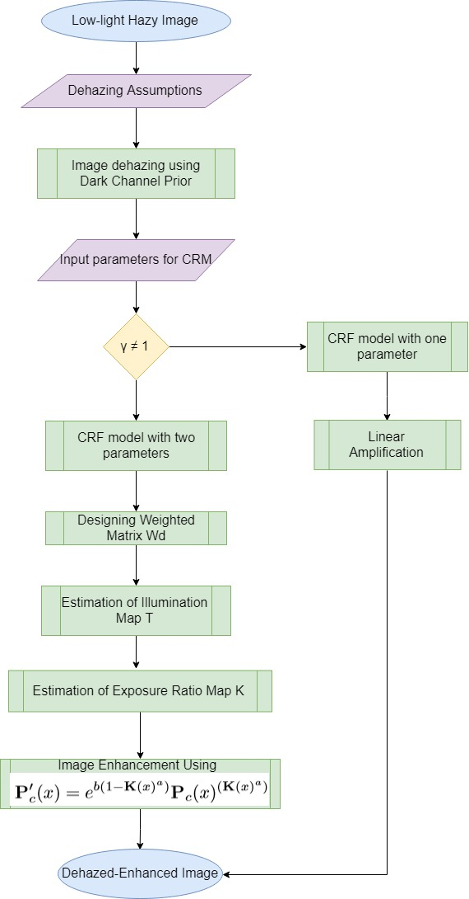
False
True
17-05-2019

Slide 47
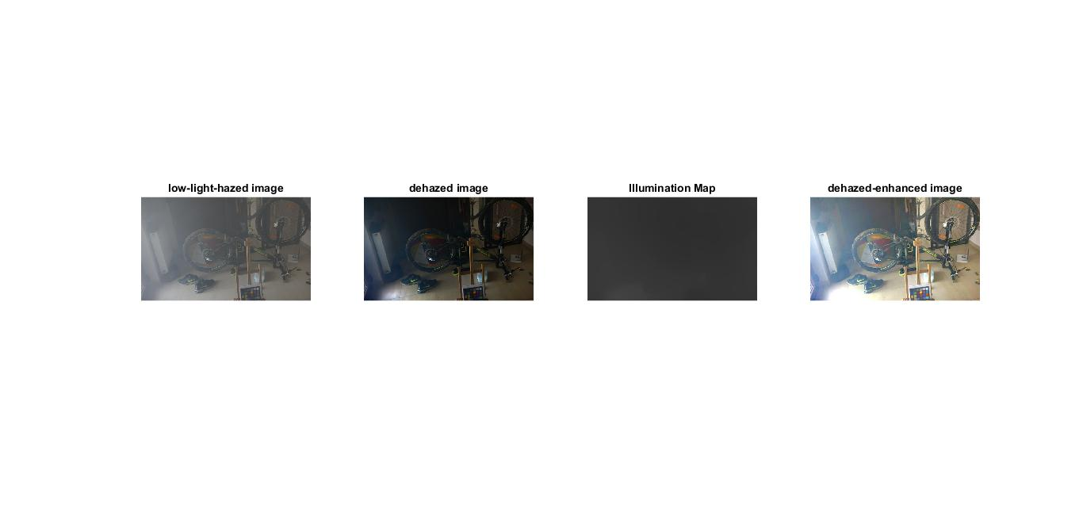
The general flowchart of the proposed framework
17-05-2019

Slide 48
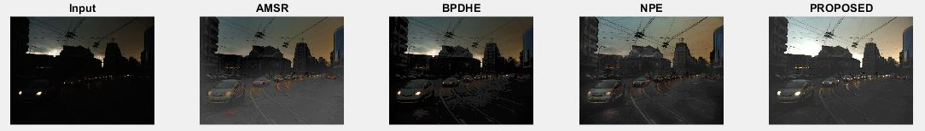
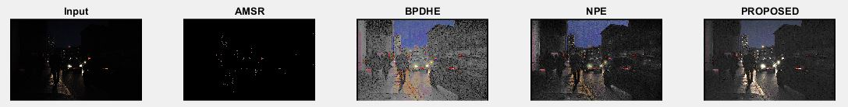
Visual Comparison
(Enhancement only)
17-05-2019

Slide 49
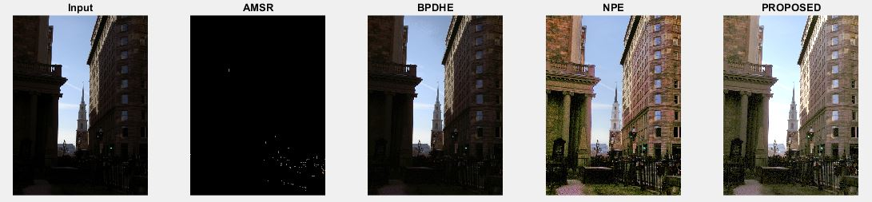
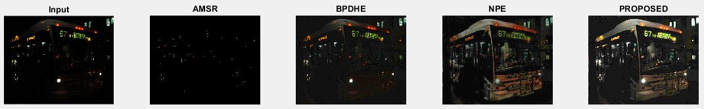
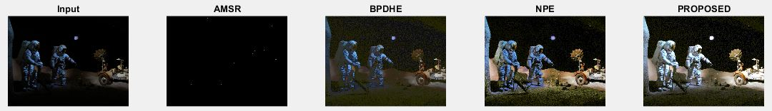

Slide 50
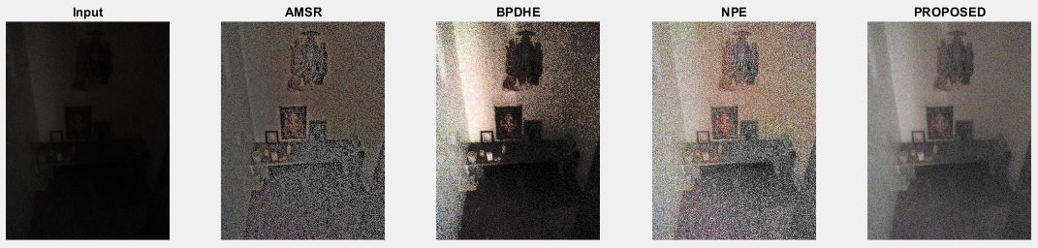
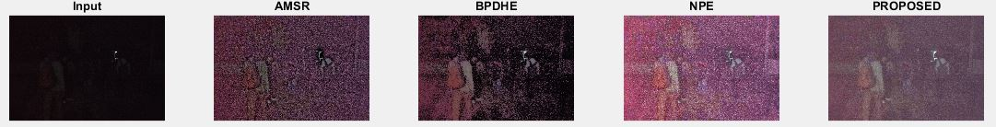
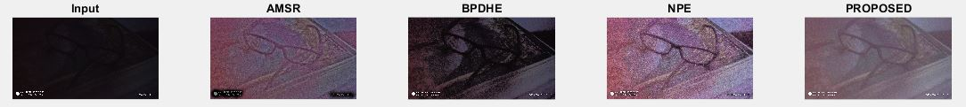
Visual comparison (enhancement only) test images captured in our phones

Slide 51
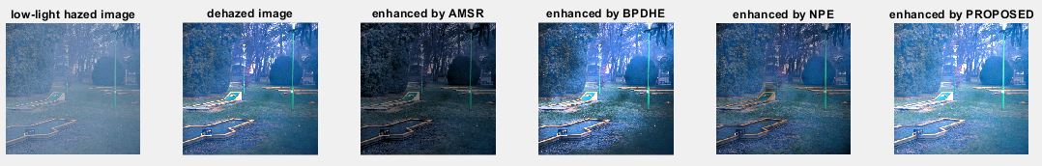
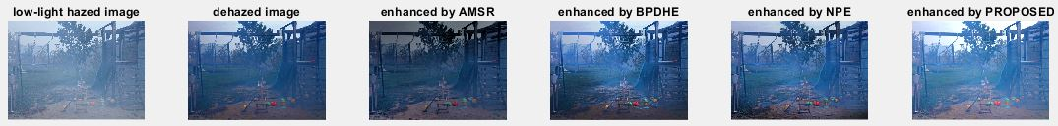
Visual comparison
(Dehazing + enhancement)

Slide 52
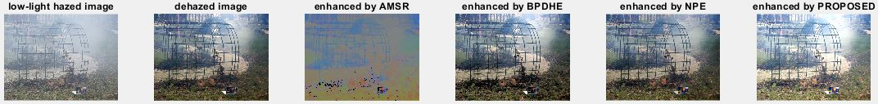
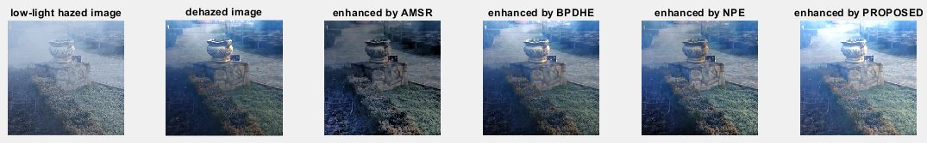

Slide 53
Performance Evaluation
17-05-2019

Slide 54
Performance Evaluation
In order to qualitatively analyze the performance of our enhancement algorithm, we compare our algorithm with several other enhancement methods: NPE, AMSR and BPDHE.
We have considered two performance metrics to compare the results of the proposed method with other methods.
Color Distortion Evaluation (CDE)
Lightness Distortion Evaluation (LOE).
17-05-2019

Slide 55
Performance Metrics

Slide 56
Color Distortion Evaluation(CDE)
To measure the color distortion,we make use of ΔE. The color difference ΔE is deﬁned as the Euclidean distance between two colors in CIE Lab color space:
The three coordinates of CIELAB represent the lightness of the color (L*), its position between red and green(a*) and its position between yellow and blue(b*).
The range of CDE is : 0 - 60.
17-05-2019

Slide 57
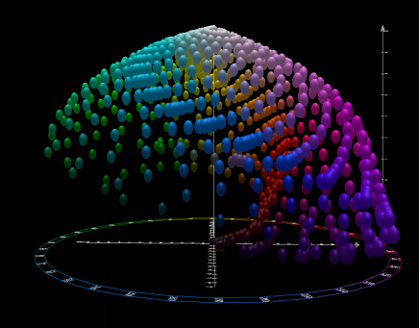
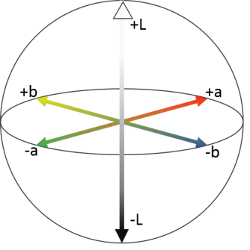
17-05-2019

Slide 58
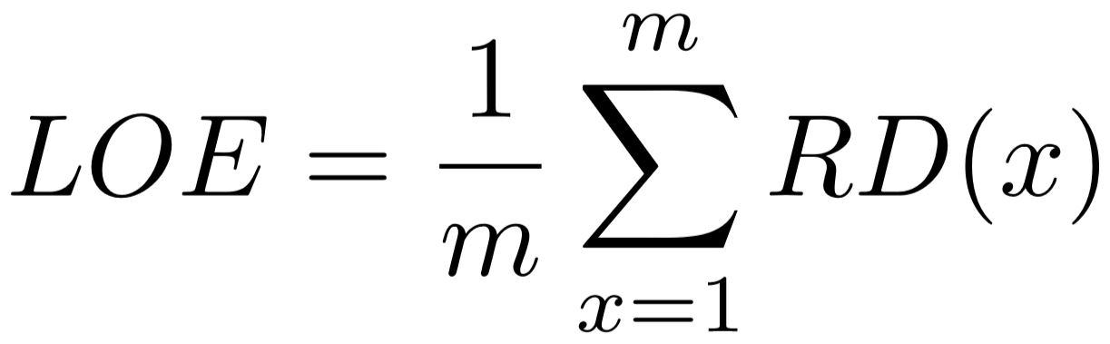
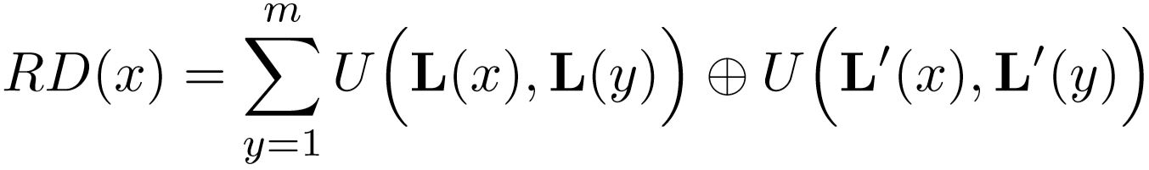
LIGHTNESS ORDER ERROR (LOE)
Lightness order error (LOE) is used to objectively measure the lightness
distortion of enhanced results.LOE is deﬁned as :
where RD(x) is the relative order difference of the lightness between the original image P and its enhanced version P’ for pixel x, which is deﬁned as follows:
L(x) and L(x) are the maximum values among three color channels at location x of the input images and the enhanced images, respectively.
The range of LOE is : 0 - 5000.
17-05-2019

Slide 59
[1] “Naturalness Preserved Enhancement Algorithm for
Non-Uniform illumination Images.” (NPE)[Wang,2013]
Technique used:
NPE is a Retinex based enhancement algorithm.
Original low light image is decomposed into reflectance and illumination.
Illumination is processed using bi-log transformation.
Finally, the enhanced image is obtained by synthesizing reflectance and mapped illumination.
17-05-2019

Slide 60
[2] “Adaptive Multiscale Retinex for Image Contrast Enhancement” (AMSR) [Chang,2013]
Technique used:
In AMSR, the weight associated with each SSR(Single Scale Retinex) output image and original input image is adaptively computed according to the pixel value of input image.
So obtained weight is used to obtain enhanced high-contrast image.
17-05-2019

Slide 61
[3] “A Modiﬁed BPDHE Enhancement Algorithm for Low Resolution Images” (BPDHE)[Pooja,2016]
Technique used:
Decompose the input low light image into low and high frequency components in frequency domain using DWT.
Low frequency components are enhanced using Brightness Preserving Dynamic Histogram equalization.
High frequency components are filtered using Gaussian filter so as to remove the noise.
Enhanced image is reproduced by taking inverse DWT (Discrete Wavelet Transformation) of modified components.
17-05-2019

Slide 62
Performance Metrics for the Algorithm Implemented

Slide 63
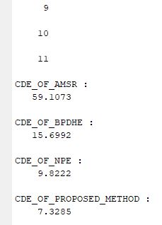
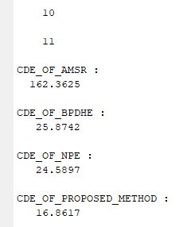
CDE for Enhanced images using CRM CDE for Dehazed-Enhanced
images by Dark Channel and CRM
17-05-2019

Slide 64
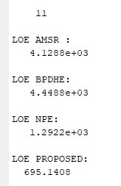
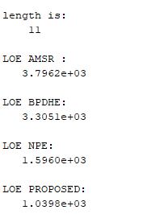
LOE for Enhanced images using CRM LOE for Dehazed-Enhanced images by Dark Channel and CRM
17-05-2019

Slide 65
Enhancement Techniques | CDE for Enhancement | CDE For Dehazing + Enhancement | LOE for Enhancement | LOE for Dehazing + Enhancement
AMSR | 59.1073 | 162.3625 | 4128.8 | 3796.2
BPDHE | 15.6992 | 25.8742 | 4448.8 | 3305.1
NPE | 9.8222 | 24.5897 | 1292.2 | 1596.0
Proposed | 7.3285 | 16.8617 | 695.1408 | 1039.8

Slide 66
Reasons for Increased Colour and Lightness Distortion for Dehazed-Enhanced Images
Most of the dehazing algorithms introduce some unwanted noise into the haze image during dehazing process.
In dark channel prior method of Dehazing, Estimation of Airlight is not done accurately. Also contrast improvement is inefficient. As a result of this, dehazing is not performed to the fullest and some noise figure is still left behind.
When image with this left-behind noise is enhanced, even though the proposed enhancement algorithm is designed to trim noise figure, a small part of the noise is also enhanced. Thus, dehazed-enhanced images are associated with slightly more Colour and Lightness distortion when compared to only enhanced images.
17-05-2019

Slide 67
Quantitative measurement results of lightness distortion for different Standard Data set
NPE-Naturalness Preserved Enhancement Algorithm for Non-Uniform illumination Images [Wang,2013]
DONG-A Low-Light Image Enhancement Method Based on Image Degradation Model and Pure Pixel Ratio Prior [Zhenfei Gu, 2018]
LIME-Low-light Image Enhancement via Illumination Map Estimation.
17-05-2019
Methods | UEA | NUS | VV | LIME | NPE | MEF
MSRCR [Ana, 2014] | 1677 | 3043 | 2728 | 1836 | 1890 | 1686
Dong [Zhenfei,2018] | 1337 | 771 | 853 | 1244 | 1012 | 1065
NPE [Wang,2013] | 691 | 413 | 821 | 1471 | 646 | 1158
LIME [Xiaojie, 2017] | 957 | 1434 | 1275 | 1324 | 1120 | 1079
SRIE [Mading Li, 2018] | 657 | 413 | 551 | 824 | 533 | 754
Proposed [Ying,2017] | 501 | 613 | 431 | 499 | 506 | 345

Slide 68
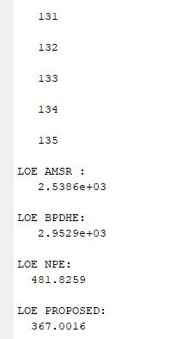
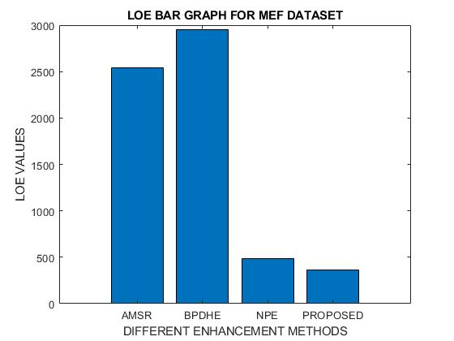
LOE values values obtained for enhanced images on MEF dataset.
17-05-2019

Slide 69
TIME COST

Slide 70

Time cost

Slide 71


Slide 72


Slide 73
NPE algorithm takes the most amount of time among the four methods.
Although BPDHE algorithm takes less time to execute than the proposed algorithm, distortion associated with images enhanced by BPDHE method is high.
Proposed algorithm takes reasonable amount of time to produce a visually pleasant enhanced image.
17-05-2019

Slide 74
Conclusion and Future Scope
We implemented an efficient algorithm to dehaze the low-light haze images and then to enhance the image in next consecutive step. First we carried out Dehazing work which uses Dark Channel Prior model to dehaze single image. Second, we implemented enhancement algorithm combining CRM and Exposure Ratio map.
Compared to several existing models, the performance results revealed the efficiency of our method.
17-05-2019

Slide 75


For the sky regions the dark channel prior is not a good one, Since the
sky is at inﬁnite and tends to has zero transmission.
The hair of the man turns grey due to over enhancement
Some strong assumptions in enhancement process are the path to improve in future. Deep learning technique can be used to reduce time cost and efficiency of the algorithm.
17-05-2019

Slide 76
References
[1]Kaiming He, jain sun, xiaoou Tang, “Single Image Haze Removal Using Dark Channel Prior”, IEEE international conference, 2009
[2] S. Wang, J. Zheng, H.-M. Hu, and B. Li, “Naturalness preserved enhancement algorithm for non-uniform illumination images”, IEEE Transactions on Image Processing, 22(9):3538–3548, 2013.
[3] ]Chang-Hsing Lee, Jau-Ling Shih, Cheng-Chang Lien,”Adaptive Multiscale Retinex for Image Contrast Enhancement”, International Conference on Signal-Image Technology & Internet-Based Systems, 2013[IEEE].
17-05-2019

Slide 77
[4] Takuya Mikami, Daisuke Sugimura and Takayuki Hamamoto, “Capturing Color and Near-infrared Images with Different Exposure times for Image Enhancement Under Extremely Low-Light Scene”, Image Processing (ICIP), IEEE International Conference, 2014.
[5] Lin Li, Ronggang Wang,Wenmin Wang, Wen Gao, “A low-light image enhancement method for both denoising and contrast enlarging”,2015 IEEE International Conference on Image Processing (ICIP), Canada,pp. 3730-3734, 27-30 Sept, 2015.
17-05-2019

Slide 78
[6] Pooja Kaushik and Unnati gupta, “A Modified BPDHE Enhancement Algorithm
for Low Resolution Images”,6th international conference of soft computing for problem solving, pp. 10-20, Dec 23-24, 2016, India,[Springer].
[7] Li Tao, Chuang Zhu, Guoqing Xiang, Yuan Li, Huizhu Jia, Xiaodong Xie , “LLCNN: A Convolutional Neural Network for Low-light Image Enhancement” Visual Communication and Image Processing (VCIP),1-4, 2017[IEEE].
[8] Li Tao, Chuang Zhu, Jiawen Song, Tao Lu, Huizhu Jia, Xiaodong Xie “Low Light Image Enhancement using CNN and Bright Channel Prior” IEEE International Conference on image processing(ICIP), 3215-3219,2017.
17-05-2019

Slide 79
[9] Xiaojie Guo, Yu Li and Haibin Ling,“LIME: Low-light Image Enhancement via Illumination Map Estimation”IEEE Transactions on Image Processing 26 (2), 982-993, 2017.
[10] Fan Wu, U Kin Tak, “Low-Light Image Enhancement Algorithm Based on HSI Color Space”, 2017 10th International Congress on Image and Signal Processing, Bio-Medical Engineering and Informatics (CISP-BMEI 2017), 1-6, 2017.
[11] Zhenqiang Ying, Ge Li, Yurui Ren, Ronggang Wang, and Wenmin Wang, “A New Low-Light Image Enhancement Algorithm using Camera Response Model”,IEEE International Conference on Computer Vision Workshops 2017.
17-05-2019

Slide 80
[12] Lincheng Jiang , Yumei Jing , Shengze Hu , Bin Ge and Weidong Xiao , “Deep Refinement Network for Natural Low-Light Image Enhancement in Symmetric Pathways” Noncommutative gravity and Lorentz Violation, Symmetry, MDPI, Vol.10, Issue 10, Oct 2018.
17-05-2019

Slide 81
THANK YOU

