Slide 1





HEART DISEASE DIAGNOSTIC ANALYSIS
By: Prafull Chandra Singh

Slide 2

Introduction
This Heart Disease Diagnostic Analysis provides a brief overview of the project, focusing on the objective of enhancing heart disease diagnosis through data analysis using Python. It also delves into the key questions posed for exploration, setting the stage for the subsequent analysis.

Slide 3
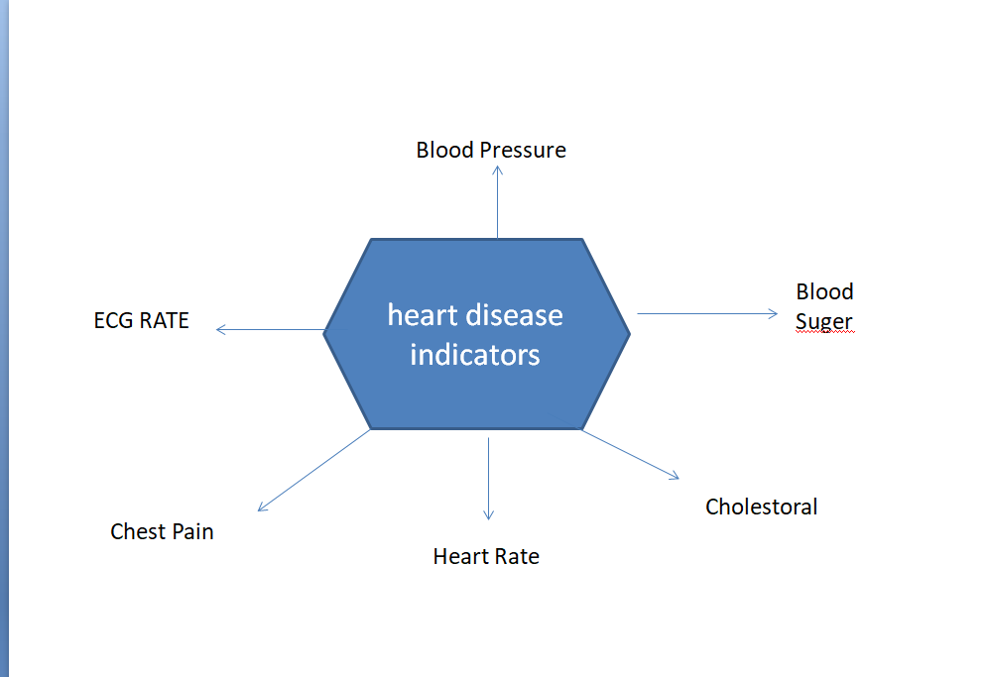
Heart Disease Diagnosis
Heart disease describes a range of conditions that affect the heart. Heart disease encompasses a range of conditions affecting the heart, including Blood vessel disease, Coronary artery disease, Irregular heartbeats, Heart failure.

Slide 4
Information about Dataset
# age: age of individual
# sex: sex of individual, 1 for male and 0 for female
# cp: chest pain type ( Typical Angina, Atypical Angina, Non-Anginal Pain, Asymptomatic)
# trestbps: resting blood pressure
# chol: serum cholestoral (in mg/dl)
# fbs: fasting blood sugar (> 120 mg/dl), 0 for False, 1 for True
# restecg: resting electrocardiographic results, 0= normal,1= non-specific disturbances,2= significant
# thalach: maximum heart rate achieved
# exang: exercise induced angina (0 for no, 1 for yes)
# oldpeak: ST depression induced by exercise relative to rest
# slope: the slope of the peak exercise ST segment
# ca: number of major vessels (0-4) colored by flourosopy
# thal: 0 = normal; 1 = fixed defect; 2 = reversable defect
# target: 0 = less chance for heart disease, 1 = more chance for heart disease Information about Dataset Import Library Load Dataset Basic Data Exploratory Data Clean

Slide 5
Data Preparation
Data Cleaning
Load Datasets
Basic Data Exploratory
Import Libraries
Data Visualization
Data Visualization
Exploratory Data Analysis
Conclusion
Insights

Slide 6
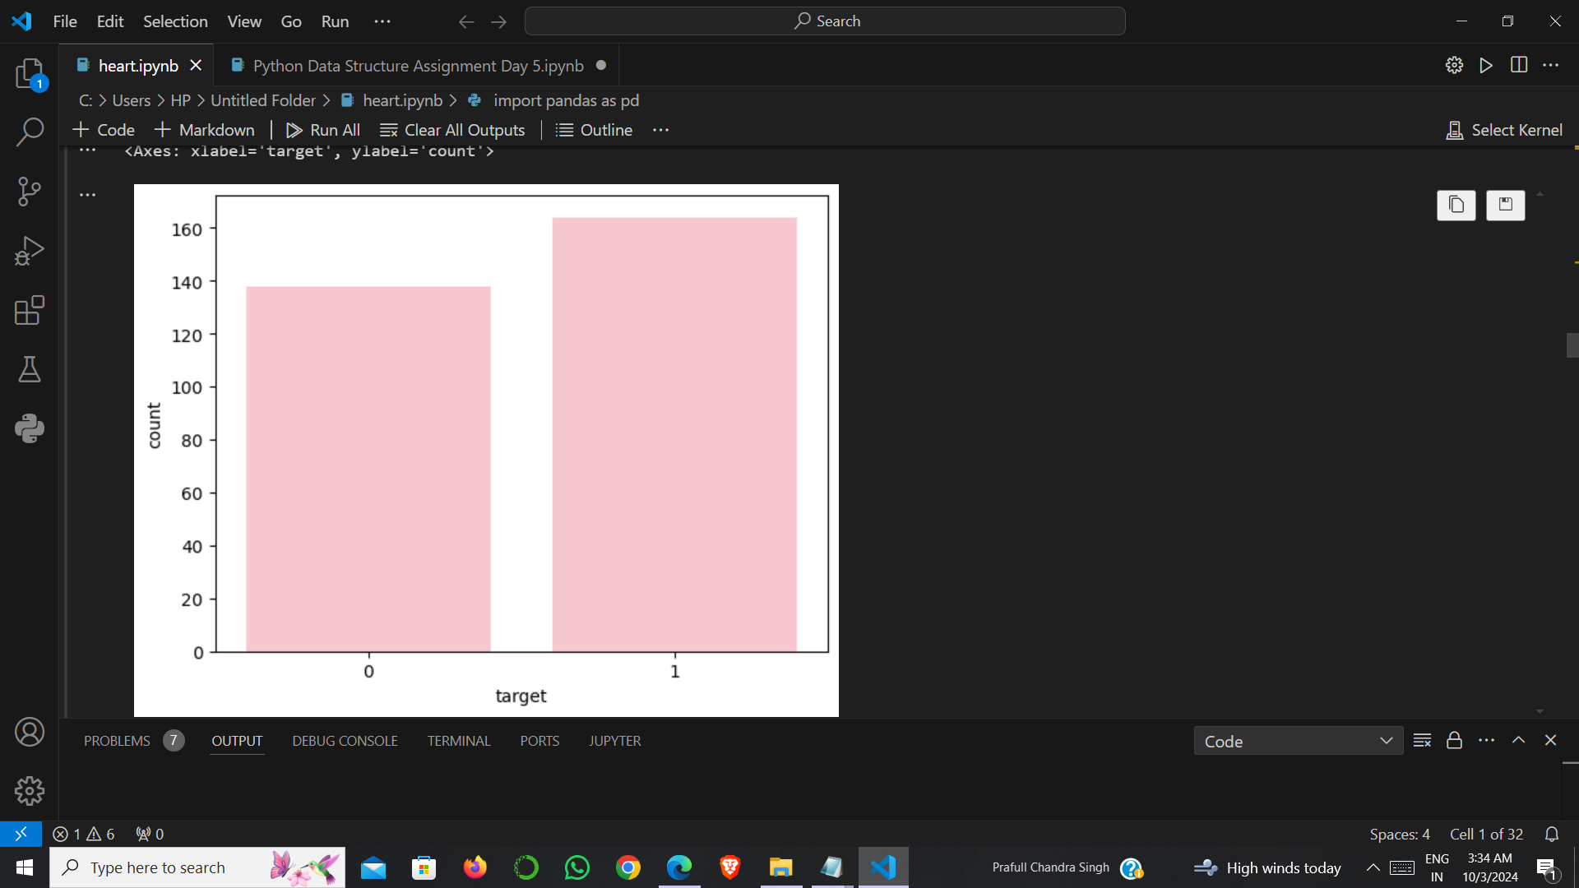
Distribution of Target Variable
Less Chance to Heart Disease and More Chance of Heart Disease , both bars have enough data to explain further.
Target
1 164
0 138
0 : Less Chance
1 : High Chance

Slide 7
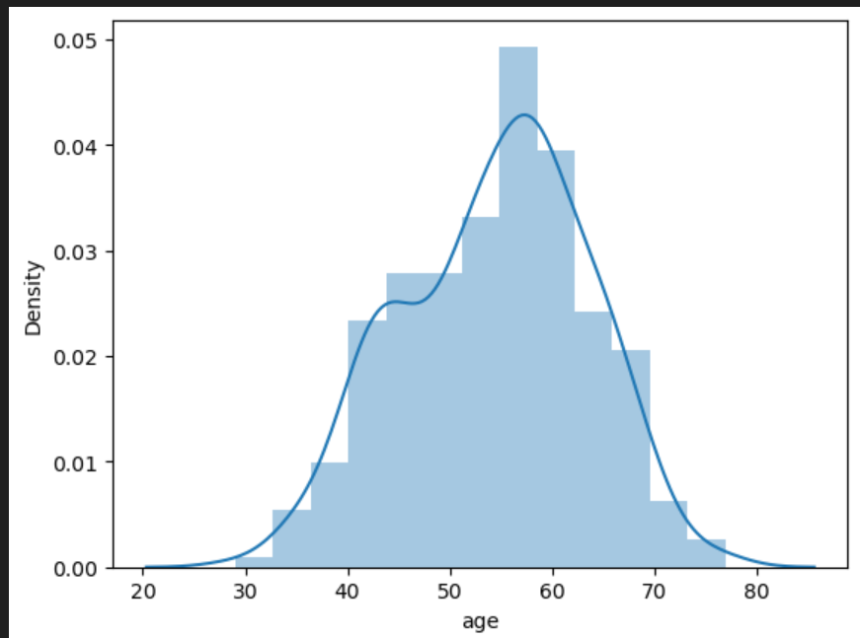
Distribution of Different Age Group
Middle Aged People (age 40-60) have a greater chance of occuring heart disease

Slide 8
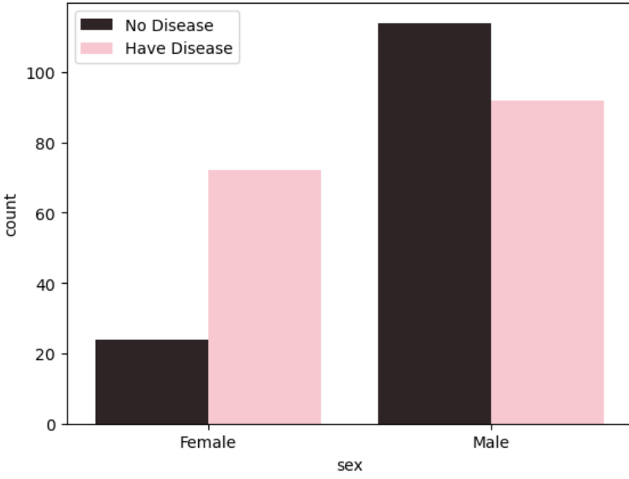
Distribution of Different Gender
The no of females who are heart disease prone is very high than females who are not heart disease prone. Male who have less heart disease is higher in number than the male who are more heart disease prone.

Slide 9
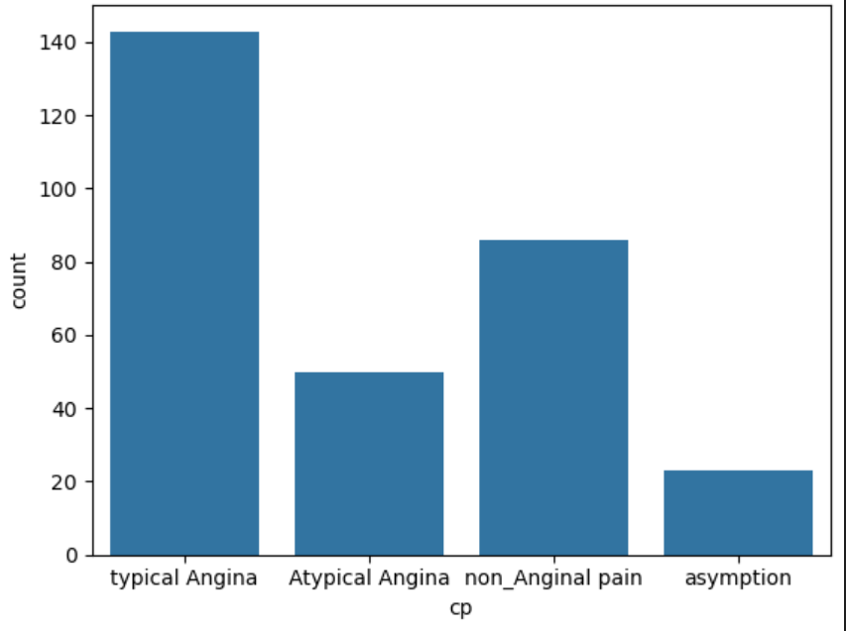
Different Types of Chest Pain
Typical Angina type chest pain is very common, whereas those who have Non_Atypical Angina have more chance to become a heart disease patient.

Slide 10
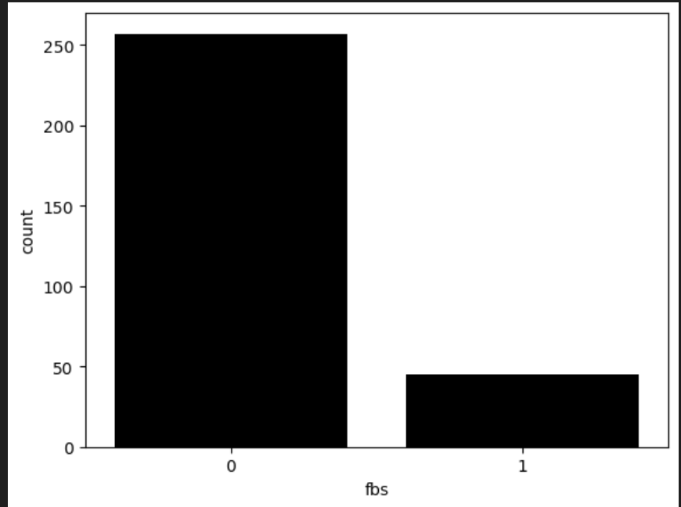
Distribution of Fasting Blood Sugar
High fasting blood sugar levels can increase the risk of heart disease.

Slide 11
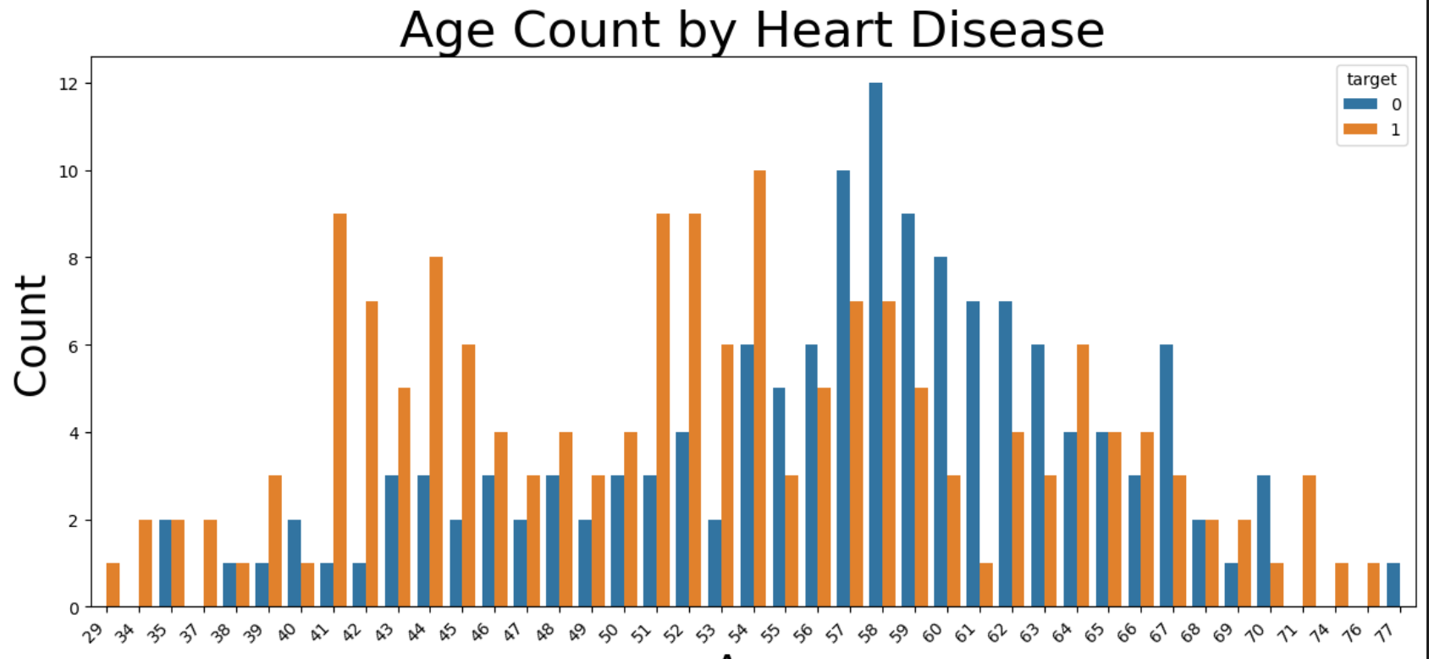
Distribution of Age Count for Heart Disease
Middle Aged People (age 40-60) have a greater chance of occurring heart disease and Old Aged People (age above 60) have a less chance of occurring heart disease.

Slide 12
Valuable Insights
1.Middle Aged People (age 40-60) have a greater chance of occurring heart disease and Old Aged People (age above 60) have a less chance of occurring heart disease.
2. Male surpass Female in number of total heart attack, but Female have more chance of heart attack.
3. Typical Angina type chest pain is very common, whereas those who have Atypical Angina have more chance to become a heart disease patient.
4. High fasting blood sugar levels can increase the risk of heart disease. 5.It is found that even if ECG has no specific disturbances, chance of getting heart disease higher.
6. If there is no vessel in human body, then chance of heart disease is much much higher.
7. Resting blood pressure in most of the cases, is in the range of 120-140. 8. In most case, heart rate can be as high as 160 times per minutes.
9. If Exercise-induced-Angina is not present, still it exists heart disease, especially in early stage of lif

Slide 13

Summary
1.There were 96 female and 206 male participants in the dataset.
2. In Target 138 were NORMAL while 164 have FIXED DEFECT.
3. In CHEST PAIN TYPE:
A. Typical angina: 143
B. Atypical angina: 50
C. Non-anginal pain: 86
D. Asymptomatic: 23
4. This dataset includes an age range from a minimum of 29 to a maximum of 77.
5. 205 individuals have a resting blood pressure greater than 120.
6.Fasting blood sugar was true for 45 individuals and false for 257 individuals.

Slide 14
Summary
The Heart Disease Diagnostic Analysis project focuses on analyzing medical data to gain insights into heart disease trends and contributing factors.
Utilizing data science techniques such as Exploratory Data Analysis (EDA), data cleaning, and correlation analysis, this project aims to identify key metrics and relationships between patient demographics and clinical features.
Through data visualization and statistical methods, meaningful patterns were uncovered, offering valuable information for predicting heart disease risks and enabling better healthcare preparation.

