Slide 1

CISC 699 Final Applied Project Computer Information Sciences - SUMMER’23
Title: MusicOn , a music player emulator
Professor: Dr. Abrar Qureshi
Contributor: Prafulla Chandra Munugoti
Term: Summer 2023

Slide 2
Agenda
Project Introduction
GRAD 695 Project
Addendum - What’s NEW in MUSIC
Available Categories
System Architecture
Tech Stack
Demo
Questions ??

Slide 3
Project Introduction
MUSICON Player application is an attempt to mimic the audio player with wide variety of functionalities
MUSICON supports various user types , admins/superusers and users.
MUSICON serves in help users create their own playlist of songs, podcasts and takes advantage of backend database to track, update, insert, delete information.
MUSICON can play a song in multiple modes, pause, and resume a long song, and change the song, play or skip to next song, FM station and podcast .
MUSICON can play audio in various real-life modes namely normal mode , loop mode, shuffle mode, single song loop mode.
MUSICON supports picking a Radio Station based on frequency, location and topics
MUSICON supports playing podcasts based on podcaster, topics and available ones.

Slide 4
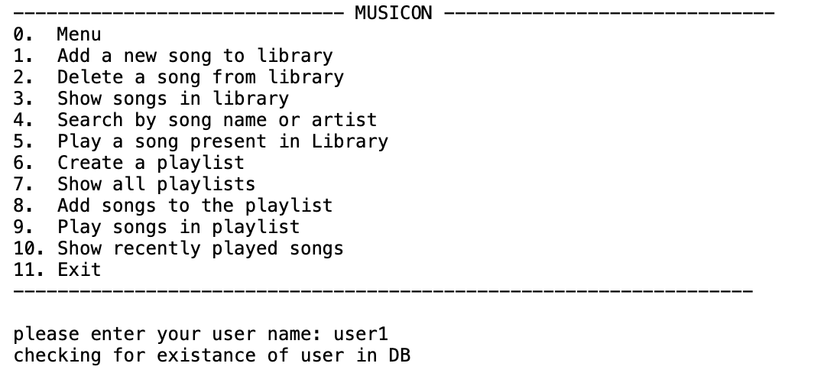
GRAD 695 Project

Slide 5
Addendum - What’s NEW in MUSICON
1. Provide music mixes to users based on their past usage of the application to play songs.
2. Provide music recommendations to users based on artist.
3. Provide music recommendations to users based on genre.
4. Provide music recommendations to users based on album.
5. Add support to run just a single song in loop mode.
6. Users can select the radio based on location.
7. Users can select the radio based on frequency.
8.Users can select the radio based on category.
9. Users can select any station based on category (sports/news/traffic/music etc.)
10. Users can select their favorite podcasts from the available in the database.
11.Users can select by podcasters.
12.Users can select by category (investment, education, meditation, sleep etc.).

Slide 6

Available Categories
Music
Allow to add/delete/display/play/skip/pause/resume/stop/loop/shuffle
Allow to create playlists of songs
FM Radio
Allow an addition to play Radio from the application based on the URL.
Podcasts
Allow to play/skip/pause/resume/stop podcasts, pick topics, pick podcasters

Slide 7
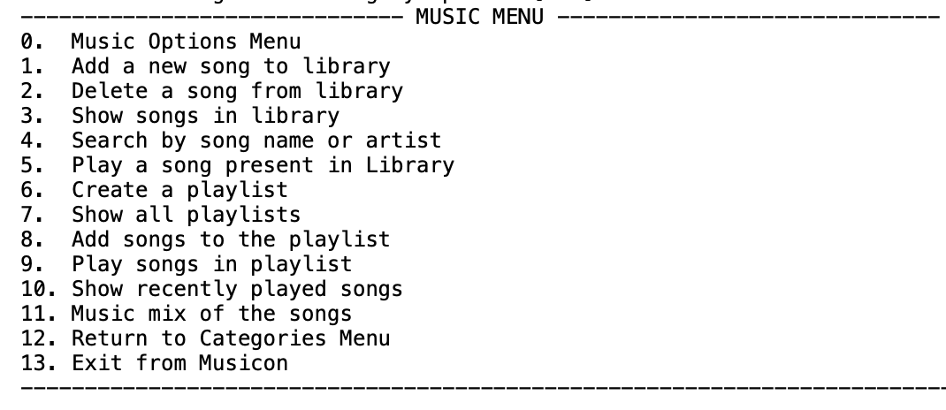
Music menu

Slide 8
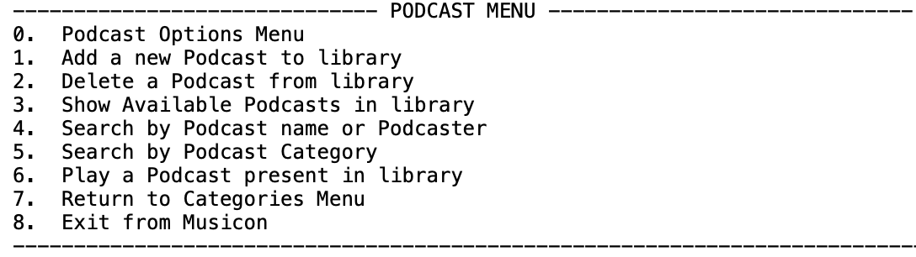
PODCASTS MENU

Slide 9
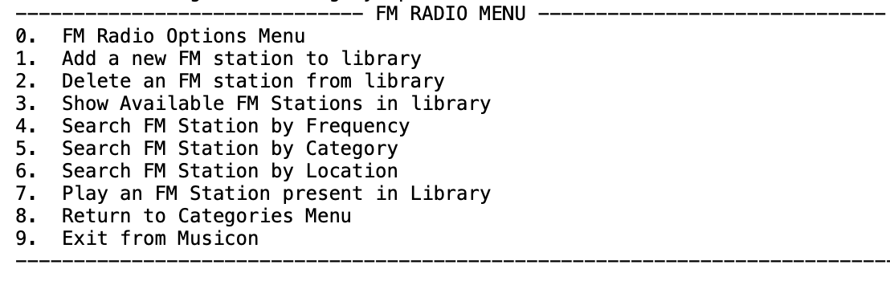
FM Radio MENU

Slide 10
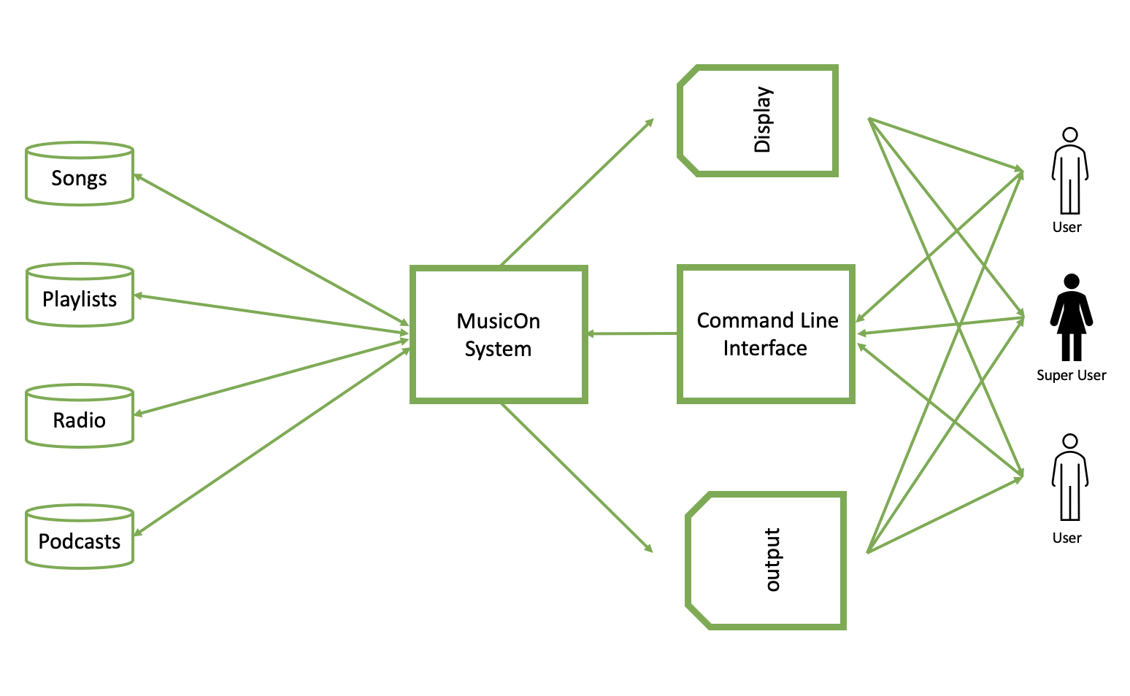
System Architecture

Slide 11
Tech Stack
Python as Programming Language(Python3)
Jupyter Notebook (from Anaconda Navigator)
Python for music mixer (pygame)
Python for Radio player(vlc)
MySQL for DB storage (pymysql)
Pandas DF for data operations (Pandas)
Many more support python libraries …

Slide 12
Demo

Slide 13



Q&A

