Slide 1

CISC 699 Final Applied Project Computer Information Sciences - SUMMER’23
Title: MusicOn , a music player emulator
Professor: Dr. Abrar Qureshi
Contributor: Prafulla Chandra Munugoti
Term: Summer 2023

Slide 2
Agenda
Project Introduction
GRAD 695 Project
What’s NEW !!!
Tech Stack
Questions ??

Slide 3
Project Introduction
MUSICON Player application is an attempt to mimic the audio player with wide variety of functionalities
MUSICON supports various user types , admins/superusers and users.
MUSICON enables users to play music and digital audio files with various extensions as mp3,wav etc ...
MUSICON serves in help users create their own playlist and takes advantage of backend database to track, update, insert, delete information.
MUSICON can play a song in multiple modes, pause, and resume a long song, and change the song, play or skip to next song.
MUSICON can play audio in various real-life modes namely normal mode , loop mode, shuffle mode.
MUSICON can support functionalities standalone as well as dependent on other features with some predefined data into the DB.

Slide 4
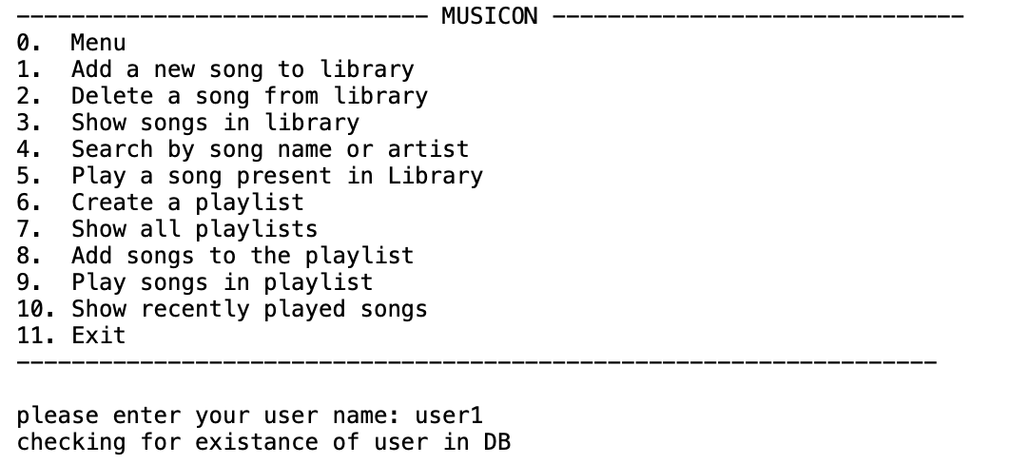
GRAD 695 Project

Slide 5
Addendum - What’s NEW in MUSIC PLAYER
1. Provide music mixes to users based on their past usage of the application to play songs.
2. Provide music recommendations to users based on artist.
3. Provide music recommendations to users based on genre.
4. Provide music recommendations to users based on album.
5. Add support to run just a single song in loop mode.

Slide 6
AM/FM Category
MUSICON is not just a software that runs only mp3 or audio files, it would allow an addition to run AM/FM from the application.
1. Users can select the FM/AM based on location.
2. Users can select the FM/AM based on frequency after picking the location.
3. Users can select any station based on category (sports/news/traffic)
Many more as the Project goes on …

Slide 7
PODCAST Category
MUSICON will be capable of adding support to play podcasts category for their daily purpose of audio to listen.
Users can select their favorite podcasts from the available in the database.
Users can select by podcasters.
Users can select by category (investment, education, meditation, sleep etc.).
Many more on Podcast Category features.

Slide 8
Tech Stack
Python as Programming Language(Python3)
Jupyter Notebook (from Anaconda Navigator)
Python for music mixer (pygame)
MySQL for DB storage (pymysql)
Pandas DF for data operations (Pandas)
Many more support python libraries …

Slide 9



Q&A

