Slide 1

CISC 699 Final Applied Project Computer Information Sciences - SUMMER’23
Title: MusicOn , a music player emulator
Professor: Dr. Abrar Qureshi
Contributor: Prafulla Chandra Munugoti
Term: Summer 2023

Slide 2
Agenda
Project Introduction
GRAD 695 Project
What’s NEW !!!
Tech Stack
Questions ??

Slide 3
Project Introduction
MUSICON Player application is an attempt to mimic the audio player with wide variety of functionalities
MUSICON supports various user types , admins/superusers and users.
MUSICON serves in help users create their own playlist of songs, podcasts and takes advantage of backend database to track, update, insert, delete information.
MUSICON can play a song in multiple modes, pause, and resume a long song, and change the song, play or skip to next song, FM station and podcast .
MUSICON can play audio in various real-life modes namely normal mode , loop mode, shuffle mode, single song loop mode.
MUSICON supports picking a Radio Station based on frequency, location and topics
MUSICON supports playing podcasts based on podcaster, topics and available ones.

Slide 4
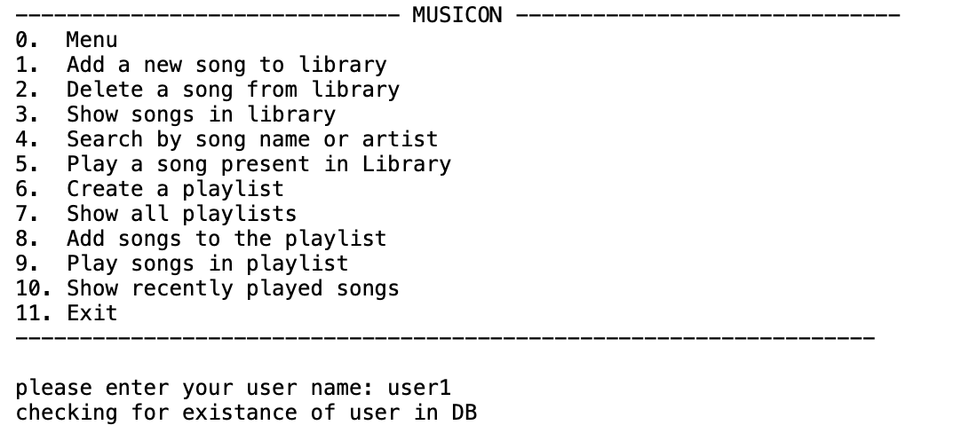
GRAD 695 Project

Slide 5
Addendum - What’s NEW in MUSIC PLAYER
1. Provide music mixes to users based on their past usage of the application to play songs.
2. Provide music recommendations to users based on artist.
3. Provide music recommendations to users based on genre.
4. Provide music recommendations to users based on album.
5. Add support to run just a single song in loop mode.
6. Users can select the FM/AM based on location.
7. Users can select the FM/AM based on frequency after picking the location.
8. Users can select any station based on category (sports/news/traffic)
9. Users can select their favorite podcasts from the available in the database.
10.Users can select by podcasters.
11.Users can select by category (investment, education, meditation, sleep etc.).

Slide 6
Available Categories
Songs
Allow to play songs, skip , pause, resume, loop, shuffle
Playlists
Allow to create playlists of songs, podcasts
AM/FM
allow an addition to run AM/FM from the application.
Podcasts
Allow to play podcasts, skip, pause, resume, shuffle , pick topics

Slide 7
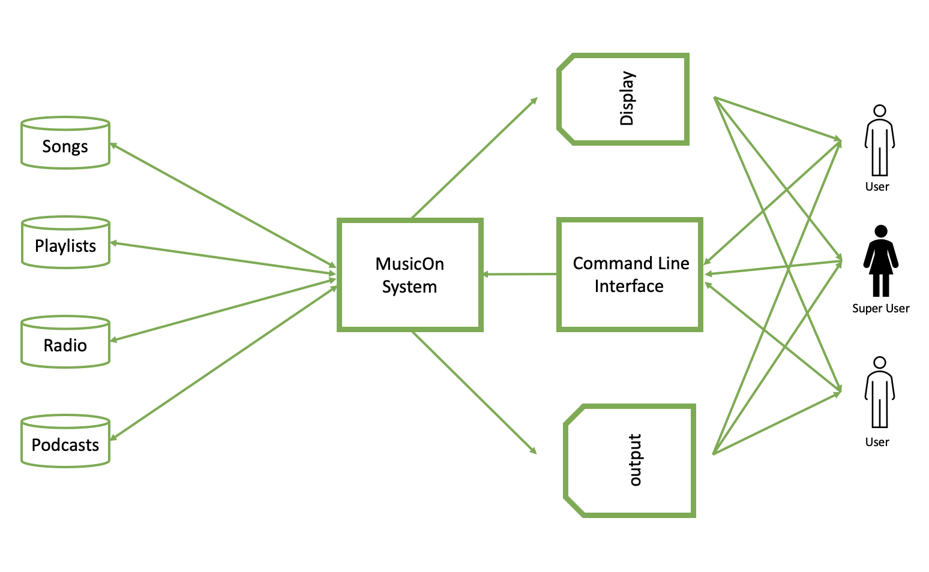
System Architecture

Slide 8
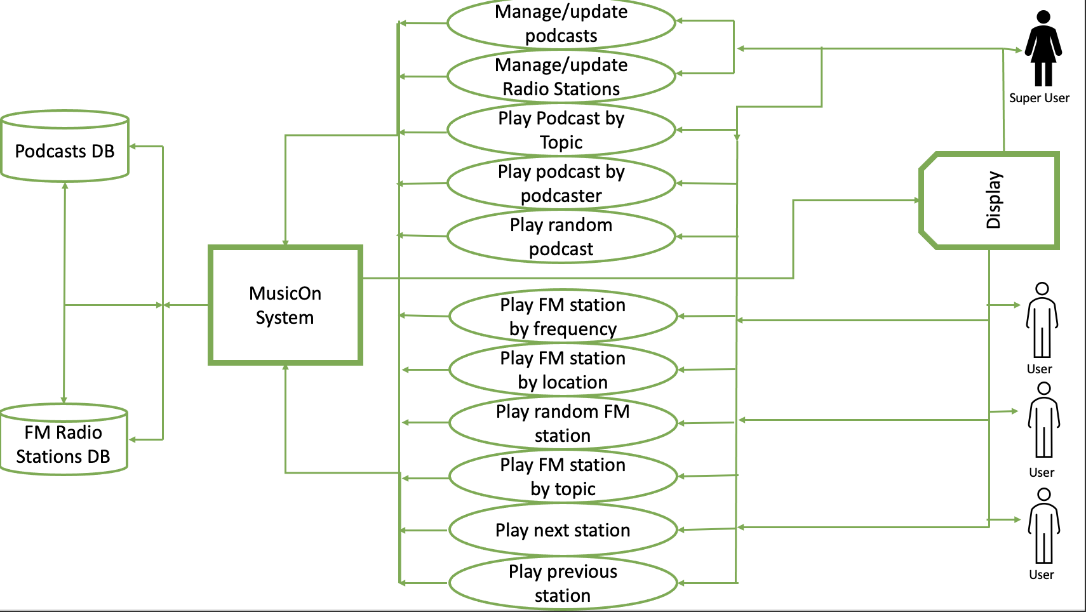
Design Approach

Slide 9
Tech Stack
Python as Programming Language(Python3)
Jupyter Notebook (from Anaconda Navigator)
Python for music mixer (pygame)
MySQL for DB storage (pymysql)
Pandas DF for data operations (Pandas)
Many more support python libraries …

Slide 10

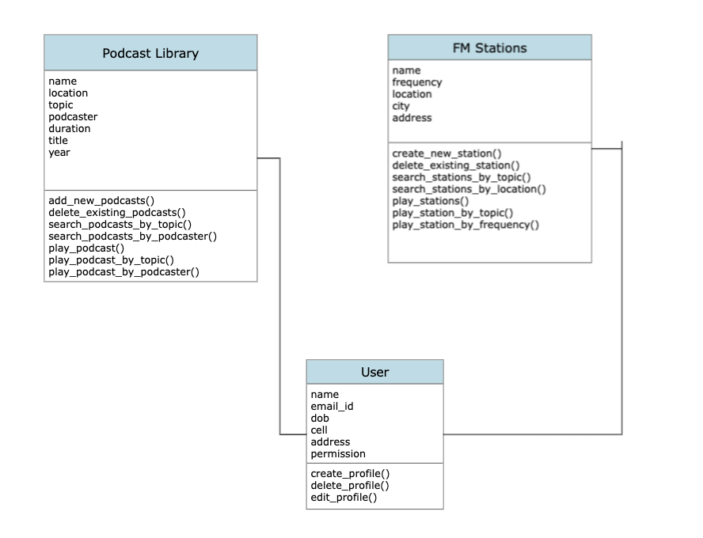

Class Diagram
Implementation Status:
add_new_podcasts() --DONE
delete_existing_prodcasts() –DONE
search_podcasts_by_topic() – DONE
search_podcasts_by_podcaster() –DONE
create_new_station() – DONE
delete_existing_station() – DONE
search_stations_by_topic() –DONE
search_stations_by_location() –DONE

Slide 11
MID Term Status
Database Setup (25% )
Completed setting up tables and ACCESS/OPERATIONS testing completed
Podcast Functions & FM Stations Functions (25%)
Completed 8 out if 14 functions , Integration of 8 functions are done.
Testing in Progress
MUSIC mixes and Recommendations (25%)
Completed Music Mix functions and play single song in a loop.
2 out of 5 functions completed, Integration of 2 functions are done.
Unit Testing & System Testing (25%)
DB setup , 11 out of 16 functions completed, taking Total Completion % of System is
25%+17%+10%+2% = 59% of the System Completed.

Slide 12


Q&A

