Slide 1
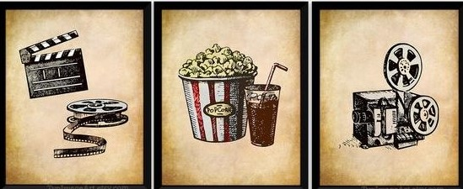
Movie Recommender Portal
INFO7390 Advances Data Sci/Architecture
Done By
Praful Praveen Badami
Sheetal Sekhar

Slide 2

INTRODUCTION
In This Project we are mainly focusing on
Natural Language Processing Fundamentals in Python
Unsupervised Learning in Python
Recommender Systems
The Goal of the project is to be able to predict a movie similar to it in a given data set by analysing its plot summary.

Slide 3

PROBLEM STATEMENT
We all love watching movies! There are some movies we like, some we don't. Most people have a preference for movies of a similar genre.
Some like action movies, horror movies and so on.
Movies within a genre often share common base parameters.
In our project we will quantify the similarity of movies based on their plot summaries based on NLP techniques and separate them into groups→ clusters.

Slide 4
Dataset and Libraries used
Link to dataset-
Plot summaries
NLP Libraries used is NLTK
Others- scikitlearn, pandas, numpy, pickle
https://www.kaggle.com/jrobischon/wikipedia-movie-plots

Slide 5
SOLUTION
We break down the problem into the following steps
Tokenization → Stemming → Creating TfidfVectorizer → Fit Transform TfidfVectorizer → Import Kmeans and create Clusters → Calculate similarity distance → Find Similar Movie
A final function :
To give an output of the most similar movie in the dataset when the user enters any movie
Edge cases and appropriate error and prompt messages are taken care of too

Slide 6





Technologies used
Flask
Heroku
NLTK
K Means

Slide 7
CONCLUSION
Thus similar movies are generated for any given movie from the data set.
NLP and K-Means were the main concepts used.
The project was deployed on the Web using Flask and Heroku.
After an ML model is built it’s important to give users a nice interface to try out the model.

Slide 8
FUTURE SCOPE
This uses NLP techniques to classify the similarity of movies.
An important application of this is also Product Recommendation.
Based on Product Description, an e-commerce company can suggest products to users with similar tastes in purchasing.

