Slide 1

SMART INDIA HACKATHON 2026
NIDHI निधि
“A fund held in trust”: every security deposit and FDR pledged to AICTE, verified with the bank, tracked to maturity and released only by the competent authority.
Problem Statement ID – 26265
Problem Statement Title – Security Deposit / FDR Management Portal
Theme – Smart Automation
PS Category – Software
Team ID – 198001
Team Name – SignalNine

Slide 2
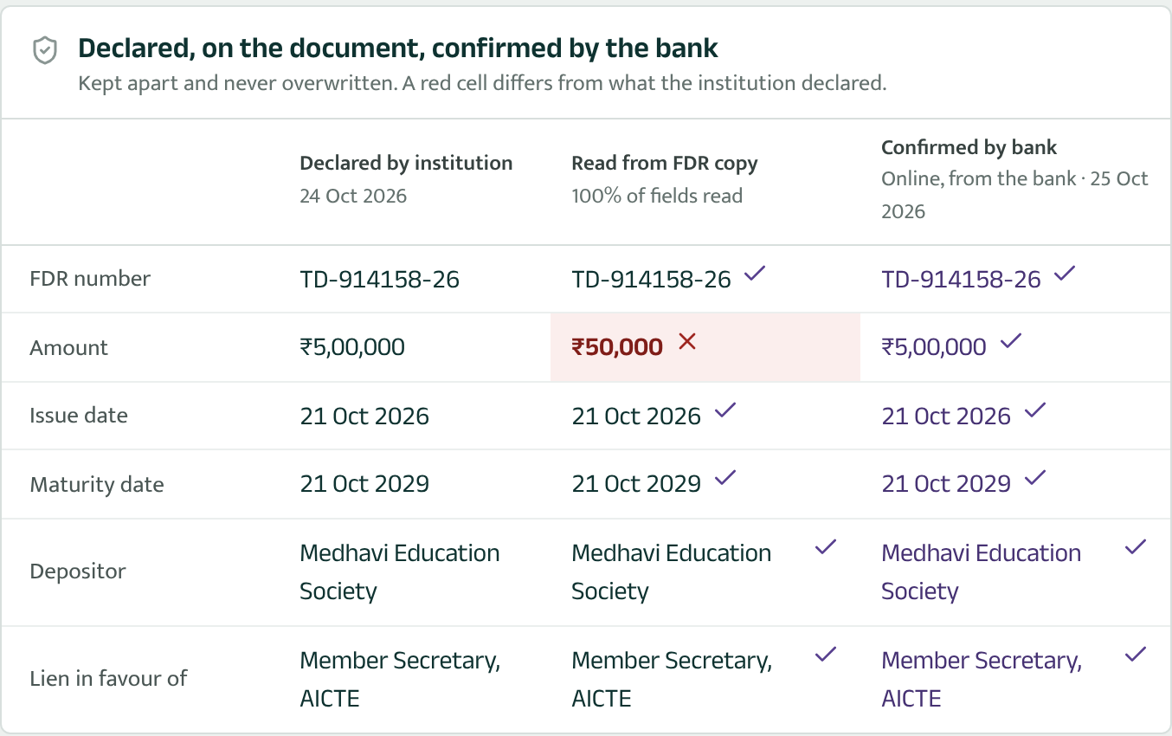
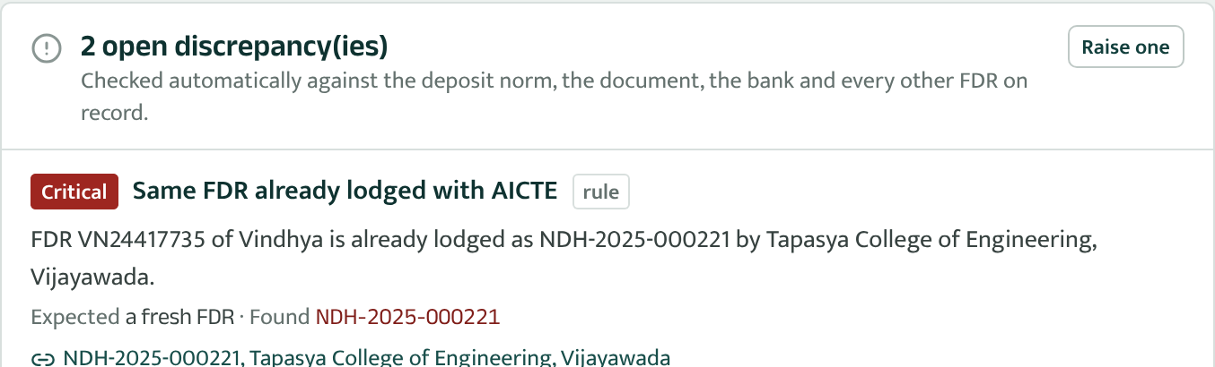
NIDHI (निधि)
SignalNine
One portal for every security deposit and FDR AICTE holds, from lodging to lien release
Problem today
Innovation and uniqueness
Files, letters and spreadsheets. Deposit status lives in many places, so no one has an up-to-date view of what is held and what is pending.
Paper is taken on trust. An FDR copy can be altered, reused by a second institution, or closed at the branch after AICTE accepts it.
Maturity slips by. Renewals are chased by hand; a lapsed FDR is security in name only.
Release by correspondence. Conditions, approvals and the lien-release letter are tracked on file notings.
1
Three sources, never mixed
Every field shown as declared, as read from the FDR copy, and as confirmed by the bank. A red cell is a difference.
2
Reads the FDR copy
Reads PDFs, scans and phone photos (OCR, offline) and catches an altered copy on lodging (100% digital, 99.6% scanned).
3
Fraud signals
Same FDR reused by two institutions, bank with no record, FDR later closed at the bank (periodic re-confirmation).
4
Verifiable letters
Acknowledgements and lien releases carry a QR and a SHA-256 fingerprint; a branch checks them without signing in.
Proposed solution
The deposit file: the FDR copy reads ₹50,000 where ₹5,00,000 was declared; the bank confirms the declaration.
Lodge online: the institution uploads the FDR copy; the portal reads it and fills in the form.
Three sources side by side: declared, on the document, confirmed by the bank. Never merged.
Monitor to maturity: reminders at 90/60/30/7 days, escalation at 15 and 45 days after maturity.
Release by maker-checker with a lien-release letter anyone can verify by QR.
5
Late-renewal prediction
Ranks held FDRs by the chance the replacement comes after maturity, with reasons, 60 days ahead.
6
Ask in English or हिंदी
“FDRs maturing in 30 days” becomes the right filters. Runs on the server: no cloud AI.
All 10 required capabilities, built:
✔ Repository
✔ Documents
✔ Verification
Fraud signal: the same FDR lodged by a second college
✔ Maturity tracking
✔ Renewals
✔ Release workflow
✔ Alerts & escalation
✔ Dashboard & reports
✔ Audit & access
✔ Integration & security
FULLY WORKING PROTOTYPE · all 6 PS test scenarios automated · 82 automated tests · 600 institutions, 1,849 deposits, 11 banks (all synthetic)

Slide 3
TECHNICAL APPROACH
SignalNine
Architecture: the life of a deposit
Declared · document · bank, field by field
1 Lodge
2 Check
3 Verify
4 Hold
5 Close
Field | Declared | FDR copy | Bank
Amount | ₹5,00,000 | ₹50,000 ✗ | ₹5,00,000 ✓
Depositor | Tapasya Edu. Society | same ✓ | other trust ✗
Lien | MS, AICTE | MS, AICTE ✓ | MS, AICTE ✓
Institution uploads
FDR copy (PDF)
17 automatic checks
norm, lien, IFSC, name
Bank connector
online, where offered
Maturity monitor
90/60/30/7 days
Renewal
replaces old FDR
Reader fills
the form
Document vs
declaration
Verification letter
reply recorded
Escalation
RB head → CA
Release
maker-checker
Banks with an online service answer through a connector (simulated in the demo); others get a letter and the officer records the reply.
Acknowledgement
letter with QR
Reused FDR or
document
Re-confirm
every 180 days
Late-renewal
risk score
Lien-release
letter to bank
Technology stack
Front end: React 19, TypeScript, Vite, Tailwind CSS 4, TanStack Query, Recharts; Hindi and English
Back end: Python, FastAPI, SQLAlchemy 2, Alembic; live updates by Server-Sent Events
Documents: pypdf and Tesseract OCR (reading FDR copies, scans, photos), ReportLab (letters, QR codes, PDF reports), openpyxl
AI/ML, all offline: scikit-learn gradient boosting, RapidFuzz name matching
Security: AES-256-GCM encryption of stored files, SHA-256 hash chain, bcrypt + JWT
Data and ops: PostgreSQL 16 or SQLite, Docker, Playwright browser tests
Foundation: SHA-256 hash-chained ledger · PostgreSQL · audit log · fingerprinted files · 8 roles
Release: no one approves their own recommendation
Institution requests
RB checks 4 conditions
RB recommends
Competent authority approves
Accounts releases lien
Every step is sealed in the deposit's own hash chain and in one system ledger; any later edit is detected and located.

Slide 4
FEASIBILITY AND VIABILITY
SignalNine
1.00 / 1.00
precision / recall of the checks on 500 test deposits with planted faults; 0 of 50 clean ones flagged
100%
of fields read correctly from 300 test FDR copies in 3 bank layouts
81%
of the top 10% flagged by the late-renewal model renewed late (base rate 44%; AUC 0.65)
~1 s
to re-verify all 15,091 sealed ledger entries and 1,849 deposit histories
Feasibility
Challenges and how we handle them
Viability and roll-out
Technical
Built and running; every number above is re-measured on the Proof page. Open-source stack on one server, NIC cloud or a state data centre.
Operational
Institutions lodge and track their own deposits; officers stop retyping. Bank letters, rectification notices and lien releases are generated.
Economic
No licence fees and no per-use AI charges; the bank connector is the only integration cost.
Legal and data
DPDP Act 2023: data stays on AICTE's server; files encrypted at rest; institutions see only their own records; contact details masked for read-only roles; every export logged.
Challenge | Mitigation built into Nidhi
No online FDR verification at many banks | Letter route with QR; officer records the reply; online connector where a bank offers one
Altered or reused FDR copies | Copy read and compared on lodging; FDR and file fingerprints checked across all institutions
FDR closed at the branch after acceptance | Every held FDR re-confirmed with the bank every 180 days
Renewals noticed too late | Reminders from 90 days; escalation at 15 and 45 days; likely-late list
Release without authority | Four conditions, maker-checker, approver ≠ recommender, sealed history
Scanned copies and phone photos | Tesseract OCR on the server: 99.6% of fields on 45 test scans; officer and bank remain the backstop
Month 1–2
Pilot with the Regulation Bureau; import the existing deposit register
Month 3–4
Institutions lodge renewals online; letter-based verification with banks
Month 5–6
Bank verification APIs where available; AICTE portal sign-on; SMS and e-mail
Beyond AICTE: any regulator or department that holds bank guarantees, earnest money or FDRs can use it; deposit norms, reminders and escalation are settings.

Slide 5
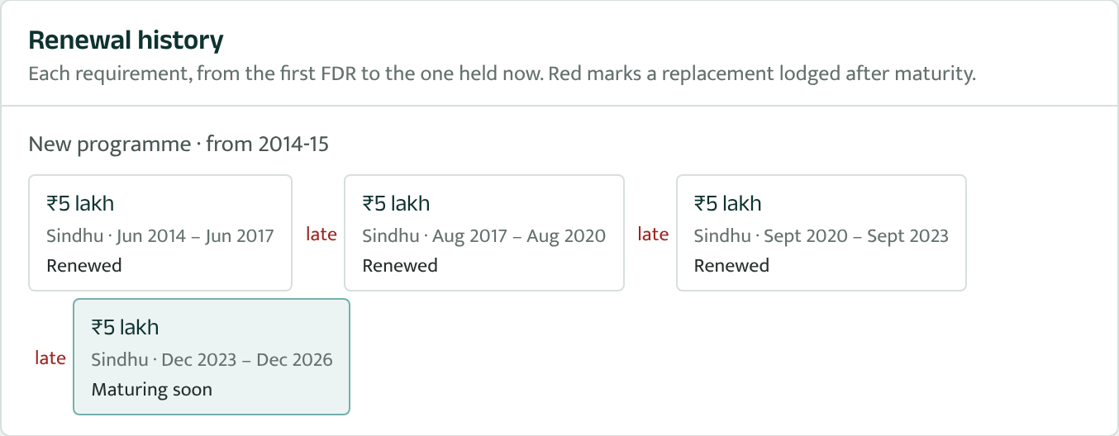
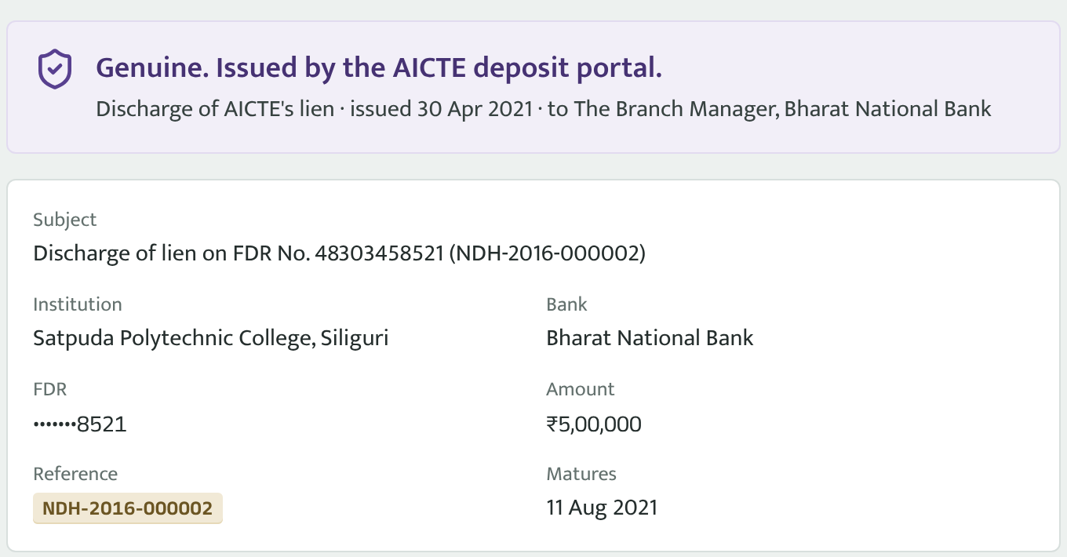
IMPACT AND BENEFITS
SignalNine
Who gains what
PS test scenarios, automated
Regulation Bureau
One register; scrutiny desk with the bank's answer beside the declaration; letters written for them.
Competent authority
Releases arrive checked and recommended; escalations of lapsed FDRs reach them automatically.
✔ New FDR submission
read, lodged, acknowledged, bank-confirmed, accepted
Finance & Accounts
Executes only approved releases; the lien-release letter is generated and verifiable.
Institutions
Lodge online, see what is required, get reminders before maturity and every letter in one place.
✔ Validity tracking
active → maturing → matured, by the monitor
Renewal history: an institution that renewed late three times; its next FDR is flagged early
✔ Approaching maturity
reminders at each offset, sent once
Banks
Scan the QR to confirm a letter is genuine; answer verification requests online where they can.
Audit / vigilance
Every decision named, timed and sealed; tampering is detected and located.
✔ Renewal
old FDR closed as renewed; chain kept
What the PS asks to improve, and how it shows
Record accuracy
three sources compared field by field; 17 checks on every lodging
✔ Discrepancy
short amount, no lien, altered copy, reused FDR, bank differs
Verification time
online where banks offer it; letters chased after 7 days
Public letter check: a bank branch confirms a lien-release letter by its QR
Timely renewal
reminders, escalation, likely-late list; on-time rate on the dashboard
✔ Authorised release
checklist, maker-checker, lien letter verified by its PDF
Manual effort
form filled from the FDR copy; letters and reports generated
✔ Also in a real browser
17 Playwright tests drive the same flows end to end
Pending visibility
every pending item has a queue, an owner and an age

Slide 6
RESEARCH AND REFERENCES
SignalNine
Today's way of working, and Nidhi
References
Need in PS 26265 | Files, letters, spreadsheets | Nidhi
One up-to-date register of deposits | Partial, per desk | ✔
Institution-declared vs bank-confirmed kept apart | ✘ | ✔
Altered or reused FDR detected | By chance | ✔
Reminders before maturity, escalation after | Manual | ✔
Release with recorded conditions and approvals | On file notings | ✔
Letters verifiable by the bank | ✘ | Y (QR)
Tamper-evident history | ✘ | ✔
[1] Smart India Hackathon 2026, Problem Statement 26265: Security Deposit/FDR Management Portal (AICTE, MoE)
[2] Digital Personal Data Protection Act, 2023 (MeitY)
https://www.meity.gov.in/static/uploads/2024/06/2bf1f0e9f04e6fb4f8fef35e82c42aa5.pdf
[3] Haber and Stornetta, “How to time-stamp a digital document”, J. Cryptology, 1991 (hash chains)
https://doi.org/10.1007/BF00196791
[4] ISO/IEC 18004: QR Code bar code symbology specification
https://www.iso.org/standard/62021.html
[5] FIPS 180-4, Secure Hash Standard (SHA-256), NIST
https://doi.org/10.6028/NIST.FIPS.180-4
[6] scikit-learn: HistGradientBoostingClassifier; RapidFuzz: string similarity
https://scikit-learn.org
Comparison drawn from the problem statement's own description of current practice.
Prototype and resources
Live prototype
[add link after deploying]
Demo video
[add link]
Source code
[add GitHub link]
Demo sign-in
rb.head@nidhi.test · kadamb@nidhi.test · password Demo@2026

