Slide 1
Nirma Canteen
Guided By: Prof. Malaram K Kumar

Slide 2
CONTENT
Introduction
Requirement analysis
Features of website
Tools and languages
E-R Diagram
Use Case Diagram
Screen Shorts
References
Conclusion

Slide 3
Introduction
To manage Nirma Canteen smoothly and to enable student and faculty to select the menu for “ Online “ which increases reliability and enhance satisfaction.
To manage crowd and provide sound free environment so that consumer could feel canteen as hygienic family like kitchen.

Slide 4
Introduction
Using virtual wallet customer can payment online when user first login to canteen they have to store certain amount in account added by admin.
After login user can order food, view order history and check order status.
User can add one or more item to cart and pay by wallet.

Slide 5
Introduction
Staff can view list of order given by user and change the food status.
Develop a web application , which can easily and effectively manage ordering and billing of food items.
Reduce paperwork.

Slide 6
The system is having three modules.
Admin
User(Student / Faculty)
Staff (work at canteen )

Slide 7
The money is added to the user account and manage by login mail id.
If the wallet is not having enough amount then the user can’t place order they need to go to admin and pay money for recharge wallet.

Slide 8
Requirement Analysis Admin:
Admin can add category of food
Admin can add food menu
Admin can view order history of each user with status.
Admin can add money to wallet by Email id.
Admin view total amount of wallet by Email Id.
Admin manage the staff.

Slide 9
User:
Can view menu , order history, current amount of wallet.
After placing order order is added to cart.
Cart will show list of item and give option to pay money by wallet.
If money is not enough in wallet then user can’t place order and also remove item from cart.
Can view order history.
Can view the status of order which manage by staff.

Slide 10
Staff:
Can view user order detail with unique Order No.
Can change the status of order.
Can view the total no of item is being order by which user using Email Id.
Can manage order by performing two operation:
Processing
Complete
Can view order history.

Slide 11
Features of Website
It contain Login page.
User can login by only Nirma’s Email id.
Allow user to place order using cart and do payment by wallet.
It will display history to each user with detail.
Staff can manage user order and view all history of order.

Slide 12
Tools and Languages
PHP
HTML
CSS
Java Script
phpmyadmin (Database)
Wamp server
Sublime

Slide 13
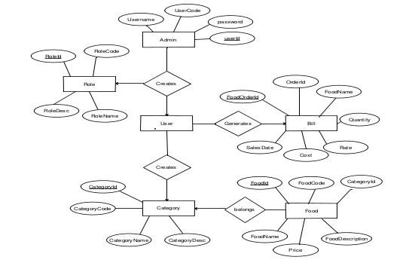
ER - Diagram

Slide 14
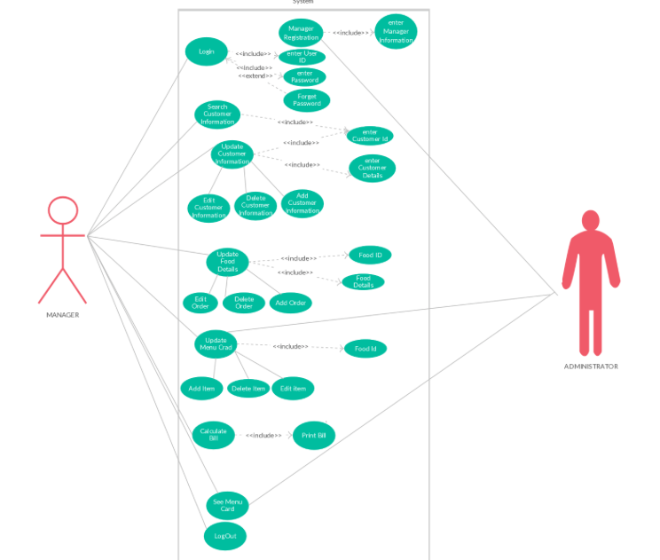
Usecase Diagram

Slide 15
Screenshots of website

Slide 16
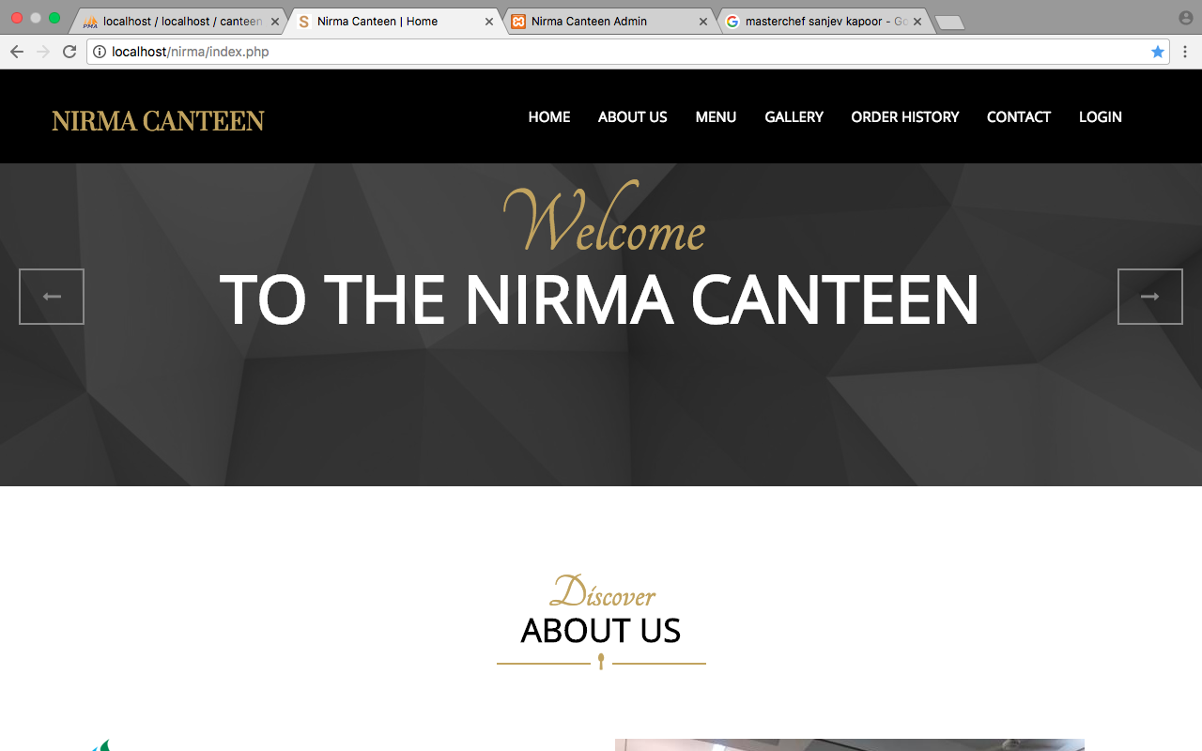
User Home page

Slide 17
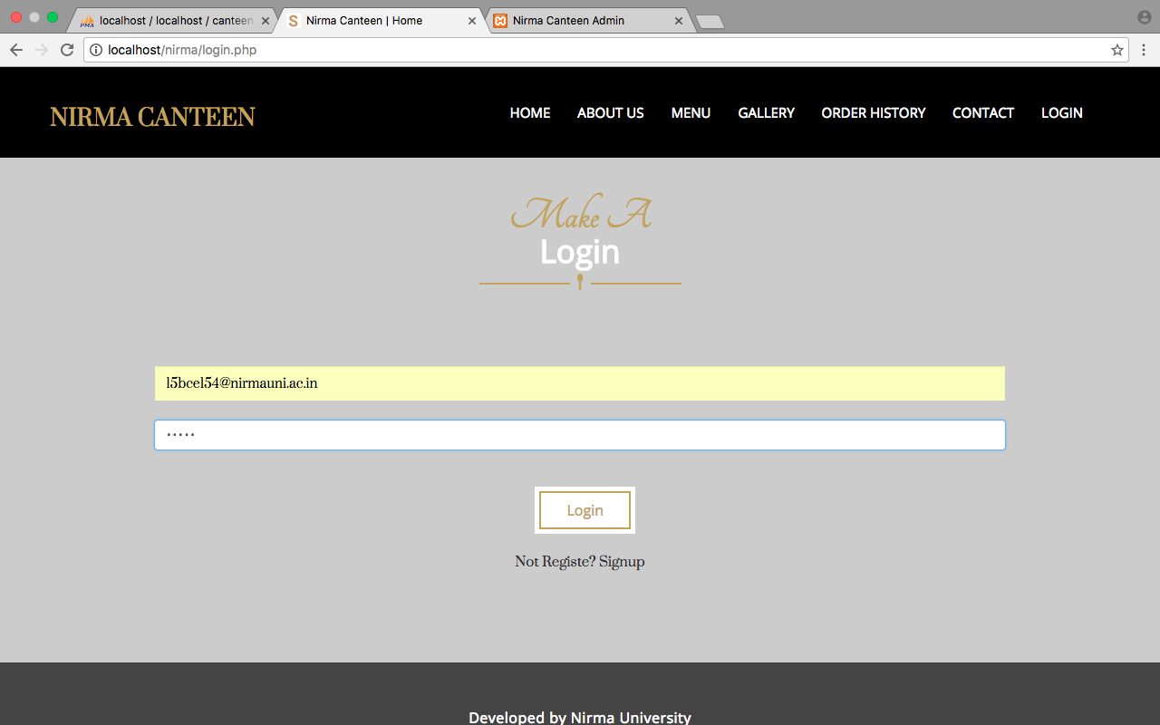
User Login Page

Slide 18
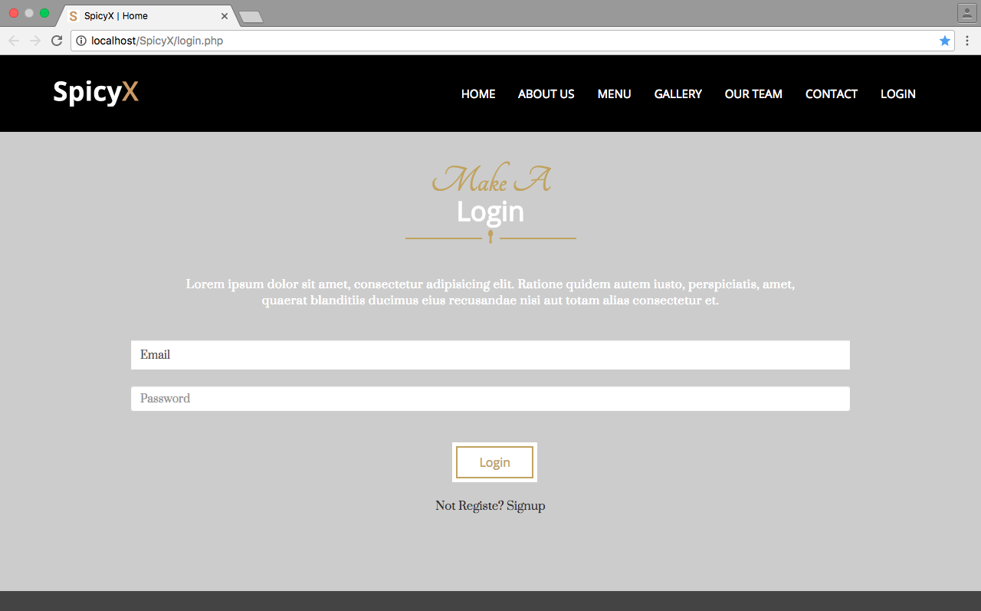
User login

Slide 19
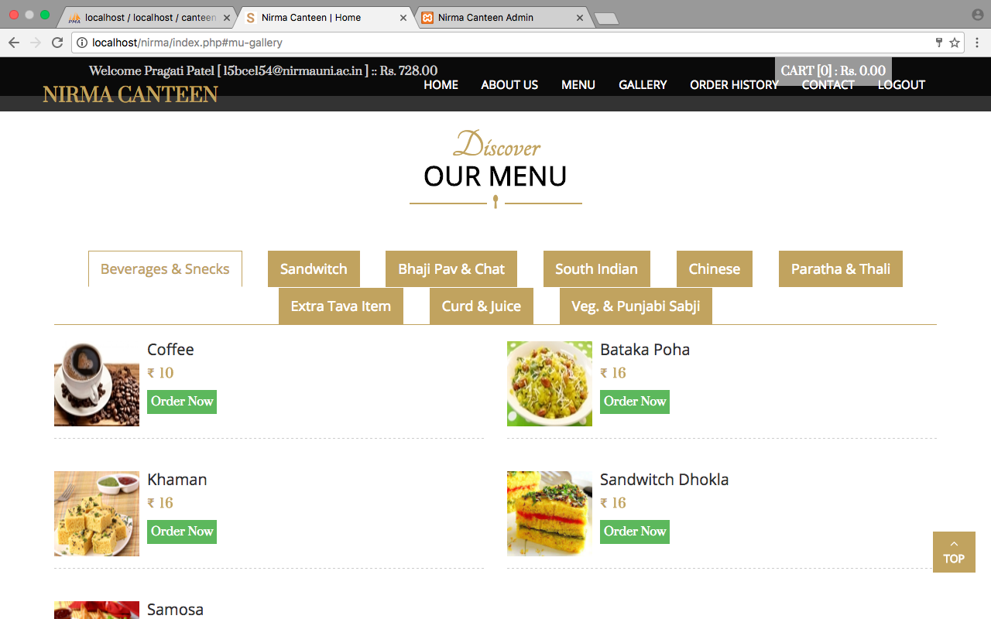
After Login

Slide 20
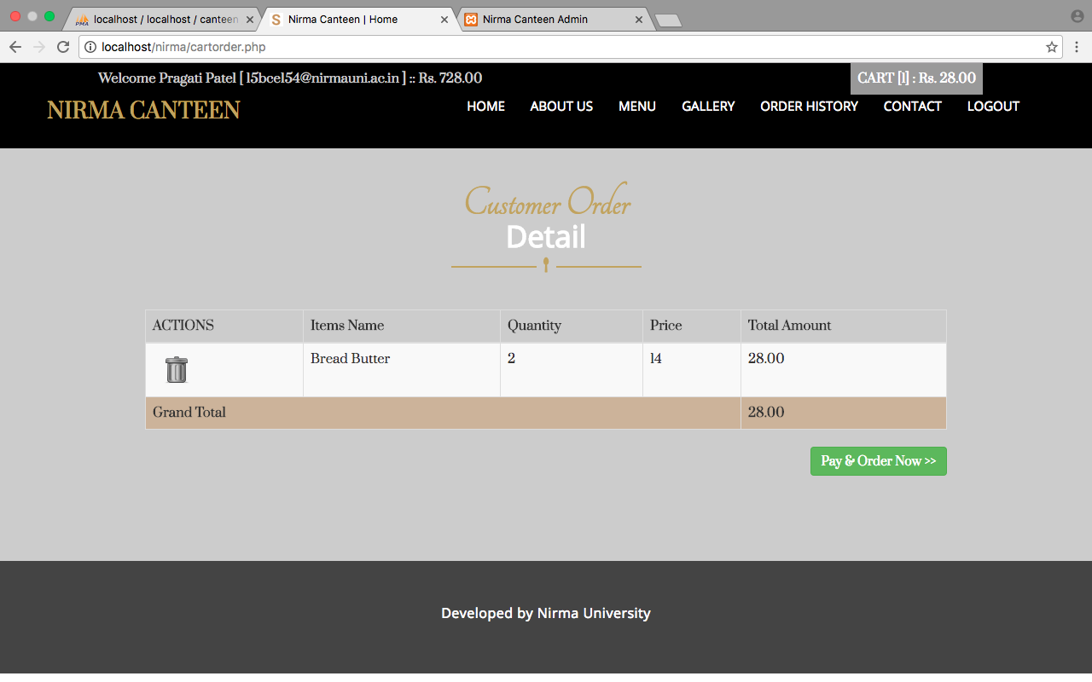

Slide 21
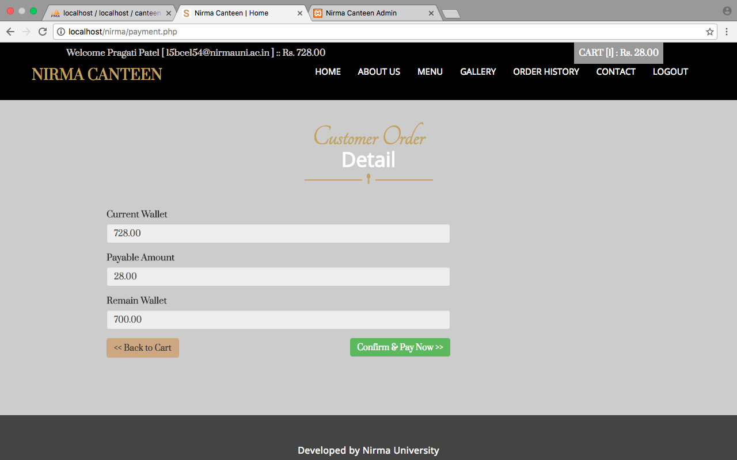

Slide 22
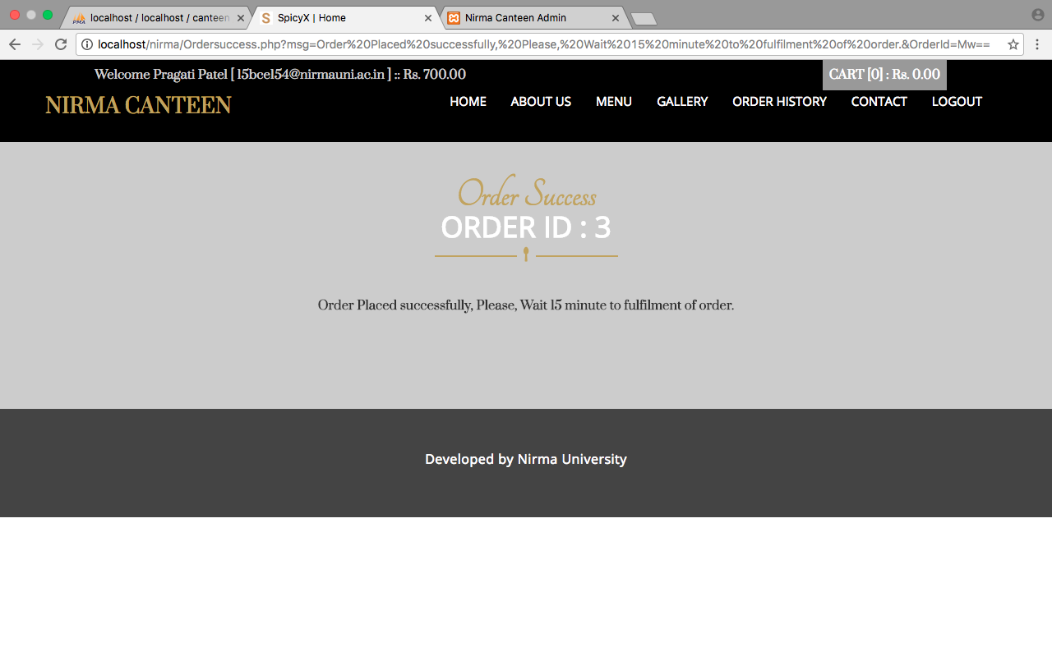

Slide 23
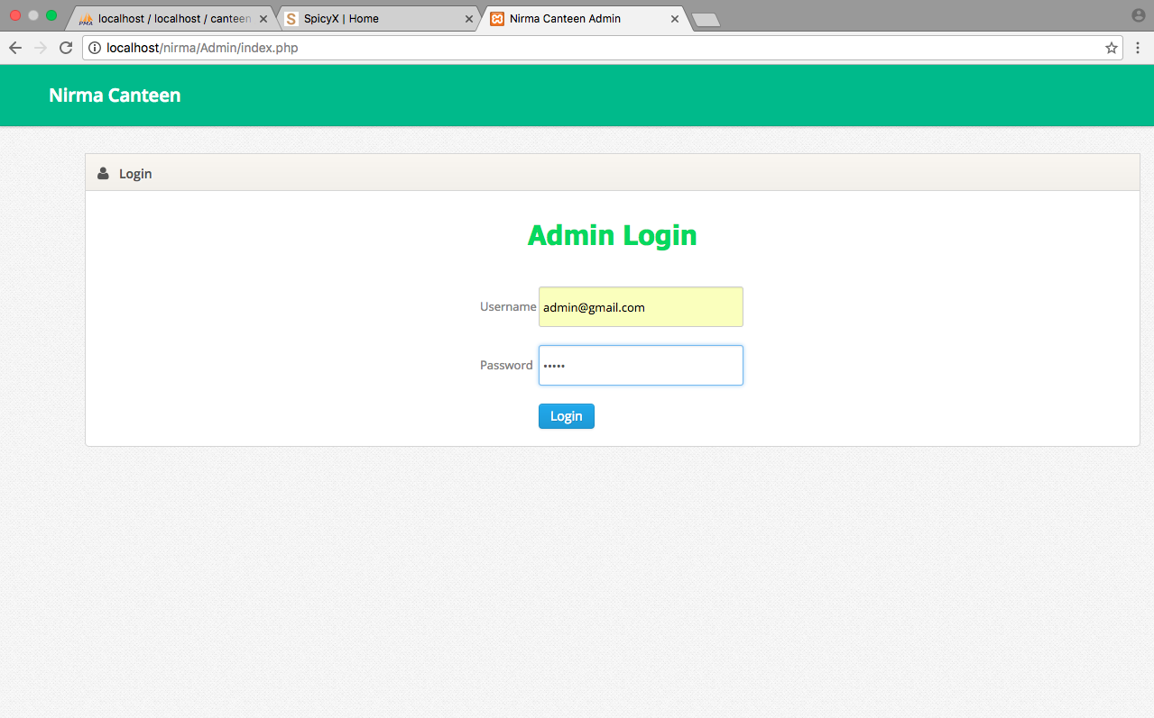
Admin Login

Slide 24
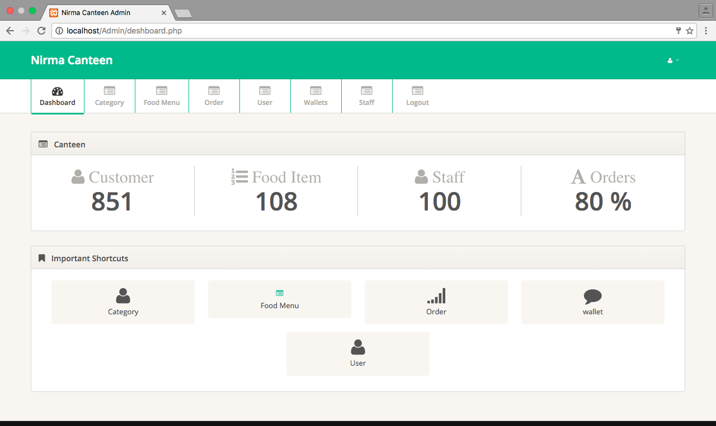
Admin Home page

Slide 25
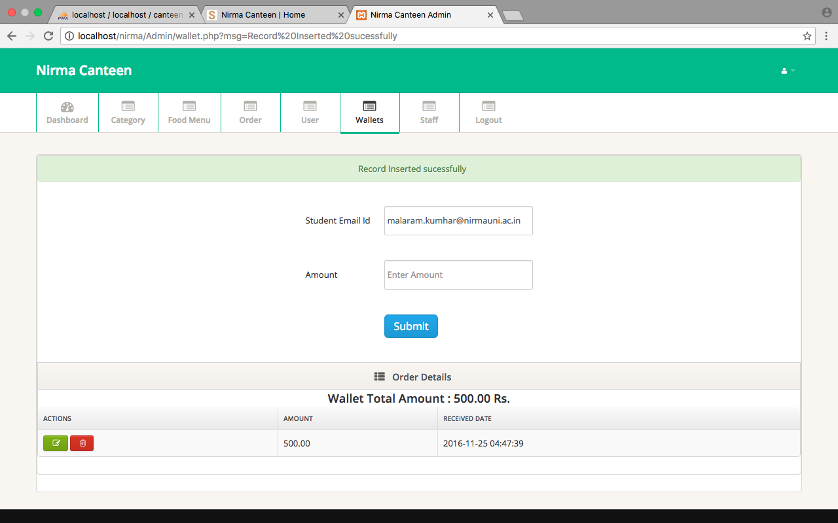

Slide 26
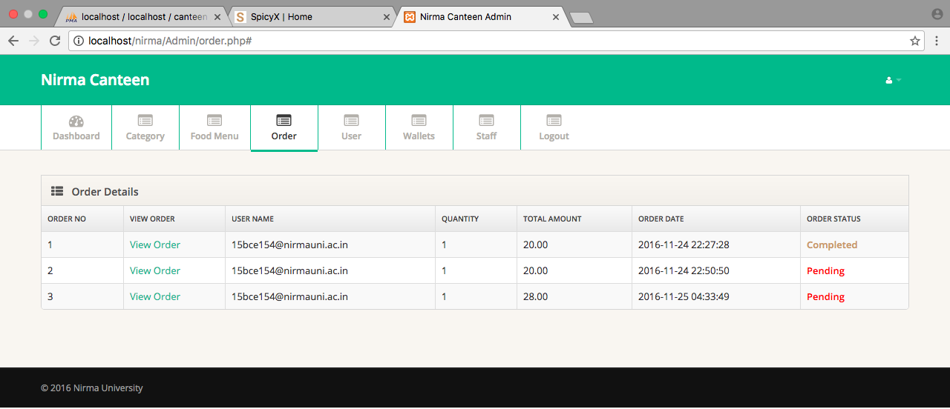

Slide 27
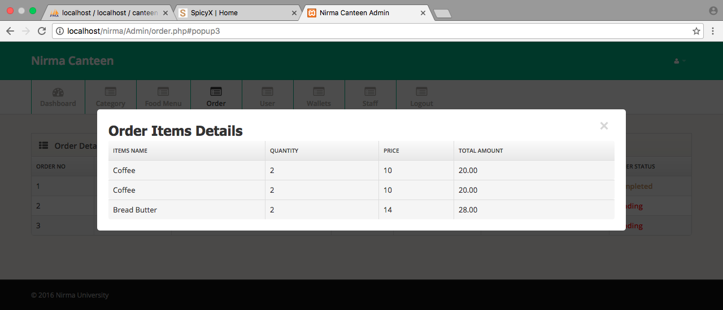

Slide 28

Staff(work at canteen) Login

Slide 29
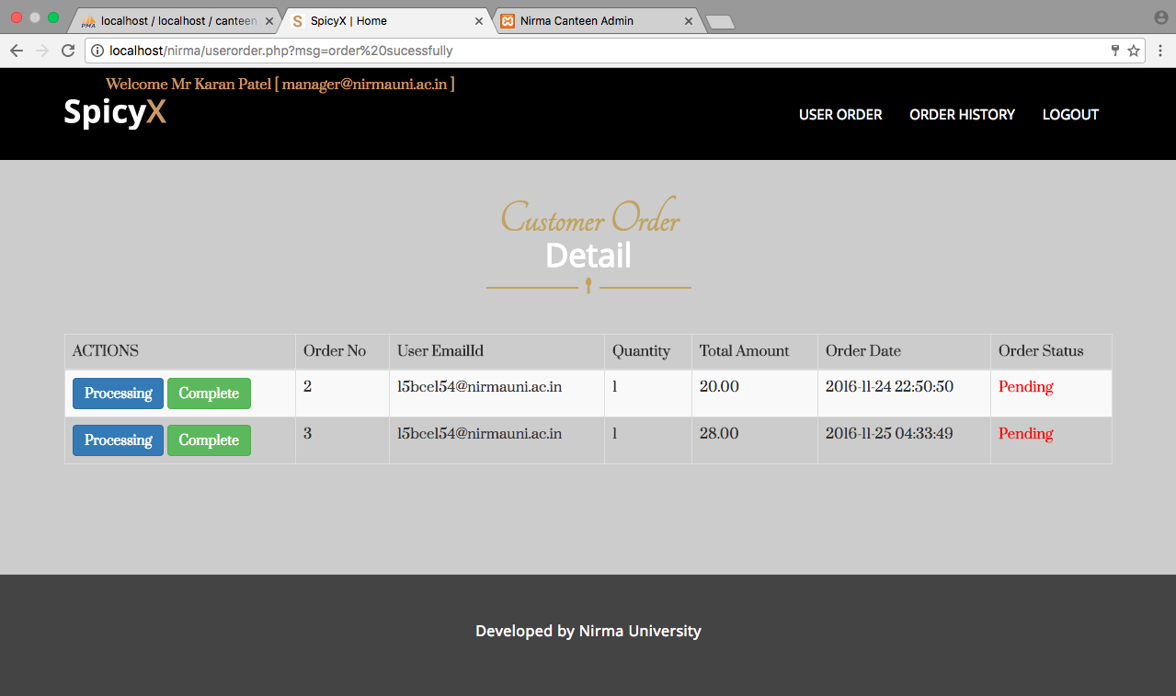
Staff Home Page

Slide 30
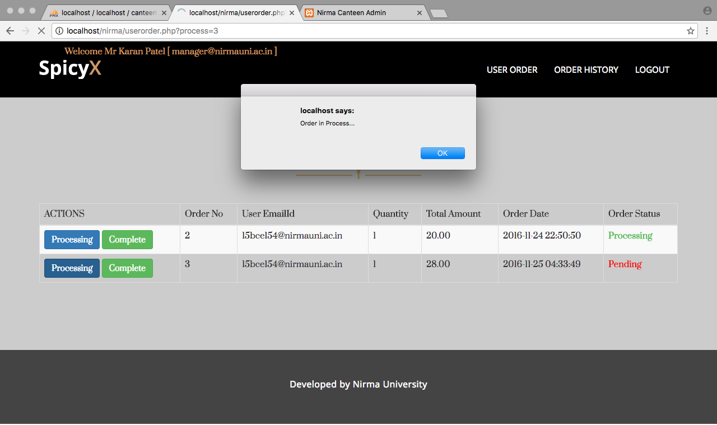
User Database

Slide 31
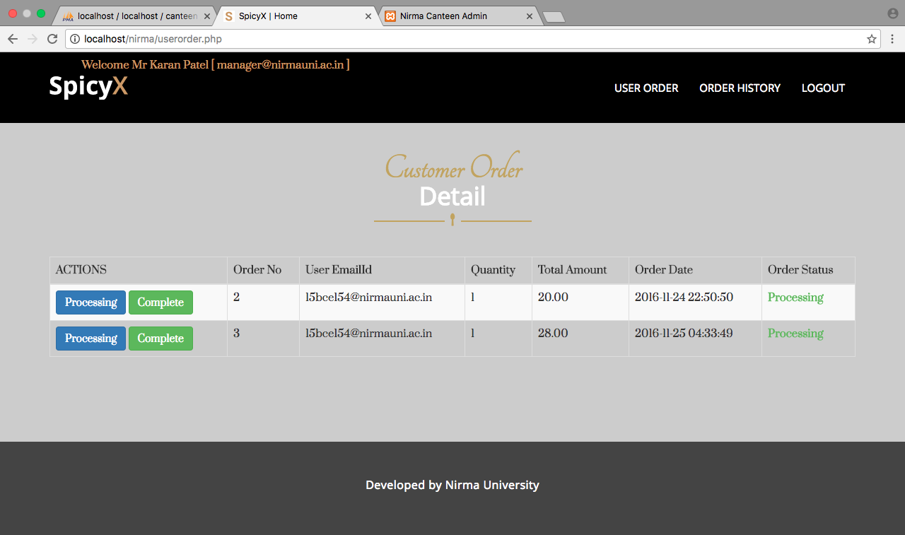

Slide 32
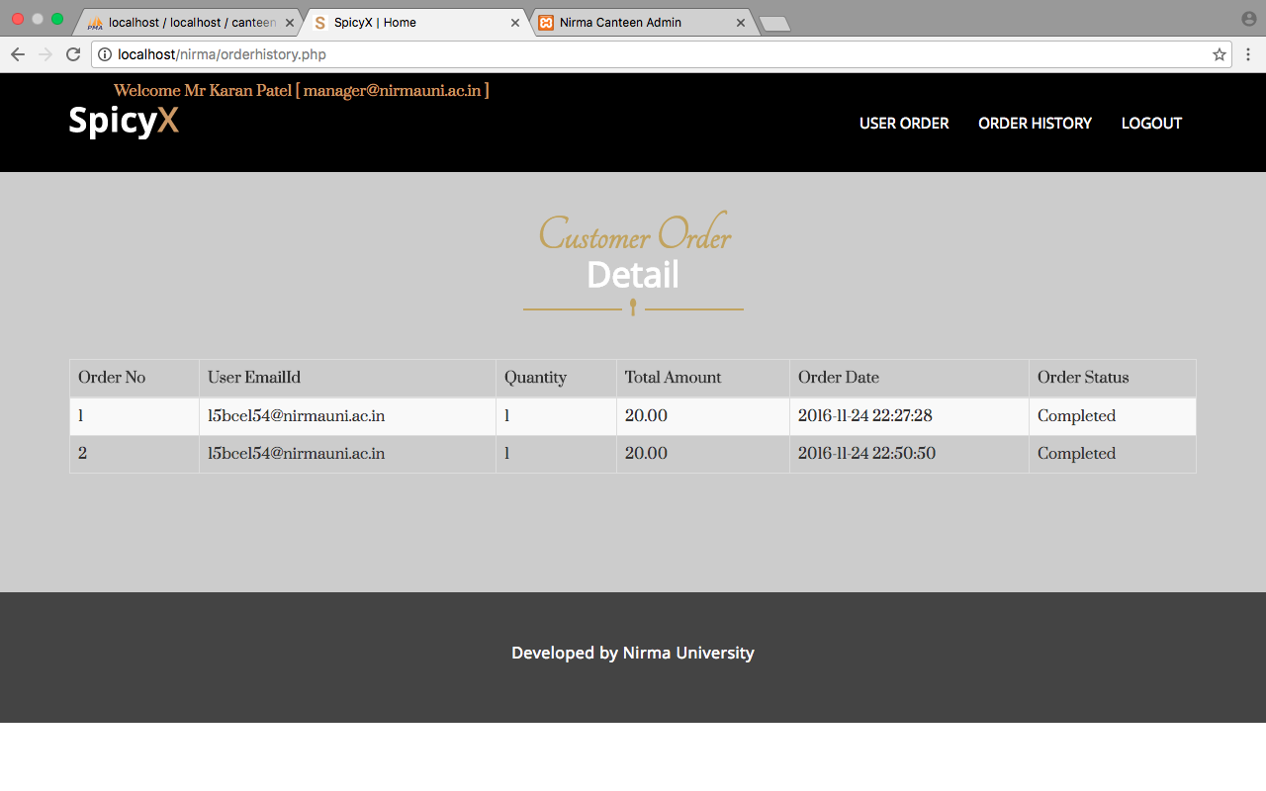

Slide 33
References
http://www.w3schools.com/php/
https://codepen.io/imprakash/pen/GgNMXO
http://php.net/manual/en/tutorial.firstpage.php

Slide 34
Conclusion
The system was mainly designed to reduce the manual work of updating and tracking and also make it easier for the user.
It also provides flexible, less time consuming and powerful reports regarding customer details and transaction details.

Slide 35
THANK YOU
Prepared by
Pragati Dobariya
(15BCE154)

