Slide 1
Attendance MONITERING System
15BCE154 & 15BCE157
Guide By,
DR. VIJAY UKANI

Slide 2
What is Face Recognition ?
Face Recognition is a method of identifying an individual by comparing live capture or digital image data with the stored record for that person.
Face recognition systems are commonly used for security purposes but are increasingly being used in a variety of other applications.

Slide 3
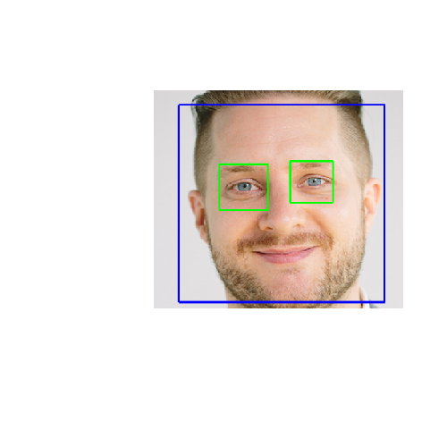
Most current face recognition systems work with numeric codes called faceprints. Such systems identify 80 nodal points on a human face.
nodal points are end points used to measure variables of a person’s face, such as the length
or width of the nose, the depth of the eye
sockets and the shape of the cheekbones

Slide 4
Algorithm
List of algorithm for face recognition system are as follow :-
Principle Component Analysis (PCA)
Linear Discriminant Analysis (LDA)
Skin colour based algorithm
Haar Cascade Algorithm

Slide 5
Haar Cascade Algorithm
Object Detection using Haar feature-based cascade classifiers is an effective object detection method, "Rapid Object Detection using a Boosted Cascade of Simple Features". It is a learning based approach where a cascade function is trained from a lot of positive and negative images. It is then used to detect objects in other images.
the algorithm needs a lot of positive images (images of faces) and negative images (images without faces) to train the classifier.
Then we need to extract features from it. Each feature is a single value obtained by subtracting sum of pixels under white rectangle from sum of pixels under black rectangle.
We select the features with minimum error rate, which means they are the features that best classifies the face and non-face regions.

Slide 6
Cascade Feature :-
In an image, most of the image region is non-face region. So it is easy to have a simple method to check if a window is not a face region. If it is not, discard it in a single shot. Don't process it again. Instead focus on region where there can be a face. This way, we can find more time to check a possible face region.
For this problem the Cascade of Classifiers is introduced.
How Cascade Works ?
Instead of applying all the 6000 features on a window, group the features into different stages of classifiers and apply one-by-one. (Normally first few stages will contain very less number of features). If a window fails the first stage, discard it. We don't consider remaining features on it. If it passes, apply the second stage of features and continue the process. The window which passes all stages is a face region.

Slide 7
Technology Tool
Python
OpenCV 2 & 3
Haar cascade Classifier

Slide 8
Thank You

