Slide 1
Capstone Project
By Pragadeesh Rajaganesh

Slide 2
Overview
1. Introduction
1.1. Problem Description
1.2 Background and Motivation
1.3. Possible Audience
2. Data
2.1 Description of Data
3. Methology
3.1. Single Neighbourhood
3.2. Multiple Neighbourhood.
4. Results and Conclusion

Slide 3
Introduction 1.1. Problem Description
Visiting a new city which seems to be to big to explore all in once is a problem when it comes to metropolies like London. Through a wide range of different cultures London developent economically, socially and politcially.
One great aspect of the diversity is the wide range of different eating possibilities.
But since it can be quite hard to distinguish between a good and bad restaurant and which one to choose there should be parameters in consideration to easen up the search. In my todays analysis i want to take the case of african food restaurants in London, which i recently heard of are quite popular.

Slide 4
Introduction 1.2 Background and Motivation
Since my coworker is from Ghana and we recently got a new colleague from Senegal, my interest for the african food quitly increased since there are bringing all kind of delicious food to work.
My Ghanese coworker mentioned therefore that he is thinking about opening a Ghanese restaurant in London, but isn't quite sure about the current information provided.
Therefore i will lend him a hand in providing a deep analysis about the possibilities.

Slide 5
Introduction 1.2 Possible Audience
Like i mentioned there is a high range of diversity in London and so we can conclude that besides the tourist also locals could be highly interested in finding the most visitable restaurant in whole london. Therefore the target audience are people who care about a high sophisticated african restaurant with high quality standart

Slide 6
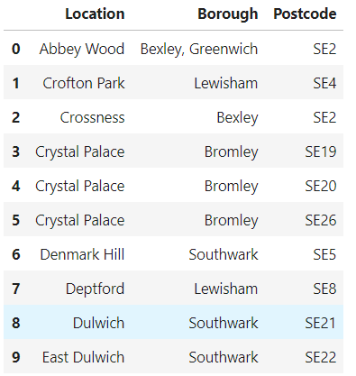
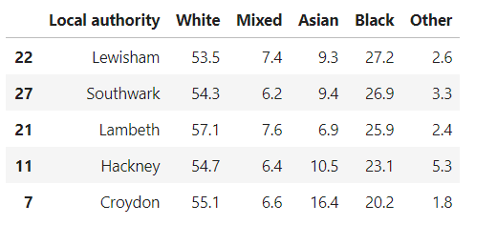
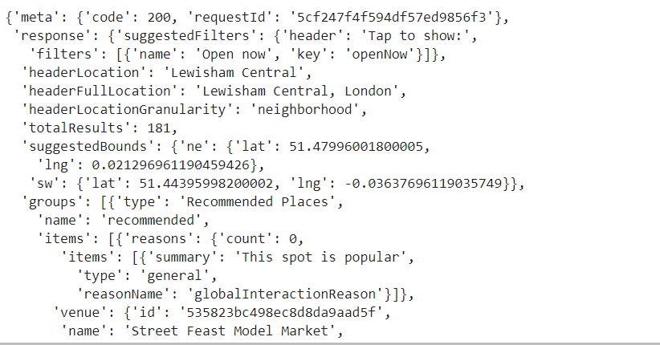
Data 3 Datsets were chosen.
1. Wikipedia to get all boroughs of London.
2. Wikipedia to get all demography of London poulation
3. Foursquare Data to get the best restaurants in the London Area.

Slide 7
Methology 3.1. Single Neighbourhood
For Area Lewishaim which seemed to be of high demographic ethnicity we concluded that following places are in following amount:

Slide 8
Methology 3.2. Multiple Neighborhoods
For multiple areas which seemed to be of high demographic ethnicity we concluded that following places are in following amount:
It its clear that Restaurants are not ranked top 5 of all locations. Smaller locations like pubs and coffee shops dominate the areas.

Slide 9
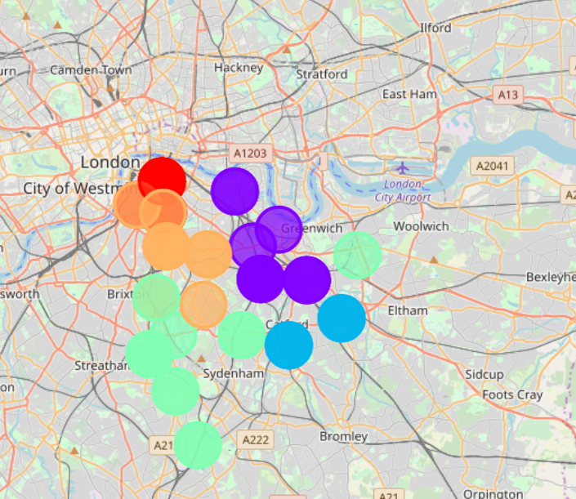
4. Results and Conclusion
Through the elbow method we could conclude that it would be quite senseful to divide South London into 3 Clusters.
Each cluster has quite visibility of restaurants. This is what we are going to see in the next slides.

Slide 10
4. Results and Conclusion Cluster 1
Borough | Cluster Labels | 1st Most Common Venue | 2nd Most Common Venue | 3rd Most Common Venue | 4th Most Common Venue | 5th Most Common Venue | 6th Most Common Venue | 7th Most Common Venue | 8th Most Common Venue | 9th Most Common Venue | 10th Most Common Venue
Southwark | 0 | Café | Coffee Shop | Pub | Hotel | Theater | Italian Restaurant | Park | Bar | Art Gallery | Street Food Gathering
Southwark | 0 | Café | Coffee Shop | Pub | Hotel | Theater | Italian Restaurant | Park | Bar | Art Gallery | Street Food Gathering
Southwark | 0 | Café | Coffee Shop | Pub | Hotel | Theater | Italian Restaurant | Park | Bar | Art Gallery | Street Food Gathering
Southwark | 0 | Coffee Shop | Hotel | Pub | Italian Restaurant | Theater | Bar | Art Museum | Seafood Restaurant | Street Food Gathering | Scenic Lookout
Lambeth | 0 | Coffee Shop | Hotel | Pub | Italian Restaurant | Theater | Bar | Art Museum | Seafood Restaurant | Street Food Gathering | Scenic Lookout
Southwark | 0 | Coffee Shop | Pub | Italian Restaurant | Hotel | Café | Theater | Street Food Gathering | Bar | Pizza Place | Art Gallery
Southwark | 0 | Coffee Shop | Pub | Italian Restaurant | Hotel | Café | Theater | Street Food Gathering | Bar | Pizza Place | Art Gallery
Southwark | 0 | Coffee Shop | Hotel | Pub | Italian Restaurant | Theater | Bar | Art Museum | Seafood Restaurant | Street Food Gathering | Scenic Lookou

Slide 11
4. Results and Conclusion Cluster 2
Borough | Cluster Labels | 1st Most Common Venue | 2nd Most Common Venue | 3rd Most Common Venue | 4th Most Common Venue | 5th Most Common Venue | 6th Most Common Venue | 7th Most Common Venue | 8th Most Common Venue | 9th Most Common Venue | 10th Most Common Venue
0 | Lewisham | 1 | Pub | Coffee Shop | Café | Park | Bar | Gastropub | Pizza Place | Italian Restaurant | Gym / Fitness Center | Turkish Restaurant
2 | Lewisham | 1 | Pub | Coffee Shop | Café | Bar | Park | Garden | Vietnamese Restaurant | History Museum | Gym / Fitness Center | Brewery
14 | Lewisham | 1 | Pub | Café | Gastropub | Park | Coffee Shop | Garden | Food Truck | Supermarket | Fish & Chips Shop | Restaurant
16 | Lewisham | 1 | Pub | Café | Coffee Shop | Park | Gastropub | Food Truck | Gym / Fitness Center | Fish & Chips Shop | Italian Restaurant | Bar
17 | Lewisham | 1 | Pub | Café | Coffee Shop | Park | Gastropub | Food Truck | Gym / Fitness Center | Fish & Chips Shop | Italian Restaurant | Bar
20 | Lewisham | 1 | Pub | Café | Gastropub | Park | Coffee Shop | Garden | Food Truck | Supermarket | Fish & Chips Shop | Restaurant
21 | Lewisham | 1 | Pub | Coffee Shop | Café | Italian Restaurant | Bar | Gym / Fitness Center | Gastropub | Park | Vietnamese Restaurant | Brewery
28 | Southwark | 1 | Pub | Brewery | Coffee Shop | Park | Bar | Vietnamese Restaurant | Café | Gym / Fitness Center | Bakery | Food Truck
33 | Lewisham | 1 | Pub | Coffee Shop | Café | Park | Bar | Gastropub | Pizza Place | Italian Restaurant | Gym / Fitness Center | Turkish Restaurant
34 | Southwark | 1 | Pub | Brewery | Coffee Shop | Park | Bar | Vietnamese Restaurant | Café | Gym / Fitness Center | Bakery | Food Truck
42 | Lewisham | 1 | Pub | Coffee Shop | Café | Park | Bar | Gastropub | Pizza Place | Italian Restaurant | Gym / Fitness Center | Turkish Restaurant

Slide 12
4. Results and Conclusion Cluster 3
Borough | Cluster Labels | 1st Most Common Venue | 2nd Most Common Venue | 3rd Most Common Venue | 4th Most Common Venue | 5th Most Common Venue | 6th Most Common Venue | 7th Most Common Venue | 8th Most Common Venue | 9th Most Common Venue | 10th Most Common Venue
12 | Lewisham | 2 | Pub | Grocery Store | Café | Park | Italian Restaurant | Fish & Chips Shop | Fast Food Restaurant | Coffee Shop | Supermarket | Train Station
19 | Lewisham | 2 | Pub | Grocery Store | Café | Park | Italian Restaurant | Fish & Chips Shop | Fast Food Restaurant | Coffee Shop | Supermarket | Train Station
26 | Lewisham | 2 | Grocery Store | Park | Supermarket | Café | Pub | Coffee Shop | Fast Food Restaurant | Gas Station | Italian Restaurant | Bus Stop
32 | Lewisham | 2 | Grocery Store | Park | Supermarket | Café | Pub | Coffee Shop | Fast Food Restaurant | Gas Station | Italian Restaurant | Bus Stop
44 | Lewisham | 2 | Grocery Store | Park | Supermarket | Café | Pub | Coffee Shop | Fast Food Restaurant | Gas Station | Italian Restaurant | Bus Stop
45 | Lewisham | 2 | Pub | Grocery Store | Café | Park | Italian Restaurant | Fish & Chips Shop | Fast Food Restaurant | Coffee Shop | Supermarket | Train Station

Slide 13
4. Results and Conclusion
Pubs, Coffee shops and Grocery Stores are highly popular in Lewisham and area of Southwark.
For restaurants we can say that italian restaurants seem to be quie popular in SE.
This results suprisingly shows that even though there is such a high range of different ethnicities in SE, theres no clear direction or tendency for african restaurants.
Publs are quite well presented .

Slide 14
4. Conclusion (Final)
Since we just had a limited range of data available we could not conclude if the best option would be to start an african business in the area of Lewisham. What we can say is that other kind of social spots are more popular than typical "african restaurants.
Further on we have to accept the limitations of our data in kind of different category features for our polation such as crime rate, interest of food etc.

