Slide 1

SAMSUNG PRISM
Generative AI
Hackathon
3rd Edition 2026 – 27
Theme ID - 02
Team Name – Koffee with Kernal
College Name - Vellore Institute of Technology, Vellore
Hariprannav S – hariprannav2006@gmail.com
Pragadeeshwar R S – pragadeeshwarrs@gmail.com
Mayur R Keni - mayur.keni3491@gmail.com
Nitin Yajatkumar T - nitinconcepts@gmail.com
Submission Github link - github.com/pragadeeswarrs/smart_guided_troubleshooting_engine

Slide 2
Theme
THEME ID 02
Smart Guided Troubleshooting Engine
Turn a vague, natural-language smartphone complaint into a structured, actionable recovery plan with native Samsung Bixby deeplinks.
Vague complaint
"My Wi-Fi keeps disconnecting and battery is draining fast"
Structured plan
Grouped action cards, sorted auto → manual → critical
One-tap fix
Each step opens the exact Settings screen via a deeplink

Slide 3
Existing Solutions & Gaps
~15 min
per scenario
agents manually translate a vague complaint into troubleshooting steps
× millions of calls
Existing solution: human agents
Customer-service agents read the complaint, guess the root cause and hand-type steps. Slow, costly, and steps vary from agent to agent.
Existing solution: self-service menus
Users still have to hunt through nested Settings menus themselves to find the right screen and toggle.
The gap
No instant path from “it’s broken” to the exact Settings screen, and no consistent, precondition-checked fix at scale.

Slide 4
Our Solutions & Architecture Diagram
1. Client
2. FastAPI gateway
3. Semantic cache
4. Context matcher
5. LLM pipeline
6. Deeplink + gate
One UI mobile web client
REST / curl consumers
Latency + deeplink buttons
POST /v1/troubleshoot
Pydantic request validation
Async ASGI on Uvicorn
Tier 1: exact hash
Tier 2: token overlap (Jaccard ≥ 0.70)
Tier 3: MiniLM cosine ≥ 0.74
Punctuation-stripped, normalized tokens
Keyword-overlap domain boosts
Chroma + BM25 over 20 SIIS scenarios
Groq, OpenAI-compatible async client
Fact-anchored JSON extraction
8–10 query paraphrases + rule-based fallback
BM25 + Chroma deeplink match
Preconditions injected
Gate G5 URL scrub, Blocks A1 / A2 / A5
Cache miss: full pipeline, ~4.3 s cold P95
Cache hit: returns stored plan, skips stages 4–6, 0.8 ms P50
Strict APIResponse envelope (Appendix A JSON schema): query, query_variations, contexts, meta

Slide 5
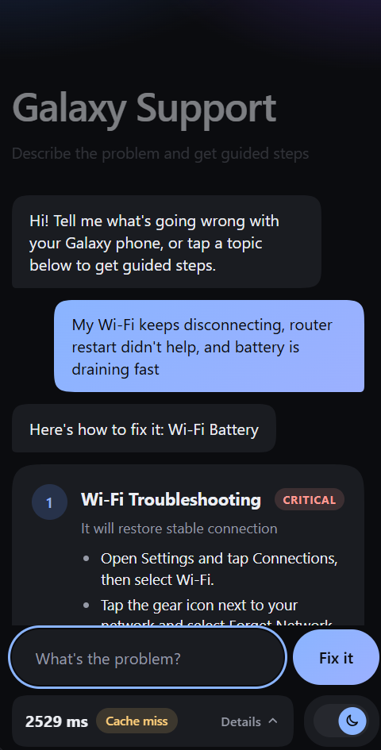
Demo & Product Walkthrough
1
Grouped action cards
One card per detected problem, so a composite complaint (Wi-Fi + battery) yields a Battery card and a Wi-Fi card in one plan.
2
Tri-category actions
Steps are sorted auto → manual → critical with colour-coded badges; critical steps carry a distinct warning.
3
Actionable deeplinks
A single tap opens the exact Settings screen, e.g. “Wi-Fi Settings” → bixby://com.samsung.android.settings.connections.wifi. Manual steps show no button.
4
Live diagnostics
Latency badge flashes green on cache hit and amber on miss; a drawer shows model and request cost.

Slide 6
Tools and tech stack used
Python 3.10+
Core language for the engine
FastAPI + Uvicorn
Async REST API, Swagger docs, ASGI server
Pydantic v2
Strict Appendix A schema validation
Groq API
Llama 3 / gpt-oss-20b via OpenAI-compatible SDK
SentenceTransformers
all-MiniLM-L6-v2, 384-dim embeddings
ChromaDB
Local vector store for deeplink + intent search
Rank-BM25
Lexical retrieval fused with vector search
DiskCache
Persistent multi-tier semantic cache
Frontend: vanilla HTML5 / CSS3 / JS One UI client | Evaluation: httpx benchmark suite (20 scenarios)

Slide 7
Impact & Use case
Vague complaint
“My Wi-Fi keeps disconnecting and battery drains fast”
Grounded plan
Matched to Samsung SIIS scenarios; steps sorted and validated
One-click fix
Deeplink buttons open the exact Settings screen
~15 min → ~4 s
Agent translation replaced by a cold-start plan (P95 4.3 s); repeat queries return in ~1 ms.
Self-service for users
No menu hunting: every actionable step is one tap away.
Consistent and safe
Same contract-valid plan every time; critical actions flagged, preconditions attached, zero URL leaks.

Slide 8
Innovation highlights, results and limitations
Innovation highlights
Results
Limitations
Keyword-overlap context finder: normalized, punctuation-stripped tokens + domain boosts feed dense + BM25 retrieval
Strict JSON derivation rules: goal regex, 2–3 word titles, “It will…” descriptions, 8–10 variations
Multi-tier semantic cache with sub-2 ms fast path
Multi-intent complaints resolved in one plan
Cache hit: 0.8 ms P50, 1.7 ms P95 (target ≤ 300 ms)
Cold start: 4,279 ms P95 (target ≤ 8,000 ms)
20 / 20 scenarios covered
100% Appendix A schema compliance
0 URL leaks; 100% cache and paraphrase hit rate
Knowledge base covers 20 SIIS scenarios
Cold-start latency (~4 s) is LLM-bound
Rule-based fallback is less rich than LLM output
Preconditions are declared, not read from a live device
Cache thresholds (0.70 / 0.74) are tuned on a small set

Slide 9
What’s next
1
Wider knowledge base
Grow beyond 20 SIIS scenarios and expand the Bixby deeplink catalog.
2
Live device state
Evaluate preconditions (wifi_enabled, brightness) against the real device before showing a step.
3
Multilingual complaints
Accept and answer in regional languages, starting with Indian languages.
4
Agent-assist and feedback
Plug into agent tooling and learn from “did it fix it?” signals to rerank steps.

Slide 10
Brownie points slide (differentiation)
Model-agnostic LLM layer
Built on an OpenAI-compatible client: Groq (Llama 3 / gpt-oss-20b) today, and a Gemini or Mistral endpoint only needs a base URL and model name.
Zero-fail fallback
On API timeout or 429, a deterministic local extractor keeps returning contract-valid plans.
Contract-perfect output
Gate G5 URL scrubbing and Blocks A1 / A2 / A5 enforced in code, not left to the LLM.

Slide 11
Checklist- Updated on Public GitHub
Working prototype code — public or shared GitHub repo - Y
README with reproducible setup instructions - Y
Demo video, max 5 minutes (YouTube or Drive link) - Y
Presentation file (PPT or PDF) - Y

Slide 12
Thank you
Organised by the Language AI Team and the PRISM Team, Samsung R&D Institute India

