Slide 1
PRAGADHIS P
Final Project

Slide 2
PROJECT TITLE
BLOOD CELL CLASSIFICATION USING
DEEP LEARNING

Slide 3

AGENDA
Problem Statement
project overview
Data collection and processing
Applications and Impact
Future direction and Conclusion
who are the end users
solution and its value preposition
modelling
result

Slide 4

PROBLEM STATEMENT
This project aims to develop a deep learning model for accurately classifying blood cell images into red blood cells (RBCs), white blood cells (WBCs), and platelets. By gathering and preprocessing a diverse dataset, designing an optimized deep learning architecture, and training the model with appropriate techniques, the goal is to achieve high accuracy in classification. Evaluation metrics such as accuracy, precision, recall, and F1-score will be used to assess the model's performance, with a focus on real-world deployment and usability. Through this endeavor, the project aims to contribute to improved diagnostic capabilities and medical research in identifying blood cell abnormalities efficiently.

Slide 5

PROJECT OVERVIEW
INTRODUCTION:
This project endeavors to employ deep learning methodologies for the classification of blood cell images, aiming to accurately distinguish between various cell types, including red blood cells (RBCs), white blood cells (WBCs), and platelets. Through meticulous data collection, preprocessing, and the implementation of sophisticated deep learning architectures, the goal is to develop a robust model capable of achieving high classification accuracy. By addressing challenges such as morphological variations and staining techniques, this initiative aims to contribute to enhanced diagnostic capabilities and medical research in blood cell analysis.

Slide 6
OBJECTIVE:
The objectives of this project on blood cell classification using deep learning are to gather a diverse dataset encompassing various blood cell types, including red blood cells (RBCs), white blood cells (WBCs), and platelets. Through meticulous preprocessing and the implementation of state-of-the-art deep learning techniques, the aim is to design a robust model capable of accurately classifying blood cell images. The project seeks to optimize model performance by exploring different network architectures and training methodologies while ensuring scalability and generalization. Ultimately, this initiative aims to advance medical diagnostics and research by providing reliable tools for blood cell classification.

Slide 7
DATA COLLECTION AND PROCESSING
Diverse Dataset Significance: A diverse dataset encompassing a wide range of blood cell types, staining techniques, and imaging conditions is paramount. It ensures that the deep learning model learns to generalize across various scenarios, thereby enhancing its ability to accurately classify blood cells in real-world applications.
Representation of Blood Cell Variability: The dataset's diversity allows for the representation of the inherent variability in blood cell morphology, including variations in shape, size, and texture. This representation is crucial for training a robust model capable of handling different cell types and conditions.

Slide 8
Improved Model Generalization: By exposing the model to a diverse range of examples during training, it learns to recognize patterns and features that are common across different types of blood cells. This improves the model's generalization ability, enabling it to perform well on unseen data.
Preprocessing Techniques: Preprocessing techniques such as image normalization, contrast adjustment, and noise reduction are applied to enhance the quality and consistency of the dataset. These techniques help in removing artifacts, standardizing brightness and contrast levels, and improving overall image clarity.
Noise Reduction: The removal of noise from the images is crucial for ensuring that the model focuses on relevant features during training. Various noise reduction methods such as median filtering, Gaussian blurring, and morphological operations may be employed depending on the characteristics of the dataset.

Slide 9
APPLICATIONS AND IMPACT
Blood cell classification using deep learning holds significant implications across various domains of medical diagnostics and research. In clinical settings, it enables rapid and accurate identification of blood cell abnormalities, facilitating early detection and treatment of diseases such as leukemia, anemia, and infections. Moreover, in research laboratories, automated classification enhances workflow efficiency and accelerates the pace of discovery in fields like immunology and hematology. Beyond healthcare, this technology has potential applications in veterinary medicine, agricultural science, and environmental monitoring, where blood cell analysis plays a vital role in disease surveillance and organism health assessment. Ultimately, the integration of deep learning-based classification systems empowers healthcare professionals with advanced diagnostic capabilities, leading to improved patient outcomes and advancements in biomedical science.

Slide 10
FUTURE DIRECTION AND CONCLUSION
Future Direction: The future of blood cell classification using deep learning involves refining models for higher accuracy, integrating multimodal data sources, such as genetic information, and exploring collaborative training methods like federated learning. Incorporating explainable AI techniques will enhance model interpretability, fostering trust in clinical applications. Interdisciplinary collaborations will drive innovation, translating research into impactful healthcare solutions.
Conclusion: Blood cell classification using deep learning holds immense promise in revolutionizing medical diagnostics and research. By leveraging advanced algorithms, we can achieve precise classification, leading to early disease detection and personalized treatments. Integrating these systems into clinical practice will enhance patient care and advance our understanding of blood cell biology, ultimately shaping the future of precision medicine.

Slide 11
WHO ARE THE END USERS?
The end users of blood cell classification using deep learning encompass a broad spectrum of stakeholders across healthcare, research, and related fields. These include:
Healthcare professionals such as hematologists, pathologists, and medical technicians who rely on accurate blood cell analysis for diagnosing and monitoring diseases.
Biomedical researchers and pharmaceutical companies utilizing deep learning models to study blood cell behavior, develop therapies, and conduct drug screening experiments.
Healthcare organizations and diagnostic laboratories implementing deep learning technologies to streamline workflows and enhance diagnostic accuracy.
Veterinary professionals and agricultural researchers leveraging blood cell classification for disease surveillance and animal health monitoring.
Educational institutions and students studying hematology, medical imaging, and machine learning techniques for blood cell analysis.

Slide 12

YOUR SOLUTION AND ITS VALUE PROPOSITION
Accuracy: Deep learning models excel at recognizing complex patterns and features in blood cell images, leading to highly accurate classification results compared to traditional methods.
Efficiency: By automating the classification process, deep learning significantly reduces the time and effort required for manual inspection by healthcare professionals, enabling faster diagnoses and treatments.
Scalability: Deep learning models can handle large volumes of data efficiently, making them scalable for analyzing extensive datasets of blood cell images, thus accommodating the growing demands of healthcare and research.

Slide 13
Adaptability: Deep learning models can adapt to variations in blood cell morphology, staining techniques, and imaging conditions, enhancing their versatility and applicability across diverse scenarios.
Enhanced Insights: By uncovering subtle relationships and features within blood cell images, deep learning facilitates deeper insights into disease mechanisms, aiding in the development of novel diagnostic and therapeutic strategies.
Cost-effectiveness: The automation and efficiency provided by deep learning-based classification can lead to cost savings for healthcare institutions through reduced labor costs and improved resource allocation.
Innovation: Blood cell classification using deep learning fosters innovation by enabling the exploration of novel research avenues, such as integrating multimodal data sources and developing explainable AI techniques for enhanced interpretability.

Slide 14
MODELING
Data Collection: Gather a diverse dataset of blood cell images containing various cell types (RBCs, WBCs, platelets) captured under different imaging conditions and staining techniques.
Data Preprocessing: Preprocess the images to enhance quality and remove noise. Common preprocessing techniques include resizing images to a uniform size, normalizing pixel values, and applying filters for noise reduction.
Model Selection: Choose a deep learning architecture suitable for image classification tasks. Convolutional Neural Networks (CNNs) are commonly used due to their effectiveness in handling spatial relationships in images.

Slide 15
Model Architecture Design: Design the architecture of the CNN model. This may involve stacking convolutional layers followed by pooling layers for feature extraction, followed by fully connected layers for classification.
Training: Split the dataset into training, validation, and test sets. Train the model on the training set using backpropagation and optimization algorithms such as stochastic gradient descent (SGD) or Adam. Monitor the model's performance on the validation set to prevent overfitting.
Evaluation: Evaluate the trained model on the test set to assess its performance in classifying blood cell images. Common evaluation metrics include accuracy, precision, recall, and F1-score.

Slide 16
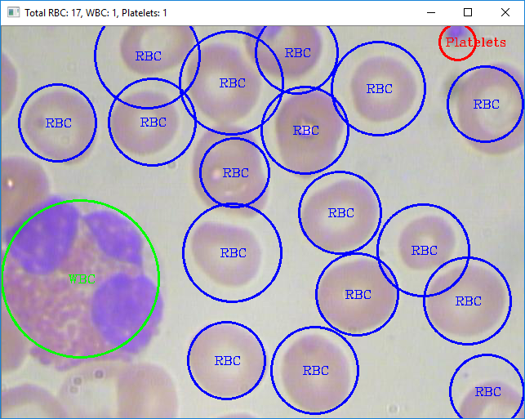
RESULTS
CODE:https://github.com/pragadhis/TNSDC_Generative-AI.git

