Slide 1
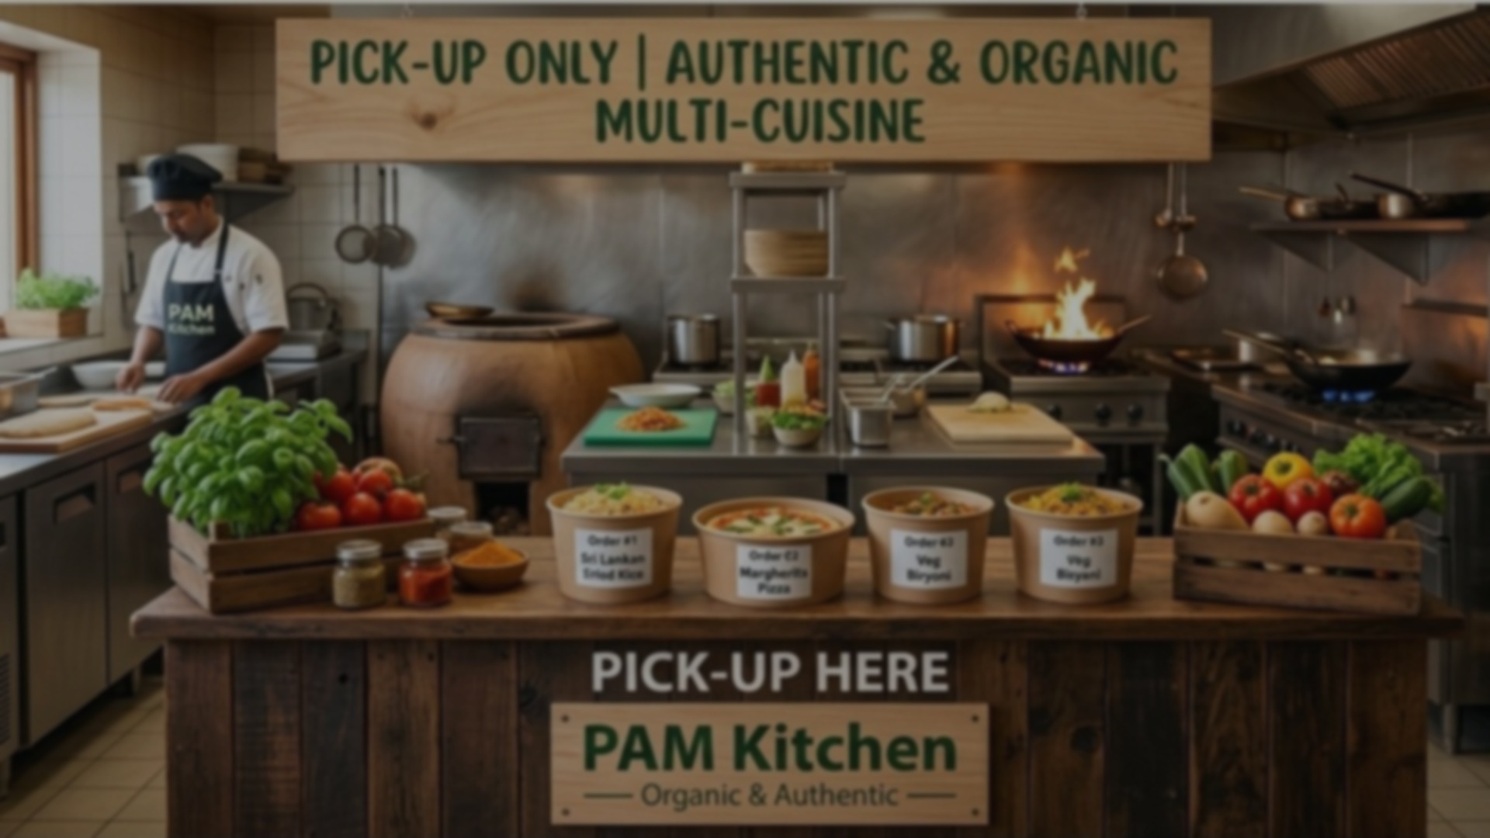
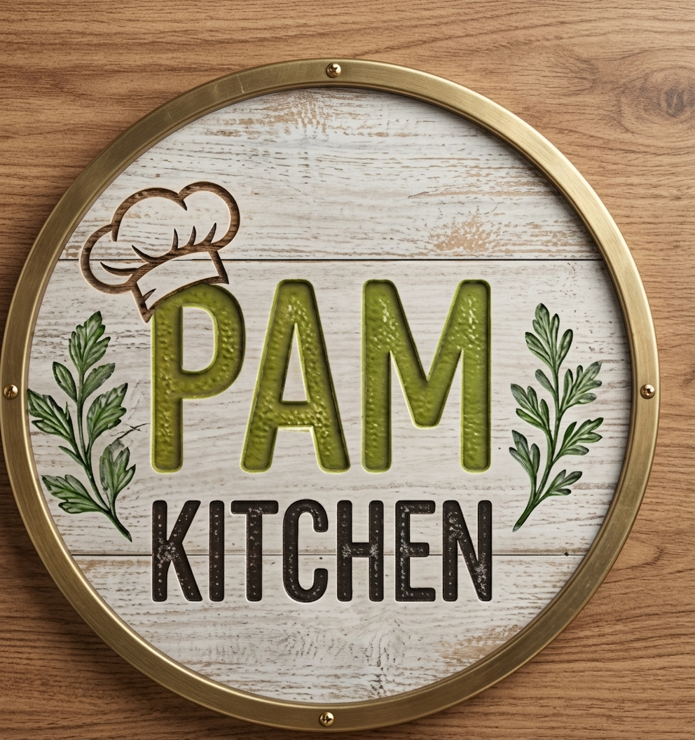
PAM KITCHEN
A Cloud-Native Multi-Cuisine Ordering Platform
Pragash Kumaravel · Ironhack Cloud Engineering Capstone · September 2026

Slide 2

AGENDA
What We'll Cover
1
Architecture
2
Automation
How the platform is built — network, compute, data
CI/CD pipeline, from commit to production
3
Security & Compliance
4
Observability
Real scans, real findings, real fixes
Dashboards, alarms, and a live-fired demo
5
Live Demo
6
Cost & Lessons
Placing a real order, right now
What it cost, and what broke along the way
Notes:
Six sections coming: architecture, automation, security, observability, live demo, cost & lessons

Slide 3

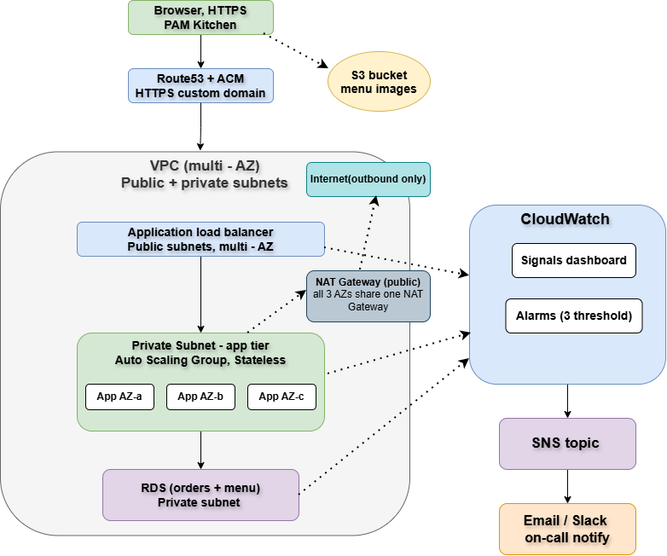
THE BLUEPRINT
Architecture
Overview
HTTPS through Route53 and ACM, into a load balancer spanning three Availability Zones, an Auto Scaling Group of stateless app instances, and RDS for orders and menu data. Menu images are served directly from S3 — never touching the app tier.
pam-kitchen.online
Notes:
HTTPS via Route53/ACM → ALB across 3 AZs → Auto Scaling Group (stateless) → RDS
Instances cycled dozens of times during testing, never lost data — that's the point of stateless
Menu images go straight from S3 to the browser, never touch the app servers

Slide 4
INFRASTRUCTURE
Built for Resilience
3
3–6
100%
0
Availability Zones
EC2 instances, auto-scaled on CPU
Terraform — zero manual console changes
SSH keys — SSM Session Manager only
Network segmented into public, private-app, and private-db subnets — three security groups enforce that each tier can only be reached from the tier directly in front of it, with route tables sending private-subnet traffic through a shared NAT Gateway rather than exposing it directly.
Single NAT Gateway shared across all 3 AZs — a deliberate cost trade-off, documented in COSTS.md.
Notes:
3 AZs, 3-6 auto-scaled instances, 100% Terraform, zero SSH access
Network split into public/private-app/private-db, security groups enforce each tier only reachable from the one in front of it
Single NAT Gateway shared across all AZs — deliberate cost trade-off

Slide 5
CI/CD PIPELINE
Commit to Production
Two parallel paths run on every push: application code deploys automatically, while infrastructure changes are validated first and applied only on a human-triggered gate — nothing reaches production untested.
1
2
3
4
Push
Validate
Deploy (App)
Apply (Infra)
→
→
→
Code lands on main
GitHub Actions: tests, Terraform lint, Terratest
Auto-zipped to a private S3 bucket — instances pull on boot
Human-gated trigger, Terratest pre-apply check
Real Terratest suite: syntax validation + drift detection (asserts “No changes” against live infra)
Notes:
App code deploys automatically on every push, no manual gate
Infra changes require a human-triggered apply, with automated tests first
Terratest checks syntax + drift — intentionally plan-only, not a full destroy/rebuild test

Slide 6
SECURITY
Tested, Not Assumed
648
32
3/4
0
Prowler checks
Trivy findings
Config compliant
Hardcoded secrets
Trivy: 32 findings across the Terraform code; 3 real fixes applied — IMDSv2 enforcement, ALB invalid-header dropping, and documented security group rules. The rest are deliberate, documented trade-offs (e.g. a public ALB is intentional for a public site).
AWS Config: 3 of 4 rules pass — RDS encryption, RDS not publicly accessible, no open SSH. The 4th flags the S3 images bucket, which is a deliberate, scoped exception: public read on the images/ prefix only, needed to serve menu photos.
Kitchen staff access: /kitchen and its management endpoints were open to anyone with the URL for a stretch of development. Now protected with HTTP Basic Auth, credentials auto-generated and stored in Secrets Manager — never hardcoded.
Notes:
648 Prowler checks, 32 Trivy findings — 3 real fixes applied (IMDSv2, ALB header hardening, SG documentation)
3 of 4 AWS Config rules compliant; the 4th is a deliberate, scoped exception (public read only on menu images)
Kitchen staff endpoints were open to anyone at one point — now behind HTTP Basic Auth, credentials in Secrets Manager

Slide 7
OBSERVABILITY
If It Breaks, We'll Know
Real Error
CloudWatch
Metric
Alarm
(2 periods)
SNS Topic
Email
Notification
→
→
→
→
This is a real, tested pipeline — not a mock. In rehearsal, a deliberately ramped error burst (4 → 6 → 8 → 10 → 12 errors) climbed visibly on the dashboard, tripped the alarm mid-ramp, and a real notification arrived within minutes.
1 dashboard, 7 widgets, 1 screen
Golden signals: Traffic · Errors · Latency (avg + p95) · Saturation
Plus: RDS CPU, real-time alarm status, business signals (orders, revenue)
Notes:
Real error → CloudWatch metric → alarm (2 consecutive breaches) → SNS → email
Will trigger this live in a few minutes

Slide 8



LIVE DEMO
Let's Place an Order
Real infrastructure. Real traffic. Real alarms.
Live site
https://pam-kitchen.online
Kitchen view
https://pam-kitchen.online/kitchen
GitHub repo
https://github.com/pragashkumar14/ce-capstone-cloud-kitchen

Slide 9
COST OPTIMIZATION
Lean by Design
Service | Est. Monthly (if run 24/7)
EC2 (3× t3.micro) | ~$29
NAT Gateway | ~$32
Load Balancer | ~$18
RDS | ~$15
S3, Route53, Secrets, Config, CloudWatch, SNS | ~$3.30
Total | ~$98
$1.18
actual amount paid to date — domain registration only
AWS infrastructure has no invoice yet — it's running now and accruing. Prorated for the actual ~1 week of use, that estimate lands around $23.
Single NAT Gateway instead of one per AZ
Single-AZ RDS — no idle standby replica
t3.micro throughout — sized for demo load
Auto-renew disabled on the domain
1-day backup retention
Notes:
Only real charge so far: $1.18 (domain) — AWS infra still running, not yet invoiced
Biggest monthly line item: NAT Gateway (~$32)
5 optimization choices made deliberately, not by accident

Slide 10
RETROSPECTIVE
What Happened — and What's Next
A wrong AWS account, silently.
A leftover environment variable pointed every command at Miguel's account. Fixed by verifying identity before every apply.
GitHub rate-limited us mid-build.
Repeated testing from one shared NAT IP tripped GitHub's abuse detection. Solved by moving deployment to S3 entirely.
A security fix silently broke alerting.
Encrypting the SNS topic blocked CloudWatch from publishing to it — found via the alarm's own action history.
What Could Be Improved
Multi-AZ RDS with automated failover · customer-managed KMS key for SNS with a correctly scoped policy · Secrets Manager rotation · a WAF layer in front of the ALB · role-based access for kitchen staff instead of one shared credential.
Notes:
3 real incidents: wrong AWS account, GitHub rate-limiting, a security fix that silently broke alerting
What's next: Multi-AZ RDS, proper KMS key policy, secret rotation, WAF, per-user staff access

Slide 11
Thank You
PAM Kitchen — Pragash, Adharvaa, Meera.
Live site:
https://pam-kitchen.online
GitHub repository:
https://github.com/pragashkumar14/ce-capstone-cloud-kitchen
Questions?

