Slide 1
PROJECT 2
Instrumented & Monitored
Cloud Service
Order API — Logs, Metrics, Alerts, and a real Incident, End to End
Pragash Kumaravel
Ironhack Cloud Engineering Bootcamp

Slide 2
AGENDA
How this project came together
01
Live Demo Kickoff
Injecting synthetic traffic, errors, and CPU load — right now
02
Architecture & Planning
How the whole system fits together
03
Structured Logging
Order API on EC2 — Winston, JSON, correlation IDs
04
Custom Metrics
5 metrics published directly to CloudWatch
05
Monitoring
The Golden Signals dashboard
06
Alerting & Auto-Remediation
Tiered alarms, and a Lambda that enriches alerts
07
Incident Response
A real CPU-saturation incident, injected and diagnosed
Traffic: Fake orders sent to the API
Errors: Requests forced to fail on purpose
CPU Load: A stress test on the server itself
Project 2 — Instrumented & Monitored Cloud Service
2

Slide 3
LIVE DEMO
Switching to the terminal
Injecting synthetic traffic, validation failures, real errors, and a CPU stress test — all at once, so every widget, both alarms, and the Lambda have real data by the time we get to results.
./run-demo.sh
Traffic
CPU Stress
Errors
~12 min, ~1300+ orders + validation failures
Both vCPUs pinned for - 6 minutes
6 fired — crosses warning + critical
Runs in the background

Slide 4
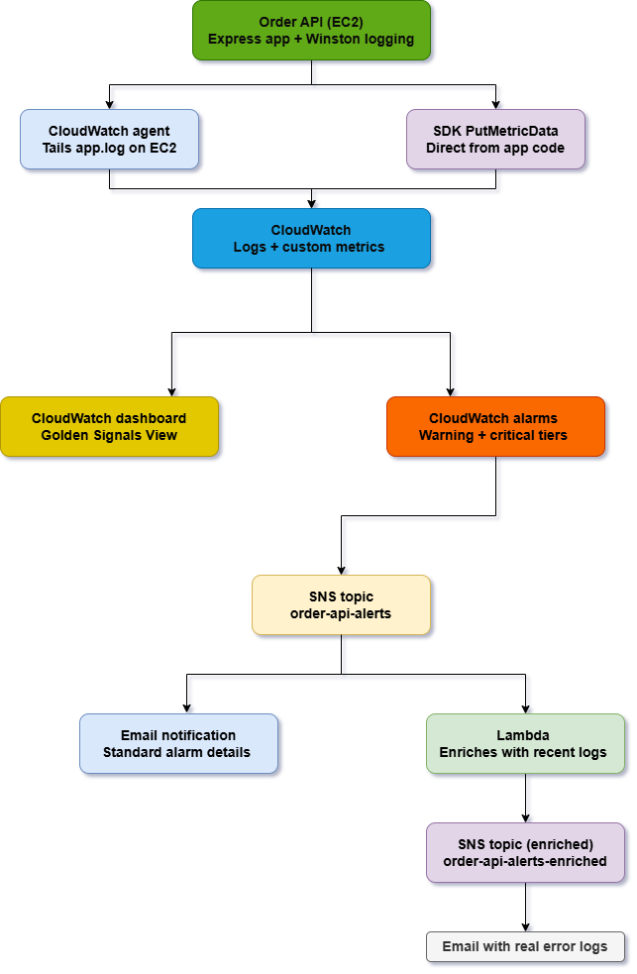
ARCHITECTURE & PLANNING
From app to enriched alert
Order API produces logs + metrics independently
CloudWatch Agent ships structured logs
SDK publishes 5 custom metrics directly
Dashboard + tiered alarms watch both
Alarms → SNS → email, and a Lambda
that enriches the alert with real logs
Project 2 — Instrumented & Monitored Cloud Service
4

Slide 5
STRUCTURED LOGGING
Order API on EC2 — Express, Winston, correlation IDs
WHERE IT RUNS
LOG LEVELS, USED DELIBERATELY
EC2 instance
Winston · JSON format · correlation ID on every line info normal flow — order_created, health_check warn recoverable — missing fields, order not found error genuine failures — the /error endpoint {"level":"info","message":"order_created",
"correlation_id":"1fa0...","order_id":"ord-404c"}
t3.micro, Ubuntu, eu-west-3
Express API
Order creation, retrieval, health check
systemd service
Auto-starts on boot, auto-restarts on failure
CloudWatch Agent
Tails application.log, ships to CloudWatch Logs
Project 2 — Instrumented & Monitored Cloud Service
5

Slide 6
CUSTOM METRICS
5 metrics published directly to CloudWatch — namespace: OrderAPI
OrdersCreated
Sum
Business
OrderValue
Average
Business
OrdersFailedValidation
Sum
Business
ApiLatencyMs
p95
Technical
ErrorRate
Sum
Technical
ApiLatencyMs is captured automatically via middleware on every request — new endpoints get latency tracking with zero extra code.
Project 2 — Instrumented & Monitored Cloud Service
6

Slide 7
MONITORING
Dashboard 9 widgets — Golden Signals, live
Traffic & Errors
Request Rate + Error Rate, side by side — read errors relative to volume
Latency & Saturation
p95 latency (not average), plus CPU and Memory below
Business Signal
Order Value + Total Orders — is the business still functioning?
Live Diagnostics
CPU gauge + real error log lines, right on the dashboard
Project 2 — Instrumented & Monitored Cloud Service
7

Slide 8
ALERTING & AUTO-REMEDIATION
3 tiered alarms, a composite, and a Lambda that enriches alerts
Warning
Critical
Critical
Composite
ErrorRate > 2 / 5min
ErrorRate > 5 / 5min
p95 latency > 1000ms
Either critical fires
GOING FURTHER — AUTOMATED DIAGNOSIS, NOT AUTOMATED FIXING
A Lambda subscribes to the same alarm topic, queries the last 5 error log lines via Logs Insights, and publishes a richer email — not a blind auto-restart
Blind restart risks masking recurring issues and causing needless downtime for problems that aren't crash-worthy
Publishes to a separate SNS topic, to avoid the Lambda re-triggering itself in a feedback loop
Proven live: a real error burst produced an enriched email with 4 correlation IDs pulled straight from Logs Insights
Project 2 — Instrumented & Monitored Cloud Service
8

Slide 9
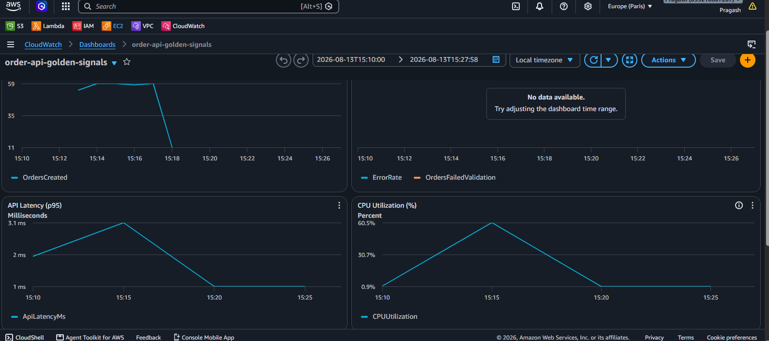
INCIDENT RESPONSE
Injected CPU saturation
FINDINGS
Graceful degradation
Zero errors, zero failed health checks — the app slowed but never broke.
No alarm fired
Deliberate finding — no CPU-specific alarm exists yet, only its downstream effect on latency is watched.
Proposed fix
Add a dedicated CPU alarm (warning >70%, critical >85%).
60.5%
3.1ms
0
Peak CPU
Peak p95 latency
Errors
Project 2 — Instrumented & Monitored Cloud Service
9

Slide 10
IMPACT & RESULTS
What that first script triggered
DASHBOARD
console.aws.amazon.com/cloudwatch → order-api-golden-signals
Request Rate + Order Value
~12 minutes of real, continuous traffic
Error Rate
6 errors fired — crossed both warning and critical thresholds
CPU + Latency
CPU spiked, p95 latency
Inbox
standard alarm emails + Lambda-enriched email with live correlation IDs
Project 2 — Instrumented & Monitored Cloud Service
10

Slide 11
LEARNINGS & IMPROVEMENTS
What this project taught me
What I'd keep
What I'd improve
Two independent telemetry paths (SDK + log-derived)
Add a dedicated CPU alarm
p95 over average for latency, always
Route composite vs individual alarms to different people in a real team
Diagnosis-first auto-remediation over blind restarts
Explore distributed tracing (X-Ray) as a next step
Project 2 — Instrumented & Monitored Cloud Service
11

Slide 12
Thank you
Questions & Discussion
github.com/pragashkumar14/ce-project-2-instrumented-monitored-service

