Slide 1
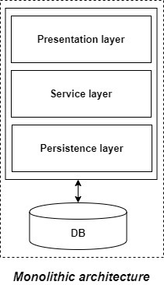
Monolithic Application
Monolithic Services - A large number of critical enterprise applications hosted as a single web application is called as monolithic service.
Disadvantages of Monolithic applications:
It becomes too large in size with time and hence, difficult to manage.
We need to redeploy the whole application even for a small change.
As the size of the application increases, its start-up and deployment time also increases.
For any new developer joining the project, it is very difficult to understand the logic of large Monolithic application even if his responsibility is related to a single functionality.
Even if a single part of the application is facing a large load/traffic, we need to deploy the instances of the whole application in multiple servers. It is very inefficient and takes up more resources unnecessarily. Hence, horizontal scaling is not feasible in monolithic applications.
It is very difficult to adopt any new technology which is well suited for a particular functionality as it affects the whole application, both in terms of time and cost.
It is not very reliable as a single bug in any module can bring down the whole monolithic application.
Advantages of monolithic applications:
Simple to develop relative to microservices where skilled developers are required in order to identify and develop the services.
Easier to deploy as only a single jar/war file is deployed.
Relatively easier and simple to develop in comparison to microservices architecture.
The problems of network latency and security are relatively less in comparison to microservices architecture.

Slide 2
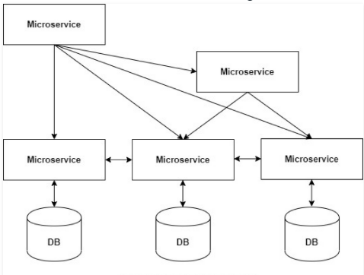
Microservice Application
Microservices - an application is built as independent components that run each application process as a service.
Characteristics of Microservices
Autonomous – Each services can be developed, deployed, operated, and scaled without affecting the functioning of other services
Specialized - Each service is designed for a set of capabilities and focuses on solving a specific problem
Advantages of microservices:
It is easy to manage as it is relatively smaller in size.
If there’s any update in one of the microservices, then we need to redeploy only that microservice.
Microservices are self-contained and hence, deployed independently. Their start-up and deployment time are relatively less.
It is very easy for a new developer to on-board the project as he needs to understand only a particular microservice providing the functionality he will be working on and not the whole system.
If a particular microservice is facing a large load because of the users using that functionality in excess then we need to scale out that microservice only. Hence, microservices architecture supports horizontal scaling.
Each microservice can use different technology based on the business requirements.
If a particular microservice goes down due to some bug, then it doesn’t affect other microservices and the whole system remains intact, continues providing other functionalities to the users.
Disadvantages of microservices:
Being a distributed system, it is much more complex than the monolothic applications. Its complexity increases with the increase in number of microservices.
Microservices are costly in terms of network usage as they need to interact with each other and all these remote calls results into network latency.
Microservices are less secure relative to monolithic applications due to the inter-services communication over the network.

Slide 3
Benefits of Microservices
Flexible Scaling
Microservices allow each service to be independently scaled to meet demand for the application feature it supports. This enables teams to right-size infrastructure needs, accurately measure the cost of a feature, and maintain availability if a service experiences a spike in demand.
Easy Deployment
Microservices enable continuous integration and continuous delivery, making it easy to try out new ideas and to roll back if something doesn’t work. The low cost of failure enables experimentation, makes it easier to update code, and accelerates time-to-market for new features.
Technological Freedom
Microservices architectures don’t follow a “one size fits all” approach. Teams have the freedom to choose the best tool to solve their specific problems. As a consequence, teams building microservices can choose the best tool for each job.
Reusable Code
Dividing software into small, well-defined modules enables teams to use functions for multiple purposes. A service written for a certain function can be used as a building block for another feature. This allows an application to bootstrap off itself, as developers can create new capabilities without writing code from scratch.
Resilience
Service independence increases an application’s resistance to failure. In a monolithic architecture, if a single component fails, it can cause the entire application to fail. With microservices, applications handle total service failure by degrading functionality and not crashing the entire application.

Slide 4
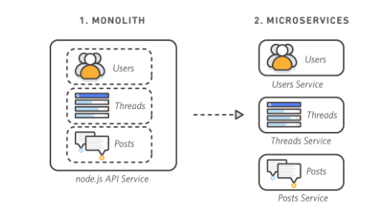
Monolithic vs. Microservices Architecture

Slide 5
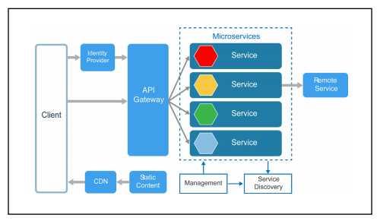
Microservice-architecture

Slide 6
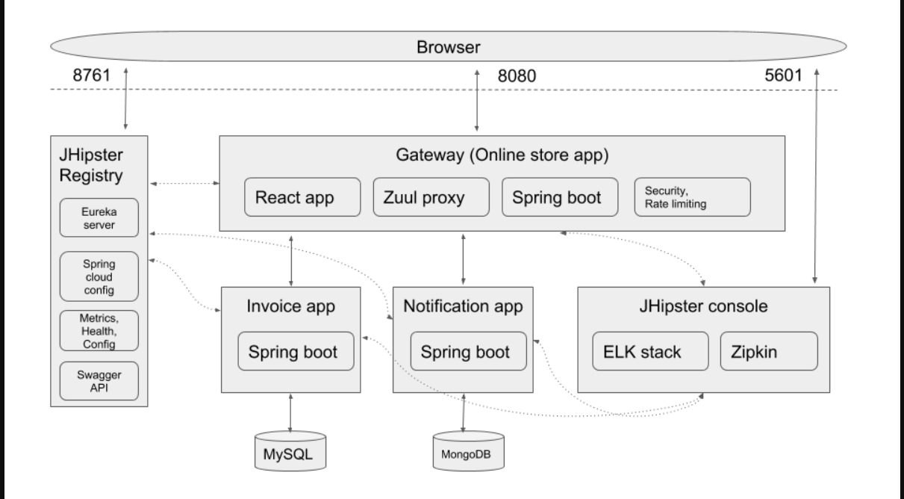
Tools used in Each layer of microservice architecture

Slide 7
API Gateway
The API Gateway is a server. It is a single entry point into a system. API Gateway encapsulates the internal system architecture.
All the requests made by the client go through the API Gateway. After that, the API Gateway routes requests to the appropriate microservice.
An API Gateway includes:
Security
Caching
API health monitoring
Routing
Advantages of API Gateway
The most important advantage of API Gateway is that it encapsulates the internal structure of the application.
Rather than invoking the specific service, the client directly talks to the API Gateway.
It reduces the number of round trips between client and application.
It simplifies the client code.
It reduces coding efforts, makes the application more efficient, decreases errors all at the same time.
It provides each kind of client with a specific API.

Slide 8
Microservices Service Registry
A service registry is a database used to keep track of the available instances of each microservice in an application. The service registry needs to be updated each time a new service comes online and whenever a service is taken offline or becomes unavailable. This can be achieved with either self-registration or third-party registration.
Eureka Server
The Eureka server is nothing but a service discovery pattern implementation, where every microservice is registered and a client microservice looks up the Eureka server to get a dependent microservice to get the job done.
The Eureka Server is a Netflix OSS product, and Spring Cloud offers a declarative way to register and invoke services by Java annotation.
Why Is the Eureka Server?
If the IP address of a server/container is fixed, then you can directly call the rest service with the static URL, but what happens when your IP addresses and hostname are unpredictable?
we can not predict the IP addresses of the container/server beforehand, so putting dependent services IP addresses in the config file is not a solution. We need a more sophisticated technique to identify the service, and Eureka server steps in here.

Slide 9
Eureka Server/Client Communication
Every microservice registers itself in the Eureka server when bootstrapped, it registers into the Eureka server, or it can use the hostname or any public IP (if those are fixed). After registering, every 30 seconds, it pings the Eureka server to notify it that the service itself is available. If the Eureka server not getting any pings from a service for a quite long time, this service is unregistered from the Eureka server automatically and the Eureka server notifies the new state of the registry to all other services.
The Eureka server works in two modes:
Standalone: in local, we configure a stand-alone mode where we have only one Eureka server (localhost) and the same cloning property from itself.
Clustered: we have multiple Eureka servers, each cloning its states from its peer.

Slide 10
Standalone Setup of Eureka Server :
Step 1: Create a project template from https://start.spring.io/.
Step 2: Add @EnableEurekaServer on top of the class
Step 3: Add below properties in application.properties file
spring.application.name=<Name Of Application>
server.port=9091
eureka.client.register-with-eureka=false
eureka.client.fetch-registry=false

Slide 11
Standalone Setup of Eureka Client :
Step 1: Create a project template from https://start.spring.io/.
Step 2: Add @EnableEurekaServer on top of the class
Step 3: Add below properties in application.properties file
spring.application.name=<Name Of Application>
server.port=8081
eureka.client.service-url.defaultZone=http://localhost:<eureka_server:Port>/eureka/

Slide 12
consume RESTful Web Services(Make a call from one service to another service)
Rest Template is used to create applications that consume RESTful Web Services. You can use the exchange() /getForEntity() method to consume the web services for all HTTP methods.
Step 1 : Create a object for RestTemplate
Step 2 : call getForEntity method on restTemplate by passing URI of the request and return type

Slide 13
Consume Restful services using feign client
Step 1 :

