Slide 1
WEEK 7
updates

Slide 2
UpDATES FROM THE IMAGE PROCESSING SIDE
Created python files for the currently existing MATLAB version for creating superpixels
Incurred a problem regarding the results not being the same
Rectified the issue
The current MATLAB vs Python comparison output is around 95% similar
Created the feature files using the python version of the Superpixels
Using these feature files tried to create the end product, accuracy is predicted as 27%
But 30 seconds per image has been brought down 0.989 seconds

Slide 3


So what next?
Why the accuracy level is at 27%
Only 250 odd super pixel
We are basing it W.R.T to a roughly marked region
So will be working on the exact image retrieval
Will be working on the cause of this 27% accuracy
As well as the super pixel accuracy
- if this can be increase, can forgoing the time per image
as now its in python.
Will be extracting exactly 9000 images from the database and creating the features and feature files than the initial suggestion of
Converting the entire database.

Slide 4
UpDATES ON THE mqtt SIDE
BACKGROUND
The device was said to be
- connecting to the server
- works for a continuous of 14-15 days and then stops working / state of non responsive
- The current MQTT header used has an issue with ATMEL 328p , this is an issue created by another person in the original github upload
So the initial assumption:-
the hardware works perfectly and the issue is caused by the local variables

Slide 5
A little bit deeper into this local variable problem
The global variables will be saved in a fixed place and with fixed bits allocated for them
Which lets an amount of space left for the local variables to use
If the Micro controller runs out of memory
Variables get corrupted
Stack gets corrupted
Program gets corrupted

Slide 6
Possible avenues predetermined
Change the micro controller
Restart the device if the device isn’t responsive for a certain amount of time
Optimize the code
- saving some strings in the flash
Eg – serial prints

Slide 7
After the initial diagnostic?
The device isn’t connecting to the MQTT server
Initially there was an issue with the SIM
We attached two header points to extracts serial prints to visualize more clearly
Eventually it was found that there is an issue in the device’s GSM port as it was always searching for the signal
In the other device the GSM fetches the signal but TCP flagging isn’t working
also the warning of the storage error is only shown when we reach a memory above 75%
We cannot check the AT commands by connecting the RX over the GSM module
as the device restarts cause of over voltage

Slide 8
Whats next ?
Already started work on the algorithm flow of the initial library.
Will be working on it , as the library itself is pretty huge ,this might take a bit of time
Will be changing the GSM module and checking,
Since the initial assumption, that the hardware part of the device is working perfectly seems to be a bit shaky, will be working on individual component analysis , of the currently existing and working 1 device

Slide 9
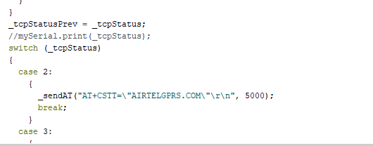
Back tracking is needed in the library as there is a small confusion in the AT commands as well, as I am not familiar with them that’s the next place I will be working on
Also my guess is the modem isn’t going pass the status number 3

