Slide 1
Week 8
Image processing and MQTT

Slide 2
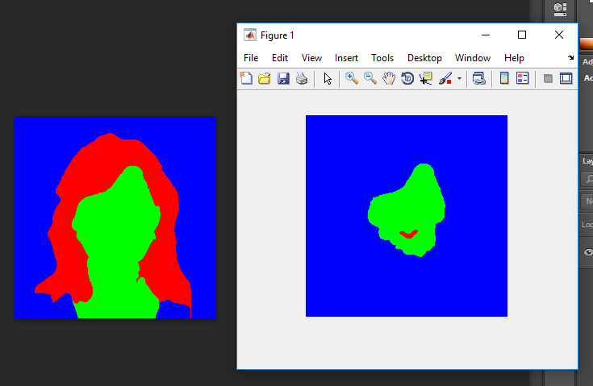
Image processing
The problem in the super pixels identifies (Guess so…)
The realignment of super pixels after the initial classification
This is not there in the current super pixel creation

Slide 3
Things that can be done with the current findings
The face detection works a bit okay.
Which means we can do face detections in low resolutions cameras
Or face detection in a distance.

Slide 4
The next step…
Will be implementing this realignment, and will be comparing the time taken.
Will be comparing the feature files
Will be looking into the feasibility of creating the data base

Slide 5
MQTT update
The initial problem of not connecting was diagnosed
It is now connecting to the server
Over all memory of the program 71%
Tested for 14 hours, no stack corruption occurred
Reasons:-
- the device was just publishing a simple string data
- we havn’t used all the local

Slide 6
GSM – a bit deeper
We were able to get the signal strength and the location of the nearest tower
Will start work on, calculation of the device radius using the signal strength and the location of the device
Some commands can be written in the GSM module itself,which will be a solution for out stack over flow issue, but there is problem with regarding to power.

Slide 7
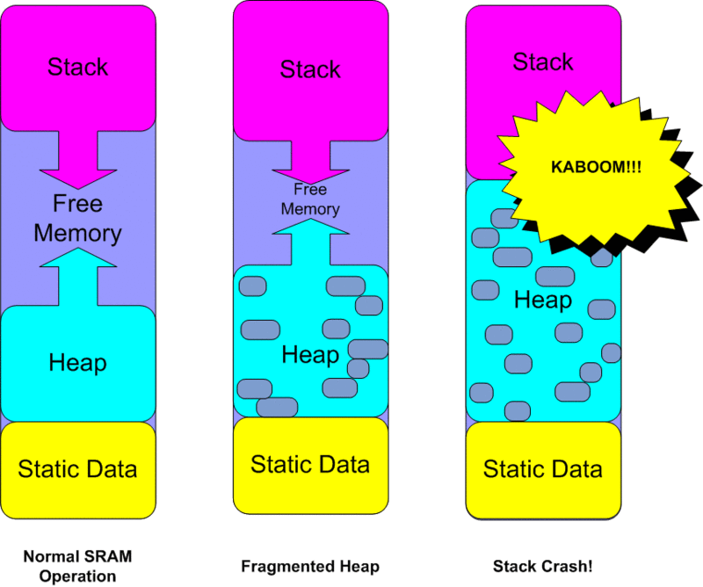

Slide 8
Ways to move forward
The calculation of the total number of bytes needed for all the local variables
From here we can say how much more memory we need
With this we can for see what atmel chip would suit out reason better

