Slide 1
EMPLOYEE MANAGEMENT SYSTEM
PRESENTED BY :-
PRAGATHEESWARAN A

Slide 2
What is Employee Management System?
Employee Management System is a distributed application .developed to maintain the details of employees working in any organization.
It maintains the information about the personal and official details of the employees.

Slide 3
OBJECTIVE OF MY PROJECT
This project aims to simplify the task of maintaining records of the employees of Company.
Application that enables users to create and store Employee Records.
The objective of this project is to provide a comprehensive approach towards the management of employee information.

Slide 4
Existing System | Proposed System
Records are maintained in registers | Maintain in computerized employee details
Time Consuming process | Time Consuming less
Complicated to search | Easy to create,update,delete,retrive employee information.

Slide 5
Software Used
Spring Boot(BackEnd):
Spring Boot to develop REST web services and microservices.
Spring Boot has taken Spring framework to the next level.it has drastically reduced the configuration and setup time required for spring projects.
Angular(FrontEnd):
Angular is a platform and framework for building single-page client applications using HTML and TypeScript.
Angular is written in TypeScript.

Slide 6
Spring Boot
Server-side
SpringData JPA(Hibernate)
Maven
JDK 1.8
Embedded Tomcat

Slide 7
Angular
Front-End
Side
NodeJS and NPM
VS Code IDE

Slide 8
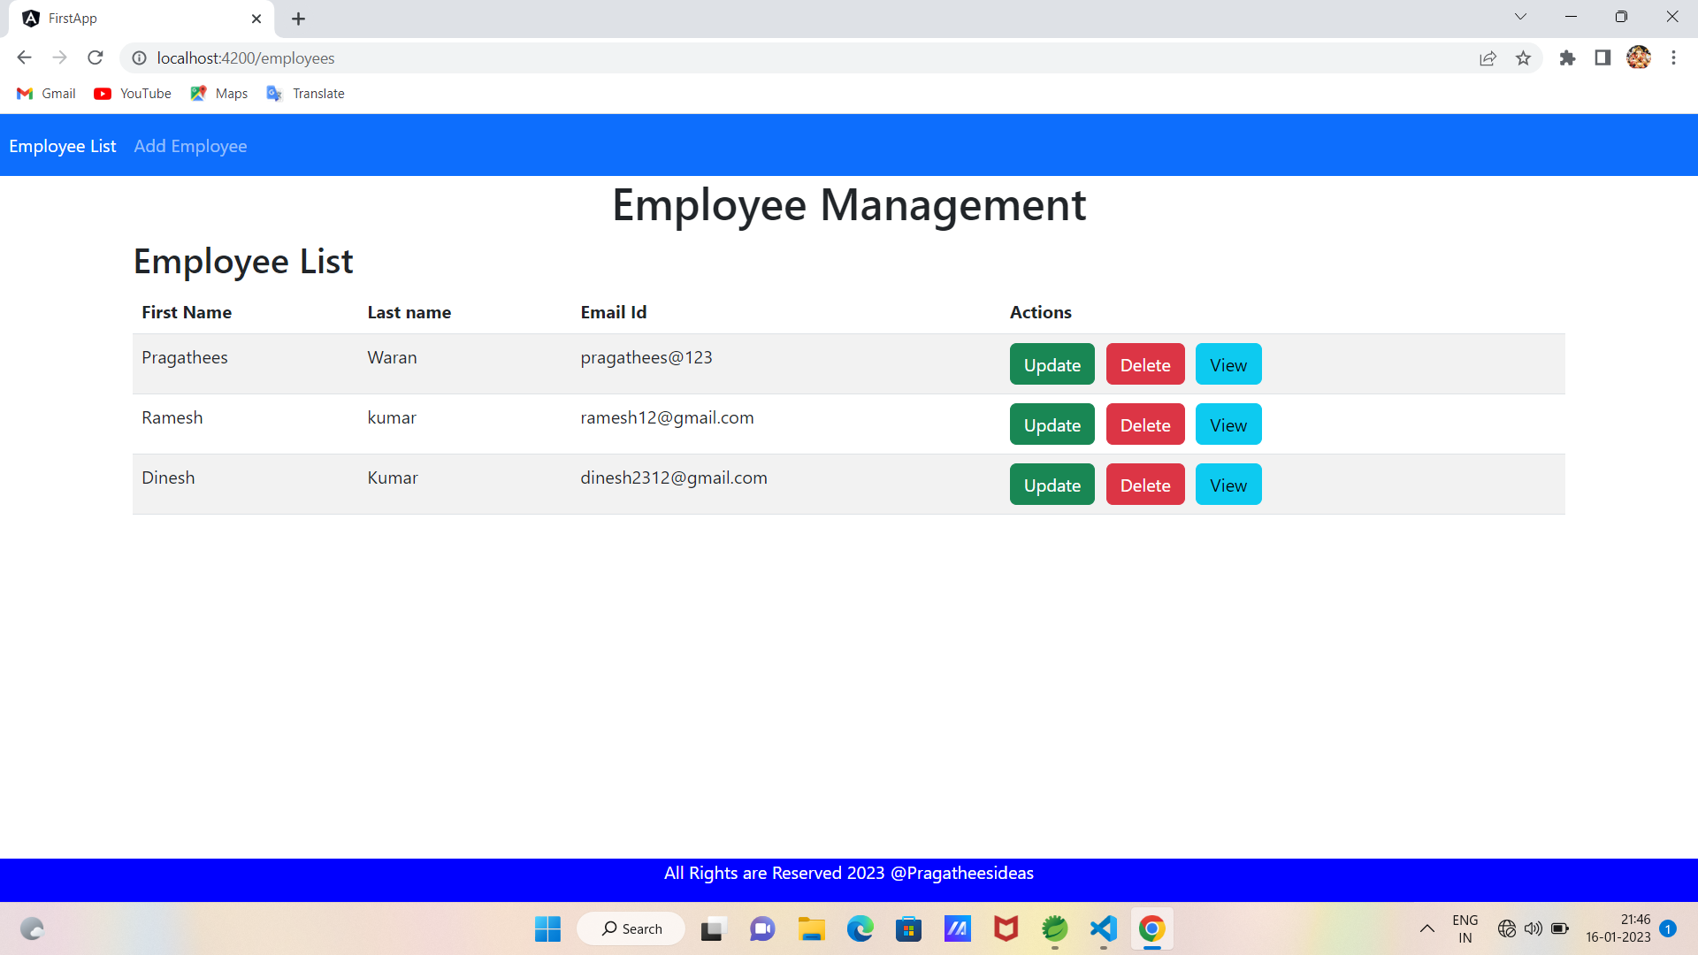

Slide 9
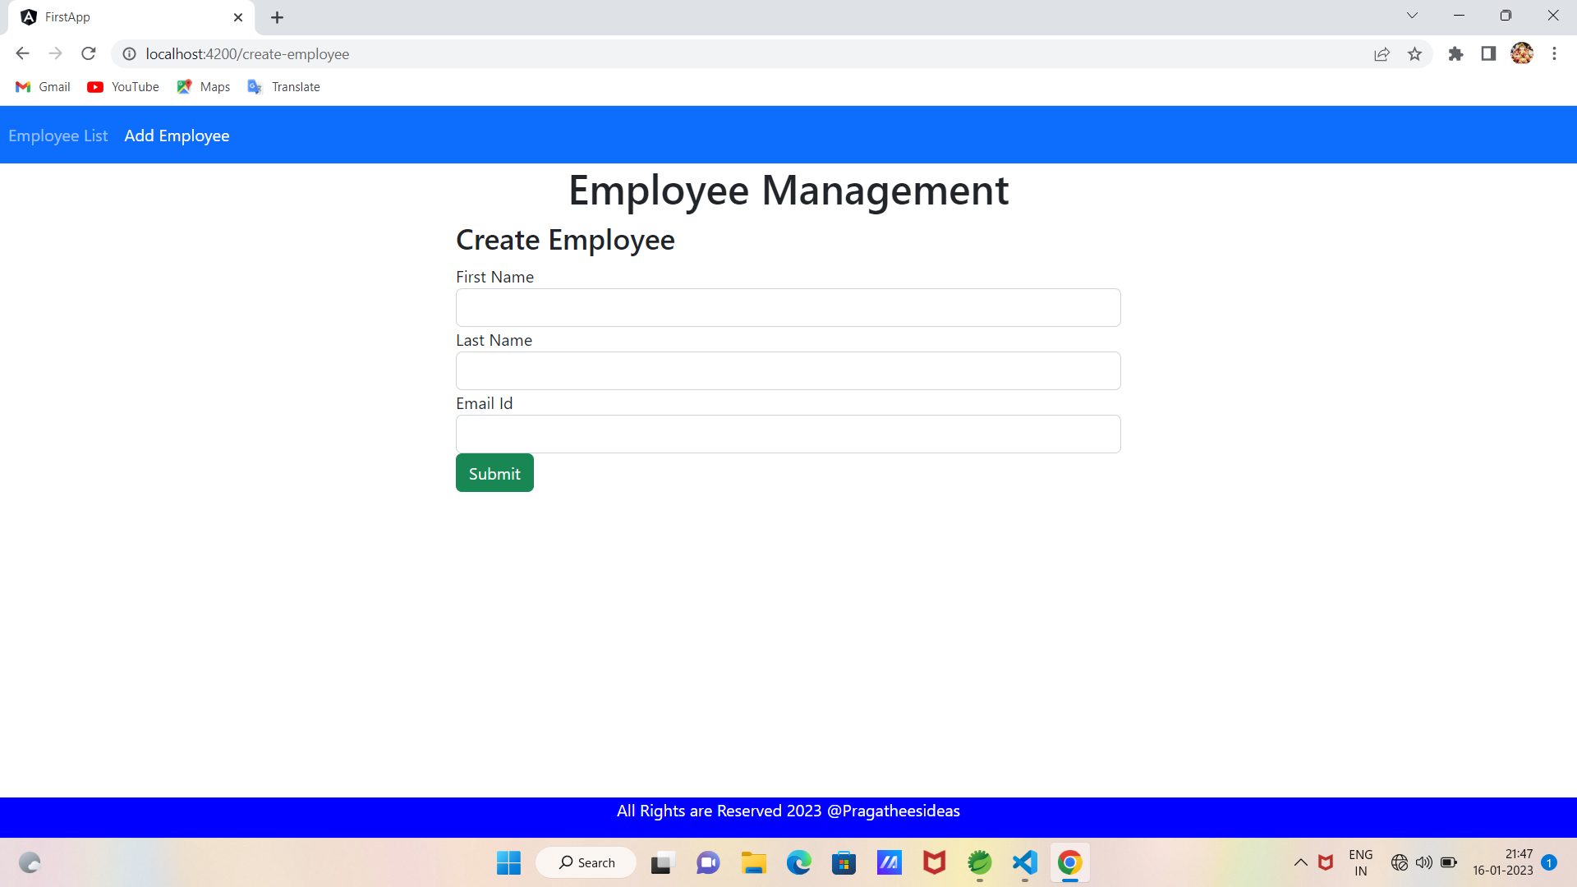
CREATE EMPLOYEE

Slide 10
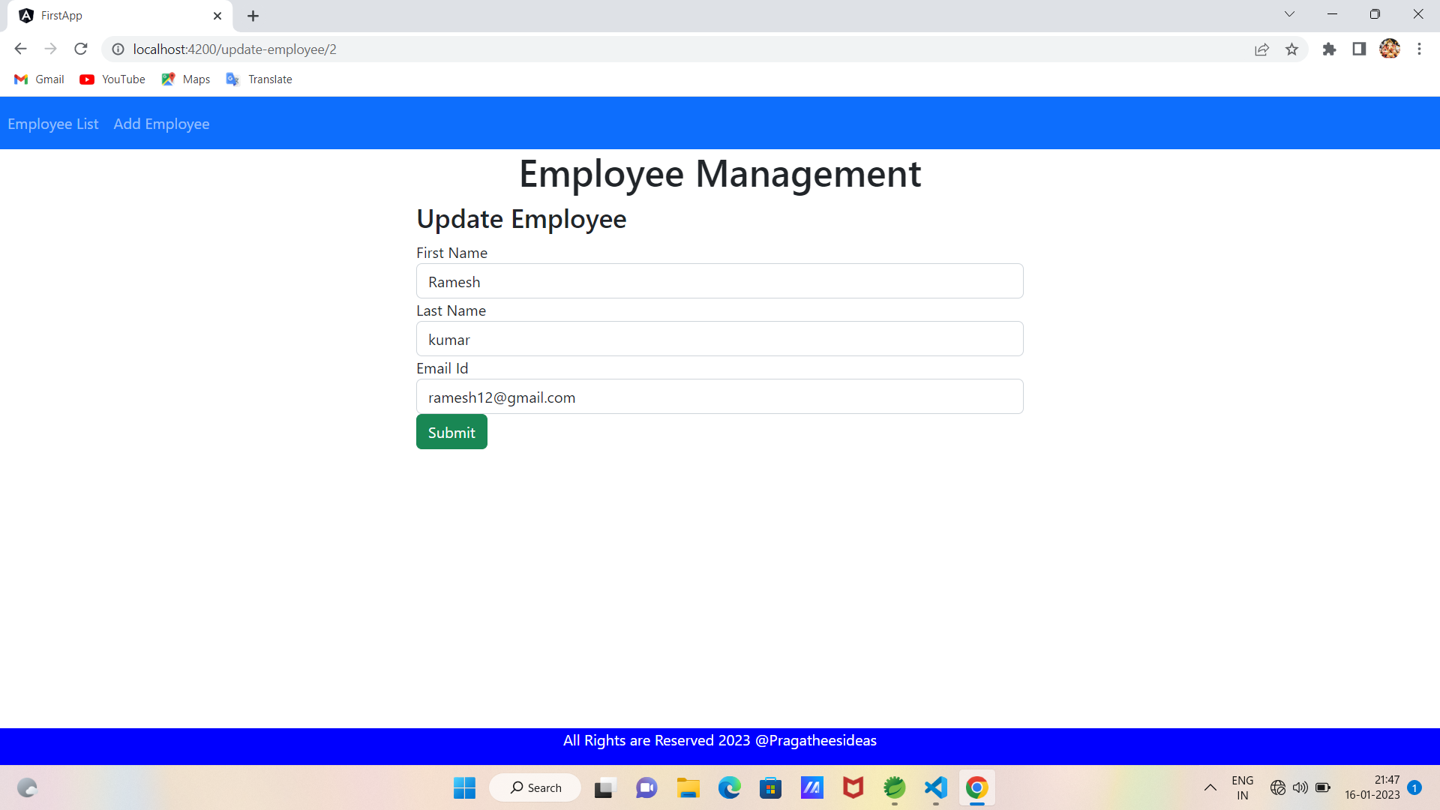
UPDATE EMPLOYEE

Slide 11
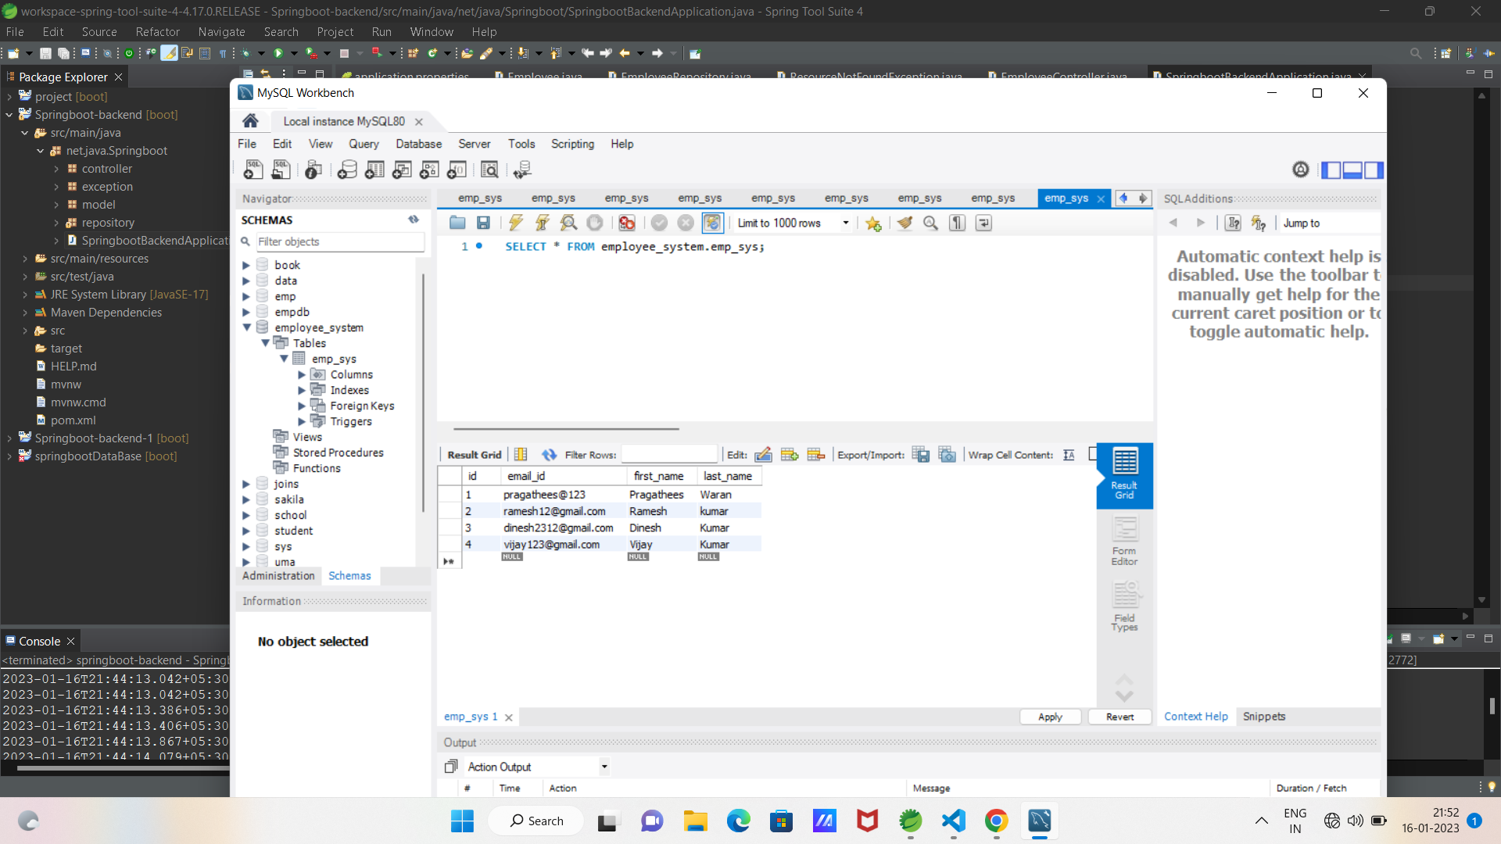
DATABASE STORES EMPLOYEE DETAILS

Slide 12
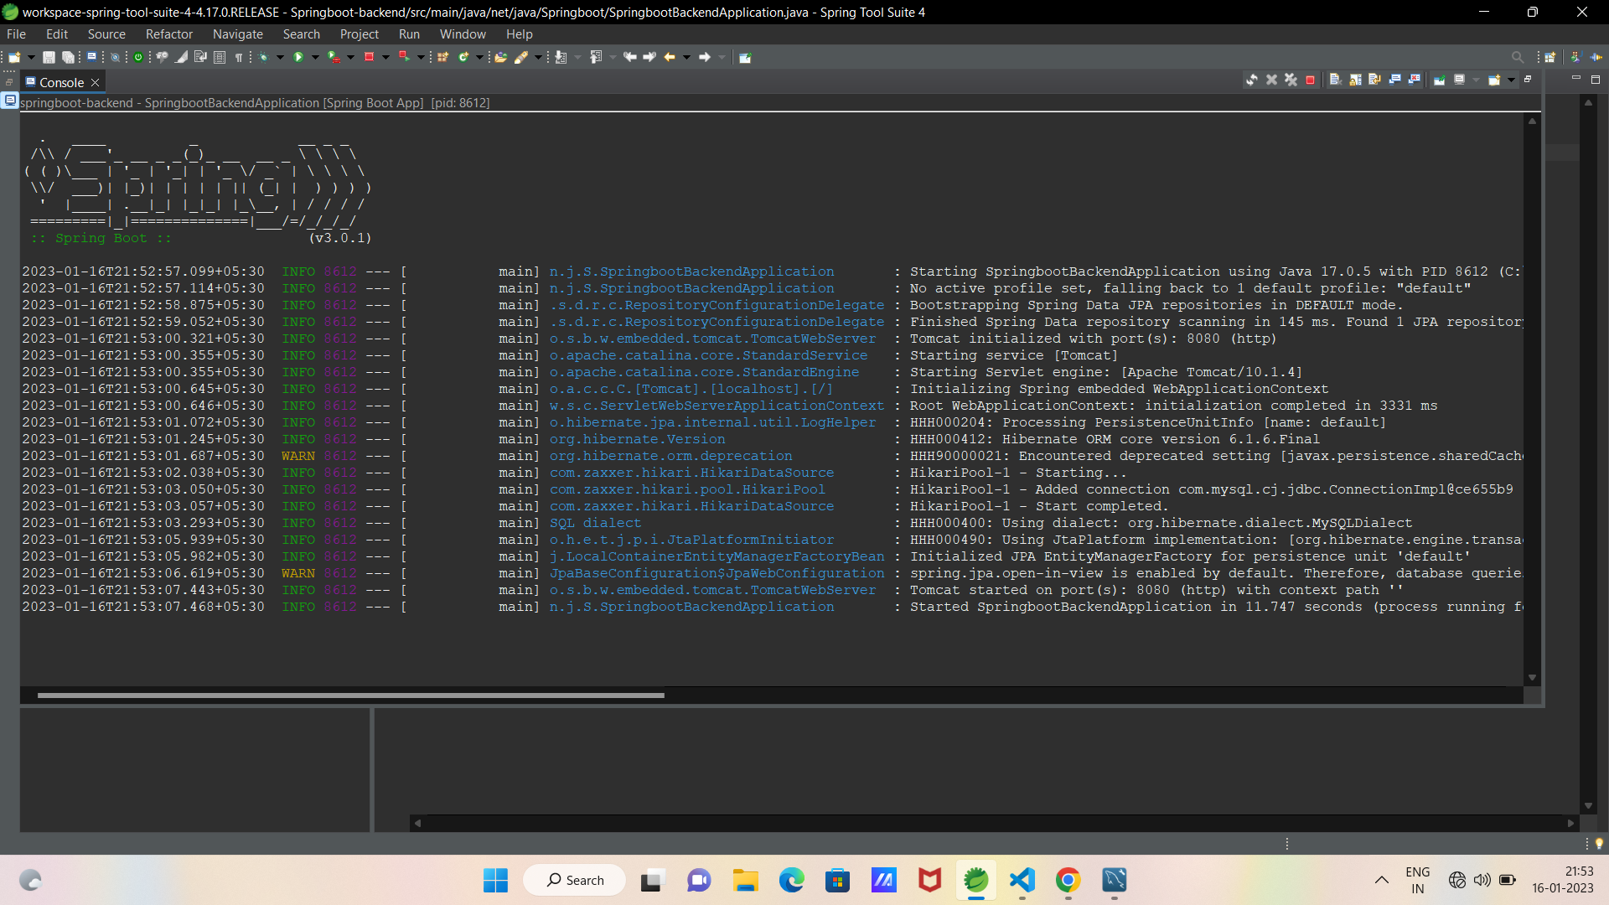
SPRING BOOT AND TOMCAT SERVER

Slide 13
Thank You

