Slide 1
ARAI / XHACK 2026
DESIGN REVIEW
ARAI
01
Observe
Return behavior over time
Adaptive Return
Abuse Intelligence
02
Explain
Product and relationship context
Investigate suspicious returns.
Understand legitimate explanations.
03
Prioritize
Human investigation
Indian online apparel • Analyst decision support
DESIGN PRESENTATION • 28 SEPTEMBER 2026
01
Notes:
Open with the distinction: a return is an event, not proof of abuse. ARAI is a proposed investigation workbench for online apparel. The goal of this meeting is to align on a feasible design and delivery plan. Suggested main presentation time is 10–12 minutes; slides 14–16 are backup.
Design baseline: components/01-goals-and-scope.md; components/13-react-vite-ui.md
Status: proposed implementation unless explicitly marked ready. UI numbers are illustrative synthetic fixtures.

Slide 2
ARAI / XHACK 2026
PROBLEM STATEMENT
High returns alone do not establish abuse.
The same headline return rate can hide very different explanations.
Legitimate fit shopping
Product quality issues
Intentional misuse
A customer may return often while choosing the right size or fit.
A style or SKU may drive returns across many unrelated customers.
Submitted deception or temporary use can warrant investigation.
Design challenge
Prioritize useful investigations while preserving legitimate explanations.
DESIGN PRESENTATION • 28 SEPTEMBER 2026
02
Notes:
Explain the ambiguity before introducing any model. We do not claim a quantified business loss because no verified business dataset or cost model exists in this baseline. Benign heavy returners, defect-driven buyers and shared households are explicit controls in evaluation.
Design baseline: components/01-goals-and-scope.md; components/02-synthetic-data-generation.md; components/08-model-evaluation.md
Status: proposed implementation unless explicitly marked ready. UI numbers are illustrative synthetic fixtures.

Slide 3
ARAI / XHACK 2026
PROPOSED SOLUTION
A ranked queue with inspectable evidence.
Help an analyst understand why a customer or product deserves a closer look.
Observe
Contextualize
Prioritize
Investigate
Sales and return events
Expected behavior for the product mix
One customer ranking at a fixed review budget
Case evidence and append-only notes
Human decision support
No automatic refund denial or account action. If models fail the gate, show the baseline.
DESIGN PRESENTATION • 28 SEPTEMBER 2026
03
Notes:
The model produces one investigation ranking. Individual signal panels do not claim that a model predicted an abuse type. The fallback preserves a demonstrable end-to-end product even if no candidate clears the evaluation gate. This is a design choice, not a claim that a model has already passed.
Design baseline: components/01-goals-and-scope.md; components/09-model-selection.md; components/11-inference-service.md
Status: proposed implementation unless explicitly marked ready. UI numbers are illustrative synthetic fixtures.

Slide 4
ARAI / XHACK 2026
KEY FEATURES
Four connected investigation views.
A focused MVP that connects customer behavior with product context.
01 Customer queue + cases
02 Style + SKU exploration
Review ranked customers, supporting events and analyst notes.
Identify product-driven returns before attributing customer intent.
03 Relationship evidence
04 Wardrobing indicator
Inspect shared identifiers with safeguards for benign households.
Keep the image-free timing signal separate from the overall model score.
DESIGN PRESENTATION • 28 SEPTEMBER 2026
04
Notes:
The fourth view is a category-relative timing indicator. It does not establish physical wear or proven wardrobing. Relationship evidence requires multiple identifier types and excludes high-fanout identifiers. The UI exposes context so an analyst can challenge the ranking.
Design baseline: components/06-feature-engineering.md; components/13-react-vite-ui.md
Status: proposed implementation unless explicitly marked ready. UI numbers are illustrative synthetic fixtures.

Slide 5
ARAI / XHACK 2026
ARCHITECTURE DIAGRAM
Separate learning from application execution.
Two execution boundaries, one shared feature contract, and versioned artifacts.
OFFLINE PYTHON PIPELINE
Synthetic generator
Data + feature engine
Training + evaluation
Frozen bundle
Events + private truth
Validate, explore, transform
Candidate comparison and gate
Model + feature references
Load a versioned bundle; never fit at runtime
LOCAL APPLICATION
PostgreSQL
React / Vite UI
FastAPI service
Single worker
Run state, metadata, audit
Submit runs, inspect cases,
record analyst notes
Validate requests, expose
run status and results
Load bundle, compute
features, score and publish
Artifact storage
Parquet results + JSON
DESIGN PRESENTATION • 28 SEPTEMBER 2026
05
Notes:
Read the top lane as offline components and the lower lane as application components. The generator produces operational tables and separate private truth. The shared feature engine supplies offline experiments and inference. Training, validation and held-out testing select a versioned frozen bundle. The analyst uses React/Vite to call FastAPI. One worker executes scoring using the bundle, operational data and the same feature contract. PostgreSQL holds durable run state, metadata and append-only audit; artifact storage holds immutable outputs. Arrows summarize primary component dependencies; API reads and responses also use the metadata/result stores. Private truth remains offline and is never a serving input.
Design baseline: components/03-data-contracts.md; components/06-feature-engineering.md; components/10-artifacts-and-versioning.md; components/11-inference-service.md; components/12-fastapi-and-api-contract.md; components/14-storage-and-audit.md
Status: proposed implementation unless explicitly marked ready. UI numbers are illustrative synthetic fixtures.

Slide 6
ARAI / XHACK 2026
DATA FLOW DIAGRAM
From raw events to reviewable evidence.
Operational tables move through shared validation and feature logic; private truth stays offline.
A / OFFLINE LEARNING
01 Generate
02 Validate
03 Features
04 Train
05 Evaluate
06 Package
Seven operational
tables per world
Schema, keys,
dates and maturity
Explore data; build
18 numeric features
Ten training worlds;
five candidates
Validation selection;
one held-out test
Winner or baseline;
frozen references
PRIVATE TRUTH
Separate labels support offline training and evaluation; never enter features or serving inputs.
B / APPLICATION SCORING
01 Register
02 Validate
03 Transform
04 Score
05 Publish
06 Review
Seven CSVs +
manifest / hashes
Reject invalid data;
create durable run
Same maturity and
feature definitions
Load frozen bundle;
rank eligible users
Atomic results;
record run metadata
Customer + style UI;
append analyst notes
DESIGN PRESENTATION • 28 SEPTEMBER 2026
06
Notes:
The top row describes model development: generate independent worlds, validate operational data, explore and compute features, train five candidates on ten worlds, select using five validation worlds and evaluate the frozen selection once on five held-out test worlds. Package the selected model if it clears the required gate; otherwise package the disclosed baseline path. The separate private-truth channel supports supervised training and offline evaluation but is excluded from feature columns. The lower row describes a scoring run. Register seven operational CSVs and their manifest, reject invalid inputs, compute the same features, score using a frozen bundle without fitting, publish immutable results atomically, then expose evidence and append-only analyst notes in the UI. Dataset validation happens at registration and run preflight as defined by the API contracts.
Design baseline: components/02-synthetic-data-generation.md; components/04-data-validation-cleaning.md; components/05-data-exploration.md; components/06-feature-engineering.md; components/07-training-and-validation.md; components/09-model-selection.md; components/11-inference-service.md; components/12-fastapi-and-api-contract.md
Status: proposed implementation unless explicitly marked ready. UI numbers are illustrative synthetic fixtures.

Slide 7
ARAI / XHACK 2026
DATA DESIGN
Synthetic data with explicit truth boundaries.
Controlled worlds support repeatable experiments and deliberate benign counterexamples.
300 SKUs
10,000 profiles
12 months
37 apparel styles
Planned per generated world
Fixed as-of cutoff; INR
Operational data
Private truth
Seven linked tables: customer, SKU, reason, sales order/line and return order/line.
Intent and deceptive actions stay outside model features and serving payloads.
Counterexamples
Heavy legitimate returners, defect-driven buyers and benign shared households.
DESIGN PRESENTATION • 28 SEPTEMBER 2026
07
Notes:
Catalog input contains 300 SKUs and 37 styles. Ten thousand profiles per world is the planned generator scale, not a completed dataset claim. The reference history is 10 September 2025 to 9 September 2026, cutoff 23:59:59 IST. Honest activity is created first; reserved units receive explicit abuse actions. Labels derive from completed submitted deception or temporary use, not from persona names or return volume.
Design baseline: components/02-synthetic-data-generation.md; components/03-data-contracts.md; contracts/generator-config.yaml; contracts/private-truth.yaml
Status: proposed implementation unless explicitly marked ready. UI numbers are illustrative synthetic fixtures.

Slide 8
ARAI / XHACK 2026
MODEL VALIDATION
A candidate must beat a simple baseline fairly.
Separate synthetic worlds prevent the same world from appearing in training and evaluation.
10
5
5
1
Train worlds
Validation worlds
Untouched test worlds
Demo world
Gate 1: better prioritization
Gate 2: protect benign groups
At a 5% review budget, precision must exceed the raw return-rate baseline.
False-positive rate must be no worse in each of three benign segments.
PASS: promote the frozen selection • FAIL: disclose and serve the baseline
DESIGN PRESENTATION • 28 SEPTEMBER 2026
08
Notes:
All five candidates use the same eligible population, features and review budget. Select on validation precision, then worst benign-group false-positive rate, then fixed ordinal. Freeze the selected fit and test once; do not search for a runner-up after test failure. Each validation benign group requires at least 200 pooled negatives. Sensitivity checks use 1% and 10% budgets. Three fixture worlds and seven stress worlds bring the overall seed plan to 31 distinct seeds. No performance results exist yet.
Design baseline: components/07-training-and-validation.md; components/08-model-evaluation.md; components/09-model-selection.md; contracts/experiment.yaml
Status: proposed implementation unless explicitly marked ready. UI numbers are illustrative synthetic fixtures.

Slide 9
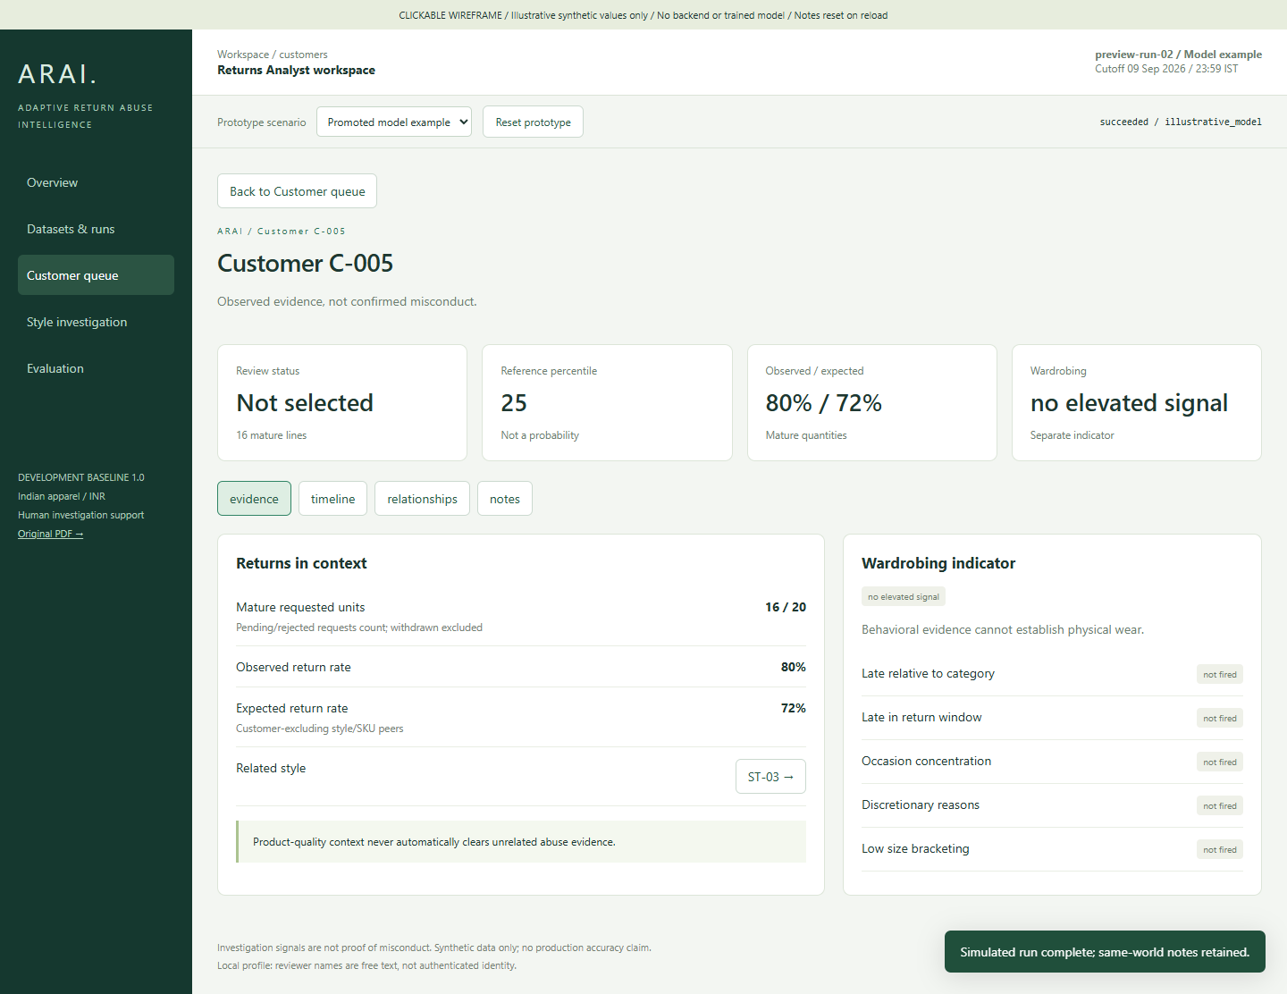
ARAI / XHACK 2026
UI / UX
Make the ranking easy to question.
Revised clickable wireframe • synthetic demonstration values • not a running ML product
01
Explain the score
A percentile is not a probability.
02
Show product context
Compare observed and expected returns.
03
Separate signals
Wardrobing stays independently labeled.
04
Record the review
Append-only notes preserve history.
DESIGN PRESENTATION • 28 SEPTEMBER 2026
09
Notes:
This image comes from the revised standalone wireframe already included in the portable spec. Its numbers are fixtures, not experiment outcomes. Key corrections from the original PDF are INR, apparel context, percentile rather than confidence, separate overall and wardrobing scores, product context and analyst notes. The wireframe can be demonstrated offline separately from this slide; no laptop-specific hyperlink is required by this PowerPoint.
Design baseline: components/13-react-vite-ui.md; wireframe/index.html; verification/wireframe-case.png
Status: proposed implementation unless explicitly marked ready. UI numbers are illustrative synthetic fixtures.

Slide 10
ARAI / XHACK 2026
TECHNOLOGY STACK
A small, familiar stack for the MVP.
Keep experimentation offline and the application runtime simple.
Data + features
Python · NumPy · pandas
Generate, validate and transform
Models
scikit-learn/XGBoost
Logistic regression · XGB · Isolation Forest
API + execution
FastAPI · one worker
Typed contracts and durable run lifecycle
Analyst UI
React · Vite
Customer, product and evidence views
Persistence
PostgreSQL · Parquet · JSON · skops
Metadata, immutable results and model bundle
AI development assistance: Codex / Claude for specifications and coding. No runtime LLM dependency.
DESIGN PRESENTATION • 28 SEPTEMBER 2026
10
Notes:
The stack is specified, not installed or deployed as a completed system. Local-first packaging supports development on another machine. Secrets stay outside the portable spec. Optional VM hosting adds TLS, access control and private database networking after the local rehearsal works. Do not expand this slide into unverified performance or compatibility claims.
Design baseline: components/07-training-and-validation.md; components/12-fastapi-and-api-contract.md; components/13-react-vite-ui.md; components/15-security-deployment-portability.md
Status: proposed implementation unless explicitly marked ready. UI numbers are illustrative synthetic fixtures.

Slide 11
ARAI / XHACK 2026
IMPLEMENTATION PLAN
Deliver the end-to-end path before polishing.
Proposed schedule for a three-person team • owners to be assigned at the design review
28 SEP–2 OCT
5–9 OCT
12–16 OCT
19–23 OCT
26–30 OCT
Bootstrap
Data readiness
Vertical slice
Model gate
Freeze + rehearse
Environment, contracts, small world
Generator, validation and features
Baseline → API → analyst UI
Full experiment and held-out test
Acceptance checks and demo recovery
Delivery checkpoints
9 Oct: data readiness • 1–14 Nov: target demo window
Protect the final week for testing and rehearsal.
DESIGN PRESENTATION • 28 SEPTEMBER 2026
11
Notes:
This schedule is a proposal, not a claim that owners or deadlines have already been committed. Suggested ownership lanes are data/ML, backend/runtime and frontend/integration, with shared acceptance checks. Bootstrap a small fixture world, then prove a baseline-driven complete workflow before running the full experiment. Preserve the specified evaluation protocol; reduce presentation polish or defer cloud hosting if time is tight. Confirm the actual demo day within the existing November 1–14 target.
Design baseline: components/16-testing-and-delivery.md; components/15-security-deployment-portability.md
Status: proposed implementation unless explicitly marked ready. UI numbers are illustrative synthetic fixtures.

Slide 12
ARAI / XHACK 2026
FEASIBILITY & RISKS
Make uncertainty visible and contain its impact.
The design includes a working demonstration path even when ML results are disappointing.
Synthetic shortcuts
RESPONSE
Isolated truth, independent worlds, stress cases and explicit limits on real-world claims.
A model learns generator artifacts.
No candidate qualifies
RESPONSE
Serve the baseline with the same evidence views; disclose the failed gate.
A complex model does not beat the baseline.
Delivery or runtime failure
RESPONSE
Baseline vertical slice, one worker, immutable artifacts and a reserved rehearsal week.
Integration and long runs threaten the demo.
DESIGN PRESENTATION • 28 SEPTEMBER 2026
12
Notes:
Synthetic success establishes behavior within controlled worlds, not proven fraud detection in production. The baseline fallback is an intentional feasibility mechanism. Application failure handling includes idempotent submissions, stable run states, recoverable publication and durable audit records. Cloud deployment is optional after rehearsal.
Design baseline: components/08-model-evaluation.md; components/11-inference-service.md; components/14-storage-and-audit.md; components/16-testing-and-delivery.md
Status: proposed implementation unless explicitly marked ready. UI numbers are illustrative synthetic fixtures.

Slide 13
ARAI / XHACK 2026
DESIGN REVIEW OUTCOME
A clear baseline. A bounded build.
Ready to move from specification into implementation.
16
90
1
Component specifications
Defined acceptance criteria
Portable clickable wireframe
TODAY: align on scope, architecture, owners and demo date.
NEXT: bootstrap a small world and prove the baseline-to-UI path.
DESIGN PRESENTATION • 28 SEPTEMBER 2026
13
Notes:
End the main presentation here. The specifications and wireframe are ready; the 90 runtime acceptance criteria have not yet been executed against an implementation. We have not yet built or trained the product. Ask the reviewers to align on scope and architecture, assign owners and confirm the demo date. The next concrete milestone is a small reproducible world connected to the baseline-driven UI. Backup slides follow only if questions require them.
Design baseline: README.md; components/16-testing-and-delivery.md; wireframe/index.html
Status: proposed implementation unless explicitly marked ready. UI numbers are illustrative synthetic fixtures.

Slide 14
ARAI / XHACK 2026
BACKUP / FEATURE DESIGN
Compare customers with their product context.
Eighteen numeric features support one overall investigation ranking.
High returns + high peer returns
High returns + low peer returns
Product fit or quality may explain the behavior. Inspect style and SKU evidence.
An unexplained excess is an investigation signal, not proof of intent.
Mature observations
Self-excluded expectation
Relationship safeguards
Captured return window elapsed; at least 3 mature sale lines to rank.
Category → style → SKU smoothing; customer excluded; k = 20.
At least 2 identifier types; exclude identifiers with fanout > 25.
DESIGN PRESENTATION • 28 SEPTEMBER 2026
14
Notes:
Maturity depends on delivery plus the captured return window being no later than the cutoff. Use customer-excluding hierarchical expectations to avoid using the customer to explain their own behavior. Graph evidence requires two types of shared identifiers and removes high-fanout identifiers. Category-relative timing supports a separate wardrobing indicator and does not infer physical condition.
Design baseline: components/06-feature-engineering.md; contracts/features.yaml
Status: proposed implementation unless explicitly marked ready. UI numbers are illustrative synthetic fixtures.

Slide 15
ARAI / XHACK 2026
BACKUP / MODEL DESIGN
Five candidates. One frozen selection rule.
Simple supervised and unsupervised approaches share the same evaluation population.
1 × Logistic regression
2 × Histogram boosting
2 × Isolation Forest
Scaled features
C = 1 · lbfgs
max_iter = 1,000
15 or 31 leaves
200 iterations · learning rate 0.05
min leaf = 50 · L2 = 1
300 trees
max_samples = 256 or 1,024
contamination = auto
Score interpretation
Percentiles use stored training references. They are not calibrated abuse probabilities.
DESIGN PRESENTATION • 28 SEPTEMBER 2026
15
Notes:
Histogram boosting has early stopping disabled. Supervised percentile references use grouped-world out-of-fold training scores; Isolation Forest uses in-sample training references. Select by validation top-budget precision, then worst benign-group FPR, then candidate ordinal. Freeze and evaluate once on held-out test worlds. No runtime training and no runner-up substitution after a failed test.
Design baseline: components/07-training-and-validation.md; components/09-model-selection.md; contracts/experiment.yaml
Status: proposed implementation unless explicitly marked ready. UI numbers are illustrative synthetic fixtures.

Slide 16
ARAI / XHACK 2026
BACKUP / SERVING DESIGN
Every result belongs to a reproducible run.
A portable local deployment is the first supported delivery target.
Register
Submit
Execute
Review
Seven CSVs + manifest; validate schema and hashes
Dataset and model identity; idempotent request
One worker; frozen features and bundle; atomic publication
Immutable outputs with append-only analyst notes
Operational safeguards
Durable run states, retry and crash recovery, versioned artifacts, externalized configuration.
DESIGN PRESENTATION • 28 SEPTEMBER 2026
16
Notes:
Keep the inference service independent of private truth. An idempotency key prevents accidental duplicate execution; durable status and atomic result publication handle failures consistently. Bundle versions tie together preprocessing, model and reference distribution. PostgreSQL holds metadata and audit; files hold immutable tabular results. Develop from the portable specification on another machine with no fixed author-laptop paths. Optional VM hosting comes after a working local rehearsal.
Design baseline: components/10-artifacts-and-versioning.md; components/11-inference-service.md; components/12-fastapi-and-api-contract.md; components/14-storage-and-audit.md; components/15-security-deployment-portability.md
Status: proposed implementation unless explicitly marked ready. UI numbers are illustrative synthetic fixtures.

