Slide 1
NEWS AND SOCIAL MEDIA ANALYTICS ENGINE
J RAKSHITHA - 2520090212 J PRAGAHTI - 2520090216

Slide 2







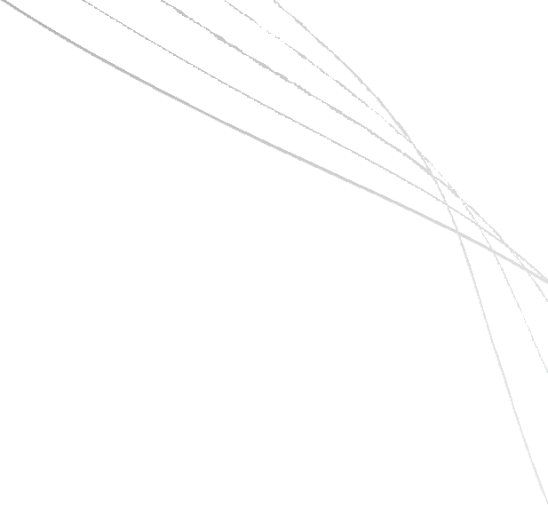














ABSTRACT
News and Social Media Analytics Engine processes and analyzes large volumes of news and social media data.
Enables fast searching, duplicate detection, and related-story clustering.
Supports content prioritization and moderator assignment.
Uses Hash Tables, Heaps, Trees, Queues, and Graphs for efficient data management.
Improves searching, retrieval, organization, and processing
efficiency.
Provides faster analysis and reduces redundant information in large-scale media data.

Slide 3





INTRODUCTION
The rapid growth of news and social media generates large volumes of content every day.
Managing and organizing such large-scale data efficiently is challenging.
Duplicate and related content can make information processing more difficult.
The proposed system provides fast searching and efficient content organization.
It uses Data Structures and Algorithms to improve data processing and retrieval.
The system supports content clustering, prioritization, and moderation. It aims to provide faster and more efficient analysis of news and social media data.

Slide 4








SOFTWARE REQUIREMENTS
Requirement | Details
Operating System | Windows/ Linux
Programming Language | Python
IDE | Jupyter Notebook / VS Code
Libraries | Pandas, NumPy,
Database | MySQL / MongoDB
Version Control | Git & GitHub

Slide 5




HARDWARE REQUIREMENTS
Requirement | Details
Processor | Intel Core i3 or above
RAM | Minimum 4 GB
Storage | Minimum 10 GB free space
Internet | Required for collecting news and social media data
System | Laptop / Desktop Computer

Slide 6




LITERATURE SURVEY
Existing news aggregation systems collect and organize news from multiple sources.
Hash-based techniques support fast searching and duplicate detection.
Heaps and Priority Queues support ranking and prioritization of content.
Trees provide efficient organization and searching of large datasets. Queues can manage incoming posts and moderation tasks.
Graphs can represent relationships between users, topics, and content.
Existing approaches often focus on individual tasks.
Our system combines multiple DSA techniques for integrated media analytics.

Slide 7


METHODOLOGY
Data Collection - Collect news articles and social media posts.
Data Storage - Store and organize the collected data using suitable data structures.
Searching - Use Hash Tables for fast searching and retrieval.
Duplicate Detection - Use Hash Tables to identify duplicate news articles and posts.
Content Clustering - Group related news articles and social media posts based on common topics.
Ranking & Prioritization - Use Heaps / Priority Queues to rank and prioritize important content.
Content Organization - Use Trees to organize and efficiently search related information.
Post Management - Use Queues to manage incoming posts and moderation tasks. Relationship Analysis - Use Graphs to represent relationships between users, topics, and content.
Output & Analysis - Generate organized, prioritized, and efficiently processed news and social media information.

