Slide 1

ANALYTICAL PROGRAMMING
STUDY ON RUSSIA-UKRAINE WAR
Presented by:
Pragathi Somashekaraiah

Slide 2
OVERVIEW OF THE INDUSTRY AND THE EVENT
Event: Russia-Ukraine War
Began in 2014 with Russia's annexation of Crimea.
Escalated in 2022 with a full-scale invasion, causing global disruption.
Defense Industry:
Produces military equipment like aircraft and missiles.
Increased demand due to conflict.

Slide 3
RESEARCH QUESTION WITH EVIDENCE
Research Question: How does increased government military spending during the Russia-Ukraine war impact defense industry stock valuations?
Evidence:
Lockheed Martin predicts a $10 billion opportunity by 2030 due to rising orders (e.g., PAC-3, HIMARS, Javelins).
Defense stocks, like Lockheed Martin's, surged as governments raised military spending.

Slide 4
DATA DESCRIPTION
Economic Indicators in Focus
Military Spending
Represents government expenditures on defense.
Drives innovation, production capacity, and revenues for defense companies.
Sample size: 5,311 observations​
The number of unique firms within Defense industry: 3 observations

Slide 5
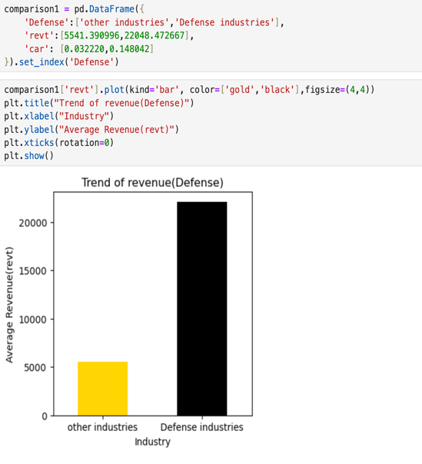
TRENDS OF INTERESTED VARIABLES etc.
Average Revenue: 22,048.47
Outperforms other industries with 5,541.39

Slide 6
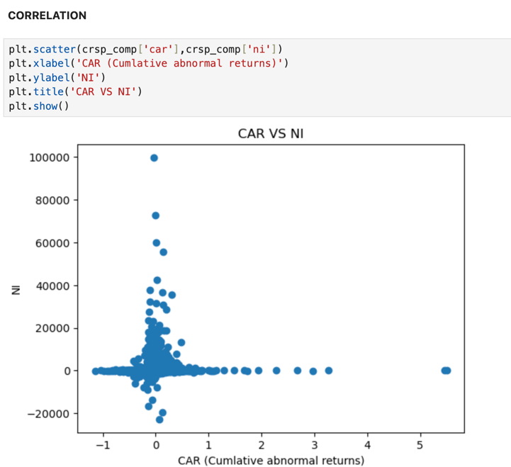
CORRELATION
Key Observations
CAR (Cumulative Abnormal Returns) shows minimal correlation with Net Income.
Net Income is mostly concentrated near zero, with a few outliers.

Slide 7
REGRESSION ANALYSIS
 | ni ~ Defense | bhar ~ Defense+log_revt | car~Defense+C(sic2)+log_revt | car ~ Defense+log_revt
R-squared | 0.000 | 0.000 | 0.113 | 0.018
Adj. R-squared | -0.000 | 0.000 | 0.099 | 0.017
F-statistic | 0.5608 | 1.031 | 8.386 | 24.09
Prob (F-statistic) | 0.454 | 0.357 | 5.13e-79 | 4.26e-11
ni ~ Defense: No impact on Net Income (R² = 0.000, p = 0.454). Hypothesis rejected.
bhar ~ Defense+log_revt: No effect on BHAR (R² = 0.000, p = 0.357). Hypothesis rejected.
car~Defense+C(sic2)+log_revt: Model significant, Defense not (R² = 0.113, p < 0.001). Hypothesis is partially supported.
car ~ Defense+lol;g_revt: Revenue matters, Defense doesn’t (R² = 0.018, p < 0.001). Hypothesis is partially supported.

Slide 8
BUSINESS IMPLICATIONS
Lockheed Martin: Increased demand for defense equipment driven by geopolitical tensions.
Strategic Opportunities:
Expand production capabilities.
Leverage military contracts to enhance revenue.

Slide 9
LIMITATION
Incomplete Data:
Missing key information or potential small errors in the dataset.
Limited Scope:
Analysis includes only a small sample of companies, limiting generalizability.
Simplistic Methods:
Use of straight-line relationships may not capture complex patterns or the impact of global events.

Slide 10
POTENTIAL PROJECT
Definition: Provides actionable recommendations based on predictive models to optimize decision-making.
Research Question: Which investment strategies are optimal for Lockheed Martin to reduce risks and maximize income during a global crisis?

Slide 11

Thank you

