Slide 1

A REAL-TIME PRIORITY SCHEDULING FOR AUTONOMOUS WILDFIRE DETECTION & RESPONSE FRAMWWORK
RTOS Project Review-1
Wednesday, August 12th, 2026
 | Under the Guidance of Dr. Srikanth Cherukuvada Assistant Professor, Department of Computer Science and Engineering, KLH CSE Bowrampet Campus
Team Members N. Sai Pragathi – 2420030672 S. Indu – 2420030710 A.V.N.S Anupama – 2420030712 T. Aashritha Reddy – 2420030719

Slide 2
Outline of Research Work
Focus
Introduction
Literature Survey
Challenges
Research Objectives
Conclusion & Future Work
References
Publications Details

Slide 3
Problem Statement
Wildfires spread rapidly and unpredictably — even a small delay in detecting or responding to a fire can lead to serious loss of life and property.
Existing wildfire monitoring systems rely on periodic sensor polling, with no formal guarantee on how fast a critical fire alert is actually processed.
Under real sensor load, a high-priority fire alert can be silently delayed behind routine, lower-priority sensor-check tasks.
Simple example: a forest sensor checks temperature every few seconds. If a fire starts, that alert must be handled immediately — not stuck waiting behind routine checks.
Research question: how can a monitoring system guarantee that urgent fire alerts are handled within a fixed time limit, even while the system is busy with routine tasks?

Slide 4
Objectives
Design BLAZE-RT, a real-time task-scheduling framework that models routine sensor checks as periodic low-priority tasks and fire-detection events as high-priority, deadline-bound tasks.
Apply Rate-Monotonic Scheduling (RMS) for periodic sensor tasks and Earliest-Deadline-First (EDF) scheduling for urgent fire alerts.
Detect and resolve priority inversion through priority inheritance, so a low-priority task holding a shared resource never blocks a high-priority fire task indefinitely.
Simulate realistic wildfire spread using a cellular-automaton fire-spread grid, generating reproducible test conditions for the scheduler.
Build a live visual dashboard and a deadline-miss/latency logger to observe task execution and measure scheduling performance.
Evaluate BLAZE-RT against a naive First-Come-First-Served baseline using deadline-miss rate, response latency, and system utilization.

Slide 5
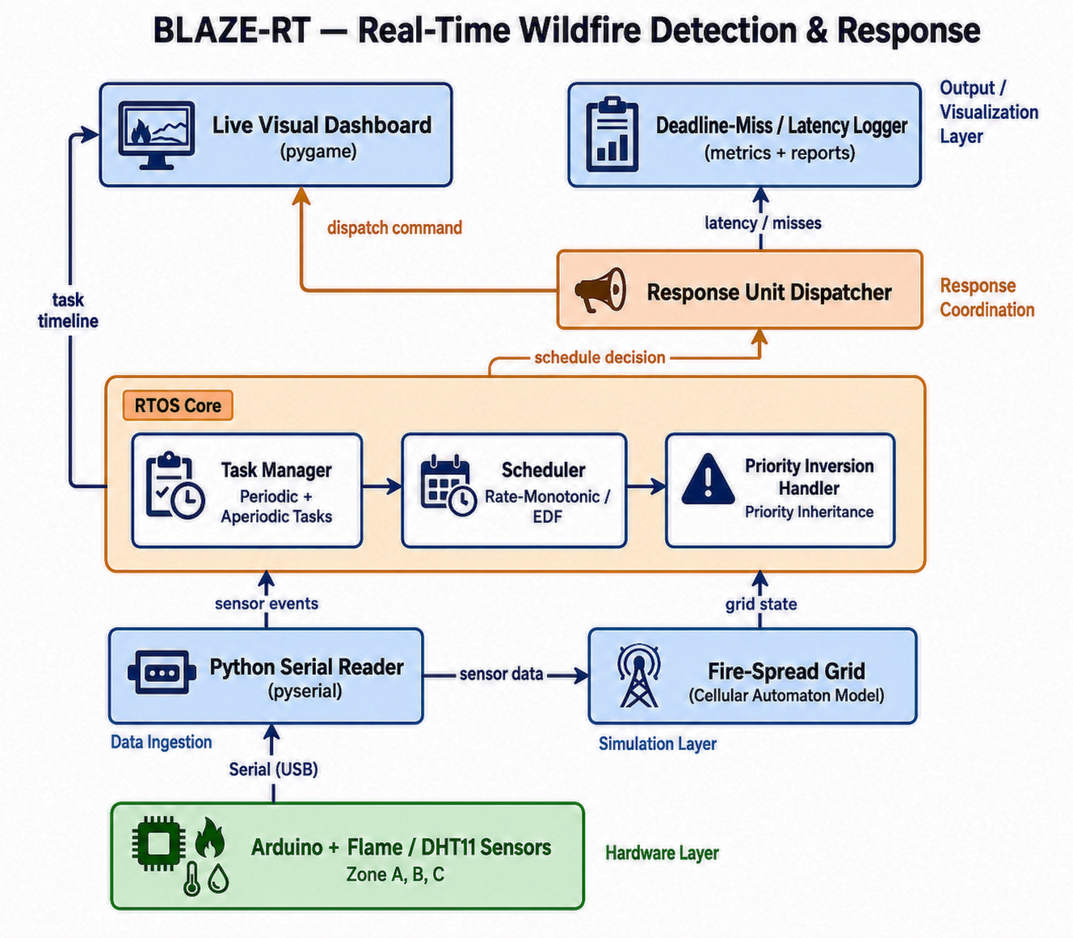
System Architecture

Slide 6
Literature Survey
Authors | Title of the Paper | Methodology | Inferences | Limitation/Future work
Sha, Rajkumar & Lehoczky | Priority Inheritance Protocols: An Approach to Real-Time Synchronization, IEEE Trans. Computers, 1990 | Basic Priority Inheritance Protocol and Priority Ceiling Protocol for resource sharing among fixed-priority tasks | Solves uncontrolled priority inversion; Priority Ceiling Protocol bounds blocking time to one lower-priority critical section and prevents deadlock | Analysis assumes single-processor, fixed-priority scheduling; does not address multiprocessor or mixed RMS/EDF task sets, which BLAZE-RT targets
Kumar & Gupta | An Adaptive Emergency-First Intelligent Scheduling Algorithm for Hybrid Hard/Soft Real-Time Embedded IoT Systems | Combined periodic and event-driven task scheduling; emergency events (e.g. fire alerts) treated as highest-priority one-time tasks | Shows event-driven emergency tasks need dedicated highest-priority handling distinct from periodic sensor tasks in IoT environments | General IoT framework not validated on a physical sensor-hardware pipeline or a simulated hazard-spread model
Recent IoT/ML Studies (2023-24) | Forest Fire Detection and Temperature Monitoring Alert using IoT and Machine Learning | Sensor network (temperature, flame, smoke) with ML-based classification and GSM/GPRS alerting | Achieves high detection accuracy, but focuses on whether a fire is detected, not on how fast the alert is guaranteed to be handled | No formal real-time scheduling or deadline guarantee once a fire event is detected — the exact gap BLAZE-RT addresses

Slide 7
Research Gap Identification
Most wildfire/IoT monitoring literature focuses on detection accuracy (sensor + ML-based fire classification), not on guaranteeing how fast a confirmed alert is handled.
Periodic-polling architectures common in environmental monitoring carry no formal real-time scheduling guarantee (RMS/EDF) for dispatching urgent alerts.
Priority inversion — a low-priority task blocking a high-priority alert — is rarely modeled or resolved in existing wildfire-response systems.
Few systems combine deadline-aware scheduling with a realistic, reproducible fire-spread simulation for testing before physical deployment.
Identified gap: the absence of a lightweight, deadline-guaranteed scheduling framework for wildfire alert response, validated on both simulated and physical sensor data.

Slide 8
Innovation, Creativity, and Novelty
Hybrid deadline-aware scheduling — combines RMS for periodic sensor tasks with EDF for urgent fire alerts, instead of a single fixed-priority scheme.
Explicit priority inheritance mechanism to resolve priority inversion between low-priority sensor tasks and high-priority fire tasks.
Cellular-automaton fire-spread simulation integrated directly with the scheduler, enabling realistic, reproducible load testing without waiting for a real wildfire.
End-to-end pipeline bridging physical hardware (Arduino flame/DHT11 sensors) with software scheduling logic and a live visual dashboard for real-time observability.
Low-cost, edge-deployable design, extensible beyond wildfire detection to other safety-critical, deadline-sensitive monitoring domains.

Slide 9
SENSOR LOAD
Baseline Approach
Proposed Approach
BLAZE-RT
FCFS
RMS + EDF
BLAZE-RT replaces simple FCFS execution with deadline-aware real-time scheduling and priority-inversion handling
Priority Inheritance
(when priority inversion occurs)
SCHEDULING DECISION
TASK EXECUTION ON CPU

Slide 10
Feasibility and Project Plan
Feasibility: the core software stack (Python, pyserial, pygame) and RTOS scheduling concepts (RMS, EDF, priority inheritance) are well-established and implementable within the semester timeline.
Low-cost hardware — Arduino with flame and DHT11 sensors — keeps the physical layer inexpensive, easy to source, and easy to test.
The sensor-to-scheduler-to-dashboard pipeline (see System Architecture) is already scoped into clear, independently buildable modules.
Project Timeline — 13-Week Plan
Wk 1-2
Literature Survey & Requirement Analysis
Wk 3-4
Hardware Setup: Arduino + Flame/DHT11 Sensors
Wk 5-6
Fire-Spread Grid Simulation & Serial Data Pipeline
Wk 7-9
RTOS Core: Task Manager, RMS/EDF Scheduler, Priority Inheritance
Wk 10-11
Response Dispatcher & Live Visual Dashboard
Wk 12-13
Testing, Evaluation & Final Documentation

