Slide 1
Battle of Neighbourhoods
Pragati Kumar

Slide 2
Table of Contents
Introduction
Data Reference
Methods
Methods & Results
Conclusion

Slide 3
Introduction
Through this exercise, a study on neighbourhoods of Toronto and New York (particularly Manhattan) has been carried out.
Foursquare API is a great tool to explore around any geographical location on the planet and thus locations have been fed into the API and each location has been further explored.
Neighbourhoods of each city have been clustered using K-Means algorithm by using venues in each neighbourhood as the features.
For tourists looking to explore either New York or Toronto can base their interest on the methods used in this study.

Slide 4
Data Reference
Toronto Neighbourhoods data: https://en.wikipedia.org/wiki/List_of_postal_codes_of_Canada:_M
New York Neighbourhoods data: https://cocl.us/new_york_dataset
Population Density Data: https://en.wikipedia.org/wiki/Boroughs_of_New_York_City
Population density data for Toronto: https://en.wikipedia.org/wiki/Demographics_of_Toronto_neighbourhoods

Slide 5
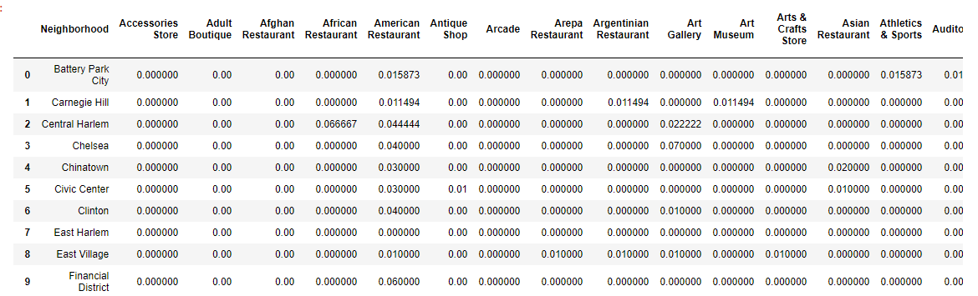
Methods – Data Collection and Refinery
Pandas library in Python has been used for data import and refinery .
Foursquare API has been used to obtain the venues for each neighbourhood.
Dummy numerical values have been used to provide weights to each venue in a neighbourhood in a Pandas DataFrame.

Slide 6
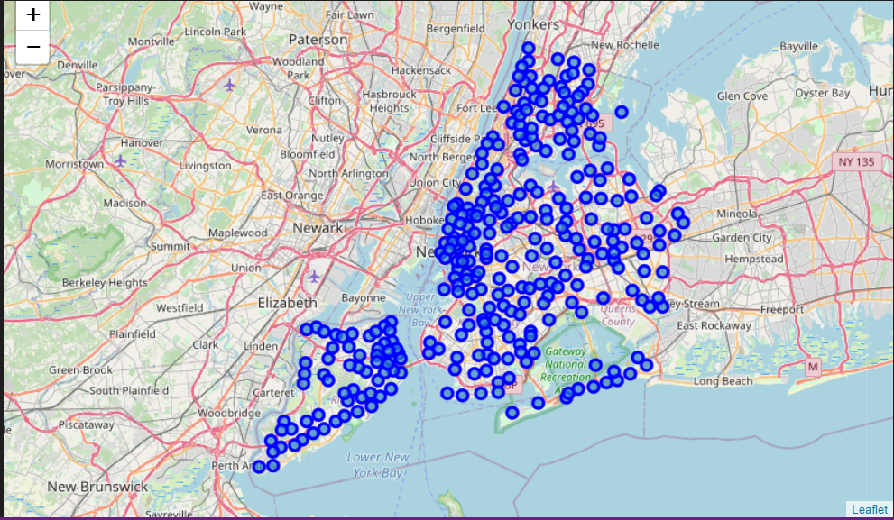
Methods - Visualization
Folium library has been used to display neighbourhoods and their locations on a map

Slide 7
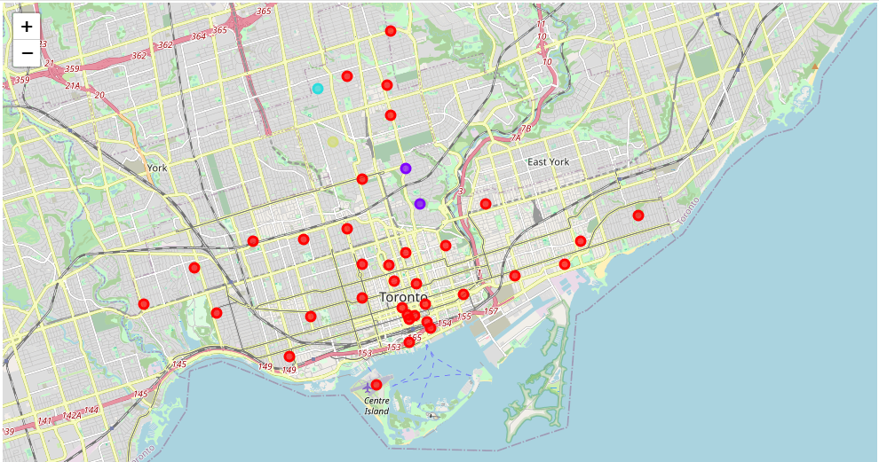
Methods & Results: K-Means Clustering
K-Means algorithm has been used to cluster neighbourhoods of Toronto
Weighted dummy numerics for venues in a neighbourhood have been used as features for clustering

Slide 8
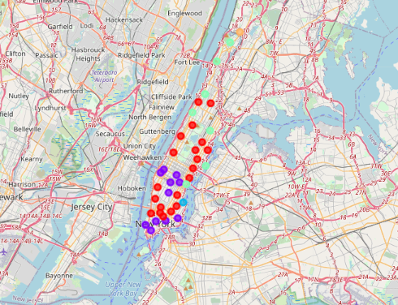
Methods & Results: K-Means Clustering
K-Means algorithm has been used to cluster neighbourhoods of Manhattan, New York City.

Slide 9
Conclusion
193 common venues between Manhattan and Toronto have been observed which implies a similar character to the cities.
Unsupervised clustering using K-Means algorithm has been used to clusters neighbourhoods into different clusters.
Use of Folium, Foursquare API, Sklearn, Pandas, Numpy libraries have been demonstrated in this study.
Use of other visualization techniques such as barplot has also been made to highlight differences between the cities.

