Slide 1
Passport Travel Readiness System
Data Science | NLP | Visualization
Why This Topic?
Problem Statement
• Airports handle millions of diverse travelers daily
• Inclusive travel needs are often overlooked
• Manual feedback analysis is slow & error-prone
• Need for automated NLP-based travel insights
• No system for inclusive passenger data collection
• Travel feedback remains unanalyzed
• No automated sentiment/entity/summary extraction
• No visual dashboard for travel patterns
What We Overcame
• Built complete GUI with 18-field registration form
• TextBlob sentiment analysis pipeline
• SpaCy NER + Regex for entity extraction
• Keyword-based text summarization
• 4-plot Matplotlib visualization dashboard
• Auto-processing on window open
• Inclusive fields: accessibility, medical, dietary
• Clean CSV pipeline with 10 complete records

Slide 2
Architecture & Data Flow
Frontend
Backend
Data Flow Pipeline
Tkinter GUI Framework
• home.py - Dashboard
• registration.py - Entry Form
• feedback_gui.py - Sentiment
• summary_gui.py - Summary
• ner_gui.py - NER
• plot_gui.py - Visualization
Python Data Processing
• Pandas - CSV I/O
• TextBlob - Sentiment
• SpaCy - NER
• Regex - Passport Extract
• Matplotlib - Charts
• NumPy - Numerical
Registration Form
↓
passenger_registration.csv
↓
→ sentiment_analysis.csv
→ feedback_summary.csv
→ entity_extraction.csv
↓
Visual Insights (4 Plots)
Tech Stack
Python 3.13
Tkinter
Pandas
Matplotlib
SpaCy
TextBlob
NumPy
Git

Slide 3
CSV Data Generated
passenger_registration.csv
sentiment_analysis.csv
Full_Name | Passport_Number | Destination_Country | Travel_Purpose
Rahul Sharma | P1234567 | France | Tourism
Ananya Verma | P2345678 | Japan | Education
Mohit Khan | P3456789 | UAE | Business
Sneha Kulkarni | P4567890 | Germany | Tourism
Amit Patel | P5678901 | USA | Business
Full_Name | Destination_Country | Sentiment
Rahul Sharma | France | Positive
Ananya Verma | Japan | Neutral
Mohit Khan | UAE | Neutral
Sneha Kulkarni | Germany | Positive
Amit Patel | USA | Negative
feedback_summary.csv
entity_extraction.csv
Full_Name | Summary
Rahul Sharma | Key points: smooth, security
Ananya Verma | Key points: helpful
Mohit Khan | Key points: baggage
Sneha Kulkarni | Key points: quick
Amit Patel | Key points: baggage
Entity | Type
Rahul Sharma | PERSON
France | GPE
P1234567 | PASSPORT_NUMBER
Ananya | GPE
Japan | GPE
P2345678 | PASSPORT_NUMBER
Mohit Khan | PERSON
UAE | GPE

Slide 4
Application GUI
Replace placeholders with your screenshots
Home Dashboard
Passenger Entry
Feedback Analysis
Main navigation hub
18-field registration form
TextBlob sentiment results
[Paste Screenshot]
[Paste Screenshot]
[Paste Screenshot]
Text Summarization
NER + Regex
Visual Insights
Keyword-based summaries
Entity extraction output
4-plot dashboard
[Paste Screenshot]
[Paste Screenshot]
[Paste Screenshot]

Slide 5
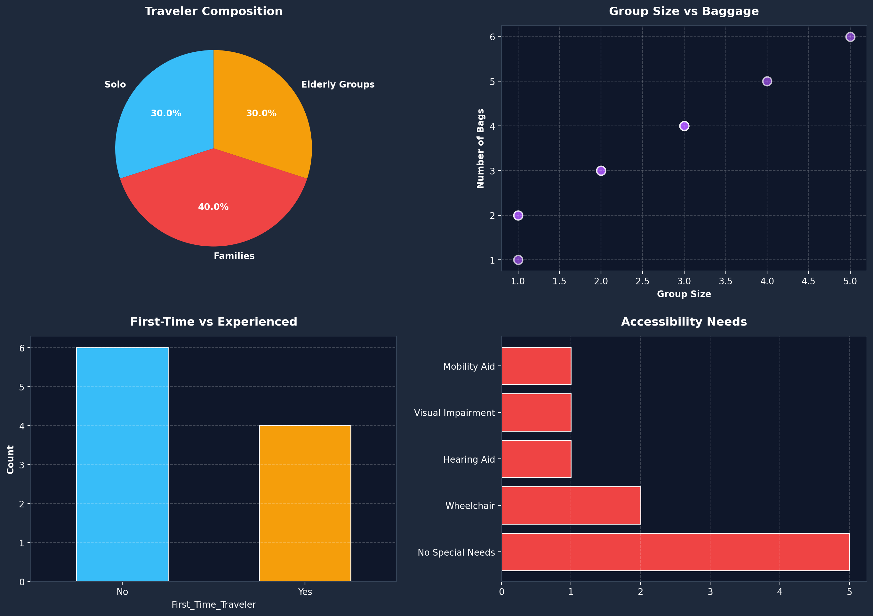
Visual Insights & Key Findings
Key Findings
• 10 passengers registered
• 10 unique destinations
• 4 first-time travelers
• 5 with accessibility needs
Sentiment Breakdown:
✓ Positive: 6
‒ Neutral: 3
✗ Negative: 1
Top Purposes:
Tourism: 4
Business: 3
Education: 2

Slide 6
Conclusion & Future Scope
What We Built
Future Scope
• End-to-end travel data management system
• NLP pipeline: Sentiment + NER + Summarization
• Interactive Tkinter GUI with 6 modules
• 4-plot visual dashboard for pattern analysis
• Inclusive design: accessibility, health, dietary
• Clean CSV data pipeline with auto-generation
• Database integration (SQLite / PostgreSQL)
• ML-based sentiment (transformers / BERT)
• Real-time flight API integration
• Web-based UI (Flask / Streamlit)
• Multi-language NER support
• Predictive analytics for travel trends
Thank You!
Passport Travel Readiness System | Data Science Case Study

