Slide 1
The Sales and Profit Conundrum

Slide 2
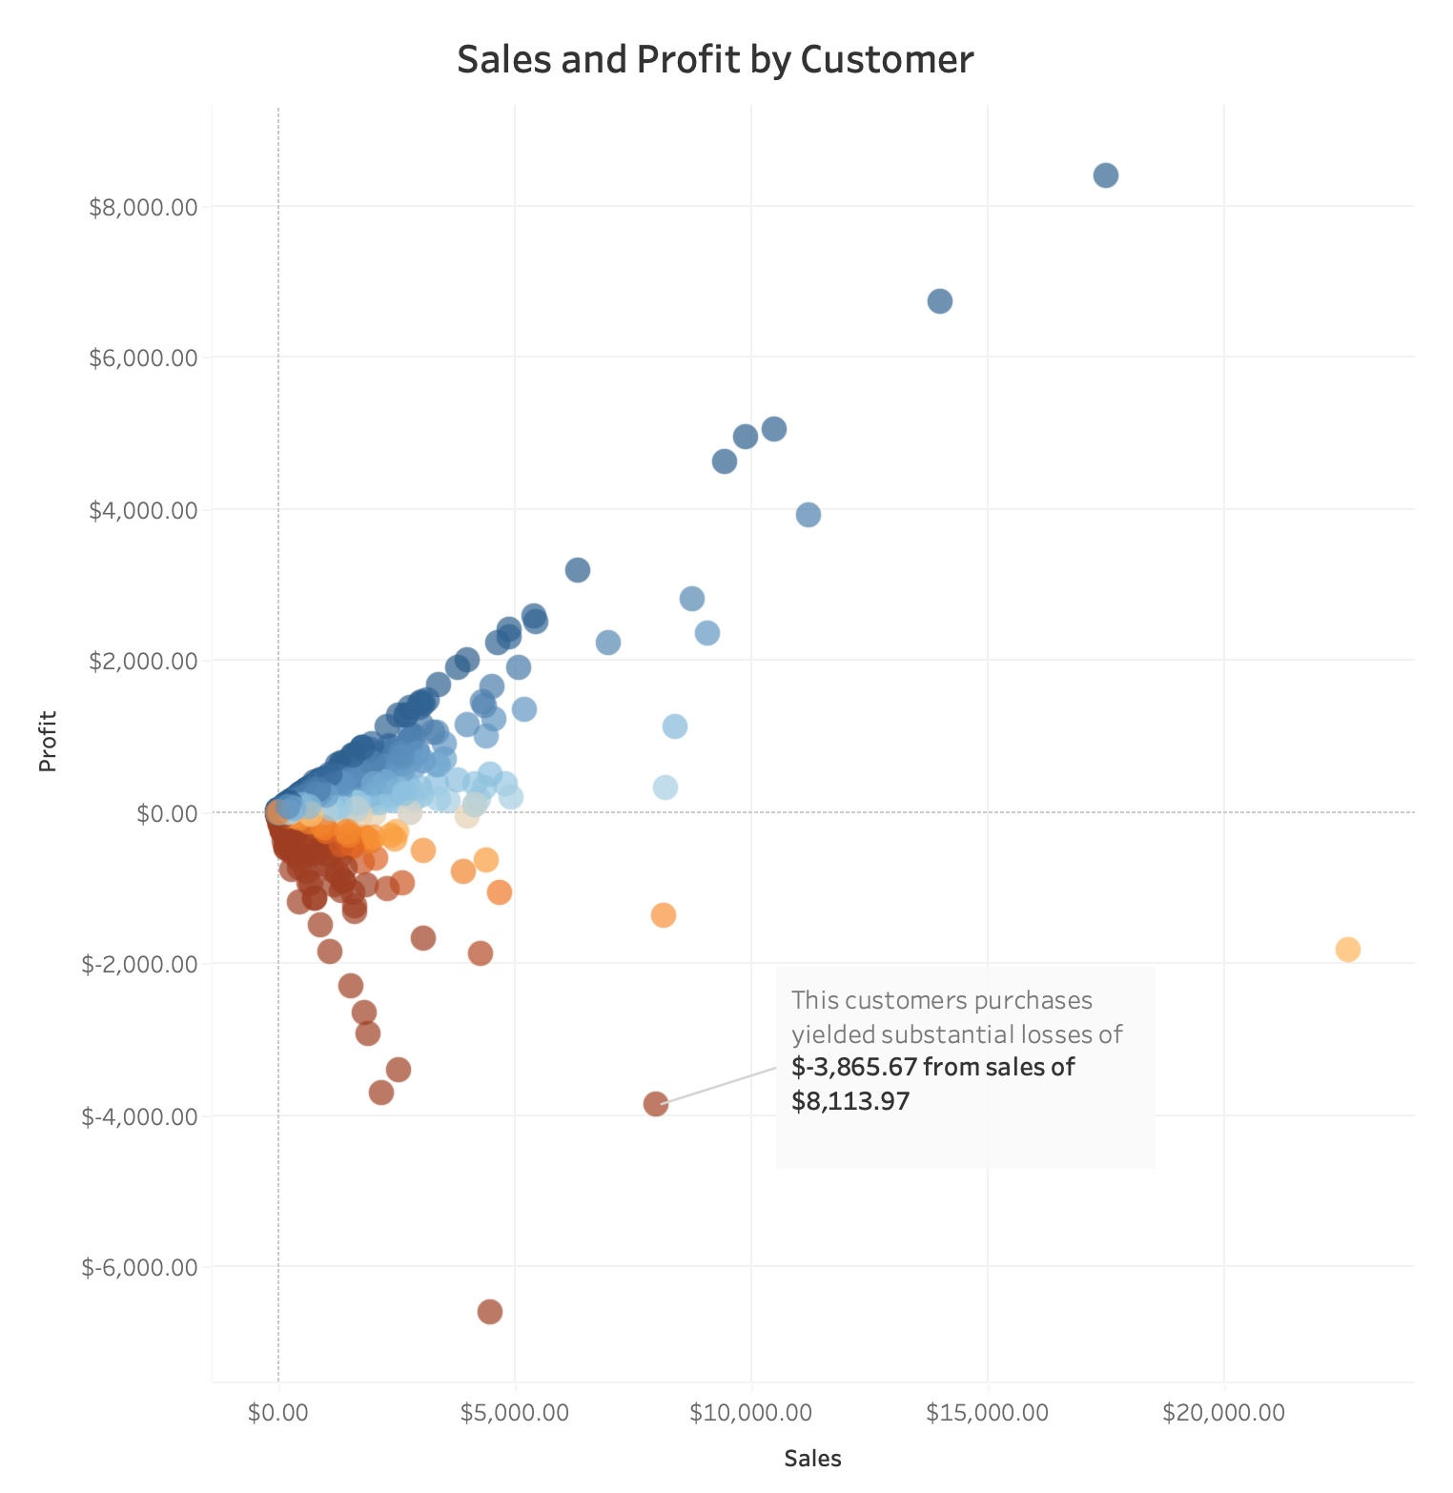
What’s the problem ?
Most Customers earn us a profit but
there are customers who have a
“lot” of sales yet the profit is a
loss!
Why ?

Slide 3
Three possibilities : Do any of these show a pattern ?
Geography
Type of products
Discounts

Slide 4
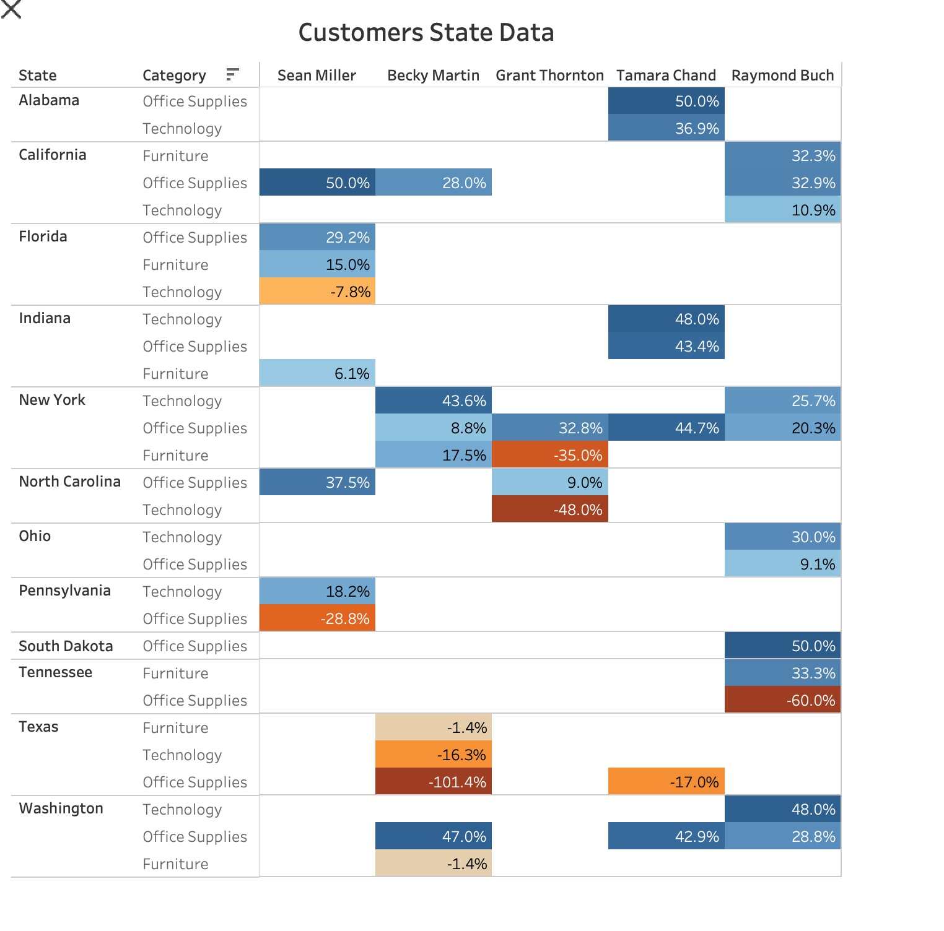


It’s not geography
Notes:
Sure Texas shows a big loss but that’s not a pattern and I want to show you a pattern. We should keep an eye on sales in Texas but let’s look further

Slide 5
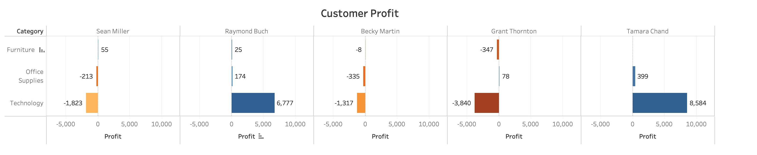
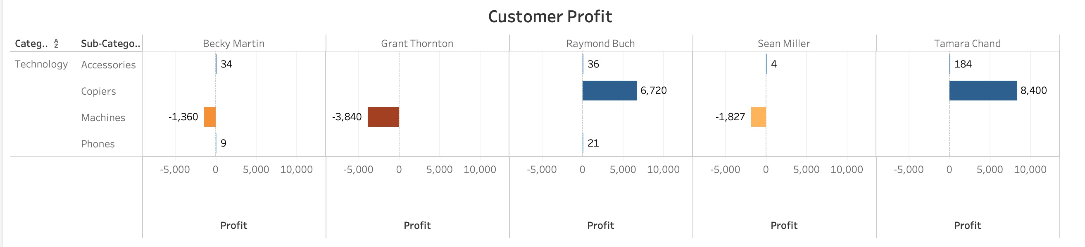
Yes, it’s type of products, but it’s not the category
Notes:
At first glance, the top visualization seems to imply that there isn’t a pattern by category. But when we drill down we see that the losses stem from sales of machines and profits stem from sales of copies

Slide 6
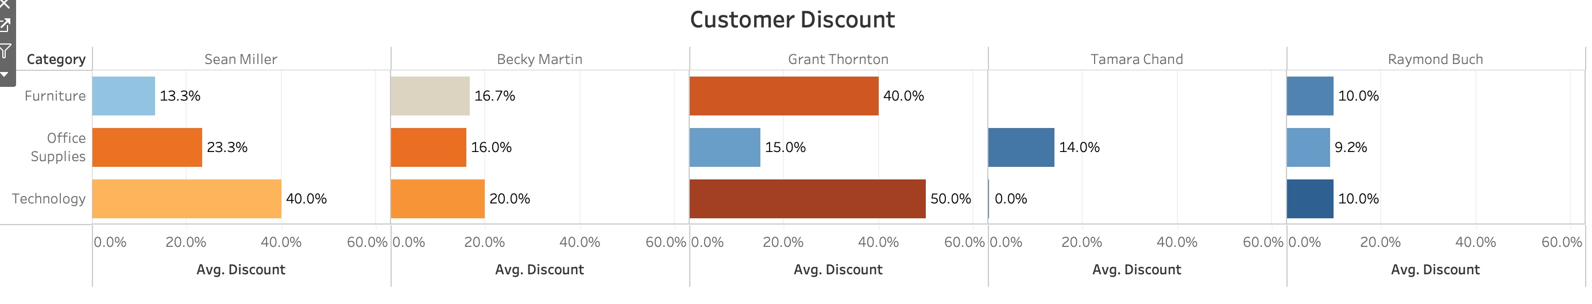
Yes, it’s the level of discounts.
Notes:
The pattern seems to be that if the discounts are too high, you might sell a lot of stuff but you will lose money on each sale.

Slide 7
Conclusions and recommendation
Sales by state may have outliers but there doesn’t seem to be a pattern. Therefore, I recommend not studying geography as a reason for losses in the first round.
Copiers are profitable, machines are not. Consider options on future sales of machines.
Some customers are receiving discounts on products well in excess of what is needed to maintain profitability. Consider reducing discounts.

