Slide 1

P R E D I C T I O N A N D D I A G N O S I S O F V A R I O U S H E A R T D I S E A S E S A N D C H A N C E S O F H E A R T A T T A C K
AJAY KUMAR GARG ENGINEERING COLLEGE, GHAZIABAD
Project Presentation on
Guided By,
Ms. Mamta Pant
Presented By,
Mayank Tyagi (2000270130102)
Mohit Arora (2000270130104)
Pragati Gupta (2000270130120)
Radhika Bhatt (2000270130128)

Slide 2

INTRODUCTION
Cardiovascular disease is one of the most lethal conditions in today’s world. It occurs across all age groups due to modern health concerns, environmental factors, dietary habits, and mental health issues. Cardiovascular diseases have become the leading cause of death worldwide over the last few decades, affecting developed, underdeveloped, and developing countries alike. Early detection of cardiac diseases and continuous supervision by clinicians can significantly reduce the mortality rate.
There is an urgent need for AI-based technologies capable of promptly and reliably predicting the future outcomes of individuals with cardiovascular disease. Heart disease detection using artificial intelligence (AI) involves leveraging machine learning algorithms and data analytics to analyze various health-related data and identify patterns indicative of cardiovascular conditions. The development and implementation of a heart disease detection and health advisory system, especially in the form of a conversational bot, address several critical needs and offer various benefits.

Slide 3
PROBLEM STATEMENT
The prevalence of cardiovascular diseases remains a major global health concern, necessitating innovative approaches for early detection, diagnosis, and preventive health management. This project introduces an integrated system comprising predictive analytics for heart diseases, a diagnostic module for identifying specific conditions, and a health advisory chatbot for personalized health guidance. The system utilizes machine learning algorithms to analyze health data, assess the risk of heart diseases, and provide timely insights for preventive measures.
This project focuses on developing the heart disease detection based on the patient health factors and developing the chat bot which will advise the patient based on their heart disease condition. The system features an intelligent and user-friendly GUI implemented using boosting algorithms and the Flask framework. The proposed project aims to develop and implement an AI-driven heart disease detection and health advisory system. This system, potentially in the form of a conversational bot, should address the following key objectives such as Early detection, Continuous monitoring, User-Friendly Interface.

Slide 4
OBJECTIVE AND SCOPE
This project holds significance objective in addressing the pressing need for early detection and continuous monitoring of heart diseases. By combining advanced technologies, boosting algorithms, and a user-friendly interface, the system aims to contribute to improved health outcomes and a more informed and engaged patient population.
The scope of this project is extensive, with potential medical and health applications which focuses on earlier disease detection, health educations, health care advisories.

Slide 5
TECHNICAL REQUIREMENTS
HARDWARE REQUIREMENTS
Intel(R) Core(TM) i5-7300U CPU @ 2.60GHz 2.71 GHz
4GB RAM
15MB Hard drive storage
SOFTWARE REQUIREMENTS
Anaconda Distribution
Vscode
Xampp Server

Slide 6
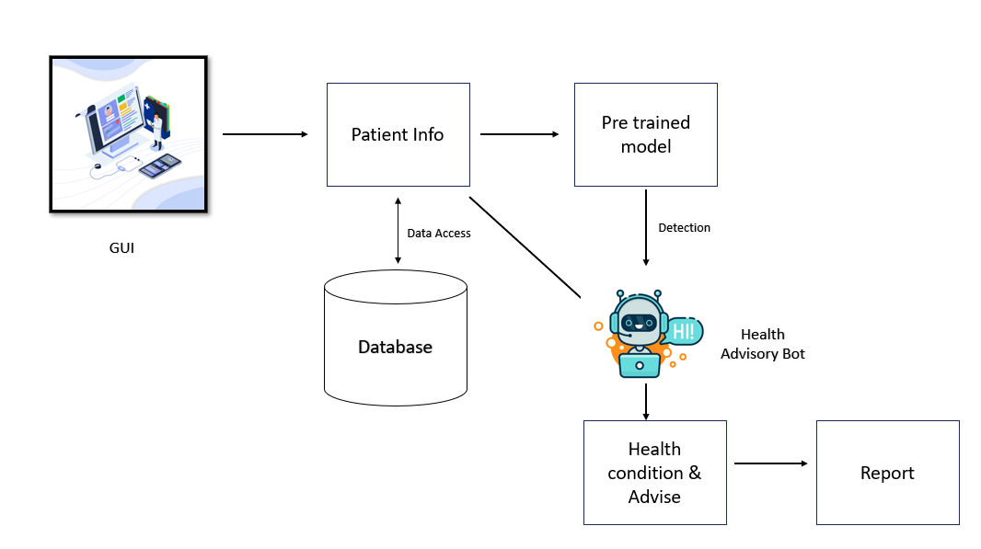
SYSTEM OVERALL ARCHITECTURE

Slide 7
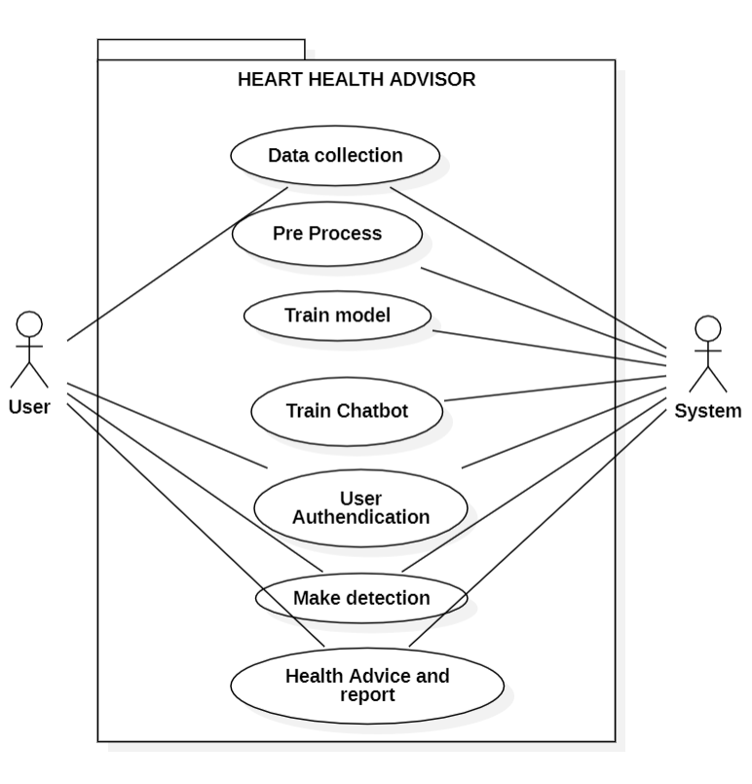
USE CASE DIAGRAM

Slide 8
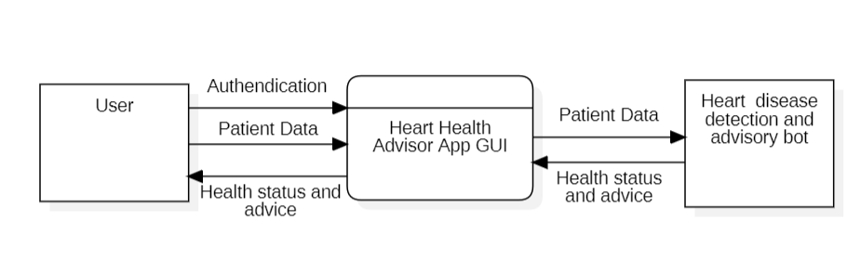
DATA FLOW DIAGRAM
LEVEL 0 DFD

Slide 9
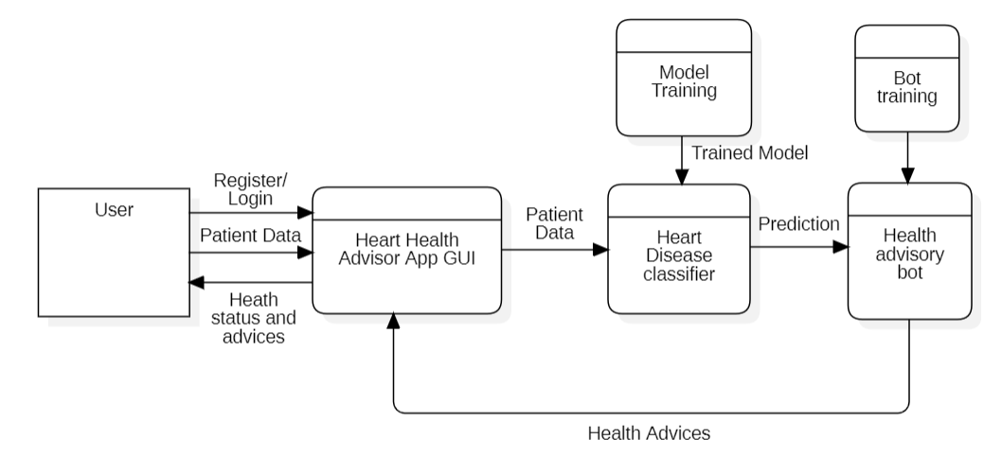
DATA FLOW DIAGRAM
LEVEL 1 DFD

Slide 10
METHODOLGIES USED
While talking about methodology, it divided as per the modules
Data collection and Preprocessing
Pandas
NumPy and Matplotlib
2. Heart Disease Detection
ML Boosting algorithms (XG Boost and Gradient Boost)
3. Health Advisor Bot
NLP
4. Web GUI
HTML, CSS
Bootstrap, jQuery
5. Data Management
MySQL Database

Slide 11
DATA COLLECTION
The data has been downloaded from the Kaggle data portal[6]. The number of data available in the dataset are
Patients Data : 319795 Rows
Pre process Done
Label Encoding
Labeling Binary columns
Dropping unwanted column by feature selection

Slide 12
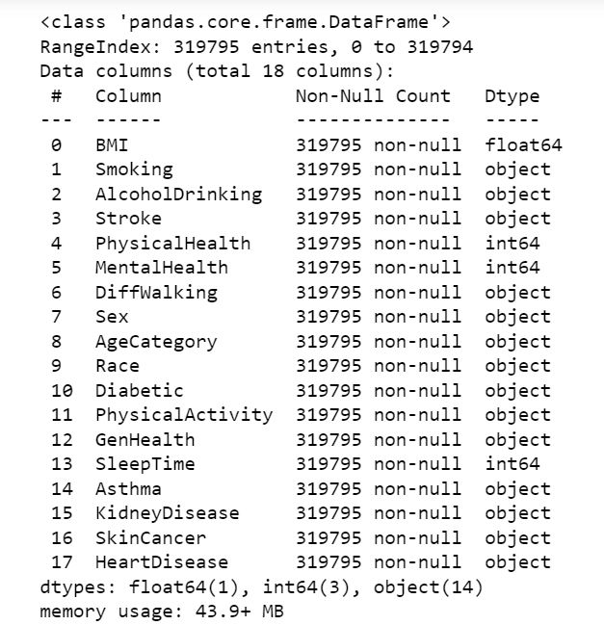
DATA PREPROCESS
Available columns

Slide 13
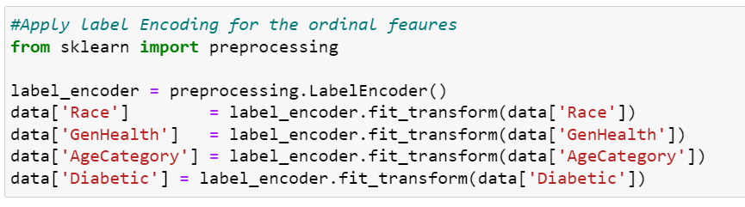
DATA PREPROCESS
Label encoding
Some of the column contain string data, which has to be converted into the numerical form for model training.

Slide 14
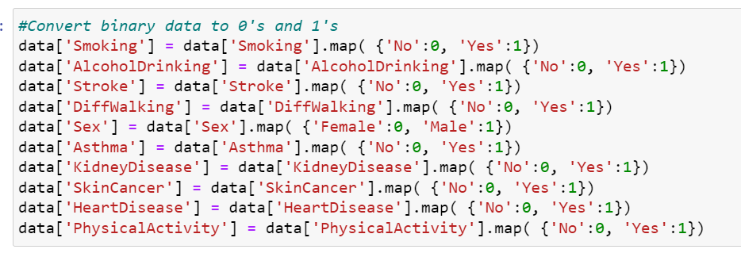
DATA PREPROCESS
Labelling binary columns

Slide 15
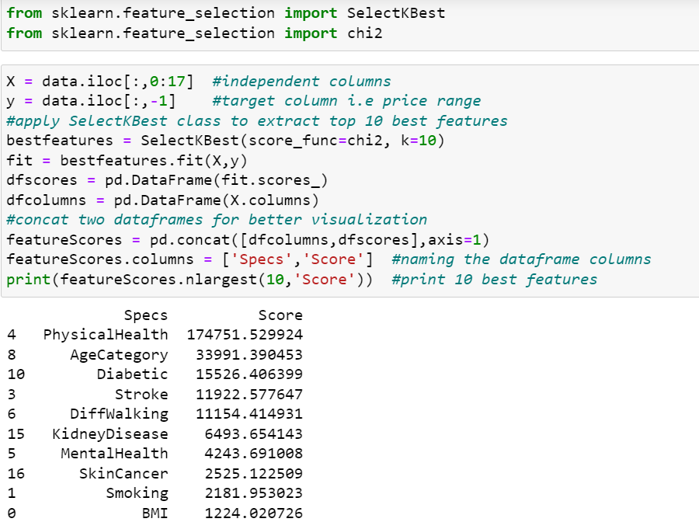
DATA PREPROCESS
Selecting Top dependent columns

Slide 16
PROJECT PROGRESS
Until this day we have completed up to the data analysis, preprocessing the data and the heart disease classification and had an good understanding on those phases. On the next progress we will concentrate over the chatbot development and web GUI development.

Slide 17
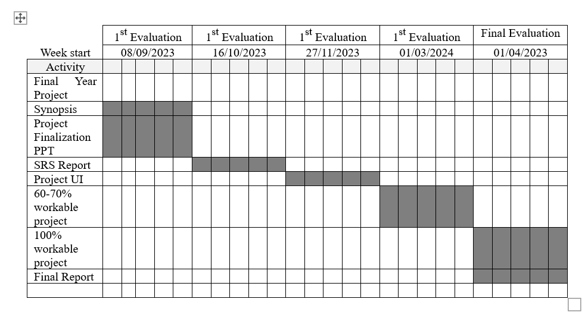
GANTT CHART

Slide 18
REFERENCES
Muniasamy, A.; Tabassam, S.; Hussain, M.; Sultana, H.; Muniasamy, V.; Bhatnagar, R. Deep Learning for Predictive Analytics in Healthcare. In Advances in Intelligent Systems and Computing; Springer: Cham, Switzerland, 2019; pp. 32– 42. [Google Scholar] [CrossRef]
Mijwil MM., Al-Mistarehi AH., Aggarwal K: The effectiveness of utilising modern artificial intelligence techniques and initiatives to combat COVID-19 in South Korea: a narrative review. Asian J. Appl. Sci. 9(5) (2021). (ISSN: 2321-0893)
Haq, A.U., Li, J.P., Memon, M.H., Nazir, S., Sun, R.: A hybrid intelligent system framework for the prediction of heart disease using artificial intelligence. Mobile Inform. Syst.. 2018, 1–21 (2018)
Barragán-Montero, A., Javaid, U., Valdés, G., Nguyen, D., Desbordes, P., Macq, B., Willems, S., Vandewinckele, L., Holmström, M., Löfman, F., Michiels, S.: Artificial intelligence and machine learning for medical imaging: a technology review. Physica Med. 83, 242–256 (2021)
Soni, J., Ansari, U., Sharma, D., Soni, S.: Predictive data mining for medical diagnosis: an overview of heart disease prediction . Int. J. Comput. Appl. 17(8), 43– 48 (2011)
https://www.kaggle.com/datasets/fedesoriano/heart-failure-prediction

