Slide 1
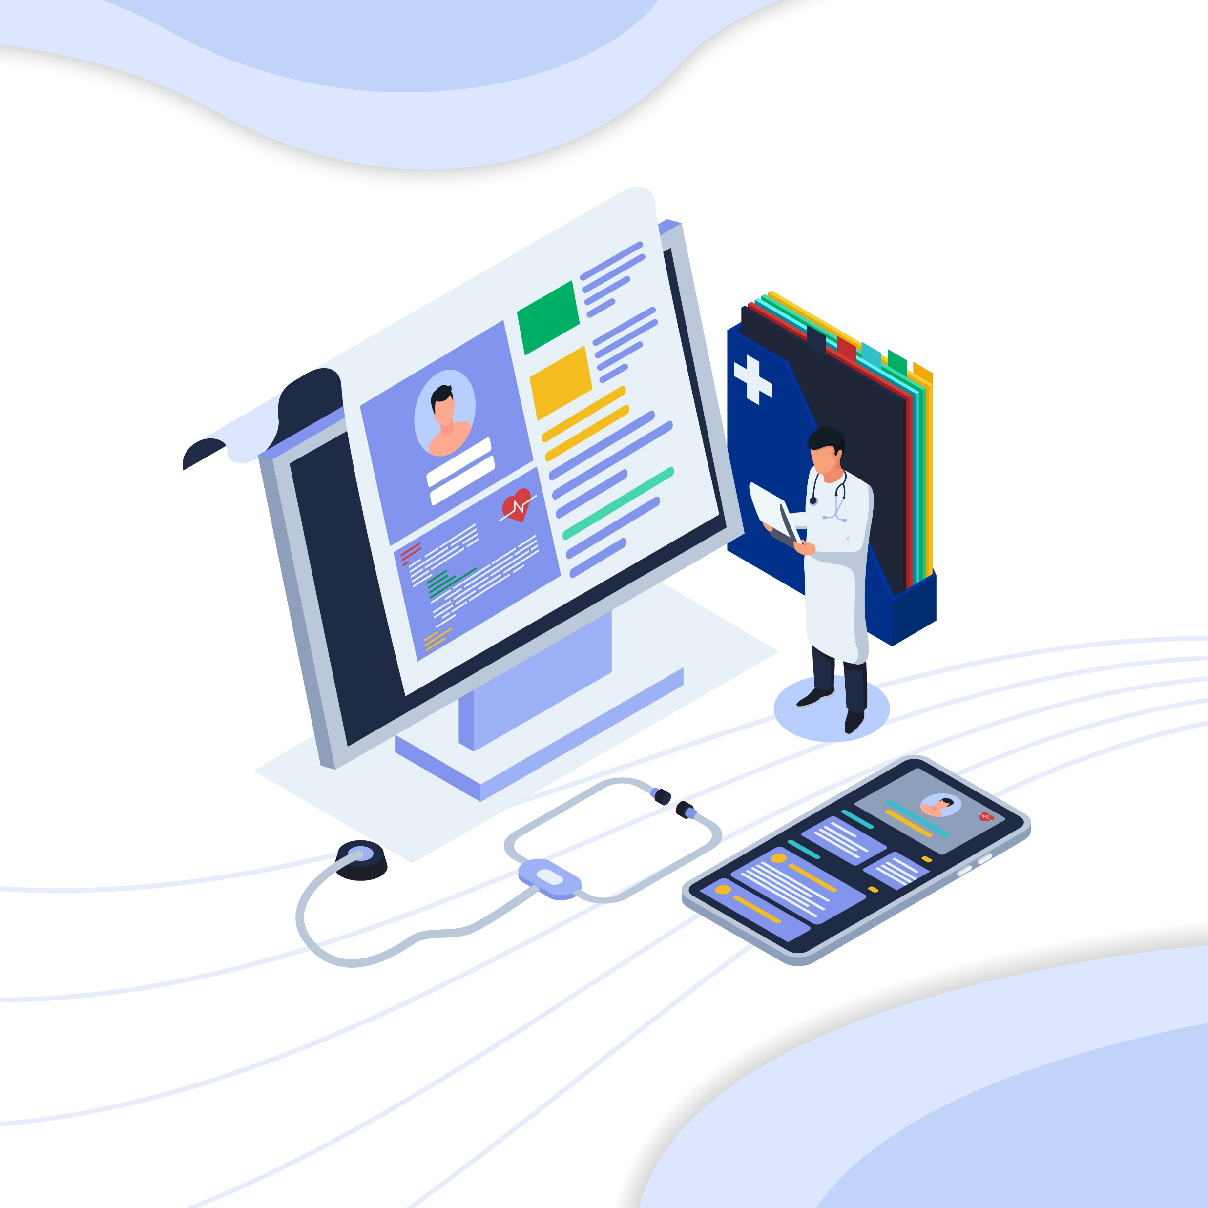

Patient Info
Pre trained model
Data Access
Detection
GUI
Database
Health Advisory Bot
Health condition & Advise
Report

