Slide 1
Ebay Beauty website under guidence of mrs.Vaishali sona0wane mam

Slide 2
Introduction
eBay is a global online marketplace, that enables individuals and businesses to buy and sell a wide variety of goods and services. It operates on both consumer-to-consumer (C2C) and business-to-consumer (B2C) models, offering products ranging from electronics, fashion, and home goods to collectibles and vehicles.
eBay is known for its auction-style listings as well as fixed-price “Buy It Now” options, giving users flexibility in how they purchase or sell items. With operations in over 190 countries and millions of active buyers and sellers, it provides secure payment methods, buyer and seller protections, and a platform for small businesses and entrepreneurs to thrive. Over the years eBay has becoming a trusted platform for rare, collectible, and everyday products while continuing to innovate in mobile shopping, personalized recommendations, and global trade.

Slide 3
Modlues
Module 1: Login – Allows a user to access their account by entering valid credentials (username/email and password). Validates authentication and error handling for incorrect credentials.
Module 2: Search a Product – Allows the user to search different products.
Module 3: Multiple Searches using ArrayList or Array – Performs repeated search operations on the site using a list or array of search terms. Helps verify that the search functionality works for multiple inputs.
Module 4: Add to Cart – Enables users to select products and add them to the shopping cart. Verifies that items are added correctly and the cart updates accordingly.
Module 5: Delete from Cart – Allows users to remove items from the shopping cart. Ensures that deletion works and the cart updates in real-time.

Slide 4
Modlues
Module 6: Change Login Name – Lets users update or modify their displayed account name. Checks that the new name is reflected properly in the account profile.
Module 7: Change Current Address – Provides functionality to update the shipping or billing address. Validates that the new address is saved and used for future transactions.
Module 8: Shop by Categories – Enables users to browse products by selecting different categories. Tests that category navigation and product listings load correctly.
Module 9: Select Particular Product & Find Description – Allows the user to select a product, right-click on its image, and verify its detailed description. Ensures product information is accurate and accessible.

Slide 5
Modlues
Module 10: Shop by All Categories Check – Tests the “Shop by All Categories” feature to ensure all categories are displayed and navigable, and that category-specific products appear correctly.
Module 11: Change Language via Settings – Lets users switch the application language through settings. Verifies that the interface language updates properly across all pages.

Slide 6

Overview
eBay is a global e-commerce platform that connects buyers and sellers. It allows individuals and businesses to buy and sell a wide variety of products, ranging from electronics, fashion, and collectibles to automobiles and services.
eBay supports both auction-style listings and fixed-price “Buy It Now” options, providing flexibility in transactions.
Key features include:
User Accounts: Buyers and sellers have personal accounts to manage transactions, track orders, and maintain feedback ratings.
Search & Categories: Products can be searched via keywords or browsed through organized categories.
Shopping Cart & Checkout: Users can add items to the cart, review, and purchase using multiple payment methods, including PayPal.
Global Marketplace: eBay operates in multiple countries, supporting international shipping and localized listings.
Settings & Customization: Users can personalize their experience by changing language, location, and notification preferences.
Security & Trust: eBay enforces buyer and seller protection programs to ensure safe transactions.

Slide 7
Defects
While Running a testcase at certain point some fields are not working as it is expected which is called as Defect.
I have created a defect report on two defects.

Slide 8

Defect identifier B_001
DEFECT SUMMARY :- After changing language in settings, some UI elements remain untranslated and still display in English.
TEST ID :- TC_020
TEST CASE NAME :- TC_CHANGE_LANGUAGE
MODULE NAME :- SETTINGS / LANGUAGE CHANGE
REPRODUCIBLE :- YES
SEVERITY :- HIGH
PRIORITY :- HIGH
RAISED BY :- Pragati
ASSIGNED TO :- DEVELOPER TEAM LEAD
DATE OF ASSIGNMENT :- [To be filled]
STATUS :- PENDING
SNAP SHOTS :- [Attach screenshot showing mixed-language UI]
FIXED BY :- DEVELOPER
DATE OF FIXING :- [To be filled]

Slide 9
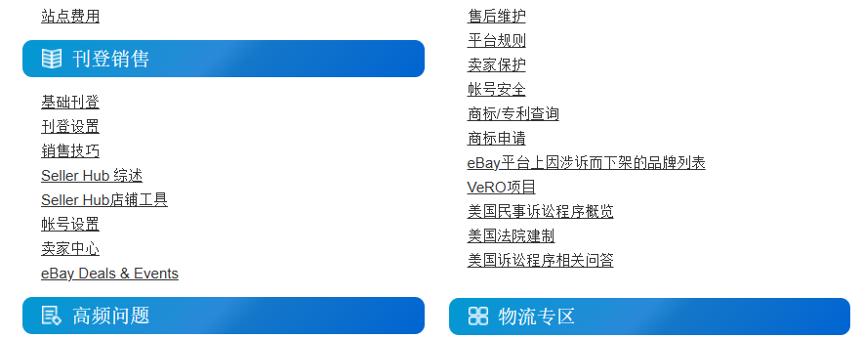

Slide 10
Defect identifier B_002
DEFECT SUMMARY :- Clicking on some categories of motors displaying an error message like 0 results found. Try Cars & Trucks or removing some filters to see more results even it is listing the related products.
TEST ID :- TC_021
TEST CASE NAME :- TC_SHOP_BY_CATEGORY
MODULE NAME :- SHOP BY CATEGORIES
REPRODUCIBLE :- YES
SEVERITY :- HIGH
PRIORITY :- HIGH
RAISED BY :- Pragati
ASSIGNED TO :- DEVELOPER TEAM LEAD
DATE OF ASSIGNMENT :- [To be filled]
STATUS :- PENDING
SNAP SHOTS :- [Attach screenshot of failed category navigation]
FIXED BY :- DEVELOPER
DATE OF FIXING :- [To be filled]

Slide 11
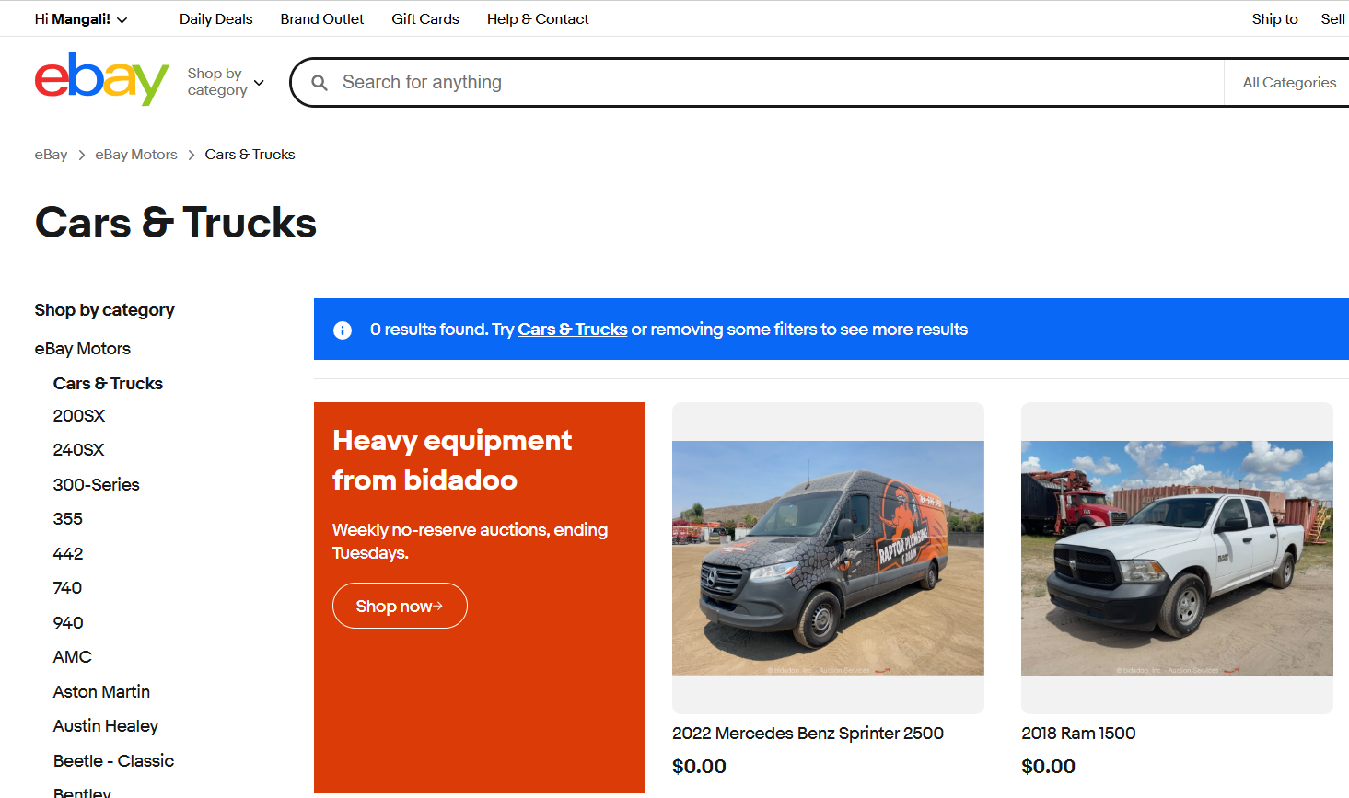

Slide 12
Challenges
1.Multiple Browsers & Devices
eBay is accessed worldwide on different browsers (Chrome, Safari, Firefox, Edge) and mobile devices.
Ensuring cross-browser and cross-device compatibility is complex.
2.Test Data Management
Requires large amounts of valid test data (user accounts, shipping addresses, payment methods, products).
Maintaining realistic test data without affecting production is challenging.
3.Localization & Internationalization
eBay supports multiple languages and regions.
Testing correct translations, currency conversion, date formats, and localized payment options is critical.
4.Performance & Load Testing
Millions of users access eBay simultaneously, especially during peak sales.
Ensuring site speed and stability under heavy load is difficult.

Slide 13

Experience
My Key Contributions & Learnings
1.Functional Testing
Designed and executed test cases for modules such as Login, Multiple Searches, Add/Delete from Cart, Checkout, and Shop by Categories.
Validated edge cases like invalid login, empty cart checkout, and incorrect address updates.
2.Automation Testing
Developed Selenium + TestNG scripts for regression testing.
Automated scenarios like searching multiple products using ArrayList, language change verification, and category navigation.
Implemented @DataProvider and @Parameters in TestNG to reuse test cases with multiple inputs.
3.Cross-Browser & Device Testing
Performed tests on Chrome, Firefox, Edge, and mobile browsers.
Verified responsiveness and ensured UI worked on different screen sizes.
From all this I get good hand on Finding bugs and writing test cases & automation scripts.

Slide 14
Thank you!
Mangali Pragati
Selenium Batch 8
mangalipragati98@gmail.com

