Slide 1





HEALTHIFY
Page 1

Slide 2
PREPARED BY
Priyati (24002171310022)
Pragati(24002171310065)
Swara(24002171910016)

Slide 3
TOPICS
Introduction
Objective
Functionalities
Languages Used
Merits and Demerits
Future Scope

Slide 4



INTRODUCTION
Healthify is a web-based healthcare management system that helps users book doctor appointments and access laboratory services online.
key Concept:- The key concept of Healthify is to digitize and simplify healthcare service access through an efficient, user-friendly platform.

Slide 5
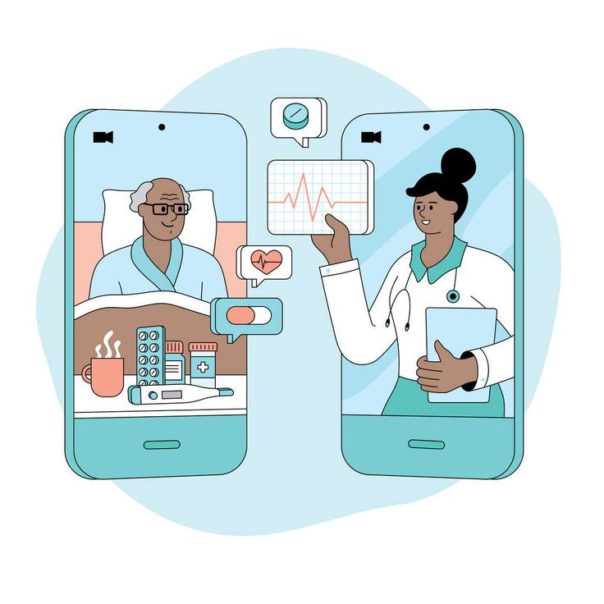

OBJECTIVE
•To develop a user-friendly online healthcare platform that enables patients to search doctors and laboratories, book appointments, and manage medical records efficiently.
•It main aims is to improve healthcare efficiency by reducing manual processes and enhancing digital health management.
www.reallygreatsite.com

Slide 6
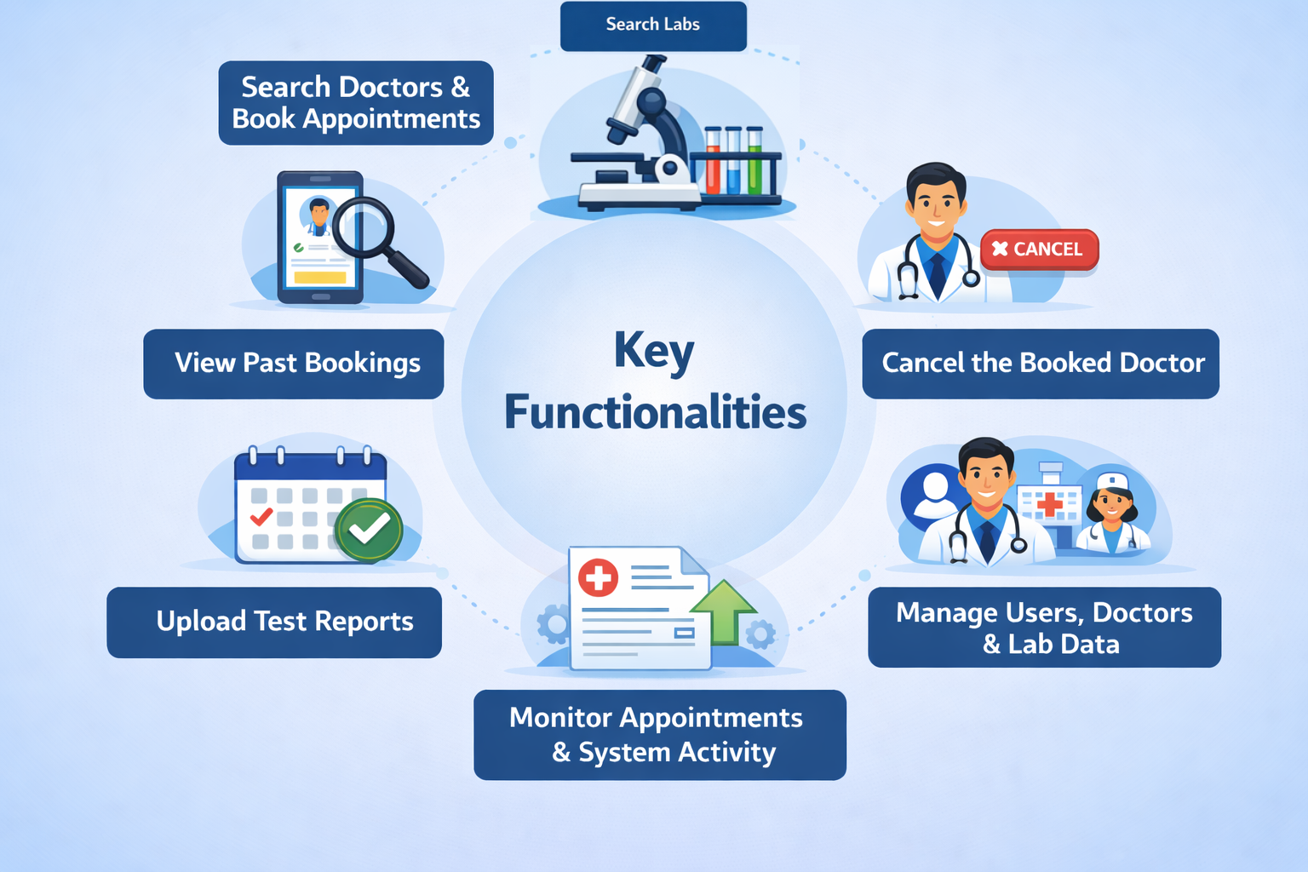
FUNCTIONALITIES

Slide 7

TOPICS USED
HTML
CSS
BOOTSTRAP
JAVASCRIPT

Slide 8
MERITS
DEMEITS
Easy and quick appointment booking
Reduces paperwork and manual effort
Improves healthcare accessibility
User-friendly and time-saving
Centralized data management
Requires stable internet connection
Data privacy and security concerns
Limited to online users only
May require technical support

Slide 9


Fauget
FUTURE SCOPE
Integration of online video consultations.
Addition of AI-based doctor recommendations.
Mobile app development for better accessibility.
Integration with wearable health devices.
Expansion to emergency and ambulance services.
Multi-language support for wider reach.

Slide 10
THANK YOU

