Slide 1
MACHINE UNDERSTANDABLE KNOWLEDGE STRUCTURE QUERY INTERFACE

Slide 2
INTRODUCTION
Natural language is difficult for computers to understand directly because computers do not think like humans. They require information to be organized in a structured format using proper models and data structures. This system connects human questions with machine-readable data by converting natural language into structured queries. As a result, it improves the accuracy and efficiency of retrieving information from the knowledge base.

Slide 3
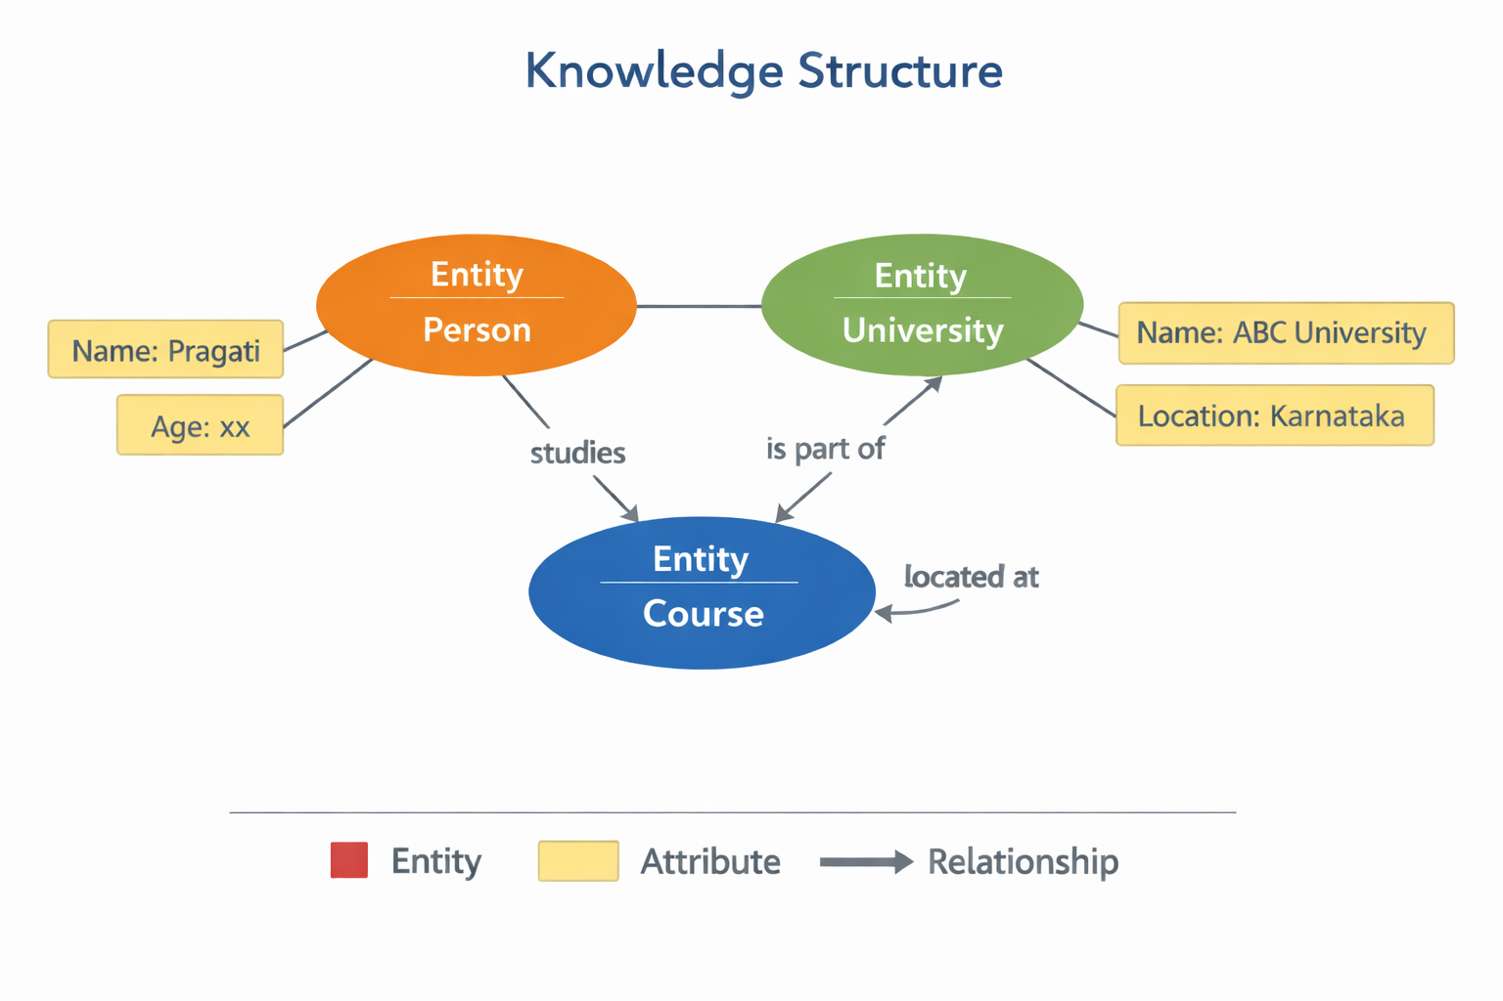
What is machine understandable knowledge?
Information is organized in a structured format so that computers can understand it easily. It uses data models such as ontologies, knowledge graphs, and RDF (Resource Description Framework) to define concepts and show relationships between different pieces of data. This structured approach helps machines process, store, and retrieve information in an intelligent and efficient way.
Knowledge Structure
A knowledge structure includes:
Entities (Objects like Person, Place, Event)
Attributes (Details like name, age, location)
Relationships (Connections between entities)

Slide 4
WHAT IS QUERY INTERFACE?
A query interface is a system that allows users to ask questions in simple language. It takes the user’s input and converts it into machine-readable queries that the computer or database can understand. After processing the query, it retrieves the relevant information from the database and displays the correct results to the user.
Examples :
Search engines
Chatbots
Database query systems

Slide 5
Architecture Diagram
User ↓ Query Interface ↓ Query Processor ↓ Knowledge Base ↓ Result Output
Technologies Used
SQL
SPARQL
RDF
OWL
Knowledge Graphs
AI & NLP

Slide 6
Applications
Search Engines
Medical Information Systems
Smart Assistants
E-learning Platforms
Recommendation Systems
Advantages
Faster information retrieval
Better data organization
Supports AI systems
Reduces human effort

Slide 7
THANKYOU

