Slide 1

Industrial Training Project
Stock Market
Price Prediction
Pragati Singh
00913211621
AIML(7th sem)

Slide 2
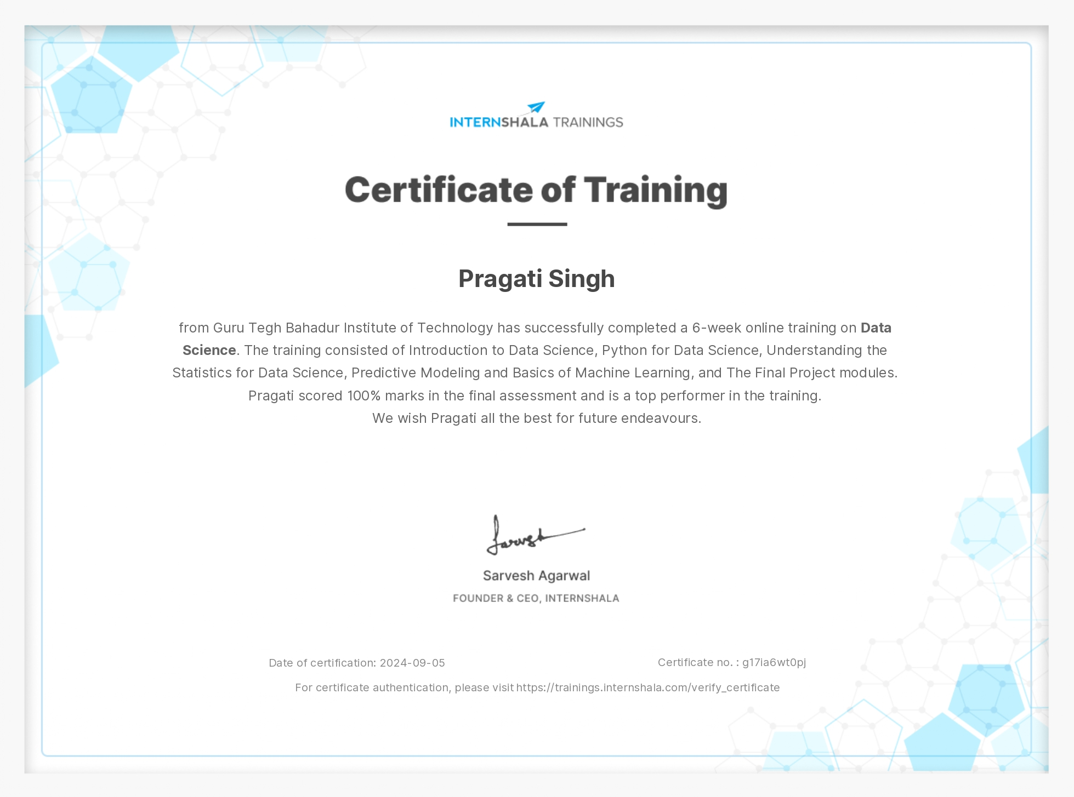
CERTIFICATE

Slide 3
Data Science Training
The foundation of this work is built upon the skills gained during a comprehensive 6-week certified training program on Data Science, which I completed through Internshala.
The training covered essential concepts, including Python programming for data science, statistics, predictive modeling, and machine learning algorithms.
These concepts were critical in developing a deeper understanding of data analysis techniques and machine learning models, enabling the successful completion of this project.
The skills gained from this training were directly applied to the stock market prediction project, where advanced machine learning techniques, specifically Long Short-Term Memory (LSTM) networks, were employed to predict stock prices.
The training also reinforced essential concepts such as data preprocessing, model evaluation, and visualization, which were pivotal in delivering a robust solution.

Slide 4
Modules Covered
1. Introduction to Data Science: This module introduced the foundational concepts of data science, including the data lifecycle, types of data, and the importance of data-driven decision-making across various industries.
2. Python for Data Science: In this module, the focus was on Python, the primary programming language used for data science. Topics covered included data manipulation, data cleaning, and the use of essential libraries such as NumPy and Pandas.
3. Understanding Statistics for Data Science: This module provided a deep understanding of statistical concepts, which are fundamental to data analysis. Topics such as probability distributions, hypothesis testing, and regression analysis were explored.
4. Predictive Modeling and Basics of Machine Learning: This was the cornerstone of the training, focusing on building predictive models. Key algorithms like linear regression, decision trees, and k-nearest neighbors were covered, along with an introduction to neural networks.

Slide 5
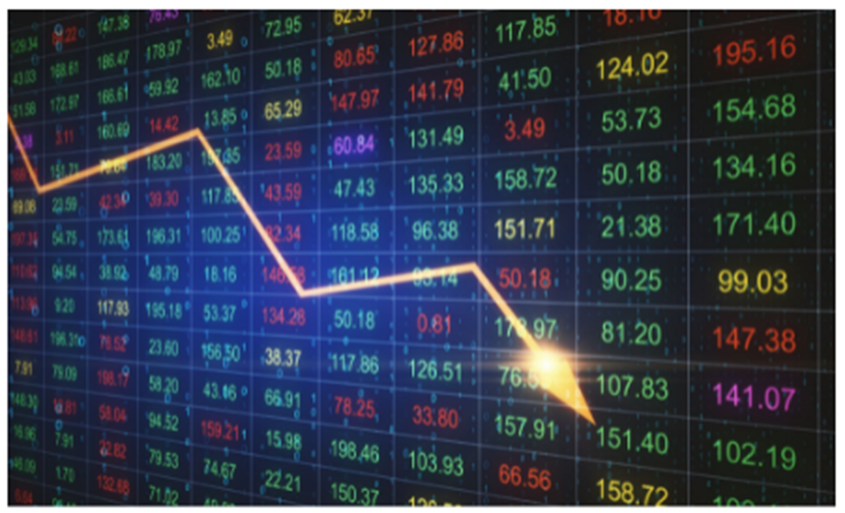
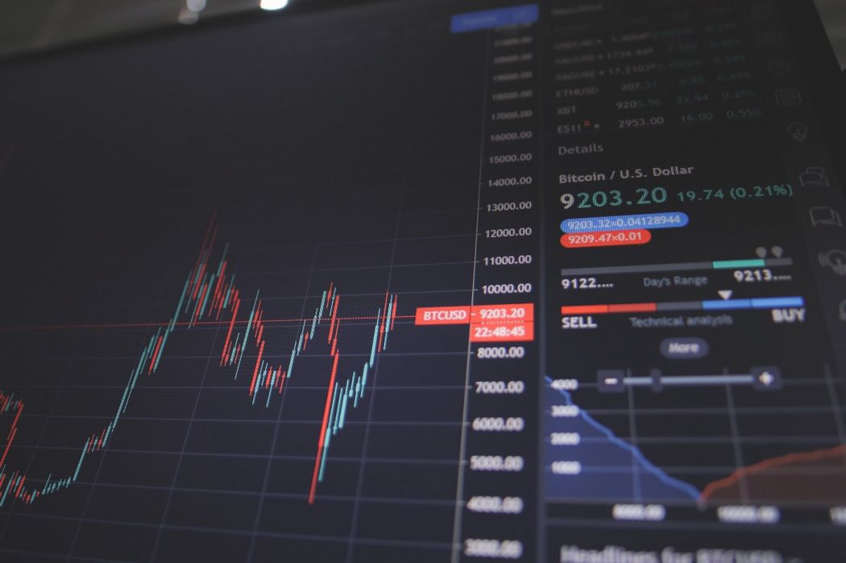
Project Objective
Predicting stock market prices using historical data and providing visualizations for analysis.
Dataset: Apple Inc. (AAPL) stock data from 2010-2019.
Developing an LSTM neural network for time-series forecasting.
Building an interactive web app using Streamlit for real-time stock analysis and prediction.

Slide 6
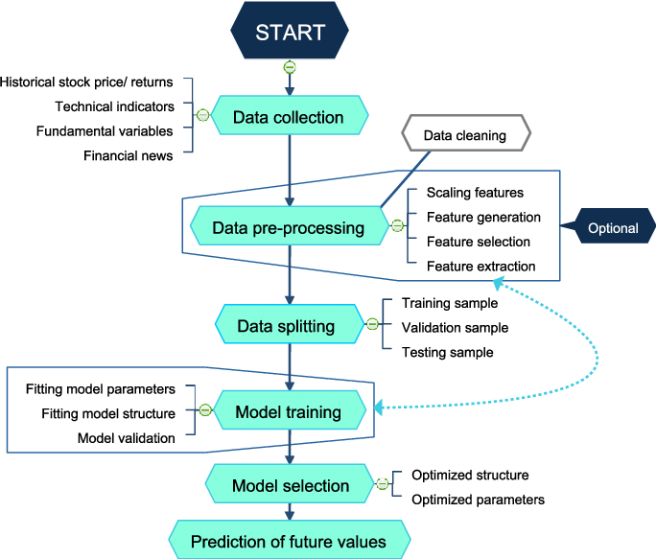
Methodology
Data Collection: Stock prices were obtained from Yahoo Finance using the yfinance library.
Data Preprocessing: Min-Max scaling, sequence generation, and splitting into training/testing sets.
Model: LSTM architecture with layers of LSTM units, Dropout, and Dense layers for stock price prediction.
Frameworks: TensorFlow, Keras, Streamlit for web app, yfinance for data fetching.

Slide 7
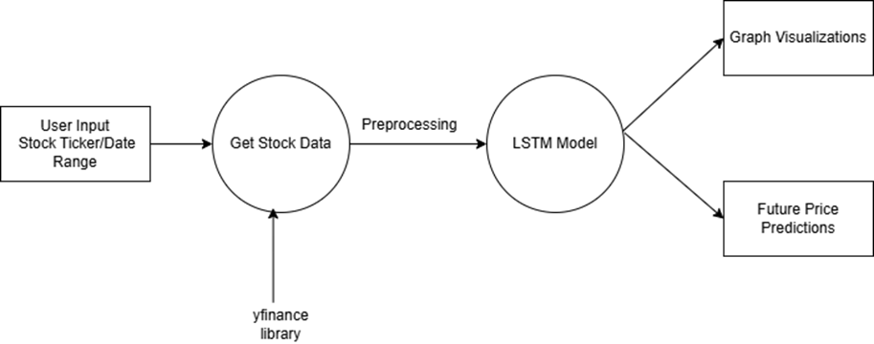
Data Flow Diagram
DATA FLOW
Data Input: The application accepts stock ticker inputs from users, along with the date range and the number of days for future prediction.
Data Fetching: Stock data is fetched from Yahoo Finance using yfinance.
Data Preprocessing: Collected stock data is preprocessed, including scaling and creating sequences for the LSTM model.
Model Prediction: The LSTM model generates predictions based on historical stock data.
Data Output: The predicted stock prices are displayed as visualizations in the Streamlit interface.

Slide 8
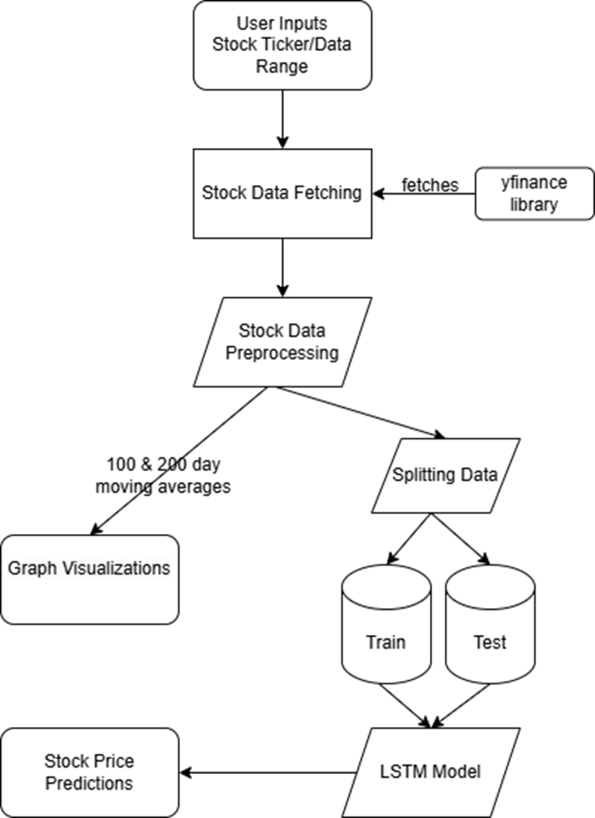
Work Flow Diagram

Slide 9
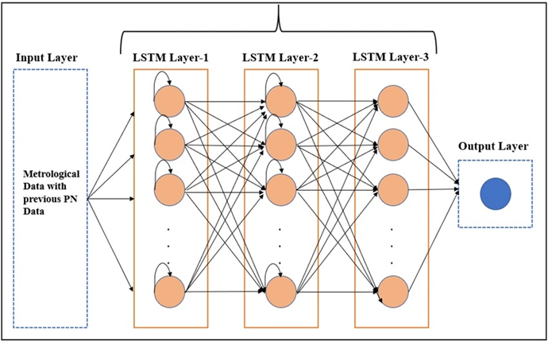
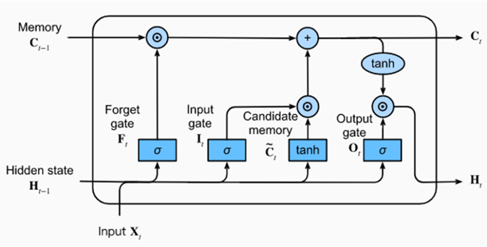
LSTM Model Architecture
Model Features: The LSTM model architecture consists of:
Input Layer: Takes in a sequence of past stock prices (50-day window).
LSTM Layers: The main component responsible for learning the sequential patterns in the stock prices.
Dropout Layers: Applied to the LSTM layers to mitigate overfitting.
Output Layer: Provides the predicted stock price.
Model Output: Predicted stock prices for future time periods based on past data.

Slide 10
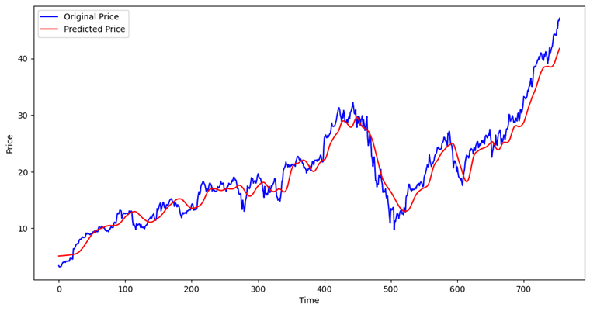
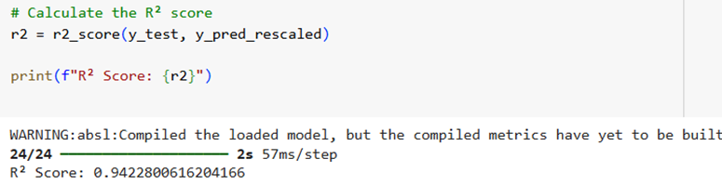
Results Model Performance: R² score of 0.9422 indicating good prediction accuracy. A visualization comparing actual vs. predicted stock prices was generated using the test data. The graph highlights that the model effectively captures the trends and overall movement of stock prices, though some deviation occurs over longer prediction windows.

Slide 11
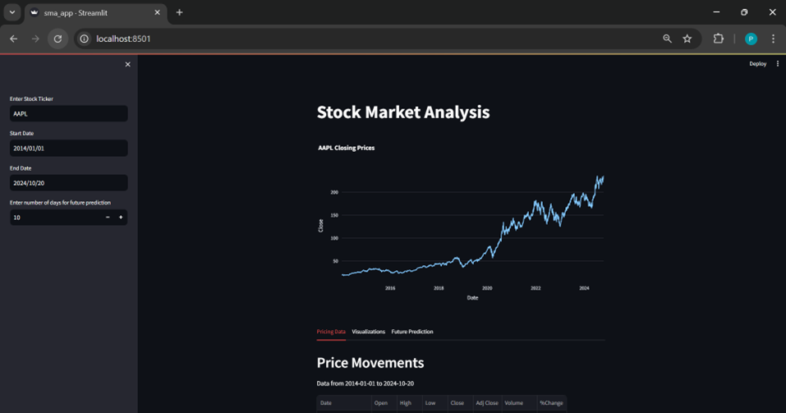
Streamlit Web App
User Interface:
Inputs: Stock ticker, date range, prediction window.
Outputs: Historical trends, moving averages, predicted prices.
Features:
Real-time stock data retrieval.
Interactive visualizations for better decision-making.

Slide 12
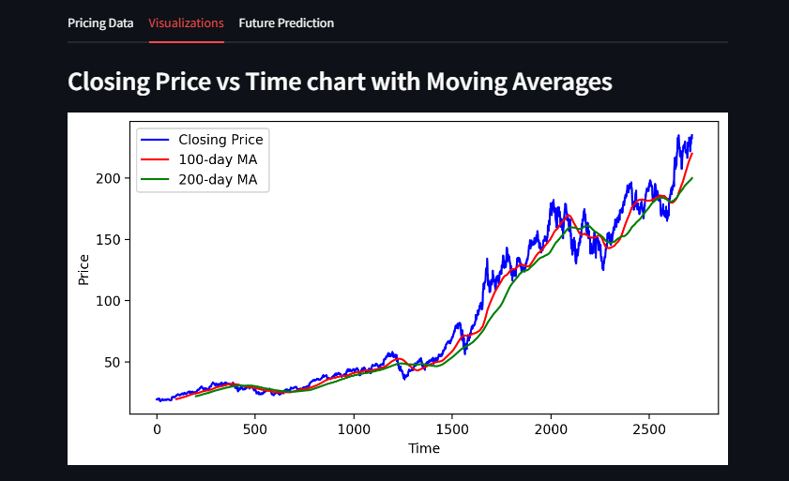
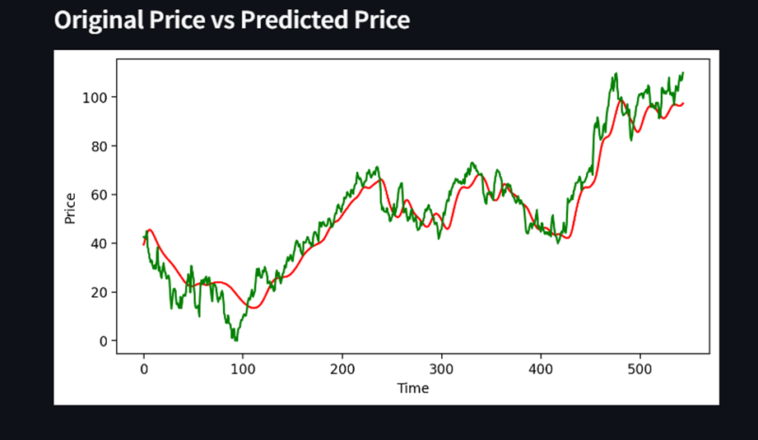
Graphical Visualizations

Slide 13
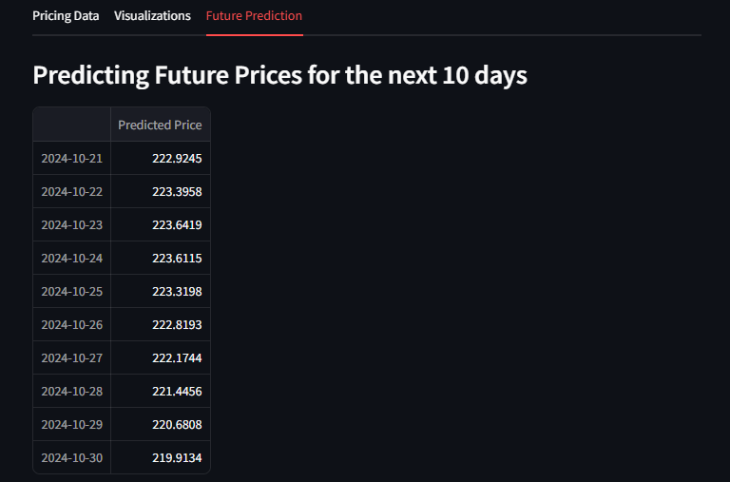
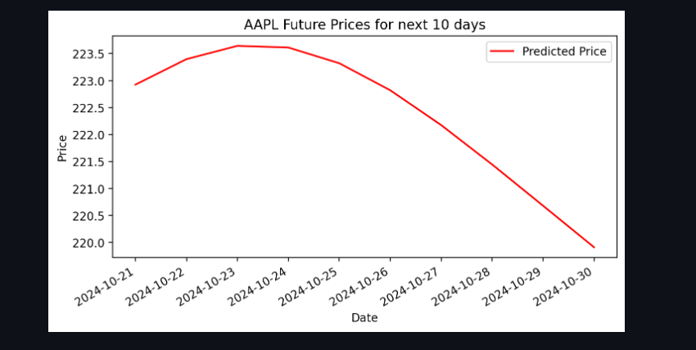
Future Price Prediction

Slide 14
Conclusion
Effective Use of LSTM:
The Long Short-Term Memory (LSTM) model was successfully applied to predict stock market prices.
The LSTM model captured both short-term fluctuations and long-term trends in stock prices, showcasing its robustness for time-series forecasting.
Streamlit Web App:
An intuitive and interactive web app was developed, allowing users to visualize historical trends and future price predictions.
The app facilitates easy real-time analysis for users, making stock trend analysis accessible to both technical and non-technical users.
Project Impact:
This project demonstrates how machine learning and deep learning techniques can be integrated to solve real-world financial forecasting problems.
The platform offers a practical tool for investors and analysts to make informed decisions based on data-driven insights.

Slide 15
Future Scope
Incorporate Additional Data Sources:
Expand the model by including external factors such as news sentiment, economic indicators, and market volatility indices.
Adding these features can enhance the accuracy of the predictions, especially for longer-term forecasts.
Improve Long-Term Prediction Accuracy:
Explore advanced models like hybrid deep learning techniques or ensemble models to handle stock market volatility more effectively.
Further training and tuning of the model to minimize prediction error over longer time frames.
User-Centric Enhancements:
Introduce features like customized alerts for stock trends or significant market movements.
Provide more advanced visualizations, such as candlestick charts, and detailed performance metrics.
Potential for Deployment:
Further development could lead to deploying this app as a commercial product for financial institutions, enabling broader use in the financial technology sector.

Slide 16
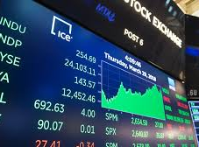
Thank You

