Slide 1
Deep Learning Aided Traffic Violation Detection Using Video Footage
D.G.P. Madhusanka (MSC/DSA/098)
Supervisor : Prof. T.G.I. Fernando

Slide 2
Introduction & Research Problem (Recap)
Background
Traffic violations are increasing due to reckless driving and ineffective enforcement, necessitating automated solutions for improved road safety.
Problem Statement:
Manually analyzing large volumes of traffic violation footage is inefficient, highlighting the need for an AI-powered detection system.
Why is this important?
Automated traffic violation detection can enhance law enforcement efficiency, reduce accidents, and improve road discipline.

Slide 3
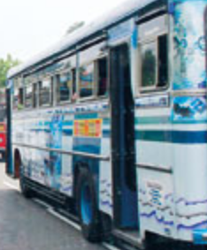
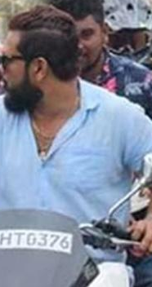
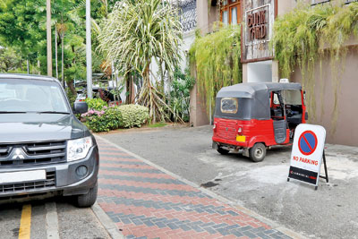
Research Objectives & Scope (Recap)
We initially planned to detect the following violations as objectives:
Detecting violations of illegal lane crossing of vehicle.
Detecting riders not wearing helmets.
Detecting illegal parking.
Detecting vehicles turning at junctions without using signal lights.

Slide 4
Literature Review Summary (MAIN)
Topic | link | Summary | Why it not matching our need
Traffic Violation Detection System | https://journals.sjp.ac.lk/index.php/contre/article/view/7390/5270 | This was based on CCTV fix position camera | The dynamic nature of the video has not been addressed
Traffic Squad - Smart Traffic Violation Detection System | https://www.ijarp.org/published-research-papers/jun2023/Traffic-Squad-Smart-Traffic-Violation-Detection-System.pdf | Not Detail explanation. | Poor documentation.
Computer Vision Based Approach for Traffic Violation Detection | http://ir.kdu.ac.lk/bitstream/handle/345/2953/FOC%20136-139.pdf?sequence=1&isAllowed=y | This is based on the mathematical modeling of computer vision-based detection | Lack of deep learning accuracy and challenging environmental conditions

Slide 5
Literature Review Summary (Lane detection)
Topic | link | Summary | Why it not matching our need
SCNN | https://github.com/XingangPan/SCNN | This is a common lane detection method.. Like a base library for the lane detection neural networks. This is based on a CNN. All below are derived from this library. | Old and lacks lane type detection support.
Ultra-Fast-Lane-Detection | https://github.com/cfzd/Ultra-Fast-Lane-Detection/tree/master | In the beginning, I used this repo and built on it, but later switched to LVLane due to unsupported lane types. | On the positive side, this is super fast. Good accuracy. No lane type categorization support.
Fast lane variation | https://github.com/yichenchan/Ultra-Fast-Lane-Detection-Attributes | This is a variation of Fast Lane, but it is not well-documented and is much more complex. | Not tool rich. Complex. Not well documented.(Repo also in Chinese)
LVLANE | https://github.com/zillur-av/LVLane | Supports lane type detection Well-documented. Rich toolset for the ecosystem Fairly well reproducible. Pitfall: Not as accurate as FastLane, but this can be mitigated with fine-tuning | TBD. (currently going with this) ☺ Fairly new; I was the second to fork it.

Slide 6

Methodology
Most traffic violations are captured by vehicle dash cameras, and they are dynamic.
Due to advancements in deep learning (DL) technology for autonomous driving, there are many existing DL models available
Passvive vodice
Illegal Lane change detection:
We have very short timeline and with scope consideration we try to address this lane violation detection with lane detection + vehicle position to detect the violation.
Fine-tune the existing lane detection model to make it applicable for Sri Lankan roads
Tools: LVLane (Spatial CNN variation | pytorch)

Slide 7
Methodology (Cont.…)
Video footages are highly dynamic.
We narrow the scope to conduct research on vehicle dash camera due to following reason.
Most of the violations are coming from vehicle dash camera
Lane detection are highly active area of research due to autonomous drive
It easy for us to obtain pre-trained models and fine-tune on Sri Lankan roads.
Lane Detection is highly critical for this research
Conducted advance literature review on the subject to cater our need.

Slide 8
Methodology (Cont.…)
Lankan roads.
Tools: LVLane (Spatial CNN variation | pytorch)
Helmet violation detection.
Planned to use a pre-trained YOLO model and fine-tune it with transfer learning.
Illegal parking detection.
Planned to use a pre-trained YOLO model and fine-tune it with transfer learning.
Illegal turn without signal light
Illegal turn without a turn signal.

Slide 9

Progress & Key Findings
Initially, Hough Transformation was used for lane detection, but it is not accurate in challenging conditions, such as curved roads that are not fully visible or roads blocked by vehicles.
Then, we switched to a deep learning (DL) model for lane detection.
There were many libraries available for lane detection..
Ultra-Fast-Lane/ SCNN/LVLane
But it is critical for us to find the matching lane type
Conducted an intensive search to find something similar to that one, ensuring it is well-documented
Found one and now refining it while understanding the tools to support transfer learning.

Slide 10

Remaining Work & Future-Plans
The most challenging task is lane violation detection also depends the downstream app. ( Working Progress)
Now I am starting to fine-tune it for Sri Lankan lanes ( data processing annotation time consuming task..)
Helmet violation detection started with a pre-existing YOLO model; fine-tuning is needed as well. (Not started)
Illegal parking violation detection. ( Not started)
Detecting vehicles turning at junctions without using turn signal lights.
(This can be aided by a lane detection model in the previous task)

Slide 11
Thank you.
Questions and Answer

