Slide 1
Deep Learning Aided Traffic Violation Detection Using Video Footage
D.G.P. Madhusanka (MSC/DSA/098)
Supervisor : Prof. T.G.I. Fernando

Slide 2
Introduction & Research Problem (Recap)
Background
Traffic violations are increasing due to reckless driving and ineffective enforcement, necessitating automated solutions for improved road safety.
Problem Statement:
Manually analyzing large volumes of traffic violation footage is inefficient, highlighting the need for an AI-powered detection system.
Why is this important?
Automats traffic violation detection can enhance law enforcement efficiency, reduce accidents, and improve road discipline.

Slide 3
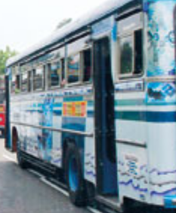
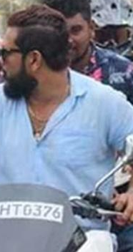
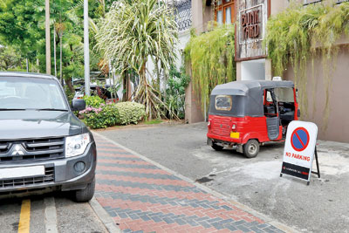
Research Objectives & Scope (Recap)
We initially planned to detect the following violations as objectives:
Detecting violations of illegal lane crossing of vehicles.
Detecting riders not wearing helmets.
Detecting illegal parking.
Detecting vehicles turning at junctions without using signal lights.
The scope is narrowed to conduct research on vehicle dash camera video footages:
Videos captured of traffic violations are highly dynamic and difficult to train on all aspects.
Most of the violation’s videos are recorded by vehicle dash cameras.

Slide 4
Literature Review Summary (MAIN)
Reference | Summary | Why it not matching our need
[1] A. M. S. Adikari and S. M. S. P. Karunarathne, "Traffic Violation Detection System," Proceedings of the International Conference on Road and Traffic Engineering, 2020. | This was based on CCTV fix position camera. | The dynamic nature of the video has not been addressed.
[2] R. K. Mohammed, "Traffic Squad - Smart Traffic Violation Detection System," International Journal of Advanced Research and Publications, vol. 6, no. 6, pp. 21-28, June 2023. | No Detail explanation is available. | Poor documentation.
[3] A. M. S. Adikari and S. M. S. P. Karunarathne, "Computer Vision Based Approach for Traffic Violation Detection," Proceedings of the 12th International Research Conference, General Sir John Kotelawala Defence University, Sri Lanka, pp. 136-139, 2019. | This is based on the mathematical modeling of computer vision-based detection. | Lack of deep learning. Accuracy and challenging environmental conditions.

Slide 5
Literature Review Summary (Lane detection)
Reference | Summary | Why it not matching our need
[1] X. Pan, J. Shi, P. Luo, X. Wang, and X. Tang, "Spatial As Deep: Spatial CNN for Traffic Scene Understanding | This is a common lane detection method. Like a base library for the lane detection neural networks. This is based on a CNN. All below are derived from this library. | Old and lacks lane type detection support.
[2] Z. Qin, H. Wang, and X. Li, "Ultra Fast Structure-aware Deep Lane Detection," arXiv preprint arXiv:2004.11757, 2020. | In the beginning, I used this repo and built on it but later switched to LVLane due to unsupported lane types. | On the positive side, this is super fast. Good accuracy. No lane type categorization support.
[3] Z. Qin, H. Wang, and X. Li, "Ultra Fast Structure-aware Deep Lane Detection, | This is a variation of the Fast Lane, but it is not well-documented and is much more complex. | Lacks extensive tools. Complex. Not well documented (Repo also in Chinese).
[4] Z. Rahman and B. T. Morris, "LVLane: Deep Learning for Lane Detection and Classification in Challenging Conditions," arXiv preprint arXiv:2307.06853, 2023 | Supports lane type detections. Well-documented. Rich toolset for the ecosystem. Reproducible. Pitfall: Not as accurate as FastLane, but this can be mitigated with fine-tuning | TBD. (currently going with this) ☺ Fairly new; I was the second to fork it.

Slide 6

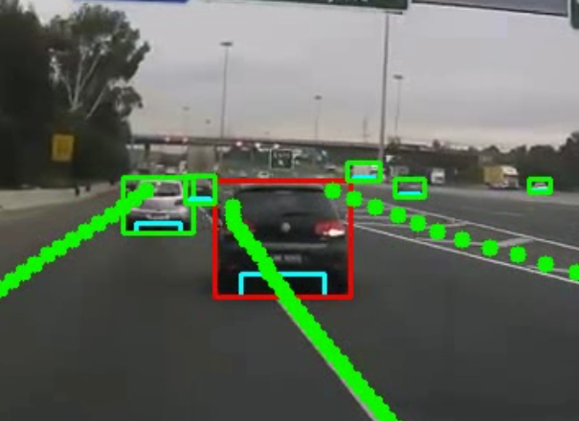
Methodology
Illegal Lane change detection:
Given our short timeline and scope constraints, we aim to detect lane violations by integrating lane detection with vehicle position analysis..
Fine-tune the existing lane detection model to make it applicable for Sri Lankan roads.
Tools:
LVLane ( Spatial CNN variation)
Assistive Python libraries like PyTorc, SciPy
VGG for lane annotations.

Slide 7
Methodology (Cont…)
Helmet violation detection.
Planned to use a pre-trained YOLO model and fine-tune it with transfer learning.
Illegal parking detection.
Planned to use a pre-trained YOLO model and fine-tune it with transfer learning.
Illegal turn without signal light
Illegal turn without a turn signal.

Slide 8

Progress & Key Findings
As previously described, lane detection is highly important in this research.
Initially, a manual Hough Transformation was used for lane detection, but it is not accurate in challenging conditions, such as curved roads that are not fully visible or roads blocked by vehicles.
Then, a deep learning (DL) model was adopted for lane detection.
Many libraries were made available for lane detection due to the advancements in autonomous driving, which is an active research field:
SCNN, Ultra-Fast-Lane, LVLane
However, finding a model that is capable of identifying lane types is critical for this research.
An intensive search was conducted to find something that caters to our needs while ensuring it was well-documented.
One has been found and is now being refined.

Slide 9

Remaining Work & Future-Plans
The most challenging task is lane violation detection also depends the downstream application ( Working Progress).
Now I am starting to fine-tune it for Sri Lankan lanes ( data processing annotation time consuming task).
Need to cross validate once fined tuned.
Helmet violation detection started with a pre-existing YOLO model; fine-tuning is needed as well (Not started).
Illegal parking violation detection ( Not started).
Detecting vehicles turning at junctions without using turn signal lights (This can be aided by a lane detection model in the previous task) ( Not started).

Slide 10
Thank you !
Questions and Answers.

