Slide 1
Deep Learning Aided Traffic Violation Detection Using Video Footage
D.G.P. Madhusanka(MSC/DSA/098)
Supervisor : Prof. T.G.I. Fernando

Slide 2
Introduction & Research Problem
Background
Traffic violations are increasing due to reckless driving and ineffective enforcement, necessitating automated solutions for improved road safety.
Problem Statement:
Manually analyzing large volumes of traffic violation footage is inefficient, highlighting the need for an AI-powered detection system.
Why is this important?
Automated traffic violation detection can enhance law enforcement efficiency, reduce accidents, and improve road discipline.

Slide 3
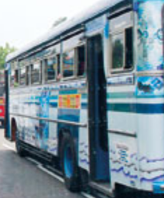
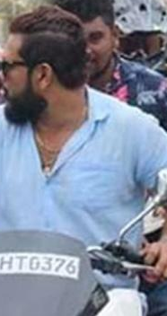
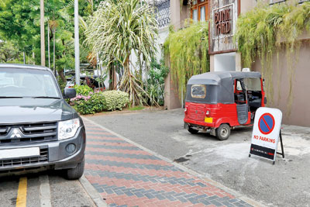
Research Objectives & Scope
We initially planned to detect the following violations as objectives:
Detecting violations of illegal lane crossing of vehicle.
Detecting riders not wearing helmets.
Detecting illegal parking.
Detecting vehicles turning at junctions without using signal lights.
However, this is not finalized list and will depend on the timeline and data collection strategy.

Slide 4
Literature Review Summary
Topic | link | Summary | Why it not matching our need
Traffic Violation Detection System | https://journals.sjp.ac.lk/index.php/contre/article/view/7390/5270 | This was based on CCTV fix position camera | Not addressed dynamic nature of the video.
Research from sliit |  | Not Detail explanation
Computer Vision Based Approach for Traffic Violation Detection | http://ir.kdu.ac.lk/bitstream/handle/345/2953/FOC%20136-139.pdf?sequence=1&isAllowed=y | This is based on mathematical modeling of computer vision based violation detection | Lack of Deep learning accuracies and challenging environment conditions

Slide 5
Methodology
Most of the traffic violations are comes with vehicle dash cameras and it dynamic.
Due to advancement on DL technology on Autonomous driving there are lot of existing DL are available.
Illegal Lane change detection:
We have very short timeline and with scope consideration we try to address this lane violation detection with lane detection + vehicle position to detect the violation.
Fine tune existing lane detection model applicable for sir Lankan roads.
Tools: LVLane (Spatial CNN variation | pytorch)

Slide 6
Methodology
Lankan roads.
Tools: LVLane (Spatial CNN variation | pytorch)
Helmet not wearing detection.
Planned to use YOLO pre trained model and fine tune with transfer learning.
Illegal Parking.
Planned to use YOLO pre trained model and fine tune with transfer learning.
Illegal turn without signal light
Planned to use YOLO pre trained model and fine tune with transfer learning.

Slide 7
Progress & Key Findings
Initially done with hog transformation for lane detection => but it not accurate when challenging condition like bend road not fully Visible. road block by vehicle.
Then went for DL model for lane detection.
There were lot of library available for lane detections.
Fast-Lane/ SCNN
But it critical for us to find marching lane type.
Done intensive way to find a something similar to that one and where it well documented.
Fond a one and now do some refinement and understanding of that tools to cater for transfer learning.

Slide 8
Remaining Work & Future-Plans
Most challenging work is lane violation detection. ( Working Progress)
Now I start fine-tune it to Sri Lankan lanes. ( data processing annotation time consuming task..)
Helmet not wearing violation started with YOLO pre existing model need to fine tune that as well. (Not started)
Illegal parking violation detection. ( Not started)
Detecting vehicles turning at junctions without using signal lights.
(This can be aided by a lane detection model in the previous task)

Slide 9
Thank you.
Questions and Answer

