Slide 1

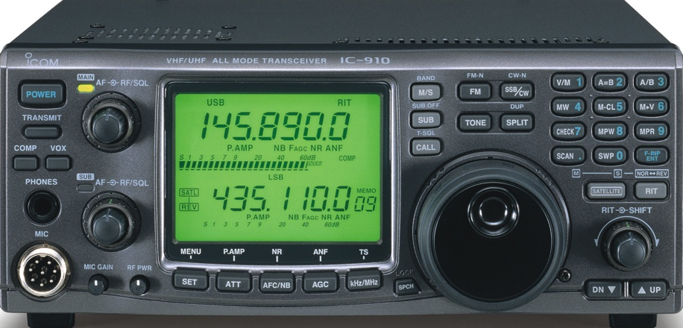
Welcome
Welcome to the Wonderful World of Amateur Radio
Larry Bradley KK6QPE

Slide 2




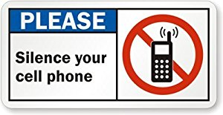
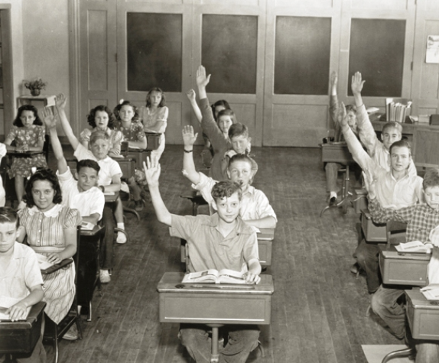
Some housekeeping thoughts
2

Slide 3


Technician Class Licensing Course Introduction
Presented by the
Mt. Diablo Amateur Radio Club (MDARC)
and
Trinity Lutheran Church
Amateur Radio Relay League
3

Slide 4
Welcome to Amateur Radio
What is the significance of the number 755,309?
As of January 5th this is the number of U.S. licensed amateur radio operators (Hams).
This is about 0.23% of the US population or about 1 out of 435 people.
What is the significance of this number 65,254?
This is the number of amateur radio operators who hold a Technician Class License in California.
This is about 0.16% of the California population
or about 1 out of every 606 Californians
4

Slide 5
What We Offer
The Purpose of this course IS TO help YOU Prepare for the Technician Class License examination with:
An Authoritative Text.
In-class Discussions of selected Key Concepts.
5

Slide 6
What We Offer (cont.)
References to useful Amateur Radio Internet Web Sites.
“Elmers” for personal student one-on-one assistance with amateur radio topics and concepts.
Relevant In-class Amateur Radio Experience shared by existing licensed Amateur Radio operators.
6

Slide 7
What We Don’t Offer
This course IS NOT designed to provide you with in-depth knowledge of the Electronic and Radio Theory that makes amateur radio possible.
7

Slide 8
Technician Course Volunteer Instructional Team
The Team Members are volunteering their knowledge, time, energy, and experience to YOU so that you can EARN your Technician Class Amateur Radio License.
The Team Members have varied academic experiences, applied experiences and employment careers but are all outstanding local amateur radio operators that want to help you earn your amateur radio license.
8

Slide 9
Technician Course Volunteer Instructional Team (cont.)
The Team Members are NOT professional educators. . . they are all experienced Amateur Radio Operators (Hams).
The Team Members may not have the answer to your specific question as an immediate response.
If that is the case, they may suggest that you perform your own research in the text or on the Internet, and then if you need to discuss the answer that you found with an Elmer from the Team, then plan to do this at a subsequent class session.
9

Slide 10
Technician Course Amateur Radio Instructional Schedule
Class Sessions
Each Thursday evening beginning 01/10/19 for eight consecutive weeks ending 02/28/19.
After tonight, each of the remaining class sessions will run from 7:00 pm to 9:00 pm.
The first opportunity to take the Technician Class License Exam will occur on 03/07/19 in this room. Further details regarding the exam will be provided in future class sessions.
10

Slide 11
The Technician Course Chapter Schedule
Class Discussion Schedule (Please refer to Syllabus page 6)
January 10, 2019
Welcome to the Course
Chapter 1: “Welcome to Amateur Radio”
“Technician Class License Exam Study Guide”
January 17, 2019
Chapter 7: “Licensing Regulations”
Chapter 8: “Operating Regulations”
11

Slide 12
The Technician Course Chapter Schedule (Cont.)
January 24, 2019
Chapter 6: “Communicating with Other Hams”
January 31, 2019
Chapter 3. “Electricity, Components and Circuits”
February 7, 2019
Chapter 2: “Radio and Signal Fundamentals”
February 14, 2019
Chapter 4. “Propagation, Antennas and Feed Lines”
12

Slide 13
The Technician Course Chapter Schedule (Cont.)
February 21, 2019
Chapter 5. “Amateur Radio Equipment”
February 28, 2019
Chapter 9. “Safety”
The first Opportunity to take the Technician Class License Examination in this room will be Thursday evening March 7, 2019.
13

Slide 14
The Text for this Course
Our Text:
The ARRL Technician Class License Manual: Level 1, 4th Edition
Chapters 1 through 9 contain discussions of the concepts that provide the information needed to understand the license exam questions and their correct answers.
Chapter 10 is a valuable resource for you. It is a GLOSSARY that defines the significant terms used in the text.
Chapter 11 is the complete Technician Class License Question Pool.
Choosing a Ham Radio is an excellent text supplement that is at the end of the text.
14

Slide 15
Additional Material
Hand Out Materials.
From time-to-time, we will have handout materials that you may download and print from your email.
If you have questions, please contact Larry Bradley, KK6QPE at:
kk6qpe@gmail.com
15

Slide 16
About the PowerPoint Slides
The PowerPoint chapter slides will not be furnished as handouts, as they represent material in your text. The handouts are intended as a supplemental guide for the in-class chapter discussion.
For more information regarding Course hand-out materials, please refer to the Technician Class License Course Syllabus.
16

Slide 17
What We Expect
We expect YOU to STUDY the weekly text book chapter assignments before the in-class discussion of the chapter key concepts.
We expect YOU to PREPARE your own Personal Study Guide in preparation for the Technician Class License Exam.
A methodology will be provided for your preparation of your own Personal Study Guide later in this first class session.
17

Slide 18
End of Course Expectations
At the close of each class session, the Trinity Lutheran Church requests that we set up our meeting room for their next planned event.
Under the direction of the Elmers we ask that each of you assist at the end of each class session by setting up the tables and chairs according to the diagram on the next slide.
18

Slide 19
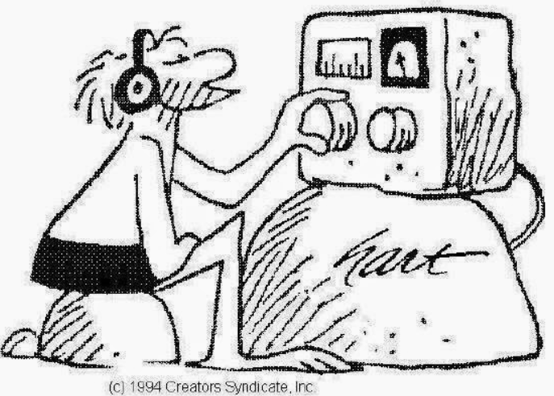
Stay tuned….there is more to come
19

