Slide 1

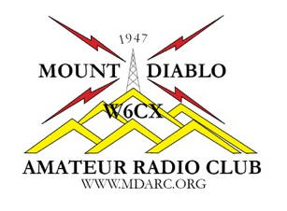
Chapter 1
Welcome to Amateur Radio
Name,
Callsign
Discussion Leader
American Radio Relay League

Slide 2
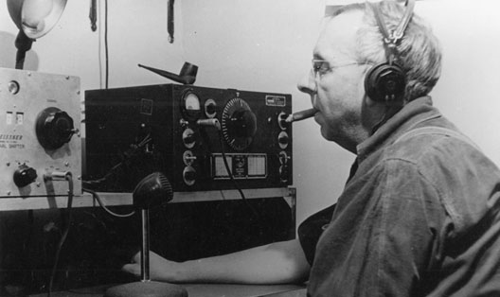
Welcome to Amateur Radio
What is Amateur Radio?
Amateur Radio is the most powerful communications service available to the private citizen anywhere on Earth - - - or even above it.
Beginnings of Ham Radio
The first U.S. amateur radio license was granted in 1912.
Mt. Diablo Amateur Radio Club (MDARC) was founded in 1947.

Slide 3
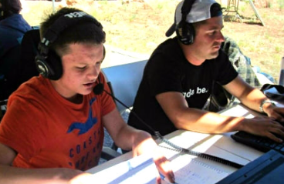
Welcome to Amateur Radio
Ham Radio Today
Amateur Radio Satellite communications
Who can be a Ham?
Anyone
What do Hams do?
Direct communications.
Talking
Byte-ing (digital code communications)
Building their own equipment
Watching . . . Exchanging pictures and videos
Emergency Communications and Public Service

Slide 4
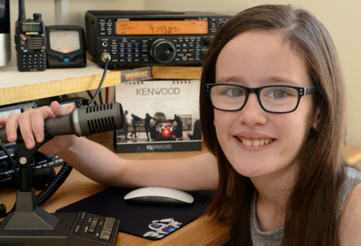
There is lots to do in Amateur Radio and these are just some of the things mentioned in your Text
Use your radio for community service! Provide communications for a bike race or a marathon.
Talk around the world without the internet or cell phones.
Support recovery efforts in emergencies and disaster
Create your own network of ham radio friends and send instant text messages without cell phones.
Talk through satellites or astronauts on board the International Space Station.
Use Amateur Radio to control models, robots, or even drones.
Meet awesome people from all over the U.S and around the world.
Be a signal sleuth, “Fox” and with GPS---GeoFox!

Slide 5
Here are 5 things I really like about ham radio.
1) It works when nothing else does.
2) It makes you part of a worldwide community.
3) The opportunity to help neighbors by providing public service and emergency communications.
4) Some of the nicest, smartest and most interesting people you'll ever meet.
5) Informal way to improve technical skills.

Slide 6
And 5 more things……
6) The opportunity to go to interesting places and do interesting things you might not otherwise go to or do.
7) A good way to get driving directions when visiting someplace new (with or without GPS).
8) Informal way to improve communication skills.
9) Hamfests
10) Field Day

Slide 7
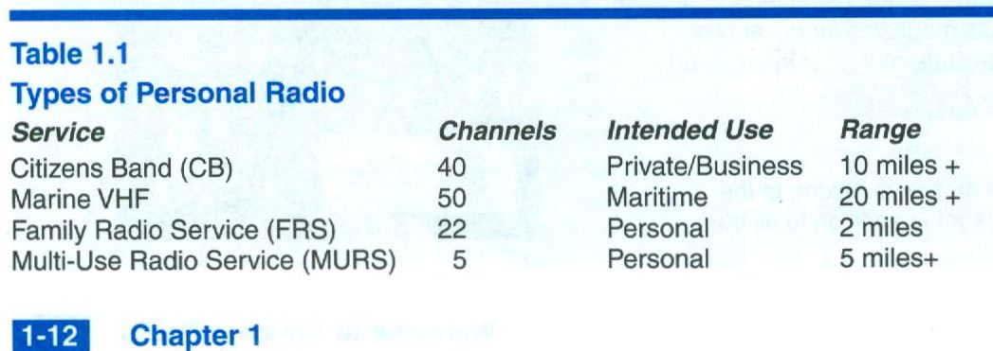
Welcome to Amateur Radio
Types of Personal Radio
Want more information? Check out Wikipedia.org

Slide 8

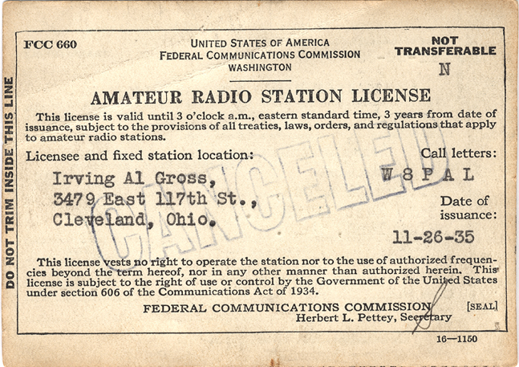
Welcome to Amateur Radio
The FCC and Licensing
Why get a License?
You have the right to be protected from interference by signals from unlicensed devices, such as consumer electronics.
Your right to use the amateur radio bands is protected by law.
Licensing Overview
There are three license types currently being issued.
The number of exam questions and significant amateur radio privileges for each license class are shown in Table 1.2
8

Slide 9
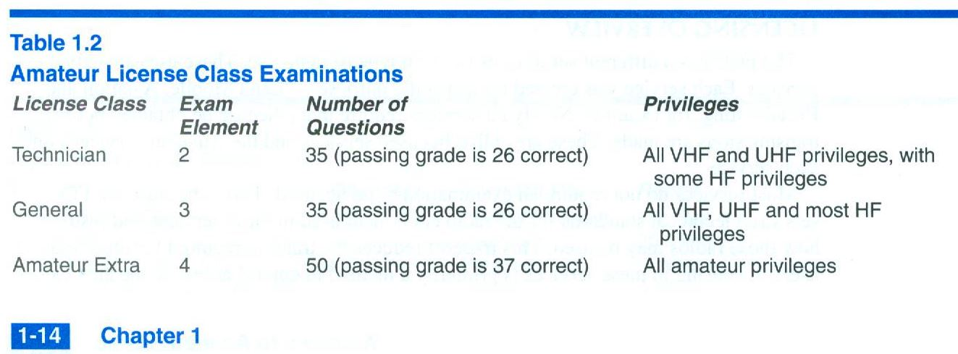
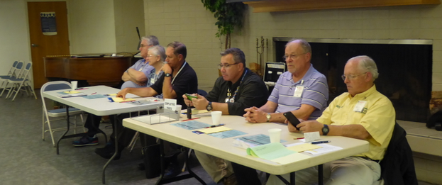
Welcome to Amateur Radio
9

Slide 10
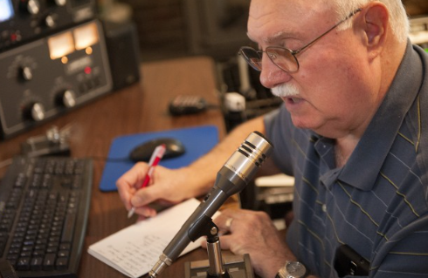
Welcome to Amateur Radio
Amateur Radio Activities
Identification and Contacts
Using your Voice
Exchanging Digital Data
Using Morse Code
Emergencies and Public Sector
Awards and Contests
Novel Activities . . . SSTV and ATV, Packet Radio, APRS (Automatic Packet Reporting System), Meteor Scatter and EME

Slide 11
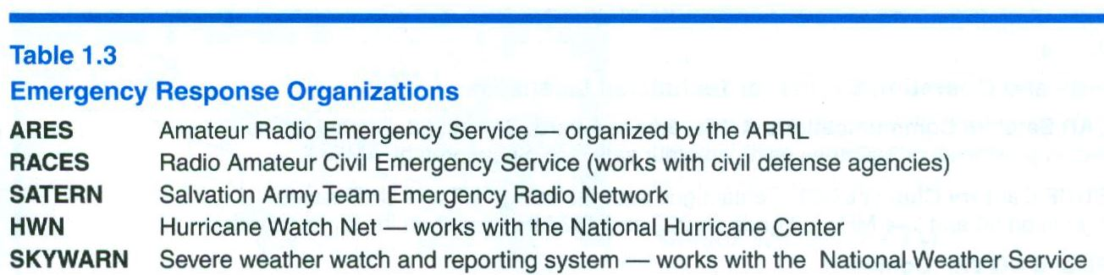
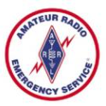

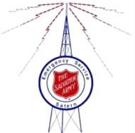


Welcome to Amateur Radio
ARES
RACES
SATERN
HWN
SKYWARN
11

Slide 12
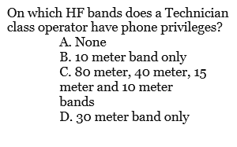
Getting Your Ham License
The Technician Class License
Obtaining a License
What We Assume About You
Advanced Students
Online Practice Exams
Testing Process

Slide 13
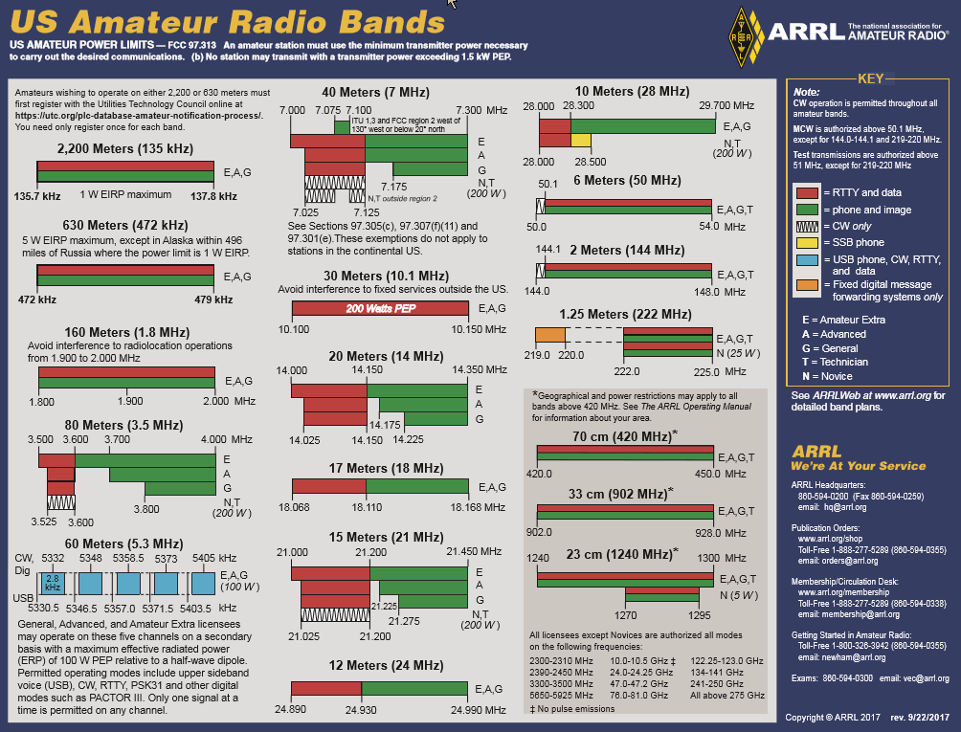
13

Slide 14
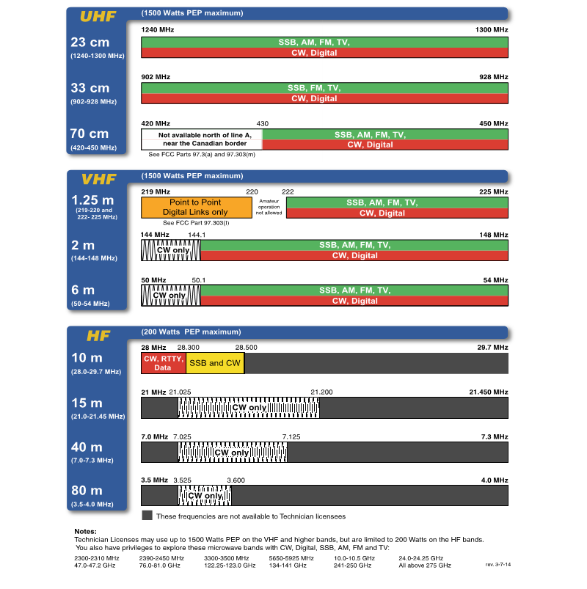
The Band Plans for the Technician Class License
Opportunities galore!

Slide 15
Assignment for Next Week
Read Chapter 1 “Welcome to Amateur Radio”
Study Chapter 7 “Licensing Regulations” and the Question Pool questions.
Study Chapter 8 “Operating Regulations” and the Question Pool questions.

Slide 16
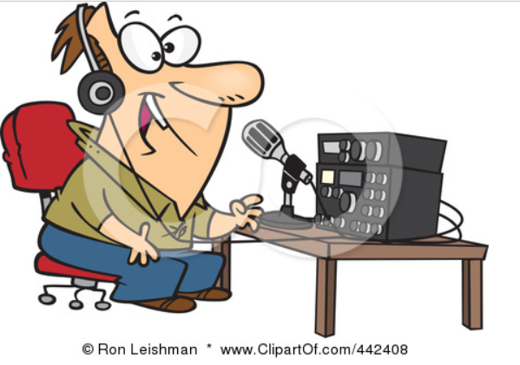
Don’t go away because there is still more to come

