Slide 1


Technician Class License Exam Preparation
This Technician Class License Exam Preparation Tool has been designed to provide you with a proven methodology to successfully pass the License Exam and Earn your Technician Class Amateur Radio License.
Amateur Radio Relay League

Slide 2
Technician Class License Exam Preparation
The Technician Class License Question Pool is in the back of your text book in Chapter 11.
This Question Pool contains 426 questions with the correct answer identified for each question.
The Technician Class Examination is composed of 35 questions from the Technician Class Question Pool found in Chapter 11 of your text.

Slide 3
Technician Class License Exam Preparation
To pass the Technician Class License Examination and Earn your Amateur Radio License, you must answer at least 26 questions (74%) correctly.
During this class session we will discuss a successful examination strategy for YOU to use in preparation for this Amateur Radio License Examination.
Your first opportunity to take the Technician Class License Examination in this room will be: March 7, 2019.

Slide 4
Technician Class License Exam Preparation
You must bring one form of government- issued Picture ID like a driver’s license or passport
or
Two other forms of identification like a library card, social security card, birth certificate with seal.
Bring $15 cash to pay the examination fee.

Slide 5
Technician Class License Exam Preparation
It is recommended that you bring a couple of pencils with erasers and a ball point pen.
You may bring a calculator, not a cell phone, to the examination, however you must demonstrate that it has nothing stored in the memory.
You MAY NOT bring notes into the examination.

Slide 6
Technician Class License Exam Preparation
It is recommended that before the exam that you set up a FRN (Federal Registration Number) with the Universal Licensing System (ULS).
This will be used instead of your Social Security Number.
As we get closer to the exam date, we will provide you with instructions on how to get your FRN.
https://www.fcc.gov/wireless/bureau-divisions/mobility-division/amateur-radio-service

Slide 7
Technician Class License Exam Preparation
The Technician Class License Exam Question Pool in Chapter 11 of your text contains ALL of the possible examination questions and correct answers.
Sample Exams can be created at this ARRL website: www.arrl.org/examreview
The Opening Screen to this website is shown on the following slide.

Slide 8
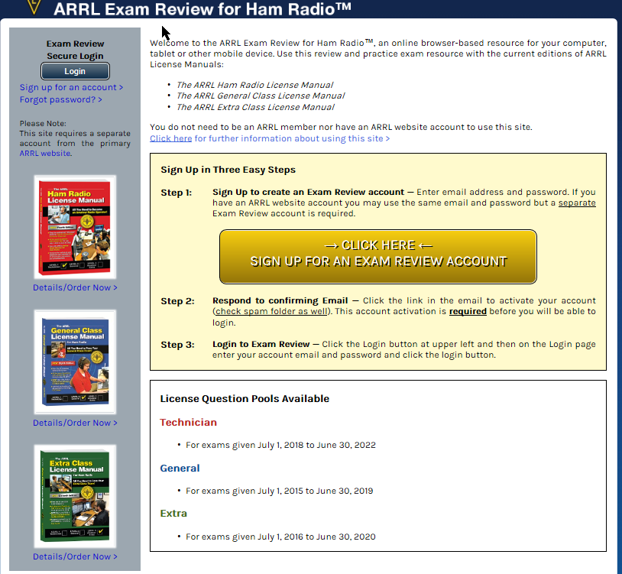
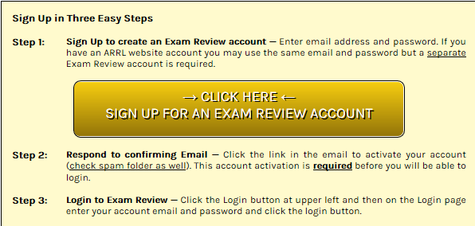
Technician Class License Exam Preparation

Slide 9
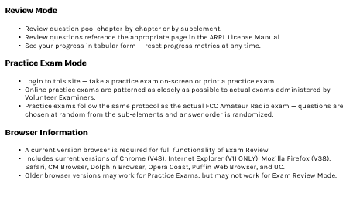
Technician Class License Exam Preparation
The Amateur Radio Relay League (ARRL) is there to help make you successful

Slide 10
Technician Class License Exam Preparation
At this ARRL Exam Review Site you can:
Select chapters to review Examination Questions that relate to a specific chapter which can be read on the screen or printed.
Take Practice Exams.
Practice Exams
The ARRL Exam Review Site uses only the current question pools.
It is your responsibility to verify that the practice exams that you are using are from the current Technician Class question pool.
Some websites are offering practice exams that may be using expired question pools.

Slide 11

Technician Class License Exam Preparation
How can I prepare for the Technician Class License Exam?
I know that the exam will have 35 questions and that I have to answer at least 26 correctly to EARN my Technician Class License.
I also know that the Technician Class License Question Pool contains 426 questions.
This can be overwhelming!

Slide 12
Technician Class License Exam Preparation
The answer to the Technician Class License Exam challenge is found in the “Test Study Guide for Ham Radio Written Tests” by Briggs Longbothum, AB2NJ.
We recommend the following proven strategy to implement the “Test Study Guide for Ham Radio Written Tests”

Slide 13
Technician Class License Exam Preparation
Step 1: Get Started
Create your own personal study guide composed of each of the 426 questions from the Technician Class License Question Pool and each correct answer.
Build your own personal study guide on a weekly basis as each of the nine (9) chapters from the text are discussed in-class.
There are no questions from Chapter 1 in the question pool.

Slide 14
Technician Class License Exam Preparation
Step 2: Follow through
Study each question and ONLY its correct answer as you create your personal study guide.
Insert the text page reference for each question in your personal study guide for your use if you have difficulty understanding a question or its correct answer.
Continue this study guide development for all of the questions identified in the question pool.

Slide 15
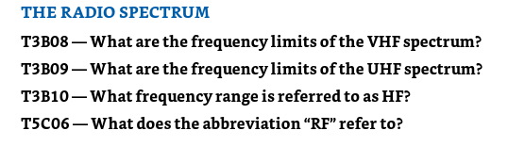
Technician Class License Exam Preparation
What is a section Question Pool list?
If you turn to Page 2-4 in the Text where you will find and example of this list.
This list of questions from the Question Pool will alert you that you will find the answers in the contents of the next section.

Slide 16
Technician Class License Exam Preparation
You will find the Question Pool with all 426 questions at: http://www.ncvec.org/
National Conference of Volunteer Examiner Coordinators
Refer to the handout to locate the questions from the current Technician Class License Question Pool.
Scroll down the Question Pool on the NCVEC website and you will find the questions.

Slide 17
Technician Class License Exam Preparation
Copy and Paste the following from the NCVEC website:
The Question Number, only the Correct Answer and the Reference. For example:
T1A01 (C) [97.1] Page 7-2
Insert the text page reference from the Question Pool in your study guide text as Page 7-2 (which is shown in the question pool on Page 11-3).

Slide 18
Technician Class License Exam Preparation
T1A01 (C) [97.1] Page 7-2
Which of the following is a purpose of the Amateur Radio Service as stated in the FCC rules and regulations?
Advancing skills in the technical and communication phases of the radio art
T1A02 (C) [97.1] Page 7-2
Which agency regulates and enforces the rules for the Amateur Radio Service in the United States?
The FCC

Slide 19
Technician Class License Exam Preparation
Repeat this Cut and Paste process for each question identified in the text chapter “blue boxes.”
The Cut and Paste methodology presented here is laborious, however, the actions of the copy & paste methodology begin your learning and exam preparation process.
There are websites that claim to provide the exam question and offer only the correct answer.

Slide 20
Technician Class License Exam Preparation
If you use web sites that claim to offer the question and correct answer, it is your responsibility to ensure that you are studying “the” question and correct answer from the current Technician Class License Exam.

Slide 21
Technician Class License Exam Preparation
Step 3: Make it happen
Study Only the TEST QUESTIONS. Learn the rest of Ham Radio LATER!
Study Only the CORRECT QUESTION ANSWERS. Don’t worry about learning the Theory at this time.
The “magic” of this strategy is:
Studying ONLY the Question and its Correct Answer builds an association in your mind, not memorization, between the question and its correct answer.

Slide 22
Technician Class License Exam Preparation
The Key Elements of our recommended Exam Preparation Strategy are:
Prepare Your Own Personal Technician Class License Study Guide.
STUDY ONLY the QUESTION and Only the CORRECT ANSWER.

Slide 23

Technician Class License Exam Preparation
There may be more than one apparently “valid” answer/choice to a Question, however, the Right Answer is the one that is MOST CORRECT.
The MOST CORRECT answer for each question in the Question Pool is identified in Chapter 11 at the back of your text.

Slide 24
Technician Class License Exam Preparation
Use Practice Tests such as those from the ARRL web site: www.arrl.org/examreview or at an online website such as QRZ.com until you are confident with your preparation for the exam.
Following the successful completion of the 35 questions from the practice exam, you will see your score and a PASS notification.

Slide 25
Technician Class License Exam Preparation
As you are preparing for your Technician Class License Exam:
Focus ONLY on the Exam Material. Avoid other Books, Magazines, etc. until you have successfully earned your Technician Class License.
Don’t try to spread your exam preparation out . . . Two weeks is the MAX.
Each Practice exam is numbered so be sure to practice with different exams, not the same exam time-after-time.

Slide 26
Technician Class License Exam Preparation
Your first Exam opportunity following the conclusion of this course will occur in this room on Thursday, March 7, 2019.

Slide 27
Technician Class License Exam Preparation
Again, this is what you need for the Exam.
One legal photo ID (driver’s license, passport)
If no photo ID is available, then two forms of identification (birth certificate with seal; social security card, library card, etc.)
Bring $15 cash to pay the exam fee.
DO NOT bring STUDY NOTES to the exam.

Slide 28
Technician Class License Exam Preparation
You have prepared to successfully pass the Technician Class License Exam.
Relax, take a deep breath, and READ each question carefully . . . The correct answer for each question should be apparent.

Slide 29
Technician Class License Exam Preparation
The MDARC Volunteer Instructional Team has conducted numerous Technician Courses. Our records reflect that:
90% of the average student attendance in our most recent Technician Courses earned their new amateur radio license. (Our youngest Technician Class Licensee was 9 years old).

Slide 30
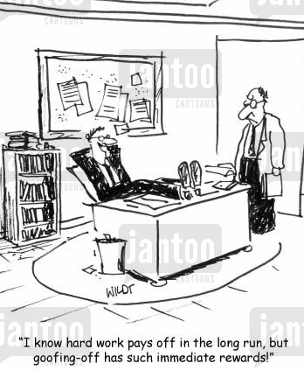
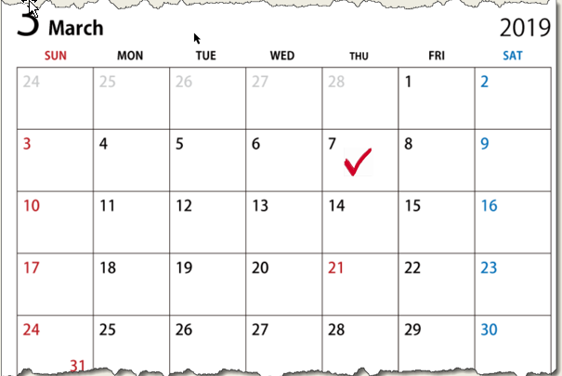
Technician Class License Exam Preparation
Don’t be like this guy!
Prepare for the 03/07/19 License Exam

Slide 31
Technician Class License Exam Preparation
Now that you have passed the Technician Class License Exam:
Be sure to sign your Certificate of Successful Completion of Examination (CSCE)
You must wait until a call sign has been issued which signifies that your name appears on the FCC database of licensees before you can Get on the Air.

Slide 32
Technician Class License Exam Preparation
Once you have received your new call sign:
Please send your new call sign to the MDARC Volunteer Instructional Team at:
HamRadioClass@gmail.com

Slide 33

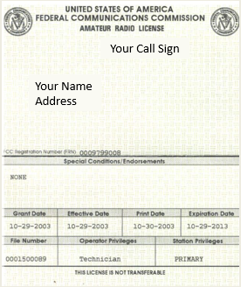
Our Goal

Slide 34
