Slide 1
How to create a Personal Study Guide
1

Slide 2
www.ncvec.org/
Start here
2
MDARC Technician Class License Course

Slide 3

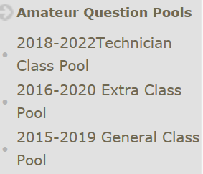
Select this choice
3
MDARC Technician Class License Course

Slide 4
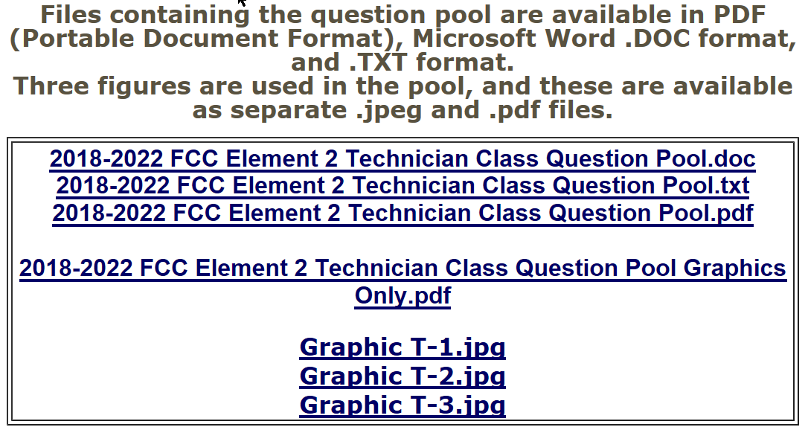
Select this choice
.doc
4
MDARC Technician Class License Course

Slide 5
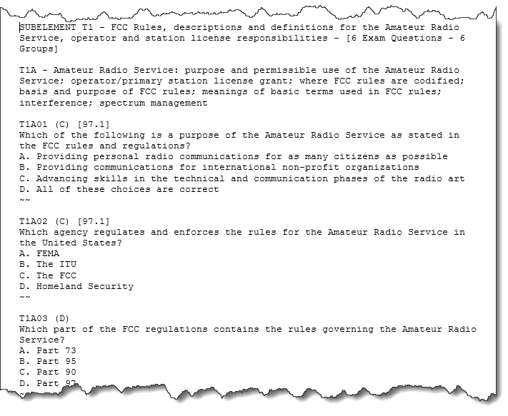
MS Word document with all 426 multiple choice questions
5
MDARC Technician Class License Course

Slide 6
Sample Question
T1A01 (C) [97.1]
Which of the following is a purpose of the Amateur Radio Service as stated in the FCC rules and regulations?
A. Providing personal radio communications for as many citizens as possible
B. Providing communications for international non-profit organizations
C. Advancing skills in the technical and communication phases of the radio art
D. All of these choices are correct
Based on the Question Pool questions listed before the relevant section, Cut and Paste the question and possible answers from the NCVEC Word Document and Paste into your Personal Study Guide.
T1A01 (C) [97.1]
Which of the following is a purpose of the Amateur Radio Service as stated in the FCC rules and regulations?
--Advancing skills in the technical and communication phases of the radio art
Delete the wrong answers and remove the letter (A,B,C,D) from the correct answer
6
MDARC Technician Class License Course

Slide 7
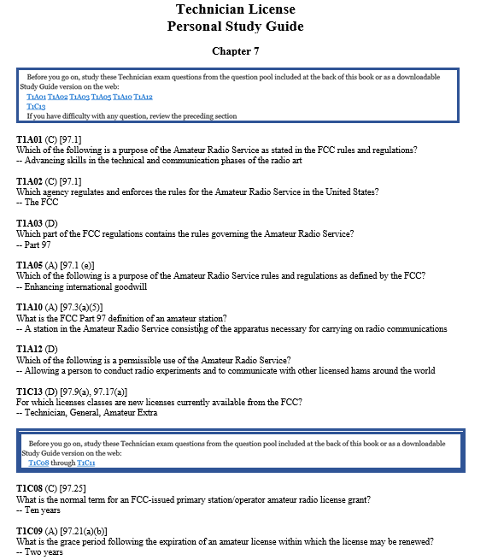

Used Snipping Tool with my Kindle edition
Question Pool questions with only the correct answers
7
MDARC Technician Class License Course

Slide 8
And at the end of the day ………SUCCESS
8
MDARC/ Technician Class License Course

Slide 9
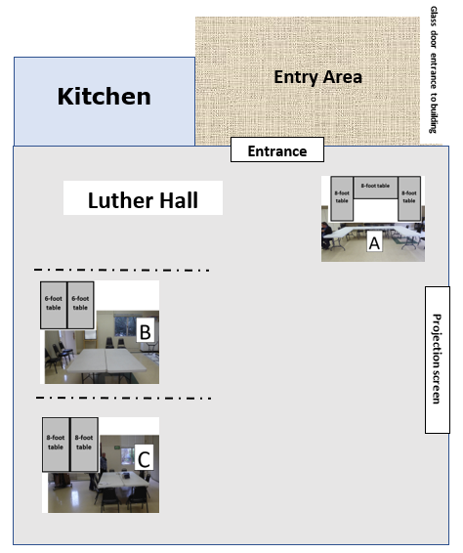
Please follow the directions from the Elmers for tables and chairs set up
8
MDARC/ Technician Class License Course

