Slide 1

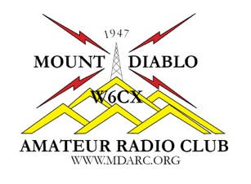
Chapter 7
Licensing Regulations
Name, Callsign
Discussion Leader
American Radio Relay League

Slide 2
Not on the license exam, but thinking of what you learned in Chapter 1
You should get an Amateur Radio License because……..
Most Home Owner Associations [HOA] require it for amateur radio operation.
You have the right to be protected from interference by signals from unlicensed devices, such as consumer electronics.
You need a license to purchase an Amateur Radio.
Amateur Radio antennas are registered by the FCC only for licensed operators.
2019 MDARC Technician License Course

Slide 3
Did you get the right answer?
You should get an Amateur Radio License because……..
You have the right to be protected from interference by signals from unlicensed devices, such as consumer electronics.
2019 MDARC Technician License Course

Slide 4
Here is one more review question
Which of these is not a bona fide Amateur Radio license class?
Technician
General
Technician, 1st Class
Amateur Extra
2019 MDARC Technician License Course

Slide 5
Not all questions are so easy
Which of these is not a bona fide Amateur Radio license class?
Technician, 1st Class
2019 MDARC Technician License Course

Slide 6
7.1 Licensing Terms
Part 97
Part 97 is a section of the FCC’s rules that regulate Amateur Radio.
Basis and Purpose
-Amateur Radio Service is a voluntary, noncommercial communications service.
-Part 97 also establishes the basic constraints and rights that pertain to amateur licensing and conduct.
2019 MDARC Technician License Course

Slide 7
7.1 Licensing Terms
Definitions
The Federal Communications Commission (FCC) makes and enforces the rules for the Amateur Radio Service in the U.S.
An Amateur Operator is a person named in an operator/primary station license grant on the ULS consolidated licensee database to be the control operator of an amateur station.
2019 MDARC Technician License Course

Slide 8
7.1 Licensing Terms
Type and Class of Licenses
An Amateur Radio license consists of two parts:
- An Operator license
- A Station license
There are three current classes of Amateur Radio licenses:
- Technician
- General
- Amateur Extra
2019 MDARC Technician License Course

Slide 9
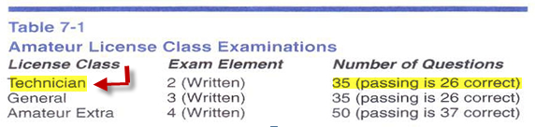
7.1 Licensing Terms
Examinations
Volunteer Examiners (VE)s
A minimum of three accredited Volunteer Examiners are required to conduct amateur radio license exams.
2019 MDARC Technician License Course

Slide 10
7.1 Licensing Terms
Volunteer Examiners (VE)s
VEs must hold a license class higher than the those of the prospective licensees………….
……..except that
Amateur Extra VEs may give Technician, General and Amateur Extra license exams.
Many of the class Elmers are Volunteer Examiners.
2019 MDARC Technician License Course

Slide 11
7.1 Licensing Terms
Taking the Exam
To take the Technician License exam, bring the following:
One form of government- issued Picture ID like a driver’s license or passport OR Two other forms of identification like a library card, social security card, birth certificate with seal.
$15 cash to pay the exam fee
2019 MDARC Technician License Course

Slide 12
7.1 Licensing Terms
Taking the Exam
To take the Technician License exam, bring the following:
Two pencils (scratch paper will be provided)
A calculator, if you desire . . . You must demonstrate that the calculator memory is empty.
2019 MDARC Technician License Course

Slide 13
7.1 Licensing Terms
CSCE and Form 605
Certificate of Successful Completion of Examination (CSCE)
National Conference of Volunteer Examiner Coordinators (NCVEC) and Quick Form 605 is the Application for Amateur Operator/Primary Station License.
Term of License & Renewal
Amateur licenses are valid for a 10-year term.
2019 MDARC Technician License Course

Slide 14
7.1 Licensing Terms
Responsibilities
Unauthorized Operation of your station is prohibited.
Personal Information must be maintained including a current mailing address on file with the FCC.
Station Inspection availability must be maintained for inspection, if requested by an FCC representative or US government official.
2019 MDARC Technician License Course

Slide 15
7.2 Working with the FCC
The FCC Universal Licensing System (ULS) Web Site
Register for online access to your license information.
Using your Federal Registration Number (FRN)
- Your FRN replaces the need to use your Social Security Number when filing FCC forms.
2019 MDARC Technician License Course

Slide 16
7.3 Bands and Privileges
Band Plans: Making the best use of the radio frequencies
Band Plans are voluntary arrangements by amateurs for using different modes or for different activities.
2019 MDARC Technician License Course

Slide 17
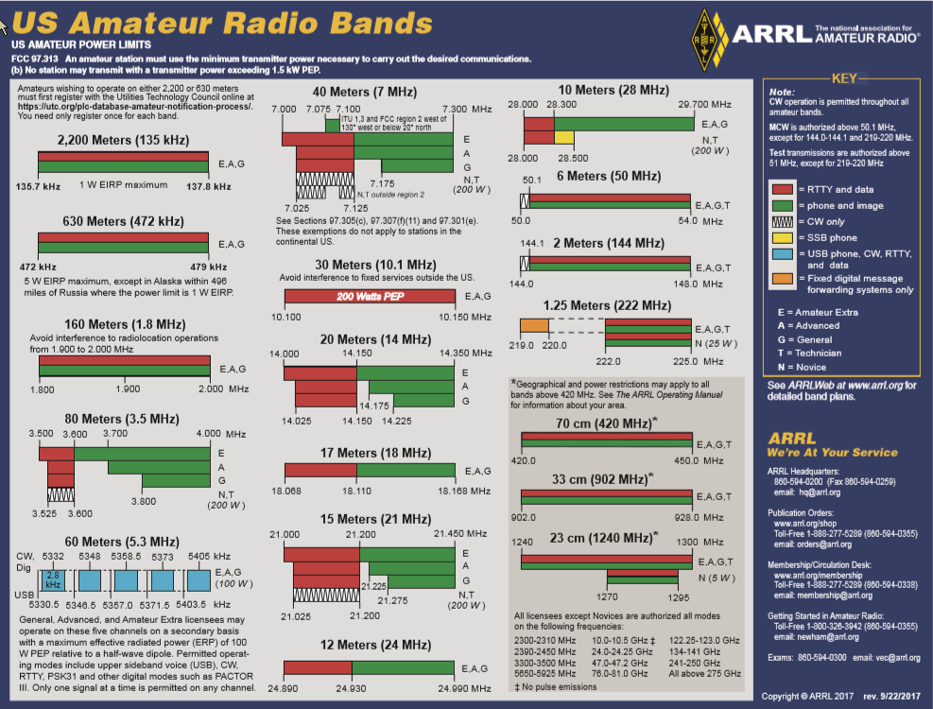
7.3 Bands and Privileges The Bands and Privileges for all Amateur Radio licenses
2019 MDARC Technician License Course

Slide 18
7.3 Bands and Privileges
This will come in handy….
We saw this in Session One and it still holds true…….many, many opportunities to have fun.
2019 MDARC Technician License Course

Slide 19
7.3 Bands and Privileges
Emission Privileges
Emission is the term for any radio signal from a transmitter.
Emission type is permission to communicate using a particular mode, such as phone, CW, data or image.
Refer to Table 7-4 in the manual on page 7-12 for all of the modes that can be used by amateur radio operators . . . as a Technician class licensee you may use all of the modes shown.
2019 MDARC Technician License Course

Slide 20
7.3 Bands and Privileges
Power Limits
The maximum power an amateur is allowed to generate at the output of a transmitter or amplifier is 1,500 watts of peak envelope power (PEP).
Peak Envelope Power (PEP) is defined as the average power during one Radio Frequency (RF) cycle of a radio signal at the crest of the modulated waveform.
2019 MDARC Technician License Course

Slide 21
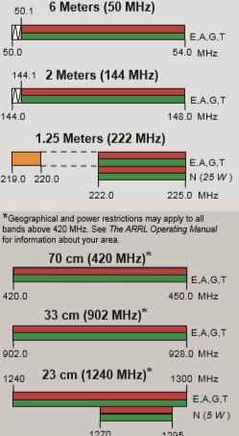
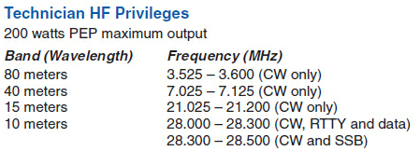
Chapter 7 Take Aways (cont)
7.3 Bands and Privileges
VHF/UHF (1500W PEP Maximum)
HF (200W PEP Maximum)
Table 7-3
Transmission power limits
2019 MDARC Technician License Course

Slide 22
7.3 Bands and Privileges
Primary & Secondary Allocations
When a frequency band is shared among two or more different radio services, the primary service is preferred.
Stations in a secondary service must not cause harmful interference to, and must accept interference from stations in the primary service.
2019 MDARC Technician License Course

Slide 23
7.3 Bands and Privileges
Repeater Coordination
Amateur Radio operators developed a system of regional frequency coordination to insure that repeaters use the amateur bands wisely and avoid interference to the greatest degree possible.
2019 MDARC Technician License Course

Slide 24
7.4 International Rules
International Rules
The International Telecommunication Union (ITU)
The ITU is an administrative forum for working out international telecommunications treaties and laws, including frequency allocations.
The ITU divides the world into three regions.
2019 MDARC Technician License Course

Slide 25
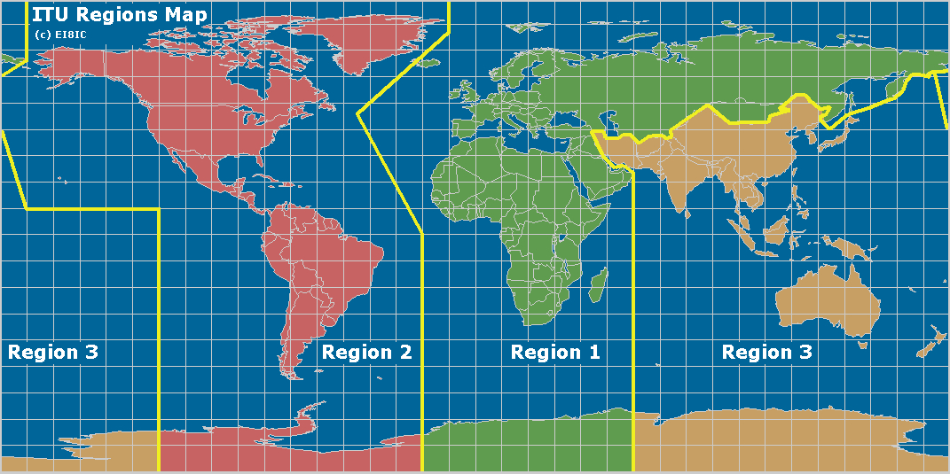
7.4 International Rules
The world in three sections
Similar to Figure 7-5 on page 7-18
2019 MDARC Technician License Course

Slide 26
7.4 International Rules
International Operating
To operate using your US amateur license, there must be a reciprocal operating agreement between the countries.
Reciprocal Operating Authority
This is a government-to-government agreement recognizing each other’s amateur licenses.
2019 MDARC Technician License Course

Slide 27
7.4 International Rules
International Amateur Radio Permit (IARP)
In some North and South American countries an IARP allows US amateurs to operate without seeking a special license or permit to enter and operate from that country.
2019 MDARC Technician License Course

Slide 28
7.4 International Rules
European Conference of Postal and Telecommunications Administrations (CEPT)
A radio-amateur license -- allows US Amateurs to travel to and operate from most European countries without obtaining an additional license or permit.
Permitted Contacts and Communications
Unless specifically prohibited by either country, any ham can talk to any other ham.
2019 MDARC Technician License Course

Slide 29
7.5 Call Signs
Prefix and Suffix
In the US, the Prefix consists of one or two letters and a numeral. The suffix consists of one to three letters.
The combination of prefix and suffix uniquely identify a station anywhere on Earth.
2019 MDARC Technician License Course

Slide 30
7.5 Call Signs
US Call Districts and Call Signs
2019 MDARC Technician License Course

Slide 31
7.5 Call Signs
Portable & Upgrade
If operating within the US, there is no requirement for indicating where in the country you happen to be located.
If operating outside the continental US, you must add the prefix of the country to your call sign.
When you earn a higher license, you must add a portable designator until your new license class is posted on the FCC Database.
General . . . Add /AG to your call sign
Amateur Extra . . . Add /AE to your call sign
2019 MDARC Technician License Course

Slide 32
7.5 Call Signs
Vanity, Club, and Special Event Call Signs
A Vanity Call sign is one selected by the amateur instead of one sequentially assigned by the FCC.
A Club Call sign can be obtained for a group with at least 4 members that has been recognized as a club by the FCC.
2019 MDARC Technician License Course

Slide 33
7.5 Call Signs
Special Event Call Sign is a call sign for a short duration special event of significance to the amateur community
For example:
Pacificon 2017 in San Ramon (October 20-22) received the Special Event Call Sign of W6P (and also used W1AW/6)
2019 MDARC Technician License Course

Slide 34
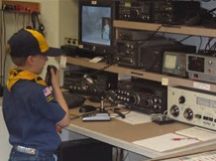
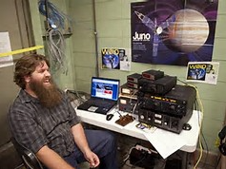
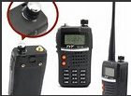
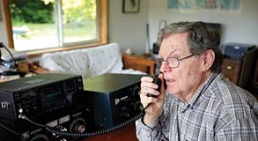
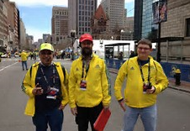
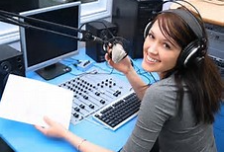
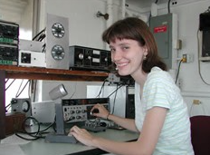
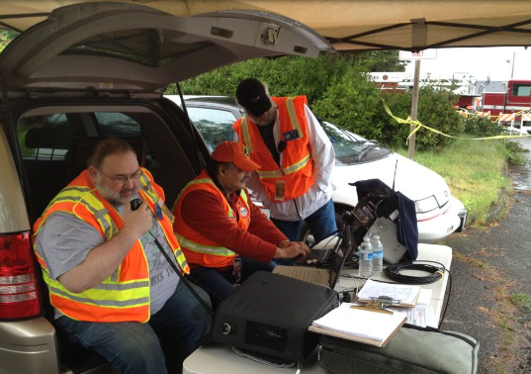
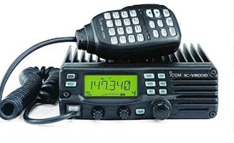
The Technician Class License opens the door to amateur radio
You are next!
2019 MDARC Technician License Course

Slide 35

2019 MDARC Technician License Course

