Slide 1

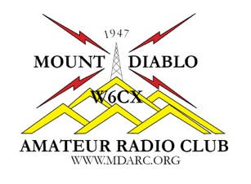
Chapter 8
Operating Regulations
Name, Callsign
Discussion Leader
American Radio Relay League

Slide 2
Brief Review of Chapter 7 Exam Questions
Except for some restrictions, what is the maximum peak envelope power output for the Technician class operators using frequencies above 30 MHz?
● 50 watts
● 100 watts
● 500 watts
● 1500 watts

Slide 3
Brief Review of Chapter 7 Exam Questions
Except for some restrictions, what is the maximum peak envelope power output for the Technician class operators using frequencies above 30 MHz?
● 1500 watts
T1B12 Page 7-12

Slide 4
Brief Review of Chapter 7 Exam Questions
How many operator/primary stations license grants maybe held by any one person?
One
No more than two
One for each band on which the person plans to operate
One for each permanent station location from which the person plans to operate

Slide 5
Brief Review of Chapter 7 Exam Questions
How many operator/primary stations license grants maybe held by any one person?
One
T1A04 Page 7-3

Slide 6
8.1 Control Operators
Definitions
A Control Operator is an amateur operator designated by the licensee of a station to be responsible for the transmissions of an amateur station.
The Control Point is the location at which a station’s Control Operator function is performed.

Slide 7
8.1 Control Operators
Privileges & Guest Operating
The Privileges of the Control Operator govern the station’s operations.
Both the Guest Operator and the Radio Station Owner are responsible for proper station operation.
Unlicensed Operators
An unlicensed operator may use an amateur station as long as a control operator is present when transmissions are made.
Unlicensed operators may use the radio equipment to receive at any time.

Slide 8
8.2 Identification
Normal Identification
Unidentified transmissions are not allowed!
Identification Rules
Give your call sign at least every 10 minutes and when the contact is finished.
Give your call sign to establish a contact (not a formal rule).
Always identify in English.

Slide 9
8.2 Identification
Tactical Call Signs are names used to identify a station’s location or function during emergency and public service communications
Self-Assigned Indicators are additional information added to an operator’s call sign so that other stations are aware of your location when the operator is away from their home station
Guest Operators will generally identify using the call sign of the host . . . Control operator

Slide 10
8.2 Identification
Miscellaneous Identification Rules
Two exceptions to the identification rules. The exceptions are:
Remote Control Signals result from the operation of a station in which the control functions of the station are operated by a control operator over a control link (i.e. model aircraft)
Signals transmitted through space stations . . . Those stations located more than 50 kilometers above the earth’s surface (31.07 miles)

Slide 11
8.2 Identification
Miscellaneous Identification Rules
Identification rules apply to Test Transmissions
Stations under automatic control must also identify themselves (i.e. repeaters)
Both the Special Event Call Sign and the regular call sign must be given once per hour to comply with the required Identification rules

Slide 12
8.3 Interference
Harmful Interference is interference that seriously degrades, obstructs or repeatedly interrupts a radio communication service operating in accordance with the Radio Regulations.
Willful Interference is intentional, deliberate obstruction of radio communications.

Slide 13
8.4 Third-Party Communications
Third-Party Communications are messages passed from one licensed amateur operator to another on behalf of a third person.
International Third-Party Communications are restricted to those countries that specifically allow Third-Party Communications with US licensed amateur radio operators.

Slide 14
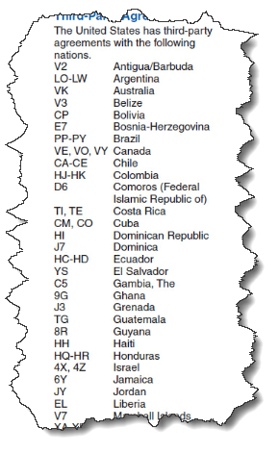
8.4 Third-Party Communications
International Third-Party Communications
Lots of countries which allow for third-party communications
Refer to Table 8-1 for the complete list

Slide 15
8.5 Remote and Automatic Operation
Definitions
Local Control occurs when a licensed control operator is physically present at the control point.
Remote Operation occurs when the control point is located away from the transmitter, but a control operator is present at the control point (i.e. Internet link).

Slide 16
8.5 Remote and Automatic Operation
Automatic Operation occurs when the amateur radio station operates completely under the control of devices and procedures that ensure compliance with FCC rules (i.e. repeaters).
No matter what type of control --- local, remote or automatic --- the amateur radio station must operate in compliance with FCC rules at all times

Slide 17
8.6 Prohibited Transmissions
Four Obvious Types
Unidentified Transmissions
False or Deceptive Signals
False Distress or Emergency Signals
Obscene or Indecent Speech

Slide 18
8.6 Prohibited Transmissions
Business Communications
Regular communications that could reasonably be performed through some other radio service are prohibited.
Transmissions related to conducting personal or employee business activities are prohibited.
A Licensed amateur radio operator may not be paid for operating an amateur radio station.

Slide 19
8.6 Prohibited Transmissions
But……………….
Teachers may use Amateur Radio as a part of their classroom instruction, even if paid to teach.
Encrypted Transmissions
Encryption occurs by changing the form of a signal into a privately-known format intended to obscure the meaning of the signal.
No Amateur Radio Operator should be prevented from receiving the communication of another Amateur Radio Operator.

Slide 20

8.6 Prohibited Transmissions
Broadcasting and Retransmission Prohibitions
Broadcasting is
defined as one-way
transmissions
intended to be received
by the general public
either direct or relayed.

Slide 21
8.6 Prohibited Transmissions
Broadcasting and Retransmission Prohibitions-cont’d.
Retransmission occurs when the signals from other communications services are repeated or relayed by an Amateur Radio station.
Special Circumstances
Amateur Radio Operators may occasionally retransmit weather and propagation information from government stations.

Slide 22
8.6 Prohibited Transmissions
In general, Amateur Radio Operators are not permitted to communicate with non-licensed radio operators, except in the following instances:
Declared communication emergencies.
RACES operators may communicate with government stations during declared communication emergencies.
Ham-to-military communications on Armed Forces Day during May each year.

Slide 23
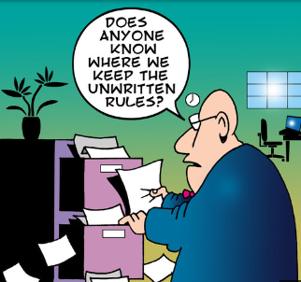
Regulations
The FCC rules and amateur radio’s unwritten rules benefit us all

Slide 24
Class Session 3 Assignment
In preparation for the next class session, do the following……………….
● Study Chapter 6 “Communicating With Other Hams”
● Study The Chapter 6 Question Pool questions that precede the subject matter content.

Slide 25
